Slide 1

An Under 35s Perspective on Market Issues
Moderator
Amy Dallaway, Marine Claims Adjuster, Antares
Panellists
Jonathan Evans, Partner, Kennedys Law LLP
Bradleigh-Aaron McArthur, Senior Marine Claims Broker, RKH Specialty
Heather Robinson, Average Adjuster, Richards Hogg Lindley

Slide 2
Topics for discussion
Management of marine claims in an international subscription market
The impact of mergers and acquisitions on the marine insurance market
Modern ways of working
Marine insurance training and education

Slide 3
Management of marine claims in an international subscription market
What difficulties do you face?
Are lead insurers/brokers providing following market insurers with sufficient information to process claims?

Slide 4
Impact of mergers and acquisitions on the marine insurance market
What impact will mergers and acquisitions have on the marine insurance market?
How will this affect claims handling?

Slide 5
Modern ways of working
Is modern technology really helping with the delivery of claims services?
How will hot-desking/working from home for some of the brokers and insurers affect claims handling?

Slide 6
Marine insurance education and training
Is there sufficient education and training in the marine insurance market?
If not, what more education and training could be provided, and on what topics?

Slide 7

Exams – introduction of a new qualification / title for associates who have passed two / three of the fellowship modules.
Associates socials:
Away day (in the UK) planned for next year.
Piraeus in May 2015. Planned socials for Hong Kong in October and for Singapore in November 2015.

Slide 8
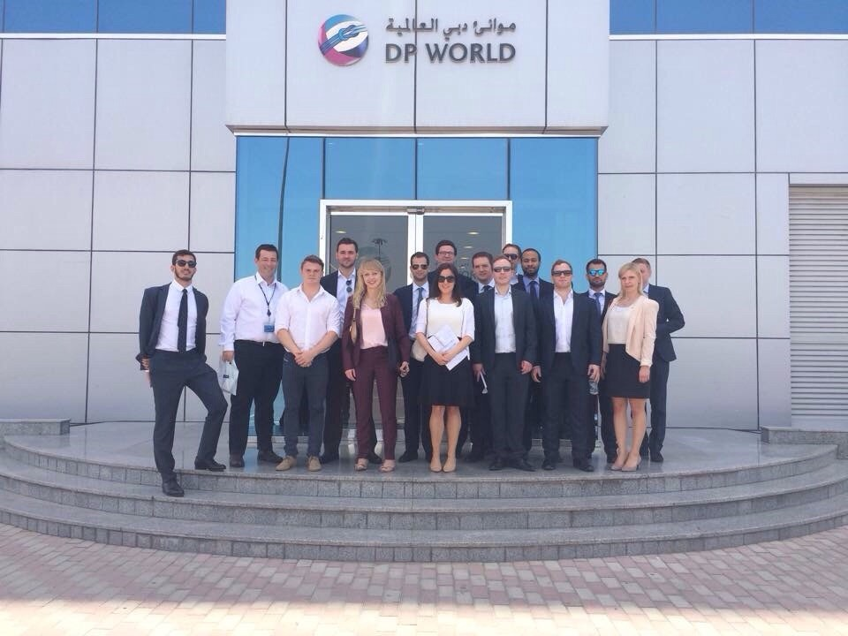
Marine insurance training and education
Marine U35s trip to Singapore & Dubai

Slide 9
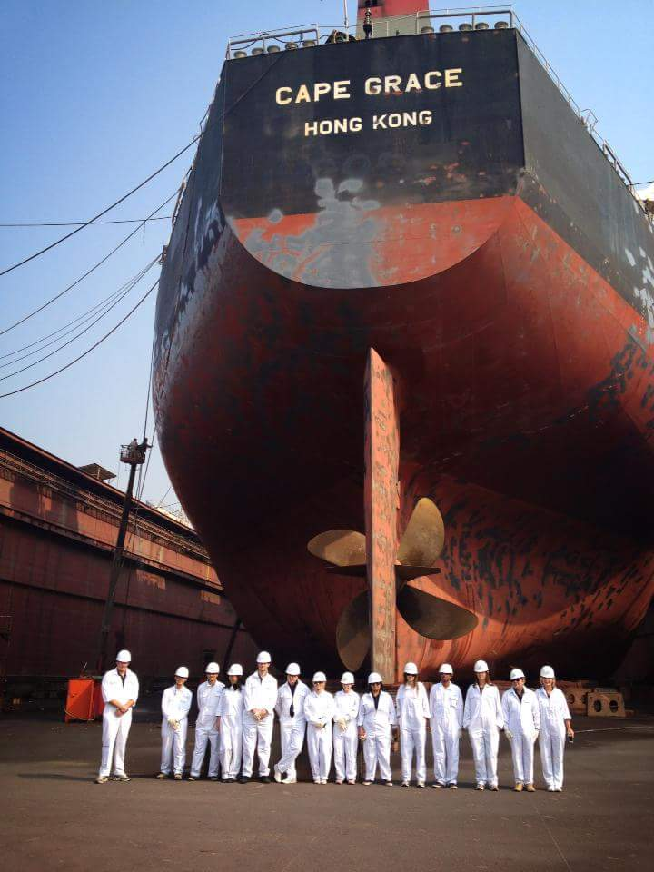
Marine U35s trip to Singapore & Shanghai

Slide 10
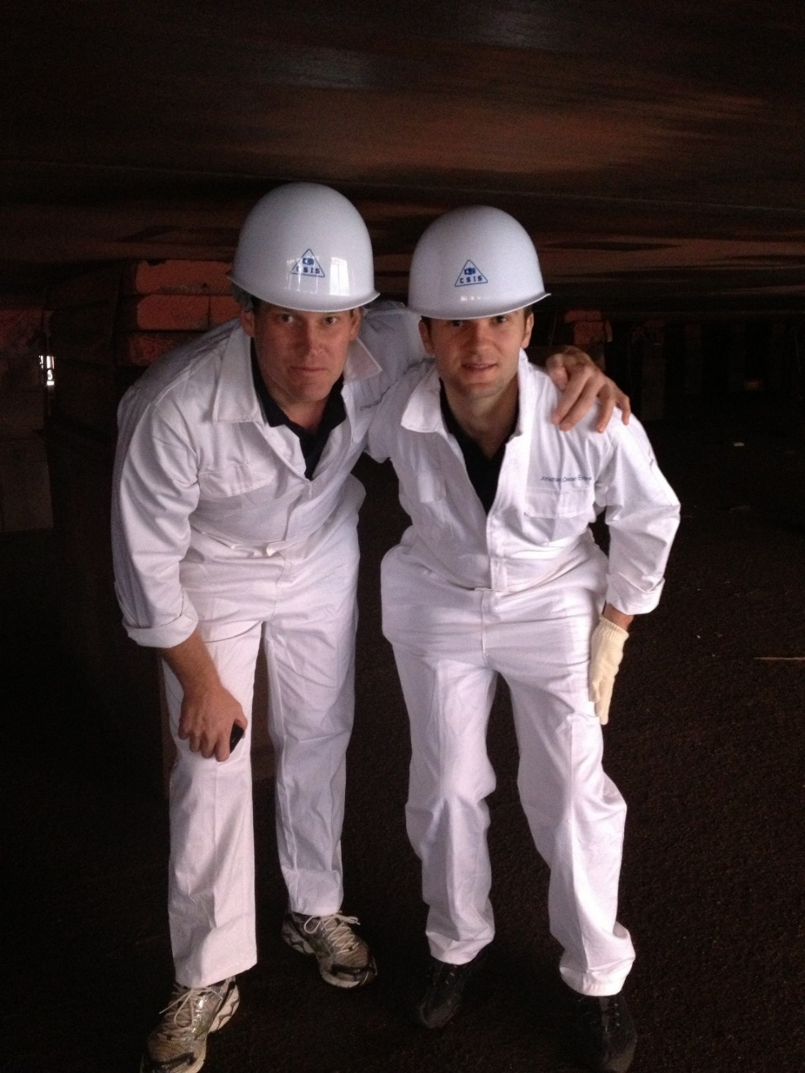
Marine U35s trip to Singapore & Shanghai

Slide 11
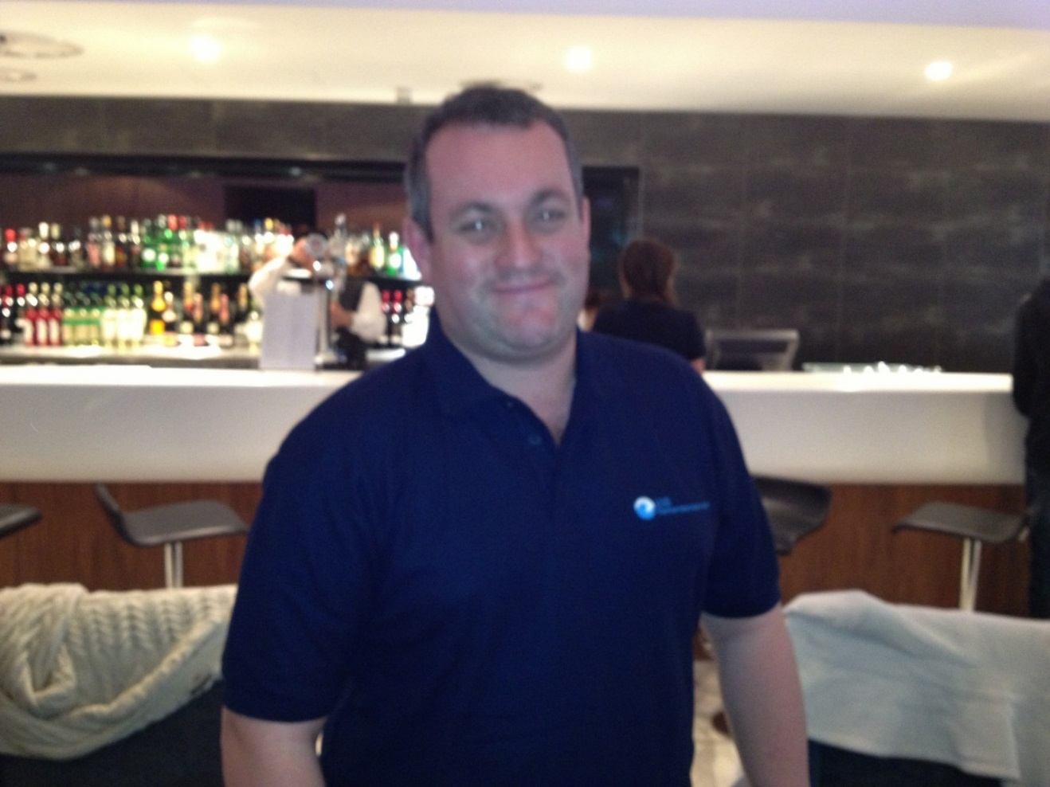
Marine U35s trip to Singapore & Shanghai –
and yes I am under 35 and can wear the t-shirt!

Slide 12

Marine insurance training and education

Slide 13
Questions/thoughts/comments?

Slide 14

GUINNESS TIME!

Slide 15
An Under 35s Perspective on Market Issues
Moderator
Amy Dallaway, Marine Claims Adjuster, Antares
Panellists
Jonathan Evans, Partner, Kennedys Law LLP
Bradleigh-Aaron McArthur, Senior Marine Claims Broker, RKH Specialty
Heather Robinson, Average Adjuster, Richards Hogg Lindley

