Slide 1
IMCC 2015 Wear versus Abnormal Wear Ray Luukas Senior Partner

Slide 2
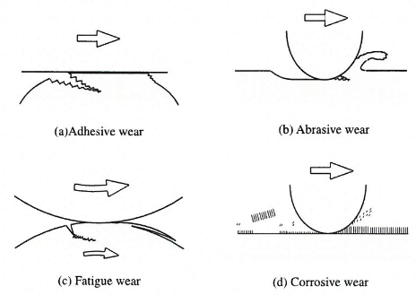
Definition of Wear “Wear is defined as the loss or removal of material from a surface.”

Slide 3
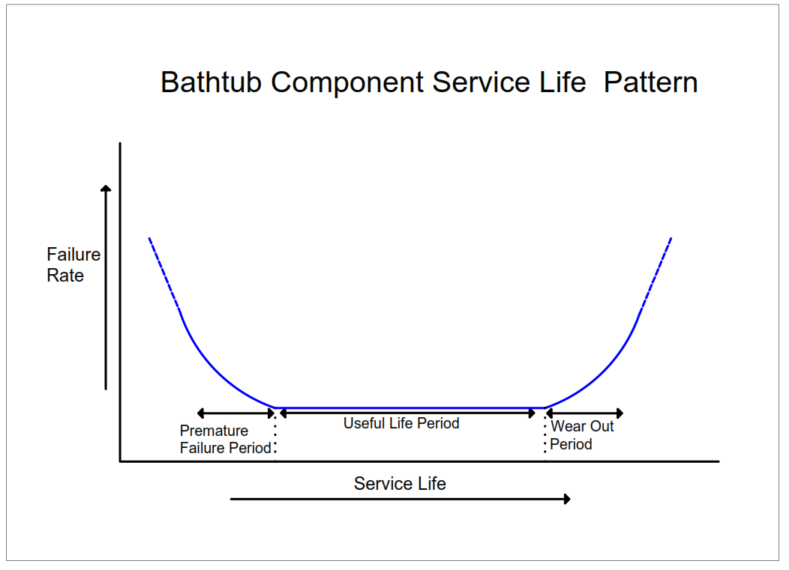

Slide 4
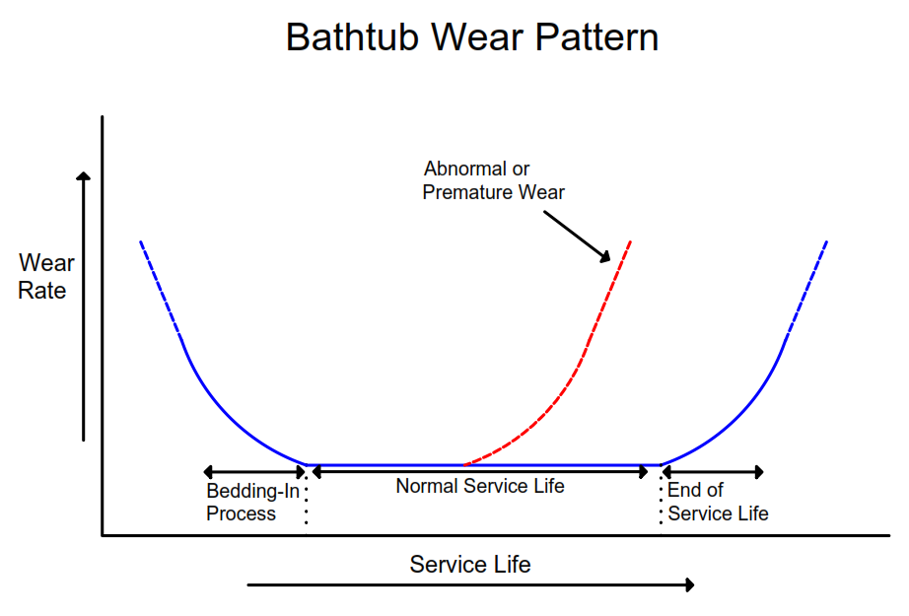

Slide 5
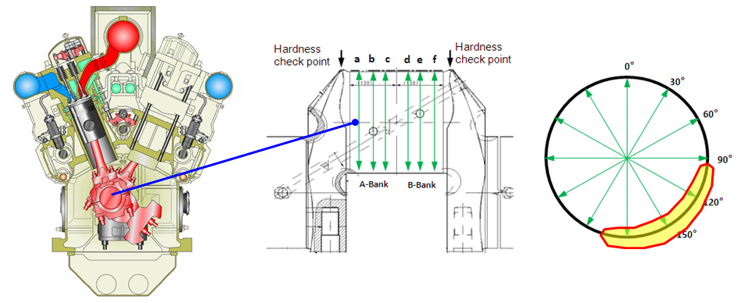
4-Stroke Marine Diesel Engine “Cam” or “Ridge” Wear

Slide 6
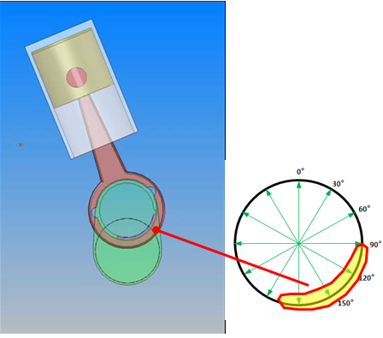
Cam or Ridge Wear Develops at the Underside of the Crankpin

Slide 7
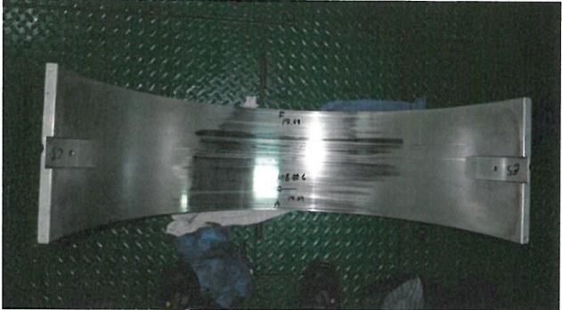
Normal Wear Pattern for Crankpin Upper Bearing Shell (In Way of TDC)

Slide 8
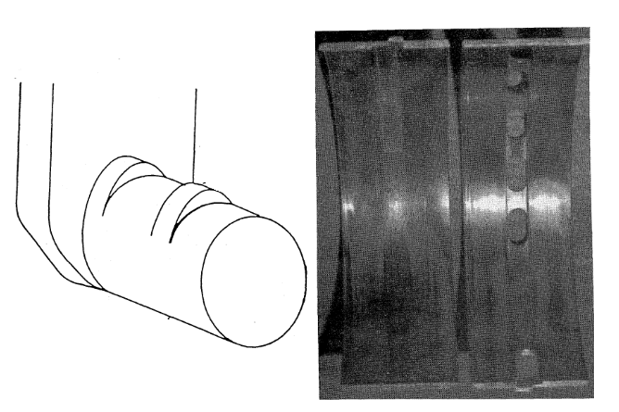
Cam or Ridge Wear Pattern at Crankpin and Bearing
Wear Strip formed by Cam/Ridge on Journal
Cam wear (Convex shape in way of Oil Groove)
Crankpin Journal
Oil groove in Lower Shell

Slide 9
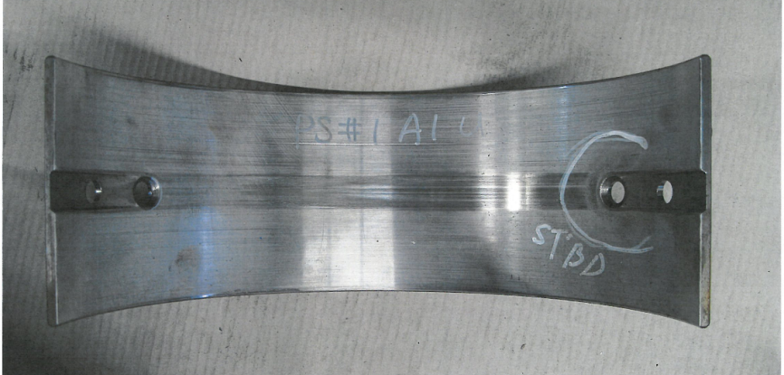
Upper Crankpin Bearing Shells
Cam Wear (slightly wider than oil groove)
Normal Wear Pattern
Cam Wear Pattern

Slide 10
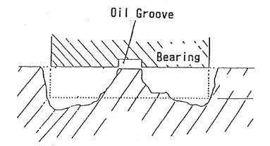
5 to 10 μ
Journal

Slide 11
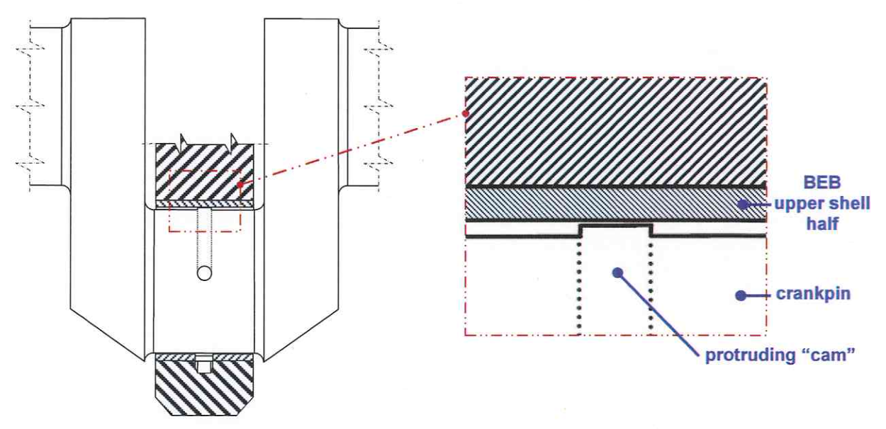
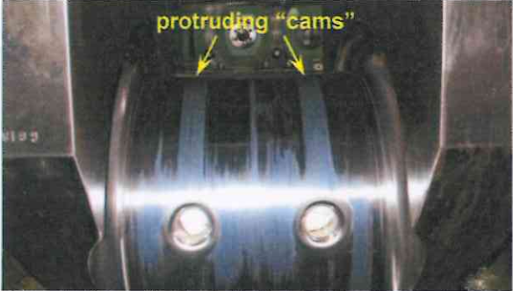

Slide 12
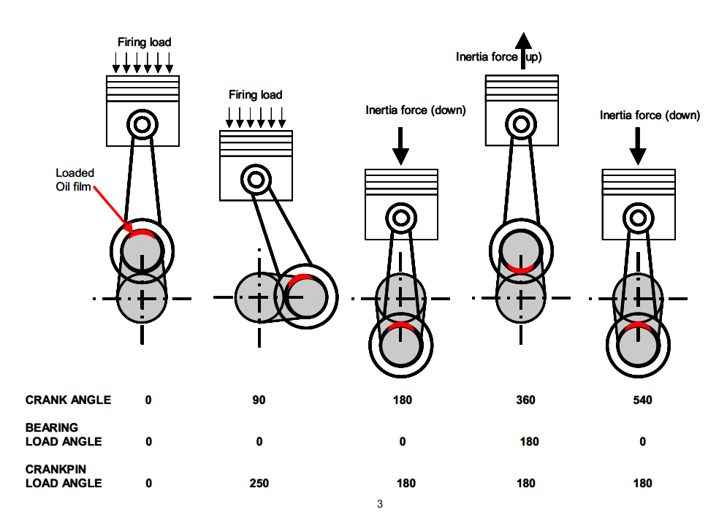

Slide 13
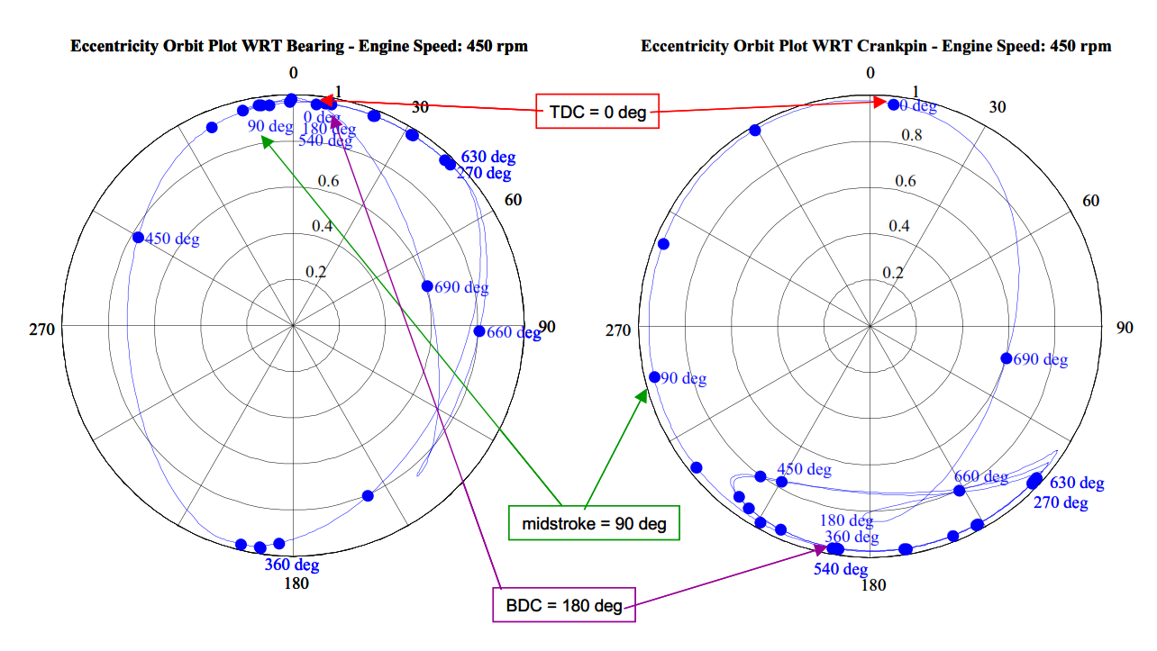

Slide 14
Crankpin Bearing Load/Oil Film Thickness

Slide 15
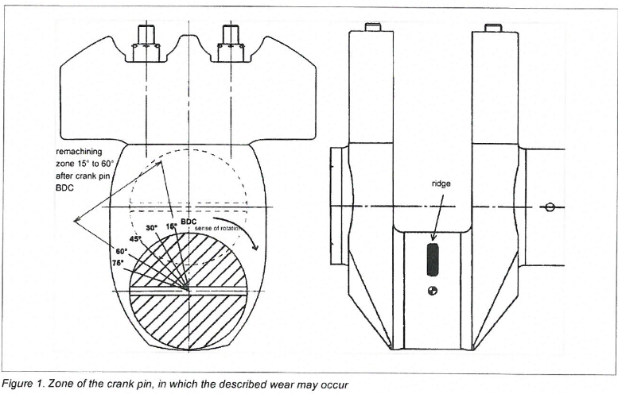
Cam or Ridge Formation At Underside of Crankpin Can Cause Bearing Failure

Slide 16
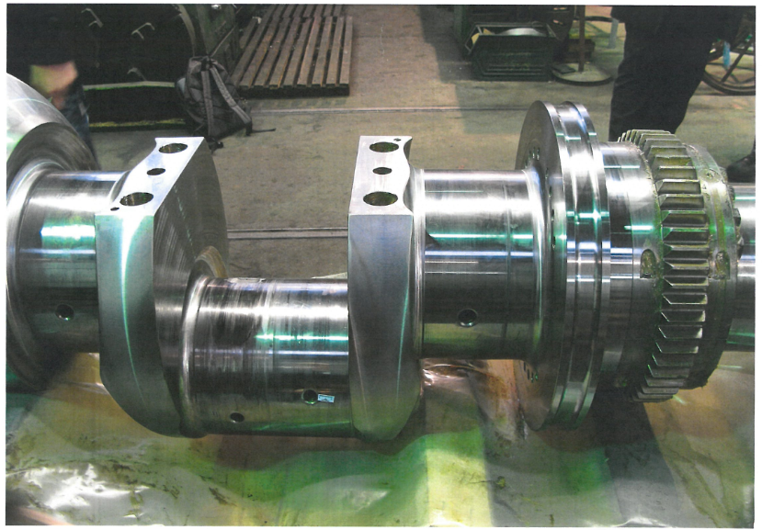
Consequences for Crankshaft
Overheating/Scoring/Hardness of Crankpin
Crankshaft Condemned

Slide 18
Have You Ever heard or Been Involved with “Cam Wear” for a Crankshaft Damage?:-
Wear Strip formed by Cam/Ridge on Journal
Cam wear (Convex shape in way of Oil Groove)
A) Once?
B) More than Once?
C) Never?
Crankpin Journal
Oil groove in Lower Shell

Slide 19
Do you consider “Cam” or “Ridge” Wear of Crankpins:-
Wear Strip formed by Cam/Ridge on Journal
Cam wear (Convex shape in way of Oil Groove)
A) Normal Wear?
B) Abnormal Wear?
Crankpin Journal
Oil groove in Lower Shell

Slide 20
Scenario (A) After just 1,500 running hours no.5 crankpin bearing suffers catastrophic failure resulting in the crankshaft being condemned due hardness/scoring being too deep for machining. Inspection of other crankpins and bearings points to advanced “cam” wear being responsible.
Is this a “damage” with costs for repair recoverable under a hull policy?
A consequence of wear and tear and so not recoverable.

Slide 21
Scenario (B) No.5 crankpin bearing shells are renewed as a normal part of routine maintenance. OEM new bearing shells are fitted but suffer catastrophic failure after just 500 running hours. Again, the crankshaft is condemned. Investigations reveal that the crankpin had formed a ridge over the previous 15,000 hours of service because of long term cam wear and the new bearing failed because of lack of clearance at this high spot.

Slide 22
Scenario (B) continued… A) Is this a “damage” with costs for repair recoverable under a hull policy? B) A consequence of wear and tear not recoverable. C) Crew negligence because they failed to notice the “cam” or “ridge” formed at the underside of the crankpin and so recoverable under the policy.

Slide 23
Summary
Normal wear is that which follows a typical Bathtub Process until the end of it’s expected service life; hopefully worn component being replaced before reaching the failure zone. Expected wear patterns; stable levels of wear debris generated.

Slide 24
Summary
Abnormal wear is that which causes limits/tolerances being reached, or failure occurring, prematurely; exhibits unusual wear patterns; high level of wear debris generated, etc.

Slide 25
Summary:
Summary
Cam or Ridge wear of Crankpins is a wear phenomenon associated with:-
Modern highly rated medium speed 4-stroke marine diesel engines.
Semi–oil grooved bearings i.e. only the bottom shell oil grooved.
Harder bearing materials, i.e. aluminium/tin as apposed to softer lead/tin white metals.
Oil contamination which accelerates cam wear.
Crankpin bearing failure shortly after a new bearing has fitted.

Slide 26
Summary:
Summary
Cam or ridge wear is difficult to detect visually during normal inspection because:-
It is at the underside of the crankpin.
It may be only 5 to 10 microns high.
It will tend to be a smooth “bump” rather than a sharp edged ridge.
Careful micrometer measurements and “blueing” techniques will be needed.

Slide 27
Summary:
Summary
Pay attention to the engine makers’ service bulletins that refer to “cam” or “ridge” wear and follow their guidelines to detect and deal with same.

Slide 28
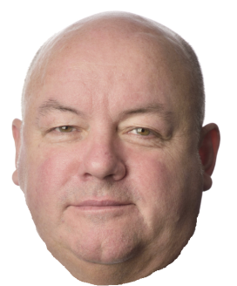
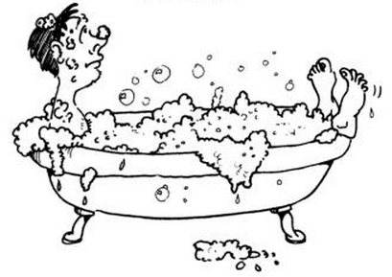

Slide 29
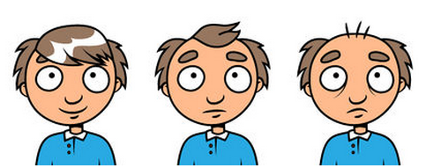

Slide 30
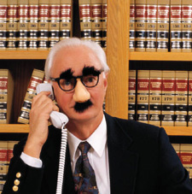

Slide 31
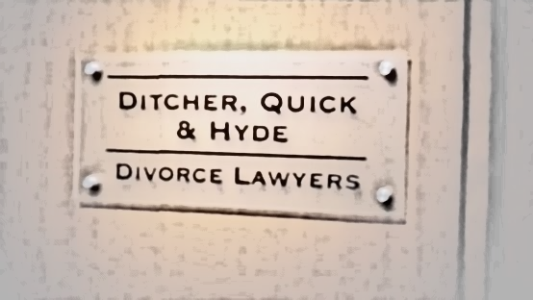

Slide 32

Approve your invoice
I WILL NOT

Slide 33


Slide 34


