Slide 1


INTERNATIONAL MARINE CLAIMS CONFERENCE 2015
FAILED / ABORTED REPAIRS
WHO PAYS & WHY?
JOE GRASSO, ATTORNEY, WIGGIN & DANA
SEAN MURPHY, NAVAL ARCHITECT & SURVEYOR ATLANTIC MARINE ASSOCIATES

Slide 2
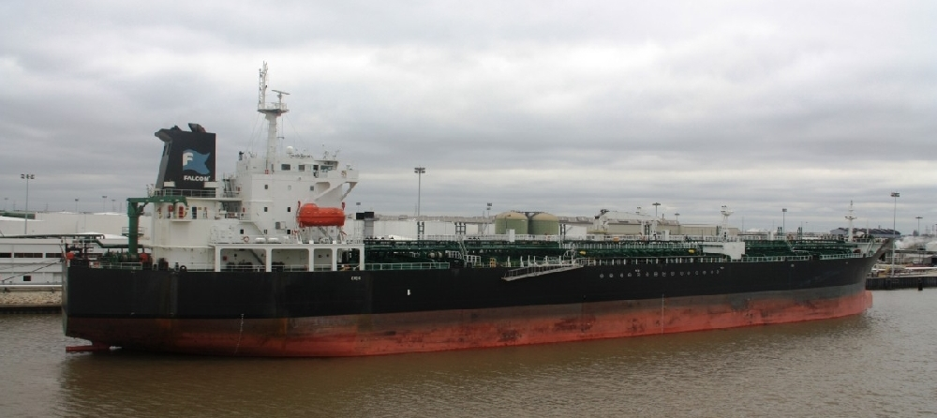
What Constitutes “Failed”
EXAMPLE – STUCTURAL DAMAGE & REPAIRS
7 YEAR OLD TANKER

Slide 3
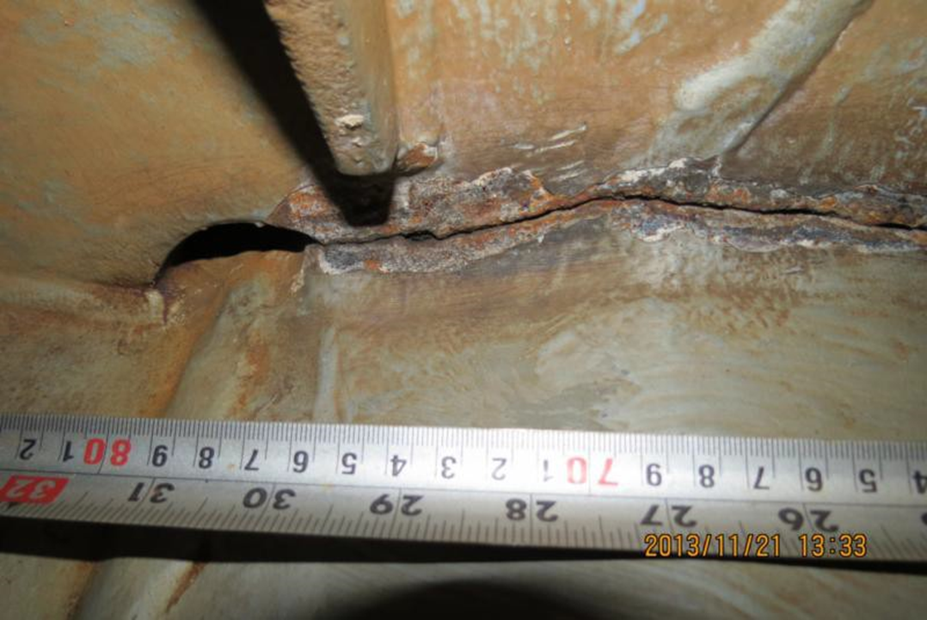
The Original Damage

Slide 4
The Original Damage
Damage found at Panama December 2013
Fractures:-
Around the rudder trunk;
Longitudinal frames fractured
Fractures between internal frames and shell plating
Rudder trunk plating fractured
Fractures between rudder horn and shell plating
A total of almost 8 metres of fractured structure

Slide 5
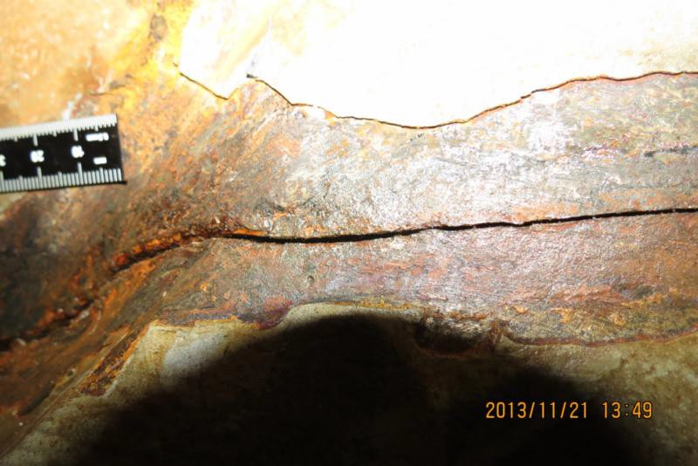
The Original Damage

Slide 6
The Original Permanent Repairs
Permanent repairs at the anchorage agreed by:-
Owners Representative(s)
Classification surveyors
Classification Welding Specialists
Hull & Machinery Surveyor
Competent Shore Contractor

Slide 7
The Original Permanent Repairs
Cleaning the areas affected
Crack dye penetrant / ultrasound testing of the areas affected
Preparation (grinding / gouging) of the areas affected
Crack dye penetrant / ultrasound testing of the prepared areas
Preheating of the areas affected
Welding of the areas affected

Slide 8
The Original Permanent Repairs
Inter welding-pass heating of the areas affected
Back gouging of the areas affected
Post heat treatment of the areas affected
Hardness measurements of the areas affected
Final weld testing.
3+ weeks to complete

Slide 9
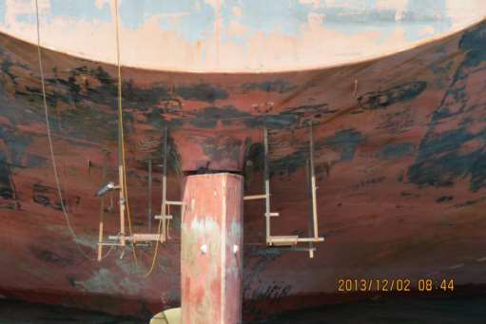
The Original Permanent Repairs

Slide 10
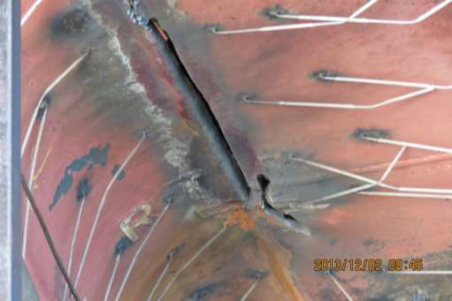
The Original Permanent Repairs

Slide 11
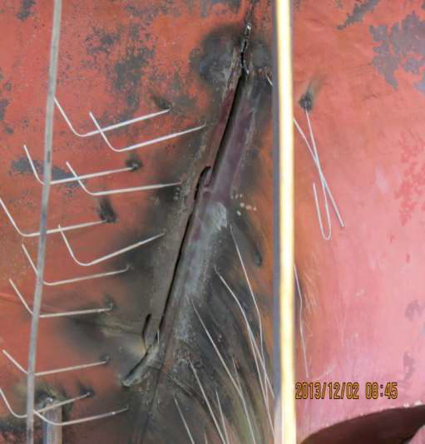
The Original Permanent Repairs

Slide 12
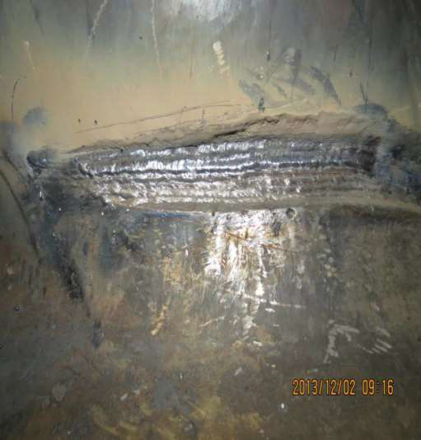
The Original Permanent Repairs

Slide 13
The Original Permanent Repairs
Ship re-enters service
Then four months later:-
Re-examination of repairs
Dye penetrant NDT
Further fracturing of the repaired areas
Classification issue further Condition of Class
Ship sails for drydock

Slide 14
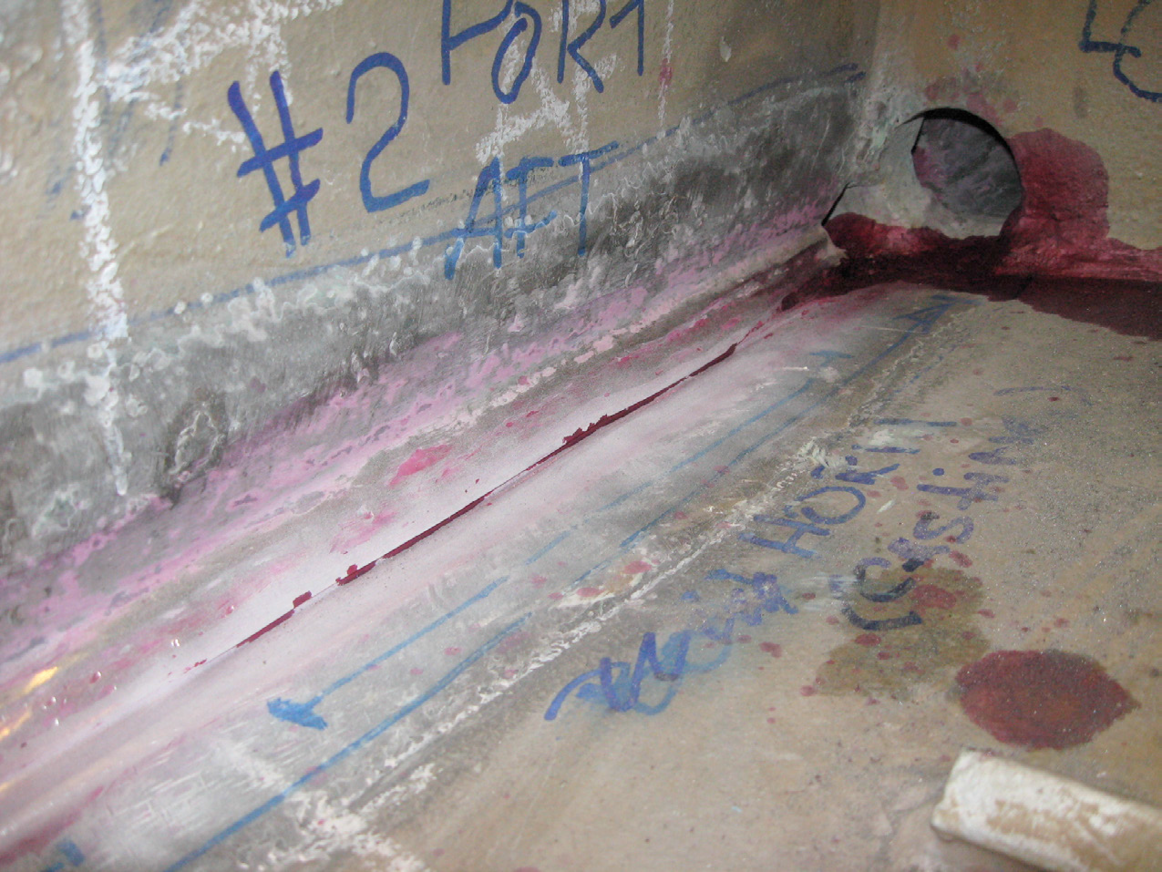
Repairs Fail

Slide 15
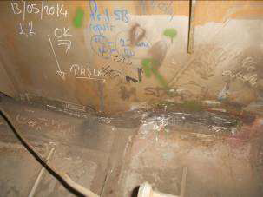
Permanent Repairs - Again

Slide 16
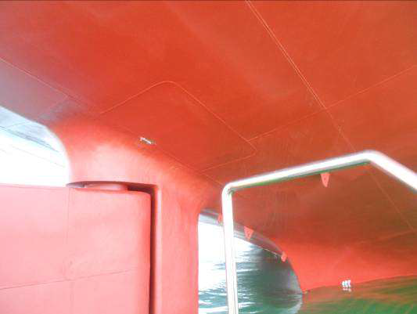
Permanent Repairs - Again

Slide 17
Summary
Initial permanent repairs effected by a competent repairer following all procedures using approved techniques
Oversight by Classification with specialist welding knowledge
Nature and scope of repairs also agreed by Owners technical department and the Underwriters surveyor
No defects when the vessel sailed but the fractures re-appeared
Total costs four times the original estimate
Various other expensive cases; engines, machinery repairs etc.

Slide 18

Questions?

