Slide 1


INTERNATIONAL MARINE
CLAIMS CONFERENCE - 2015
DAMAGES RELATED TO ELECTRONICALLY CONTROLLED ENGINES
Mark McGurran
Manager, Marine Engineering Services
Regional Manager, Hull & Machinery

Slide 2

What are Electronically Controlled Engines?
Although engines, including two stroke, slow speed main engines have had some form of electronic control for some time now, when we talk about Electronically Controlled Engines in this context we mean:
Modern engines that do not use mechanical camshaft means to control fuel injection, exhaust valve actuation and cylinder lubrication, but which control these parameters electronically.

Slide 3
Question:
How deal of with underwriters who request information on main engine make prior to writing a risk?
A – Yes
A – No

Slide 4
A traditional camshaft controlled engine uses a gear and / or chain driven camshaft to actuate the following:
The air distributor for staring air
The fuel pumps for fuel injection
The exhaust valve actuators to open the exhaust valves
The cylinder lubricators to deliver lube oil to the cylinders through lubricator quills
In addition the engine may mechanically drive through running gear the governor and reversing mechanisms.

Slide 5
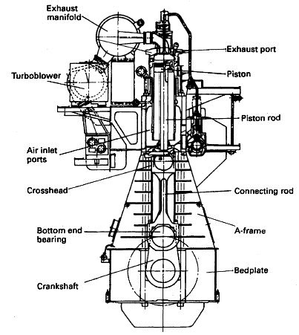

Slide 6

An animation of a traditional two stroke engine operating with a camshaft – credit to www.marinediesels.co.uk

Slide 7
An Electronically Controlled Engine instead relies on the hydraulic actuation of theses mechanical components by utilising an electronically controlled
Engine Control System (ECS).
The main ECS components are:
Control units including the Main Operating Panels (MOPS – software)
Hydraulic power supply assembly
Electronically controlled fuel injection actuators
Electronically controlled exhaust valve actuators
Electronically controlled air start valves
Integrated governor & tachometer features
Electronically controlled cylinder lubricators
Various ancillaries and monitors

Slide 8
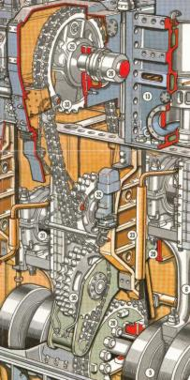
Therefore a substantial amount of expensive and precision made components and assemblies are no longer needed in the engine, including the camshaft and running gear.

Slide 9
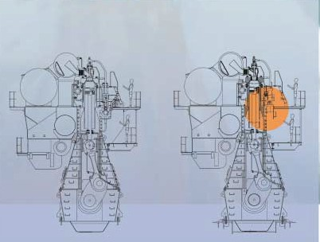

Slide 10
Question:
How often is the technical complexity of the main engine systems asked about by the underwriters you deal with prior to their writing risk – do theye specifically ask if the engine is electronically controlled?
A – Never
A – Sometimes
A – Always

Slide 11
The Benefits
Electronically Controlled Engines offer a far greater level of finite control over the variable engine parameters. Where a mechanical camshaft can only offer so much in the way of fuel injection and exhaust valve timing, the electronic control allows for a greater range of adjustment – including for individual cylinders.
This leads to greater fuel efficiency and reduced emissions allowing the engine to comply with current and the likely future emissions regulations.

Slide 12
As the engine no longer needs to physically drove a large and heavy camshaft or the running gear, the power losses associated with this are avoided.
The reduction in large components also leads to reduction in major maintenance tasks and in crease in running hours between overhauls.
The overall weight of the engine is reduced which has benefit in power to weight ration and leads to further fuel savings.
A common rail fuel system is utilised providing fuel injection pressure at all times, so injection timing can be precisely controlled.

Slide 13
The Drawbacks
Electronically Controlled Engines require a sophisticated operating systems which can be prone to faults.
There exists a lack of knowledge with ships crews to deal with complex computer control faults.
Highs costs are associated with the software and electronic hardware required.
As there is no mechanical means of actuation, there is no local control station or emergency control. If the electronics or software fail, the engine becomes inoperable.

Slide 14
Typical Damages
Failure of the control boards due to heat and vibration continues to cause concern.
With conventional engines, the cylinder lubricators often incorporate a visual indication of their operation so that engine room crew can tell with a quick glance if the cylinders are receiving a flow of lubricating oil.
With an electronic system this is not the case, and we must rely on sensors to tell us if something is amiss. These sensors are prone to fault and can mistake oil pressure with the correct quantity of oil flow.

Slide 15
This can lead to significant and rapid wear of the piston rings and cylinder liners resulting in expenses and long lead time repair.
With worn piston rings and liners, starting the engine can become difficult. The control system will only allow start air to remain on for certain time period before it decides that the start was not successful and stops the start air supply.
In a conventional engine the engineers could simply admit the air for longer by using the local control panel. The only way to achieve this with an Electronically Controlled Engine is to access the software parameters.

Slide 16
This presents a problem. Either the engine room crew are given the access rights to alter the parameters, or they are not.
In the former they can easily alter all sorts of parameters and upset the delicate balance of the engine, thereby reversing all of the fuel and efficiency savings that the system can offer.
In the latter they are unable to start the engine and could be faced with an unsafe situation with regards vessel navigation.

Slide 17
We often see engine builders reluctant to share the software access codes, to the extent that they have to attend the vessels themselves to make adjustments. This puts the vessel at risk.
With the increasing complexity of these systems, dedicated training is required to be provided to the engine room crew. This is often supplied by the engine builder when the vessel is new – but what will happen when these vessel are older?
Now that the fuel price has reduced the fuel cost savings might not be as attractive when weighed against the high capital cost of the engines.

Slide 18
Question:
If an otherwise competent and qualified crew are unable to rectify a software malfunction due to their own lack of software manipulation ability, would you consider this to be crew negligence or negligence of the assured in their failure to ensure that the crew had been given this dedicated taring?
A – Crew negligence
A – Negligence of the assured (or managers)
A – Neither / I don’t know

Slide 19
Final Thoughts
The technological advancements offered by these engines are significant in terms of improved fuel economy and engine balance, reduction in big ticket engine components and weight for the same power. This will lead to longer intervals between overhauls and a reduction in maintenance costs.
The kicker is electronic systems are more prone to failure and many of these failures will result in breakdowns that cannot be repaired by ships crews and / or may require a supply of proprietary parts to be sourced. All of which may lead to high repair costs and long repair durations.

Slide 20
One Last Question:
DO you think that the use of Electronically Controlled Engines benefits the assured, their managers and charterers more; or the underwriters more?
A – Assureds / managers / charterers
A – Underwriters
A – Benefits both communities equally

Slide 21
Mark A. McGurran
London Offshore Consultants Singapore Pte Ltd
+65 9634 4825
m.mcgurran@loc-group.com
Thank You!

