Slide 1
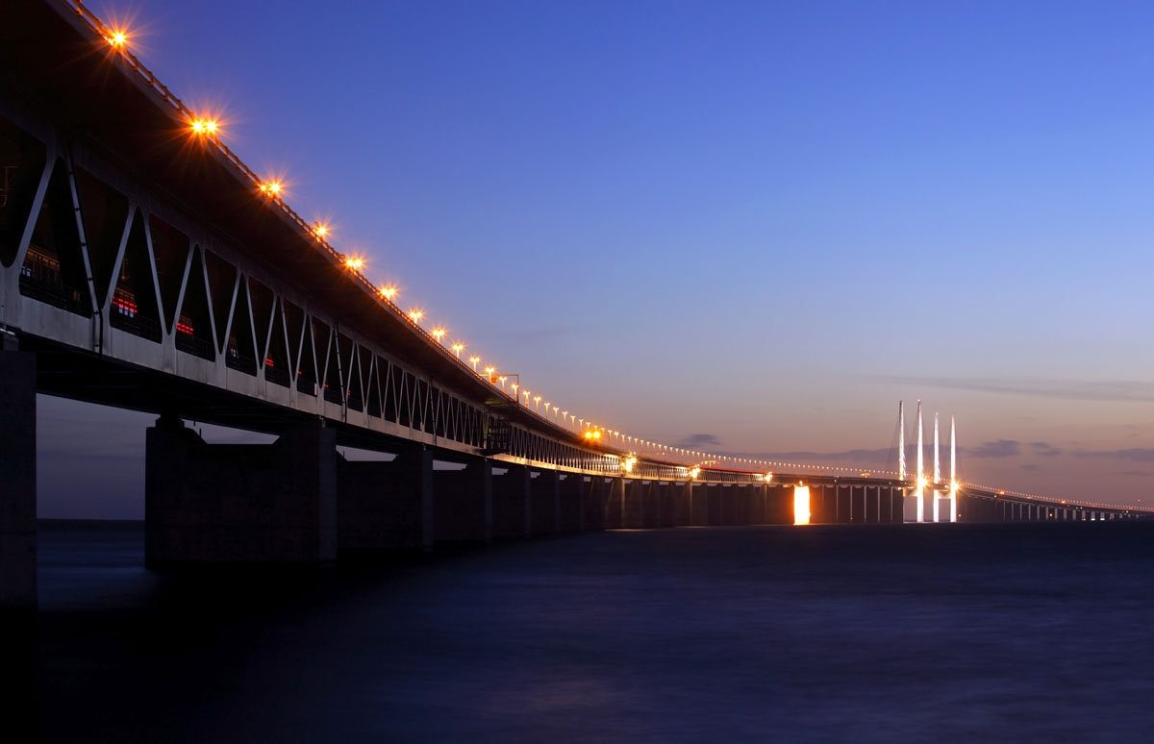



From Titanic to Costa Concordia
Human Factors in maritime accidents
Jens-Uwe Schröder-Hinrichs
Professor
Notes:
Tetd
uj7j7

Slide 2
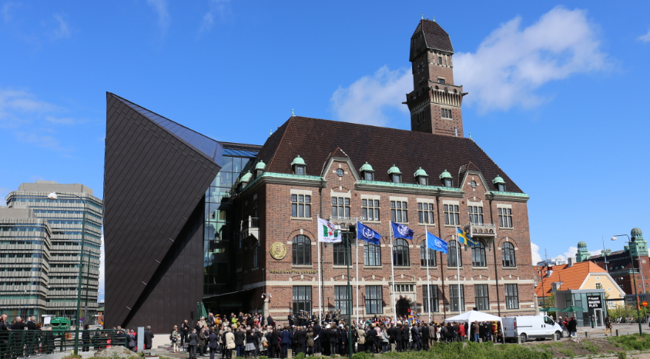
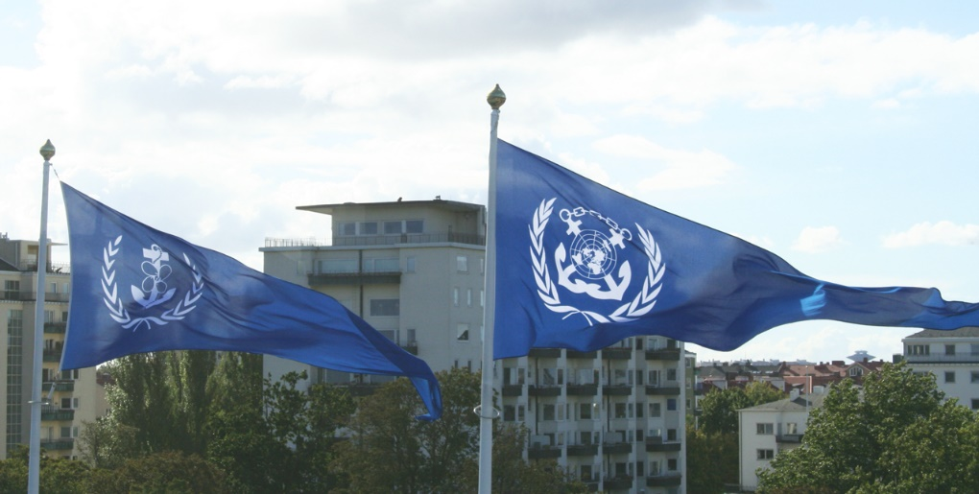
About WMU
Maritime Post-graduate University
Established by IMO in 1983
Focus on Maritime & Oceans Education, Research & Capacity-Building
2
Principal Financial Supporters
Government of Sweden City of Malmö Nippon Foundation, Japan

Slide 3
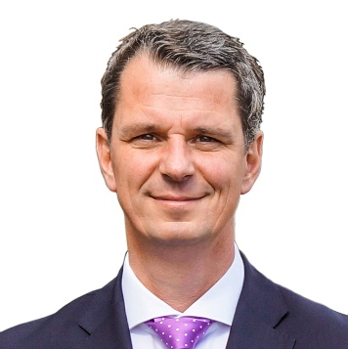
About the Presenter
Dr. Jens-Uwe Schröder-Hinrichs
Professor (Nippon Foundation Chair of Maritime Administration)
Head, Maritime Safety and Environmental Administration (MSEA)
Head, Maritime Risk and System Safety (MaRiSa) Research Group
Editor, WMU Journal of Maritime Affairs
Areas of work/research
Implementation and enforcement of international maritime safety standards
Maritime accident investigations
Maritime risk assessment and management
Maritime human factors
Links
MaRiSa Group (http://marisa.wmu.se)
WMU Journal (http://www.springer.com/13437)

Slide 4
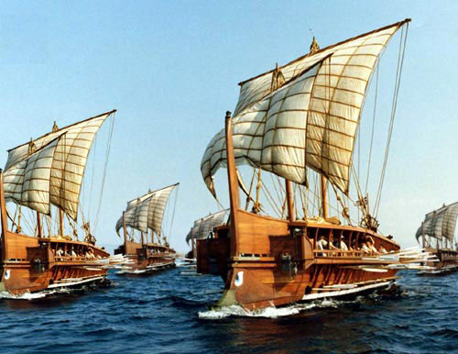
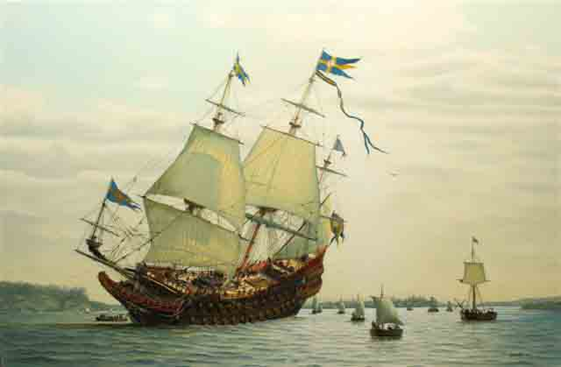
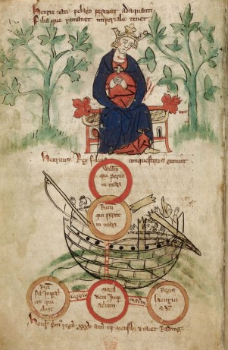
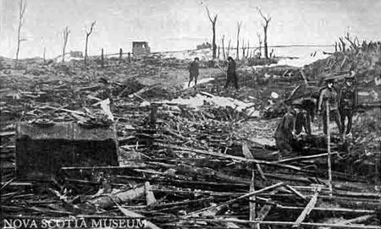
Human factors in maritime accidents …
Roman fleet 255 BC
Wasa 1628
Mount Blanc 1917
White Ship 1120

Slide 5
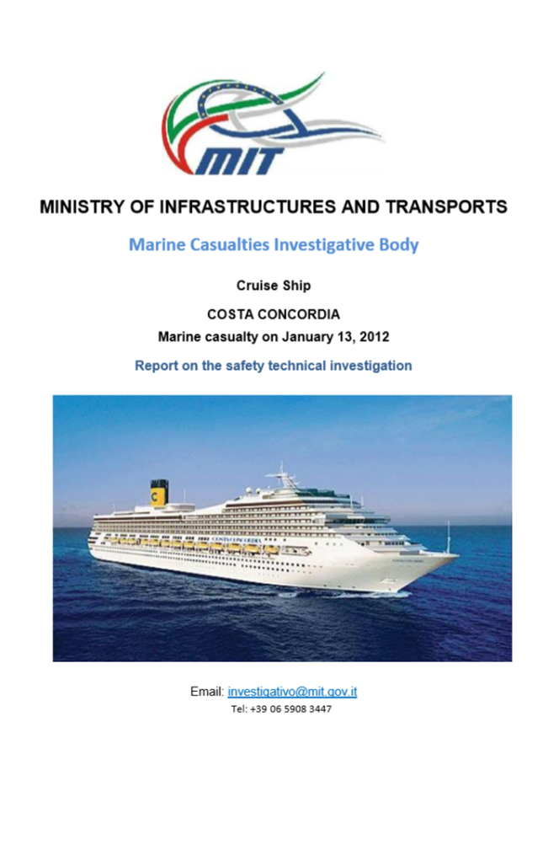
The example of the Costa Concordia (2012) (1)
Report submitted to IMO’s MSC 92
Human factor related key findings
“the Master’s unconventional behaviour … represents the main cause of the shipwreck.” (p. 9)
Contributing from a human factor perspective
BRM related issues
No clear handover between Master and C/O
Inattention of Master due to other persons on the bridge
Inattentive bridge team
“… passive attitude of the Bridge Staff. Nobody seemed to have urged the Master … ot to give warning …”

Slide 6
The example of the Costa Concordia (2012) (2)
Report submitted to IMO’s MSC 92
Contributing from a human factor perspective
Emergency management
Unfamiliarity with the procedures to abandon the ship
Lack of leadership from the bridge
Dissoriented crew
Shipping company involvement
No questioning of the decisions of the Master
In appropriate cooperation with the SAR services
Qualification of the crew – e.g. communication problems

Slide 7
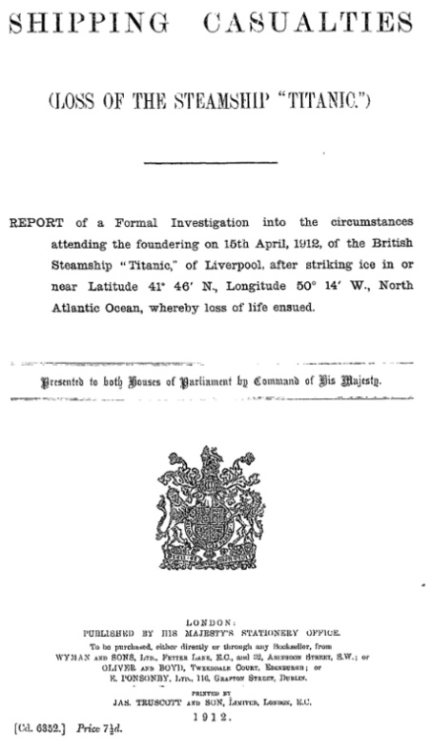
Similarities? (1)
TITANIC (1912)
The ship’s track was 25 miles south of the area for field ice, but well within the area "Icebergs have been seen within this line in April, May and June." (page 24)
Several sailing directions mention the danger resulting from ice in this area. (page 25)
Ice warnings were first received 48 hours before the accident and acknowledged. Several other warnings were received before the collision. (page 26-28)
The master and the officers on watch were aware of the presence of ice in the vicinity of the ship. They expected to reach it before midnight (ship collided 23:40). (page 29)
The officers were confident to identify ice in a safe distance from the ship (2nd officer about the ice "... I judged I should see it (the ice) with sufficient distinctness and at a distance of a mile and a half, more probably two miles."). (page 28)
Notes:
Even though, I guess, you all were reading recently quite a lot about TITANIC and the accident, as well as the COSTA CONCORDIA are concerned, I would like to mention the facts that I need for my argumentation here in this case.
The TITANIC was a state-of-the-art passenger ship on her maiden voyage from Southampton to New York in April 1912. The ship foundered after a collision with an iceberg in the early morning of 15 April 1912.
All facts have been taken out from the UK investigation report headed by Lord Mersey.

Slide 8
Similarities? (2)
TITANIC (1912)
The report makes reference to several reported conversations on the bridge between officers and the master about the ice and how likely it will be to see it under the given weather circumstances. (page 28-29)
From tests made with a sister ship the report concludes that it would have required 37 seconds to change the course of the ship at an assumed speed of 22 knots to the extent made prior to the collision with the iceberg as it was testified during the investigation. This meant that the iceberg was sighted in a distance of approximately 450 meters off the ship (500 yards). (page 29, 30-31)
The total capacity in the lifeboats was 1178 persons. There were 3560 life belts on board (page 18). The report lists 2201 persons on board - 885 crew and 1316 passengers. (page 23)
Notes:
In short – the dangers of the situation were known, but underestimated.

Slide 9
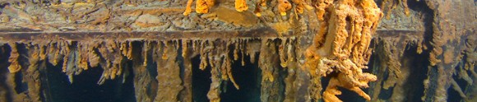
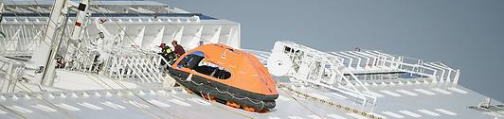
Similarities? (3)
TITANIC (1912) vs. COSTA CONCORDIA (2012)
Both captains were very experienced and had immaculate service records prior to the accidents. They had spent their entire professional life at sea without larger accidents.
Both captains were aware of the potential dangers, but felt that the risks so small that they easily could be controlled – without the need of changes in speed and course.
In case of the TITANIC, no officer on the bridge objected to the navigation of the ship. So far, no information was published that officers on the COSTA CONCORDIA disagreed with the maneuvers of the captain.
Both accidents resulted into emergency situations for which the ships were not built (beyond design-base accidents). Both scenarios were considered as being highly unlikely.
Notes:
As already mentioned, the technology of 1912 and 2012 is so different that it can hardly be compared. The materials used and the principles of ship’s constructions were different and the equipment available to assist the decision makers was different as well. The technology to support navigation is even more different. Whereas the Titanic had access to wireless communication, the Costa Concordia had all kinds of support and computer systems, including GPS, automated maneuvering systems etc. And while the two accidents happened in different sea areas and under different circumstances, the ‘mechanics’ were basically the same – colliding with an object underwater that caused significant structural damage to the hull.
A closer look at the two accidents revels even further similarities:
If it is possible to find similarities between two accident scenarios over a period of time of almost 100 years in between, the question to be raised certainly is why these underlying factors seem to have survived despite all technological progress made in the last 100 years.

Slide 10
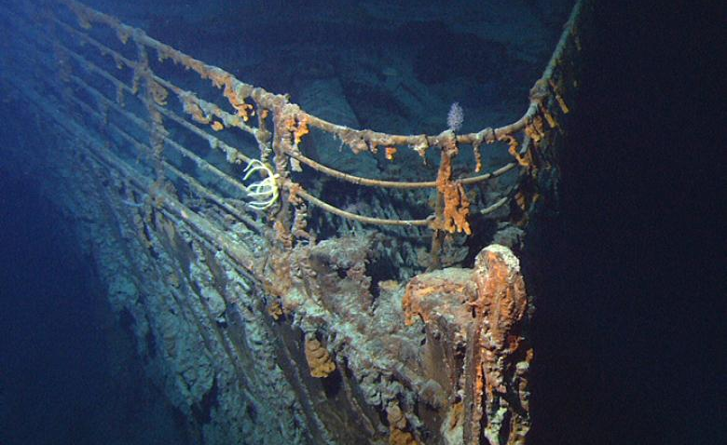
Human factors reviewed
Technology and regulations have changed, but human factors …
Possible Titanic factors
Authority gradient
Group think and the desire for harmony
Cognitive hysteresis
Efficiency thoroughness trade-offs (ETTO)
Organizational factors
Additional Non-Titanic factors
Communication

Slide 11
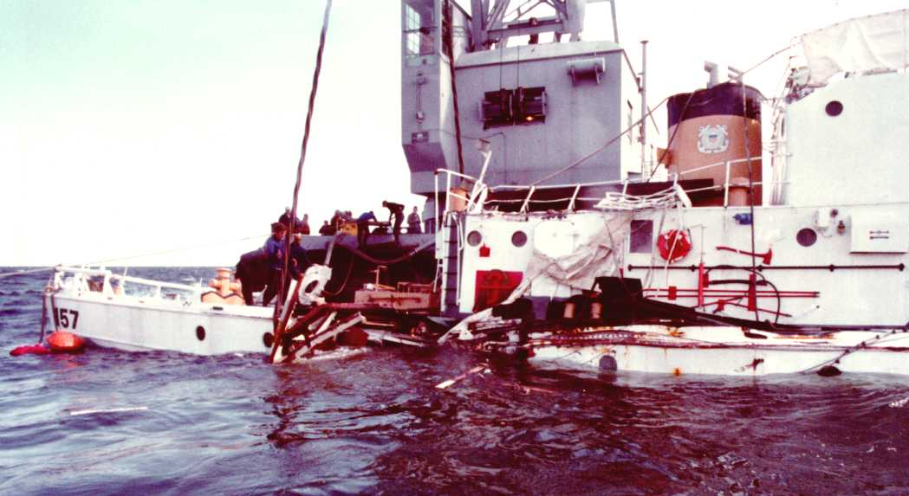
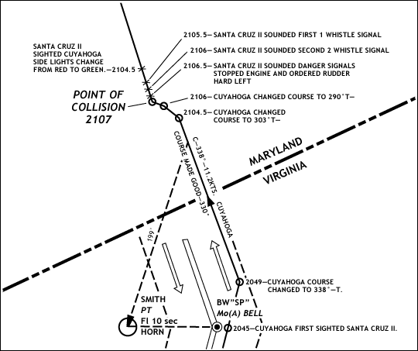
Authority gradient (1)
USCG CUYAHOGA (1978)
Pictures: WMU, www.uscg.mil
The ability to challenge decisions taken on a higher level of authority

Slide 12
Authority gradient (2)
USCG CUYAHOGA (1978)
Pictures: WMU, www.uscg.mil
The ability to challenge decisions taken on a higher level of authority

Slide 13
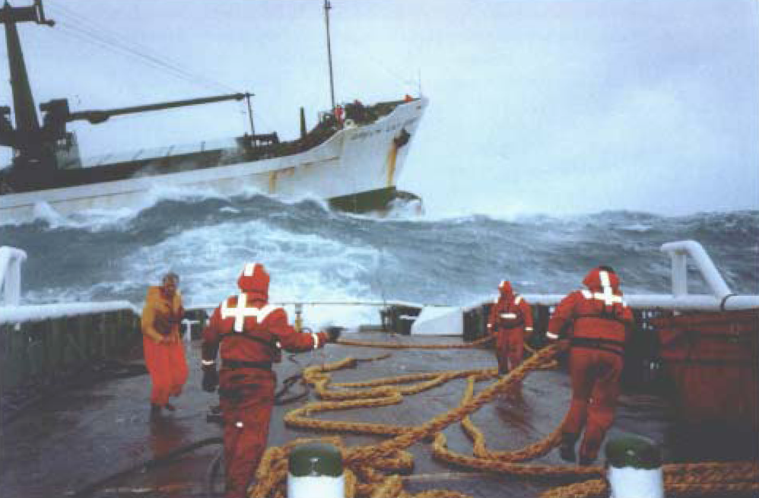
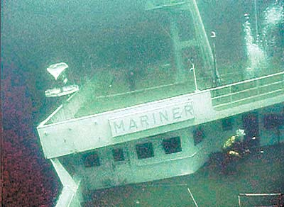
Authority gradient (3)
BOW MARINER (2004)
GREEN LILY (1997)
...
Pictures: www.dieselduck.ca; MAIB
Notes:
In February 2004 the chemical tanker BOW MARINER caught fire and exploded while the crew was engaged in cleaning a cargo tank. The ship sank about 45 nautical miles east of Virginia. Of the 27 crewmembers aboard, six abandoned ship and were able to make it to an inflatable life raft and were rescued by the US Coast Guard. An unknown number of other crewmembers abandoned ship to the water. The Coast Guard and Good Samaritan vessels recovered three of these crewmen from the water, one deceased. The other two died before reaching a hospital. 18 crewmen remain missing and are presumed dead.
Contributing to this casualty was the failure of the operator and the senior officers of the BOW MARINER, to properly implement the company and vessel Safety, Quality and Environmental Protection Management System (SQEMS). The senior officers were from one nationality and the junior officers and rating of a different nationality. There was no trust between the two groups and the senior officers directed the junior officers and ratings with direct orders, did not delegate tasks etc. So, the junior officers and ratings had no birdseye perspective of the overall operational situation. One crew member later on said that the words of the senior officers were like “words from God”.
Green Lily was a general cargo vessel, built in 1978 and lengthened in 1984. It left the Shetland Islands and sailed for the Ivory Coast early on in November 1997. The weather on departure was south-east force 7, increasing to severe gale force 9, and eventually storm force 10. During the passage a sea water supply line fractured in the engine room. The flooding was controlled and pumping out had begun when the main engine stopped suddenly. Unsuccessful attempts were made to restart the engine while the vessel drifted. The Coastguard was advised of the situation. Three tugs unsuccessful managed to stabilize the ship. The ship finally run aground. Among the contributing factors, missing teamwork was mentioned.
Working cultures can influence the identification of the drift of a system into a dangerous zone. Navigation of a ship is has in a historical context always been characterized by semi military organizational structures and decision making by a single person in command, although there are a few sources that require collective agreement before taking a risk, such as, e.g., the Rolls of Oléron in the 12th Century, who in their article 2 require the master to consult the crew before setting sails (Mukherjee, 2002, p. 31). There is still a debate about the extent of military elements involved in shipping operations and what consequences that may have (Cox, 2011). Accidents like the collision of the CUYAHOGA with the SANTA CRUZ II in October 1978 certainly highlight what a missing critical bridge communication may finally result in.

Slide 14
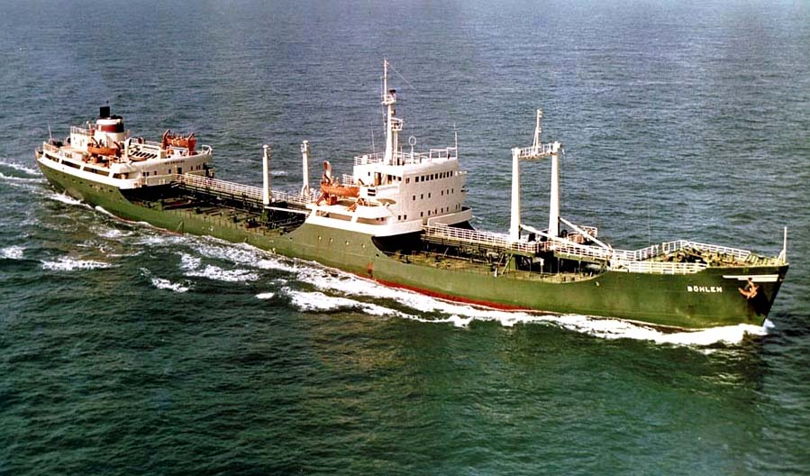
Group think or the desire for harmony … (1)
BÖHLEN (1976)
Are critical comments appreciated ...?

Slide 15
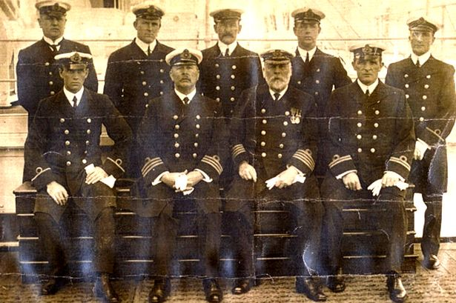
Group think or the desire for harmony … (2)
Picture: www.mirror.co.uk
... were they all in agreement?

Slide 16

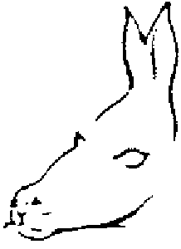
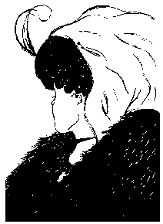
Cognitive hysteresis (1)
What do you see and what
does it require to change this?

Slide 17
Cognitive hysteresis (2)
What do you see and what
does it require to change this?

Slide 18
Cognitive hysteresis (3)
What do you see and what
does it require to change this?

Slide 19
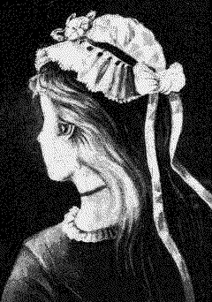
Cognitive hysteresis (4)
What do you see and what
does it require to change this?

Slide 20
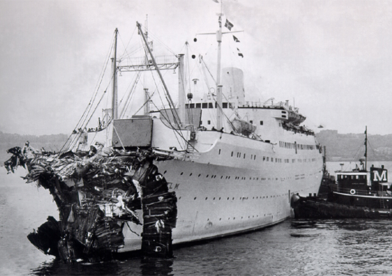
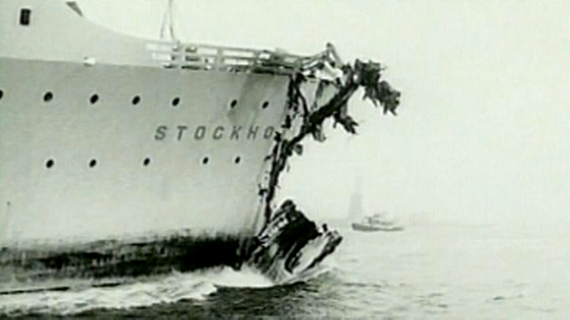
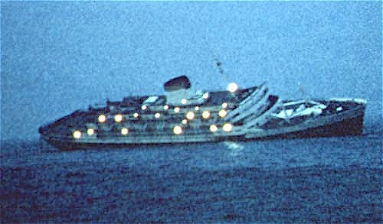
Unanticipated side effects of new technology … (1)
ANDREA DORIA vs. STOCKHOLM (1952)
New technologies and procedures
change the system ...

Slide 21
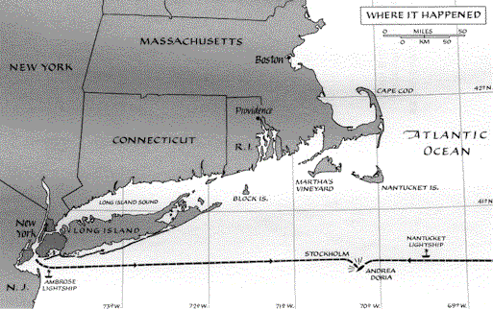
Unanticipated side effects of new technology … (2)
ANDREA DORIA vs. STOCKHOLM (1952)
New technologies and procedures
change the system ...

Slide 22
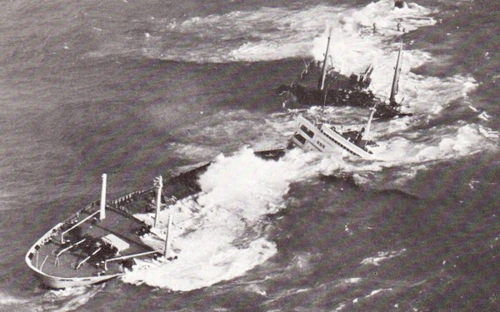
Efficiency thoroughness trade-offs (ETTOs) (1)
TORREY CANYON (1967)
How to balance operational priorities and safety concerns ...

Slide 23
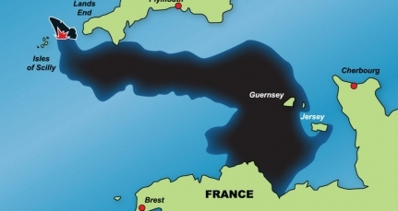
Efficiency thoroughness trade-offs (ETTOs) (2)
TORREY CANYON (1967)
How to balance operational priorities and safety concerns ...

Slide 24
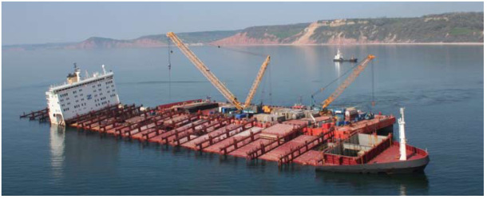
Efficiency thoroughness trade-offs (ETTOs) (3)
MSC Napoli (2007)
How to balance operational priorities and safety concerns ...

Slide 25
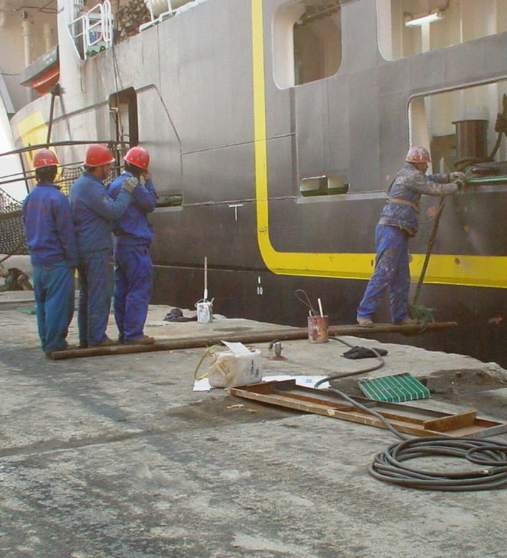
How were human factors treated?
Often accidents were attributed to single causes
Reactive approaches in follow-up to an accident rather than proactive approaches in ship safety
Preferred way following accidents were technical regulations until the end of the 1990s (double hull in case of the EXXON VALDEZ)
Changes in design, new regulations or training were suggested
A few examples only where the system as such was changed (HERALD OF FREE ENTERPRIZE – ISM Code)

Slide 26
Problem issue (1) – accident investigation & follow-up
What safety problems are identified during accident investigation? (Schröder-Hinrichs et al. (2011))
3.5%
20.4%
13.9%
5.7%
56.5%
Flag State influences
Organizational influences
Contributing factors to accidents
Unsafe supervision
Preconditions for unsafe acts
Unsafe acts

Slide 27
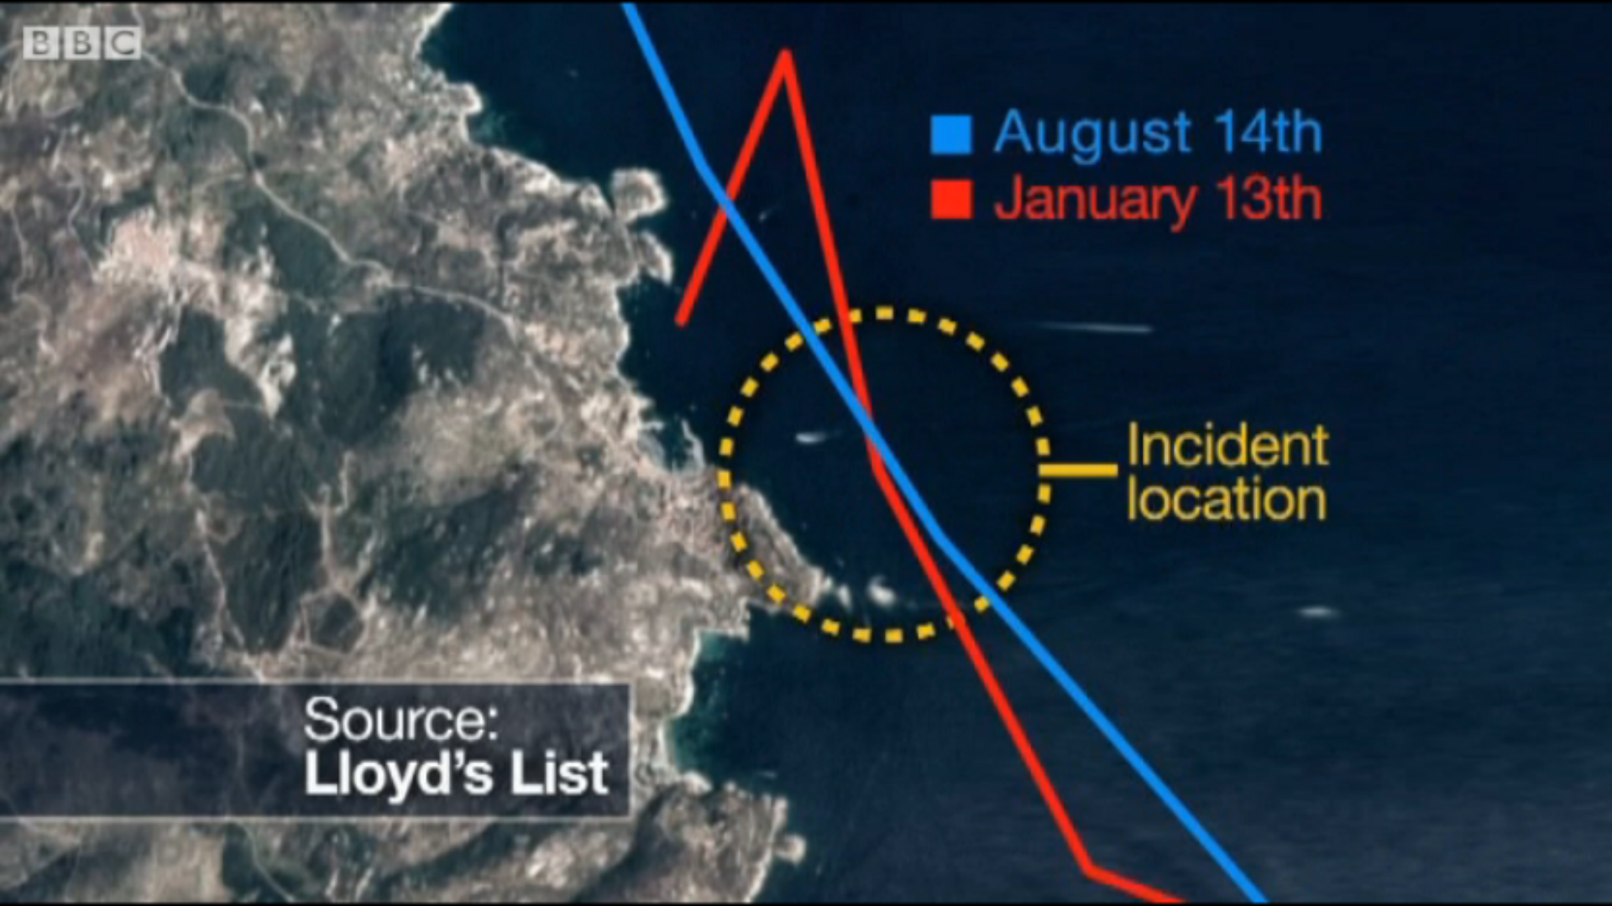
Problem issue (1) – accident investigation & follow-up
Some of the issues not questioned by the investigators
Earlier passages
Training and qualifications of the crew
Emergency training
Working language
…
Notes:
As it was said before, performance of individual components of a large system, such as a ship, is never constant, at least not, when we talk about human beings. Our performance varies in terms of perception and attention and many other factors. Hollnagel, as shown here on this slide, considers complex systems typically comprising of a large number of subsystems and components and the performance variability of each of these can be seen as periodic weak signal. It is weak in the sense that it is too small to constitute a hazard or to have noticeable effects, mainly because the rest of the system normally catches these before they have time to develop into something bigger. Most complex systems are in practice self-correcting either by design or nature.
The principle of stochastic resonance makes it clear that every now and then a weak signal, which is normally too weak to represent any problems or be a cause of concern, will be amplified by the background noise so that it raises over the threshold. In the case of the TITANIC, it is reported that there was confusion prior to departure from Southampton, which officers should be on the ship during the voyage. The shipping company replaced the 2nd officer on very short notice. The original 2nd officer David Blair may have locked the binoculars away and may during the hasty handover to the later 2nd officer Charles Lightholler have forgotten to tell him where he had locked the binoculars. They were later on not available. Under normal circumstances not a big deal. However, combined with other circumstances they had an impact on the overall performance during the search for icebergs in the night of the collision.

Slide 28
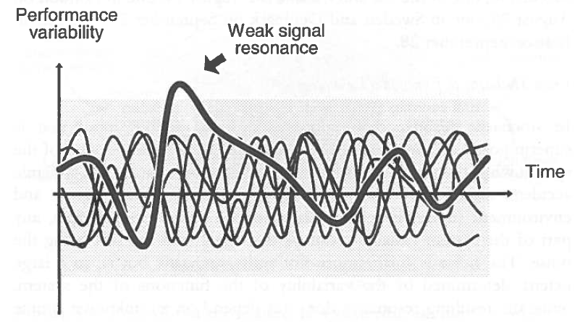
The search for single causes is often too simple
A systemic view is required
Functional resonance
Source: Hollnagel (2004)
Notes:
As it was said before, performance of individual components of a large system, such as a ship, is never constant, at least not, when we talk about human beings. Our performance varies in terms of perception and attention and many other factors. Hollnagel, as shown here on this slide, considers complex systems typically comprising of a large number of subsystems and components and the performance variability of each of these can be seen as periodic weak signal. It is weak in the sense that it is too small to constitute a hazard or to have noticeable effects, mainly because the rest of the system normally catches these before they have time to develop into something bigger. Most complex systems are in practice self-correcting either by design or nature.
The principle of stochastic resonance makes it clear that every now and then a weak signal, which is normally too weak to represent any problems or be a cause of concern, will be amplified by the background noise so that it raises over the threshold. In the case of the TITANIC, it is reported that there was confusion prior to departure from Southampton, which officers should be on the ship during the voyage. The shipping company replaced the 2nd officer on very short notice. The original 2nd officer David Blair may have locked the binoculars away and may during the hasty handover to the later 2nd officer Charles Lightholler have forgotten to tell him where he had locked the binoculars. They were later on not available. Under normal circumstances not a big deal. However, combined with other circumstances they had an impact on the overall performance during the search for icebergs in the night of the collision.

Slide 29

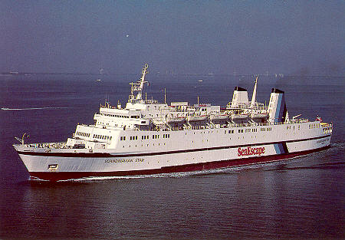
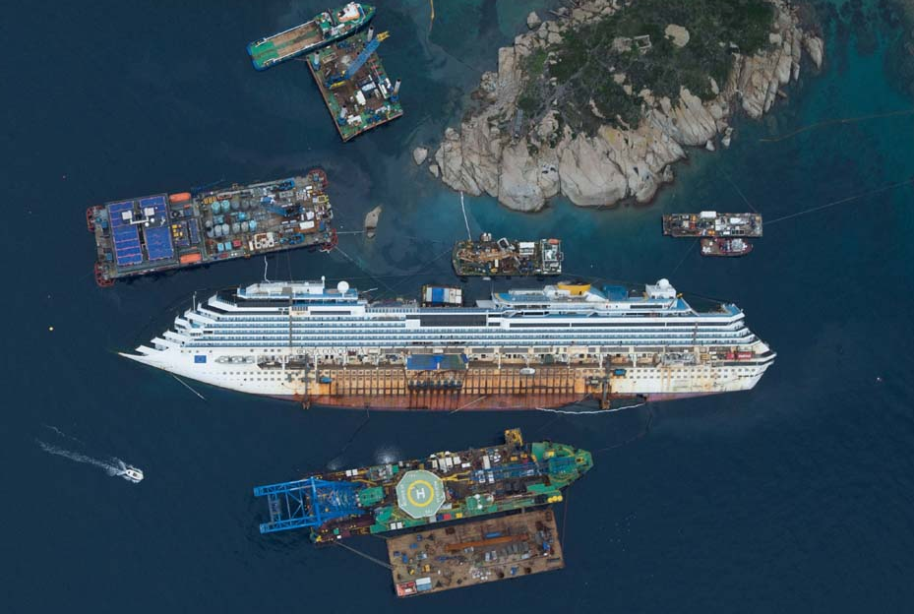
Problem issue (2) - Missing collective memory
Why is the collective memory lacking?
Examples
Communication problems on board
Scandinavian Star (1988)
Costa Concordia (2012)
Notes:
As it was said before, performance of individual components of a large system, such as a ship, is never constant, at least not, when we talk about human beings. Our performance varies in terms of perception and attention and many other factors. Hollnagel, as shown here on this slide, considers complex systems typically comprising of a large number of subsystems and components and the performance variability of each of these can be seen as periodic weak signal. It is weak in the sense that it is too small to constitute a hazard or to have noticeable effects, mainly because the rest of the system normally catches these before they have time to develop into something bigger. Most complex systems are in practice self-correcting either by design or nature.
The principle of stochastic resonance makes it clear that every now and then a weak signal, which is normally too weak to represent any problems or be a cause of concern, will be amplified by the background noise so that it raises over the threshold. In the case of the TITANIC, it is reported that there was confusion prior to departure from Southampton, which officers should be on the ship during the voyage. The shipping company replaced the 2nd officer on very short notice. The original 2nd officer David Blair may have locked the binoculars away and may during the hasty handover to the later 2nd officer Charles Lightholler have forgotten to tell him where he had locked the binoculars. They were later on not available. Under normal circumstances not a big deal. However, combined with other circumstances they had an impact on the overall performance during the search for icebergs in the night of the collision.

Slide 30
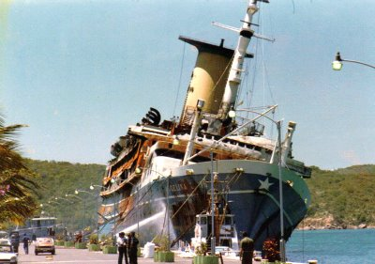
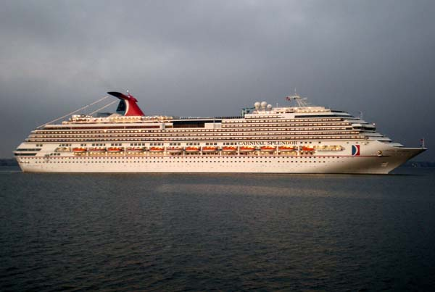
Problem issue (2) - Missing collective memory
Why is the collective memory lacking?
Examples
Fire fighting training
Angelina Lauro (1979)
Carnival Splendor (2010)
Notes:
As it was said before, performance of individual components of a large system, such as a ship, is never constant, at least not, when we talk about human beings. Our performance varies in terms of perception and attention and many other factors. Hollnagel, as shown here on this slide, considers complex systems typically comprising of a large number of subsystems and components and the performance variability of each of these can be seen as periodic weak signal. It is weak in the sense that it is too small to constitute a hazard or to have noticeable effects, mainly because the rest of the system normally catches these before they have time to develop into something bigger. Most complex systems are in practice self-correcting either by design or nature.
The principle of stochastic resonance makes it clear that every now and then a weak signal, which is normally too weak to represent any problems or be a cause of concern, will be amplified by the background noise so that it raises over the threshold. In the case of the TITANIC, it is reported that there was confusion prior to departure from Southampton, which officers should be on the ship during the voyage. The shipping company replaced the 2nd officer on very short notice. The original 2nd officer David Blair may have locked the binoculars away and may during the hasty handover to the later 2nd officer Charles Lightholler have forgotten to tell him where he had locked the binoculars. They were later on not available. Under normal circumstances not a big deal. However, combined with other circumstances they had an impact on the overall performance during the search for icebergs in the night of the collision.

Slide 31
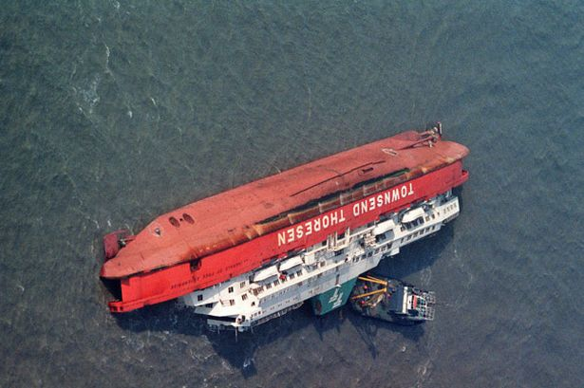
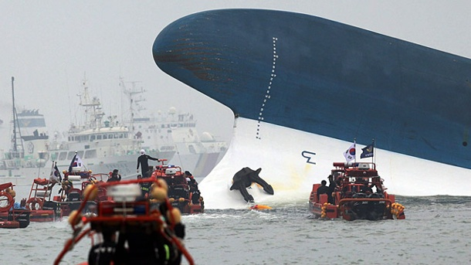
Problem issue (2) - Missing collective memory
Why is the collective memory lacking?
Examples
Organizational influences
Herald of Free Enterprize (1987)
Sewol (2014)
Notes:
As it was said before, performance of individual components of a large system, such as a ship, is never constant, at least not, when we talk about human beings. Our performance varies in terms of perception and attention and many other factors. Hollnagel, as shown here on this slide, considers complex systems typically comprising of a large number of subsystems and components and the performance variability of each of these can be seen as periodic weak signal. It is weak in the sense that it is too small to constitute a hazard or to have noticeable effects, mainly because the rest of the system normally catches these before they have time to develop into something bigger. Most complex systems are in practice self-correcting either by design or nature.
The principle of stochastic resonance makes it clear that every now and then a weak signal, which is normally too weak to represent any problems or be a cause of concern, will be amplified by the background noise so that it raises over the threshold. In the case of the TITANIC, it is reported that there was confusion prior to departure from Southampton, which officers should be on the ship during the voyage. The shipping company replaced the 2nd officer on very short notice. The original 2nd officer David Blair may have locked the binoculars away and may during the hasty handover to the later 2nd officer Charles Lightholler have forgotten to tell him where he had locked the binoculars. They were later on not available. Under normal circumstances not a big deal. However, combined with other circumstances they had an impact on the overall performance during the search for icebergs in the night of the collision.

Slide 32
The F/S Principle in Accident Investigation (Schröder-Hinrichs)
Find
Fix
Forget
The 3F Loop
There is no collective memory of the lessons that could be learnt
You look quickly
at accidents
You do the sterotype follow up – changing a procedure, a checklist …
You are frustrated and surprised if you do not see improvements or similar accidents happen in future
The route to failure

Slide 33
The F/S Principle in Accident Investigation (Schröder-Hinrichs)
Search
Solve
Sustain
The potential 3S Loop
You follow up on the lessons learnt
You carefully
assess the learning potential of an accident
You look at the system and develop solutions in consulation with all parties affected and involved
You will see improvement in the overall safety performance
The route to success

Slide 34
Problem issue (3) – organizational culture in shipping
Types of organizational cultures in shipping companies (Mathiesen, 1994)
Evasion culture
Compliance culture
Safety culture
“When costs of complying with the Rules and Regulations is considered to be high, so are the benefits of evading them”
“a situation where the shipowners strive to comply with Rules and Regulations as this is the ‘Ticket to Trade’”
“a situation where owners are engaged in a continuous process to improve safety and see this as their management philosophy and operational mode to reduce losses”
“focus on the entire management chain; from the boardroom to the ship”

Slide 35
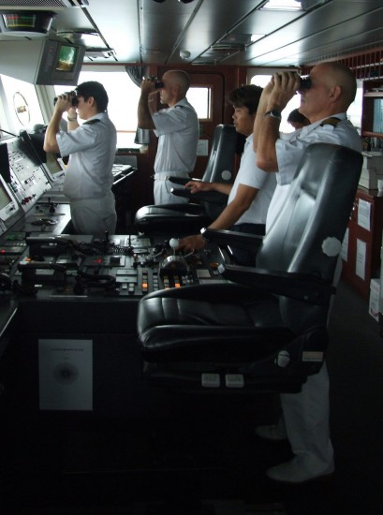
Problem issue (3) – organizational culture in shipping
Work as imagined vs. work as done
How useful are the procedures and checklists that you use on your ships?
Do you know what your seafarers do on board?
Notes:
As it was said before, performance of individual components of a large system, such as a ship, is never constant, at least not, when we talk about human beings. Our performance varies in terms of perception and attention and many other factors. Hollnagel, as shown here on this slide, considers complex systems typically comprising of a large number of subsystems and components and the performance variability of each of these can be seen as periodic weak signal. It is weak in the sense that it is too small to constitute a hazard or to have noticeable effects, mainly because the rest of the system normally catches these before they have time to develop into something bigger. Most complex systems are in practice self-correcting either by design or nature.
The principle of stochastic resonance makes it clear that every now and then a weak signal, which is normally too weak to represent any problems or be a cause of concern, will be amplified by the background noise so that it raises over the threshold. In the case of the TITANIC, it is reported that there was confusion prior to departure from Southampton, which officers should be on the ship during the voyage. The shipping company replaced the 2nd officer on very short notice. The original 2nd officer David Blair may have locked the binoculars away and may during the hasty handover to the later 2nd officer Charles Lightholler have forgotten to tell him where he had locked the binoculars. They were later on not available. Under normal circumstances not a big deal. However, combined with other circumstances they had an impact on the overall performance during the search for icebergs in the night of the collision.

Slide 36
Problem issue (3) – organizational culture in shipping
A systemic view is needed
Ship and shore are part of the same system
There is a need to go beyond currently considered frameworks to foster a safety culture and to stimulate organizational learning
Issues to be considered, among others
Worker engagement
Ship-shore communication
Shore-staff training
…
Notes:
Lord Mersey comments on the performance of the master of the TITANIC on page 30 of the report and I would like to cite the statement, as they seem to have been made for the COSTA CONCORDIA to a certain extent as well. Lord Mersey says:
“Why, then, did the master persevere in his course and maintain his speed? The answer is to be found in the evidence. It was shown that for many years past, indeed, for a quarter of a century or more, the practice of liners using this track when in the vicinity of ice at night had been in clear weather to keep the course, to maintain the speed and to trust to a sharp look-out to enable them to avoid the danger. This practice, it was said, had been justified by experience, no casualties having resulted from it. I accept the evidence as to the practice and as to the immunity from casualties which is said to have accompanied it. But the event has proved the practice to be bad. Its root is probably to be found in the competition and in the desire of the public for quick passages rather in the judgement of the navigators.”

Slide 37
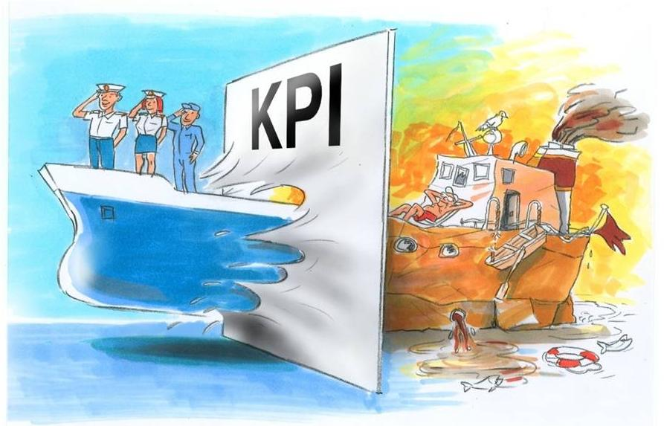
Problem issue (3) – organizational culture in shipping
How to handle maritime safety more effective
Key performance indicators
Tanker Management and Self Assessment
Intermanager KPIs
Picture: Intermanager
Notes:
As it was said before, performance of individual components of a large system, such as a ship, is never constant, at least not, when we talk about human beings. Our performance varies in terms of perception and attention and many other factors. Hollnagel, as shown here on this slide, considers complex systems typically comprising of a large number of subsystems and components and the performance variability of each of these can be seen as periodic weak signal. It is weak in the sense that it is too small to constitute a hazard or to have noticeable effects, mainly because the rest of the system normally catches these before they have time to develop into something bigger. Most complex systems are in practice self-correcting either by design or nature.
The principle of stochastic resonance makes it clear that every now and then a weak signal, which is normally too weak to represent any problems or be a cause of concern, will be amplified by the background noise so that it raises over the threshold. In the case of the TITANIC, it is reported that there was confusion prior to departure from Southampton, which officers should be on the ship during the voyage. The shipping company replaced the 2nd officer on very short notice. The original 2nd officer David Blair may have locked the binoculars away and may during the hasty handover to the later 2nd officer Charles Lightholler have forgotten to tell him where he had locked the binoculars. They were later on not available. Under normal circumstances not a big deal. However, combined with other circumstances they had an impact on the overall performance during the search for icebergs in the night of the collision.

Slide 38
Questions instead of a conclusion
What can the insurance industry do to increase safety?
How is accident investigation by insurance carried out?
What is the focus of the accident investigation?
How are lessons from accidents treated?
How good do loss prevention programs work?
Notes:
As it was said before, performance of individual components of a large system, such as a ship, is never constant, at least not, when we talk about human beings. Our performance varies in terms of perception and attention and many other factors. Hollnagel, as shown here on this slide, considers complex systems typically comprising of a large number of subsystems and components and the performance variability of each of these can be seen as periodic weak signal. It is weak in the sense that it is too small to constitute a hazard or to have noticeable effects, mainly because the rest of the system normally catches these before they have time to develop into something bigger. Most complex systems are in practice self-correcting either by design or nature.
The principle of stochastic resonance makes it clear that every now and then a weak signal, which is normally too weak to represent any problems or be a cause of concern, will be amplified by the background noise so that it raises over the threshold. In the case of the TITANIC, it is reported that there was confusion prior to departure from Southampton, which officers should be on the ship during the voyage. The shipping company replaced the 2nd officer on very short notice. The original 2nd officer David Blair may have locked the binoculars away and may during the hasty handover to the later 2nd officer Charles Lightholler have forgotten to tell him where he had locked the binoculars. They were later on not available. Under normal circumstances not a big deal. However, combined with other circumstances they had an impact on the overall performance during the search for icebergs in the night of the collision.

Slide 39
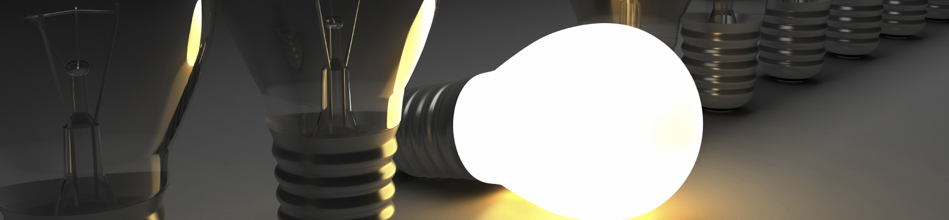
Any questions?
Questions & Answers

Slide 40

Further information
For more information regarding the issues addressed in this presentation, refer to
Schröder-Hinrichs J-U, Baldauf M, Ghirxi KT (2011) Accident investigation reporting deficiencies related to organizational factors in machinery space fires and explosions. Accident Analysis and Prevtion 43 (5):1187–1196
Schröder-Hinrichs J-U, Hollnagel E, Baldauf M (2012) From Titanic to Costa Concordia—a century of lessons not learned. WMU Journal of Maritime Affairs 11 (2):151-167

Slide 41

Thank you!
Many thanks to Erik Hollnagel for stimulating discussions related to the topic.
Photo sources are acknowledged as much as it was possible to
find the source of origin from the web. My apologies to the copyright holders if sources were not identified and displayed. This is not intentional.
The views expressed in this presentation represents the personal view of the author and do not necessarily reflect the views of IMO or WMU.
Contact
World Maritime University
Dr. Jens-Uwe Schröder-Hinrichs MaRiSa Research Group
PO Box 500
201 24 Malmö
Sweden
Phone: +46-40-356 306
Email: jus@wmu.se
www.wmu.se

