Slide 1
Loss Prevention from the Insurers perspective
The LP process as a whole
The LISCO GLORIA fire in a LP perspective
The Insurers role
Magnus Gustafsson
Senior Claims Executive, Marine
MICC 2015

Slide 2
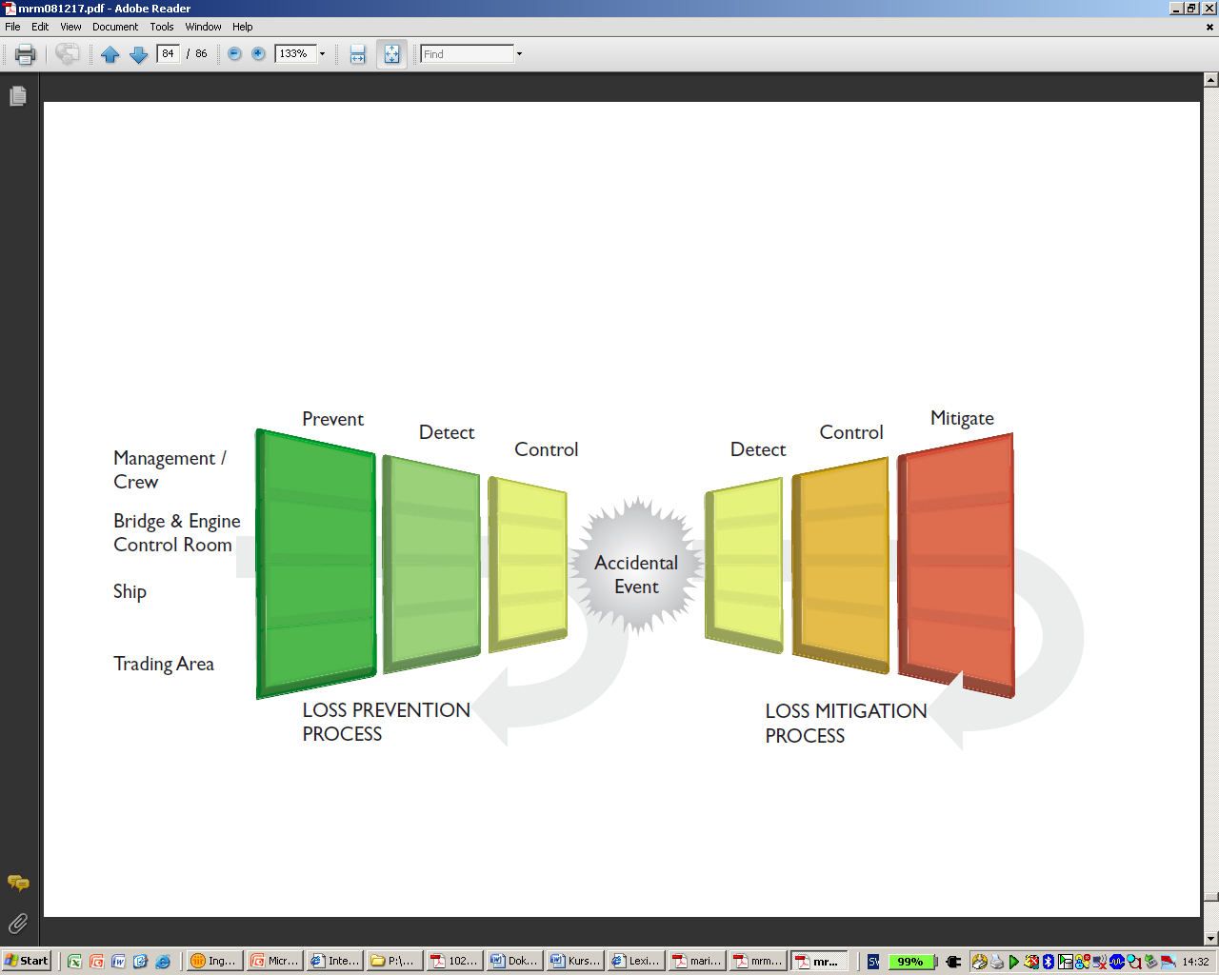
The ”BOWTIE” loss prevention model
MICC 2015

Slide 3
BOWTIE – cargo fire on roro / ropax
Who are the stakeholders?
Authorities / Regulation
Vessel, construction
Ignition
Cargo deck
Crew
Cargo shipper
IMCC 2015

Slide 4
BOWTIE – cargo fire on roro / ropax.
The ”barriers”, RCM’s
Authorities / Regulation
Vessel, construction
Ignition cargo deck
Crew
Cargo, shipper
IMCC 2015

Slide 5
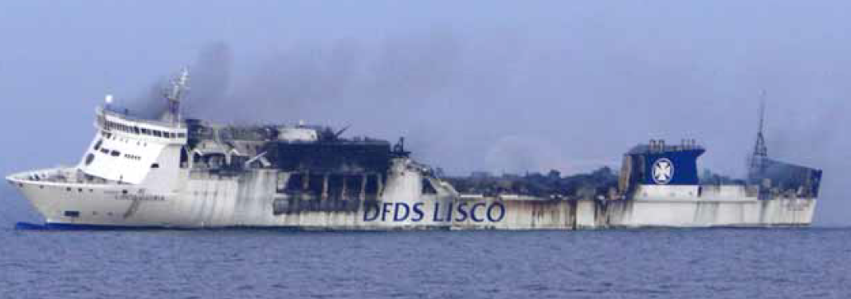
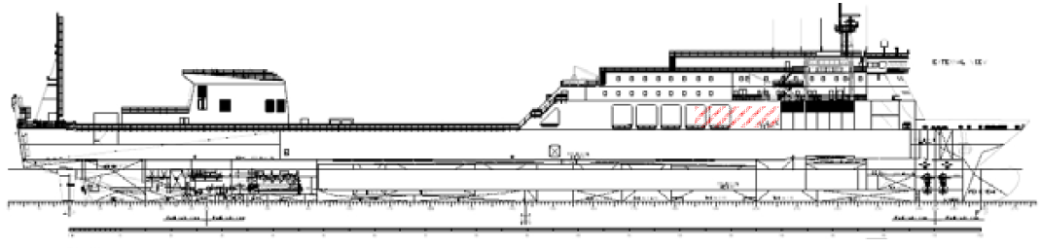
The LISCO GLORIA
Fire refigeration unit / CTL in South Baltic 8th October 2010
Departs Kiel 22:00, total 32 crew + 204 pax. Fully loaded including 5 IMDG units and several refrigerated trailers on weather deck.
23:30 AB does temperature check of refrigeration trailer, all in order
23:50 AB first notices smell of smoke
23:58 smoke detector alarm on bridge, smoke confirmed by CCTV
23:59 fire allocated by AB, rushes to his fifi station
24:00 crew is alerted via PA system
00:01 power supply switched off to weather deck
00:02 fixed water drencher system activated from bridge – unsuccessful
00:04 Master orders the fixed water drencher system to be activated from ECR – unsuccessful
00:09 evacuation ordered
00:35 stb lifeboat lowered, 00:59 port side lifeboat lowered
IMCC 2015

Slide 6
The LISCO GLORIA
Risk barriers
Authorities / Regulation
2
Vessel, construction
2
5
6
7
Ignition cargo deck
3
Crew
2
4
1
Cargo, shipper
Possible fault in refrigeration unit not detected.
Drencher system – design error, crews familiarization and procedures
Presence of fire / smoke detected by smell, sensors, CCTV, sight
Fixed drencher system triggered….
Fixed drencher system failure
Evacuation efficient and successful
What has the insurance contributed with? Financial mitigation!
IMCC 2015

Slide 7
Loss Prevention – The Insurers role
Technical Risk Management vs Financial Risk Management for a Shipowner
Are we as Insurers interested in Technical Risk Management?
How can we do it?
  Regulations
  Ship Management
  Crew
IMCC 2015

Slide 8
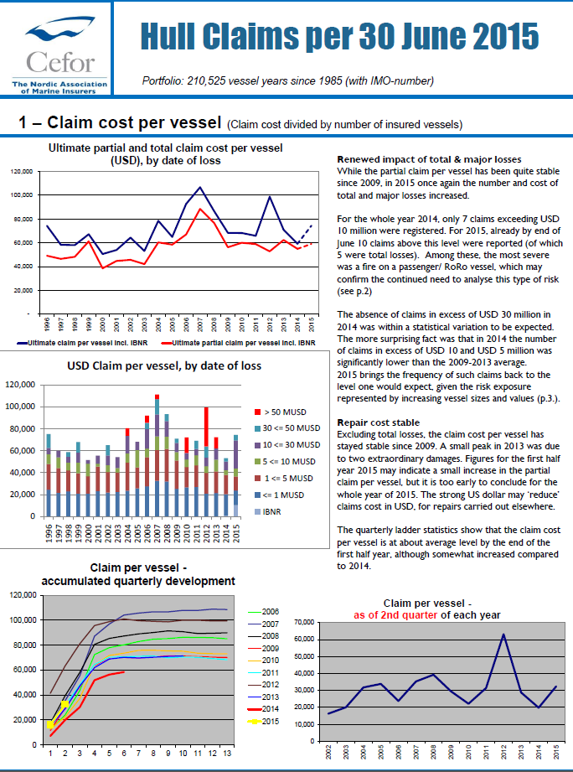
Loss Prevention – The Insurers role
Loss Prevention through Regulations
IG P&I – International Group of P&I Clubs
  Sharing of information – amongst Clubs and to Members
  22 working groups including Ships Standards Group and Regulatory Affairs
CEFOR – The Nordic Association of Marine Insurers
  Identifying trends through statistical analysis
  The 8 CEFOR Forums including Technical Forum
Isolated projects with Classification Societies
IMCC 2015

Slide 9
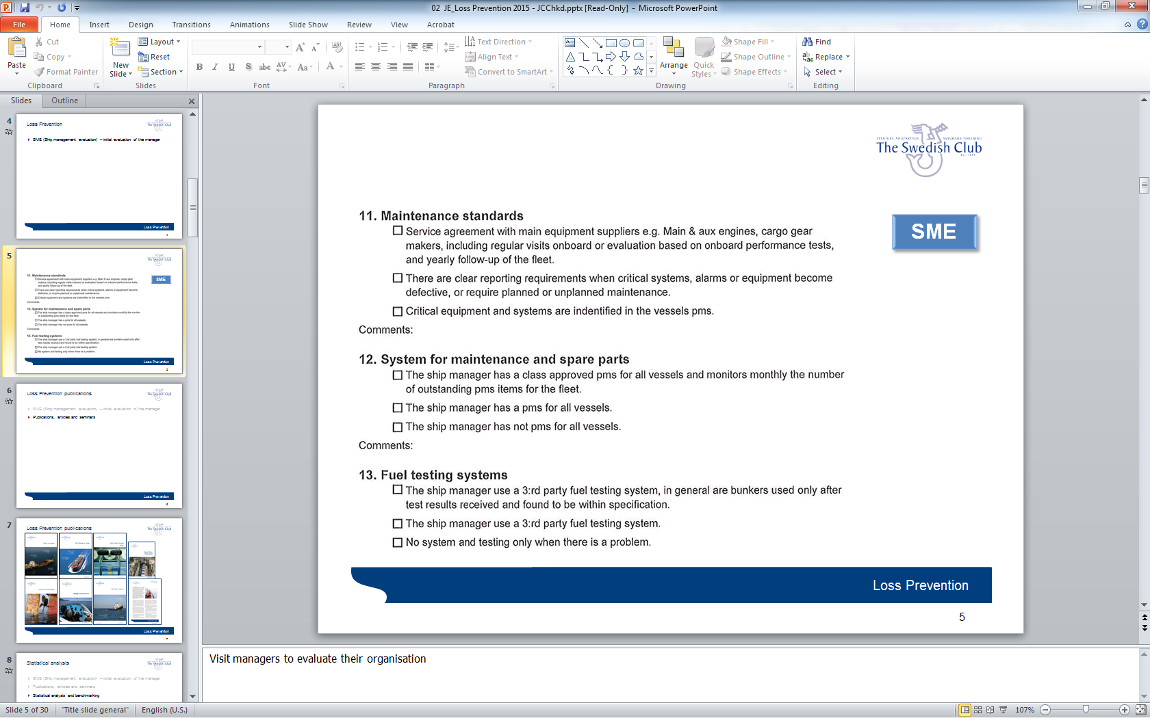
Loss Prevention – The Insurers role
Loss Prevention through Ship Management
SME – Ship Management Evaluation
  Twenty questions on
    technical management,
    commercial operation,
    Crewing / HR,
    safety / quality management etc..
  Score system, max 120 points
  Basis for the continued LP
  cooperation with Insurer
IMCC 2015

Slide 10
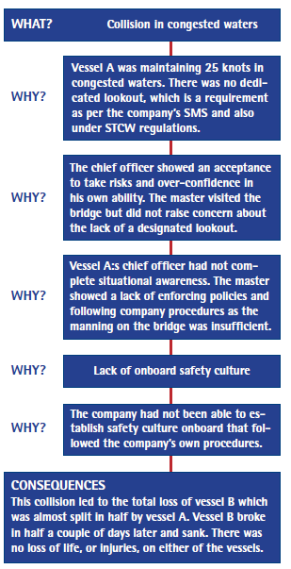
Loss Prevention – The Insurers role
Loss Prevention through Ship Management
IRCA – Interactive Root Cause Analysis
  Starting point from the immediate cause…
  Leading to root cause…
  Recomended actions to be taken
  IRCA’s published on website
IMCC 2015

Slide 11
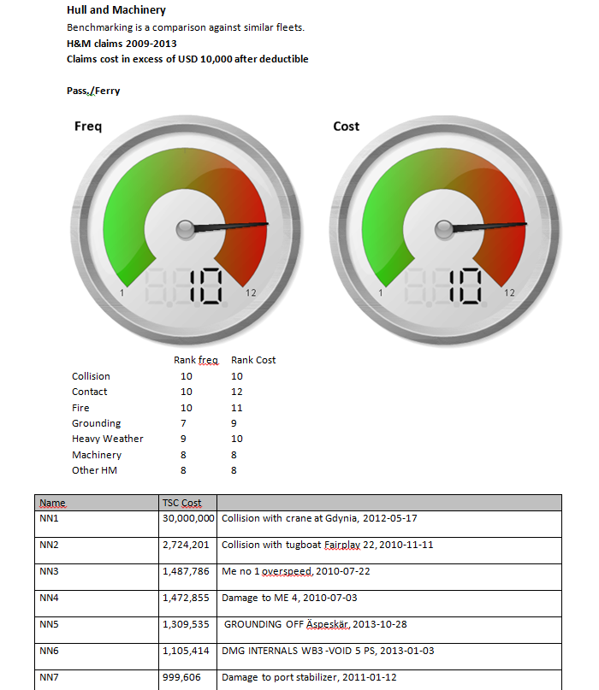
Loss Prevention – The Insurers role
Loss Prevention through Ship Management
SCORE – Swedish Club Operations Review
  Review of Client claim statistics
  Benchmarking against similar fleets
  Identifying abnormities – freq / cost
  Office visits
  Verification of Client SMS
  Review of Client LP program
  Recommendations for improvement
  SCORE Certificate
IMCC 2015

Slide 12
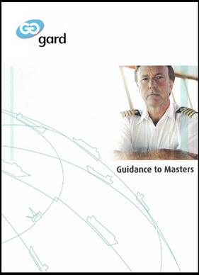
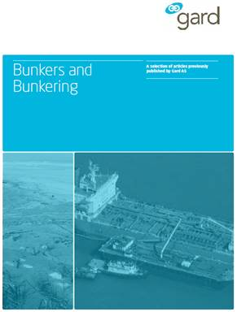
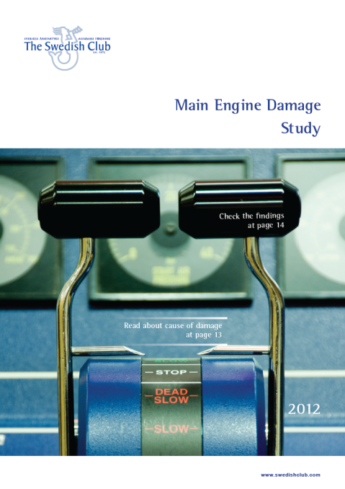
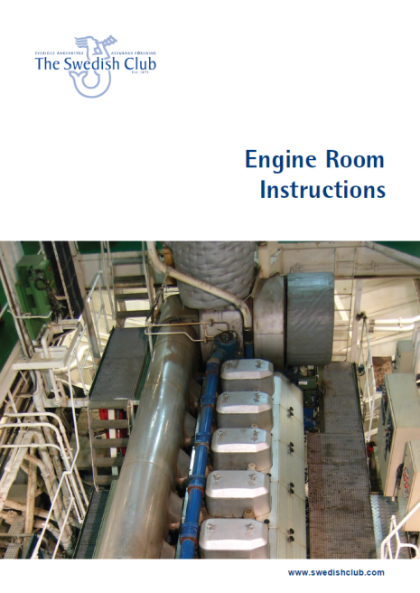
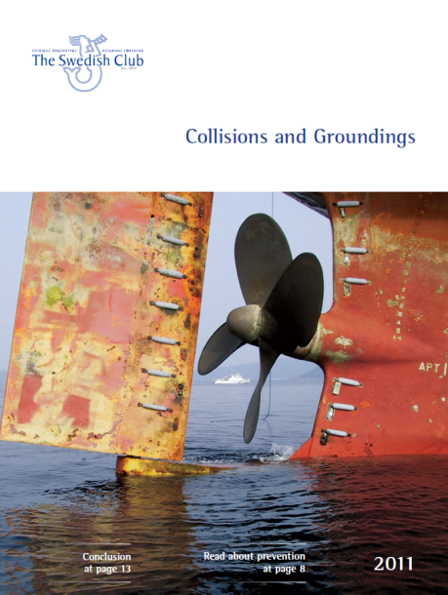
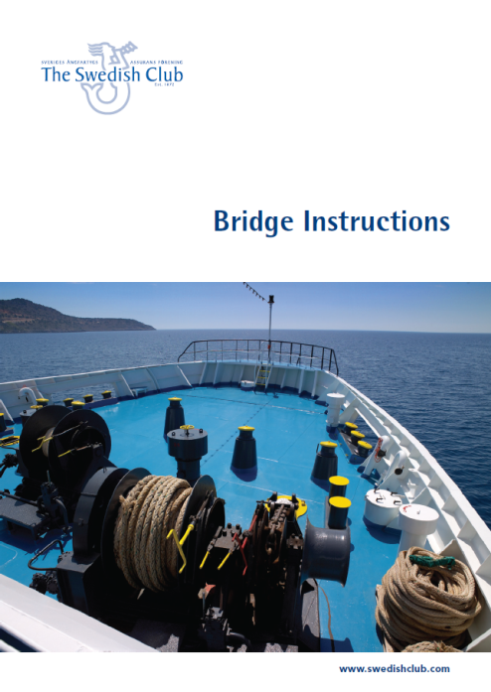
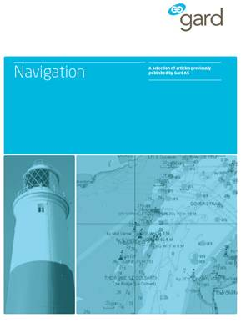
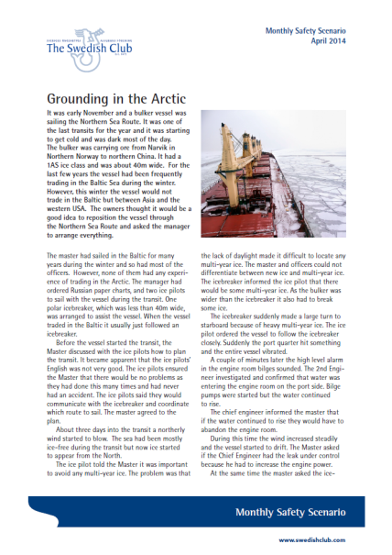
Loss Prevention – The Insurers role
Loss Prevention through Ship Management - Publications
IMCC 2015

Slide 13
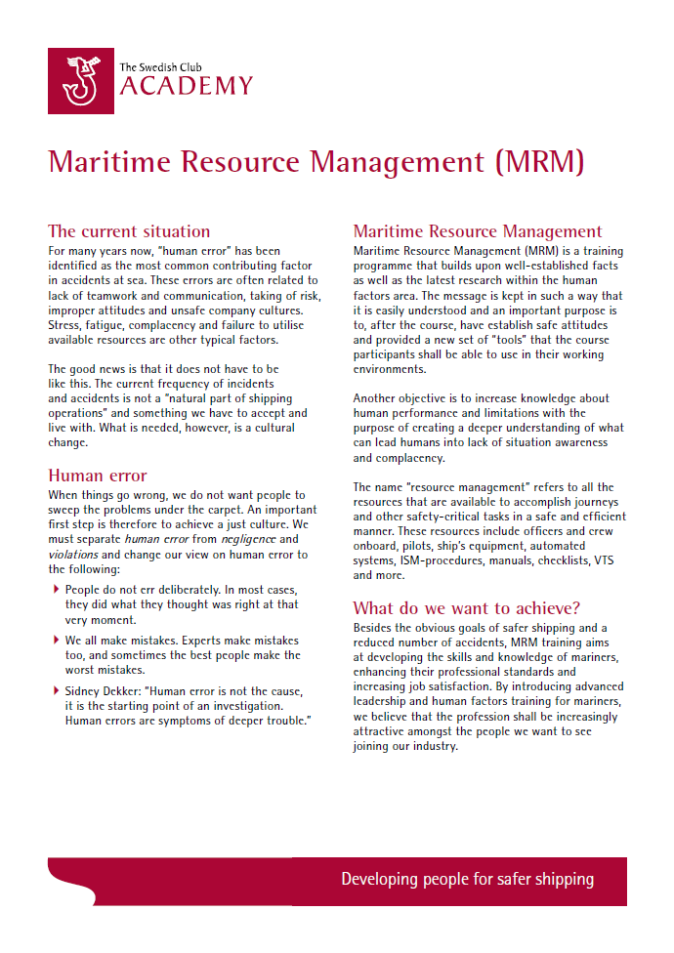
Loss Prevention – The Insurers role
MRM – Maritime Resource Management
MRM training
  Situational awareness
  Cultural awareness
  Attitudes and Management Skills
  Communication techniques
  Challenge and Response
  …
MRM in TSC Academy
  Since 1990
  Train the trainer
  300 facilitators trained to date
  Approx 10 training sessions per year worldwide
  Current ongoing campaign to P&I and Lead HM
IMCC 2015

Slide 14
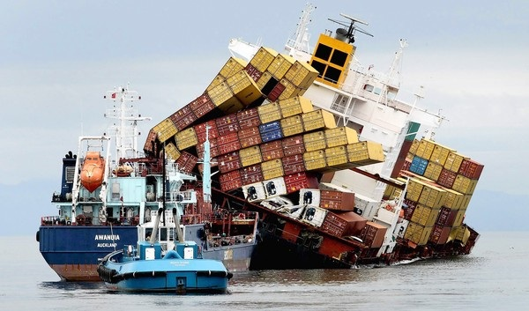
Loss Prevention – The Insurers role
Why do it?
The worlds most expensive attitude P&I Claims? (USD)
Costa Concordia (2012) - USD 2 billion and counting
Rena (2011) – 425 mUSD and counting
Exxon Valdez (1989) – 400 milion
Hebei Spirit (2007) – 235 mUSD
Cosco Busan (2007) – 210 mUSD
IMCC 2015

Slide 15
Thank you
MICC 2015
Notes:
.

