Slide 1
IMCC 2015 Presentation Machinery Damage Claims – A Legal Perspective
September 24, 2015
Presented by:
Joseph G. Grasso

Slide 2
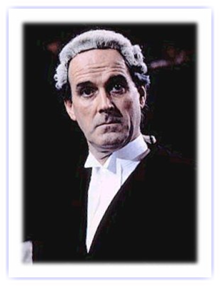
Agenda
Insurance Coverage Considerations
Policy wording
Causation
Quantum
Roles of experts
Evidentiary issues
Dispute resolution issues

Slide 3
Agenda (con’t.)
Subrogation and Recovery
Causation
Quantum
Roles of experts
Evidentiary issues
Nature of claims
Dispute resolution issues

Slide 4
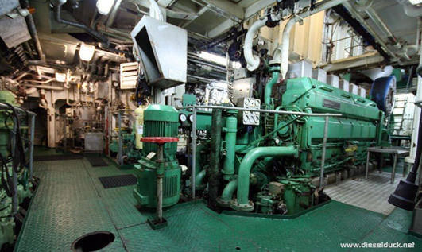
Policy Wording – Interpretation
Slips and certificates
Forms or manuscript
Exclusions
Endorsements
Ambiguities?

Slide 5
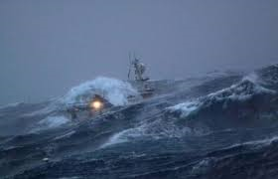
Causation
Fortuity requirement
Peril of the sea (e.g., grounding or collision?)
Inchmaree clause cause (e.g., latent defect or crew/repairer negligence?)

Slide 6
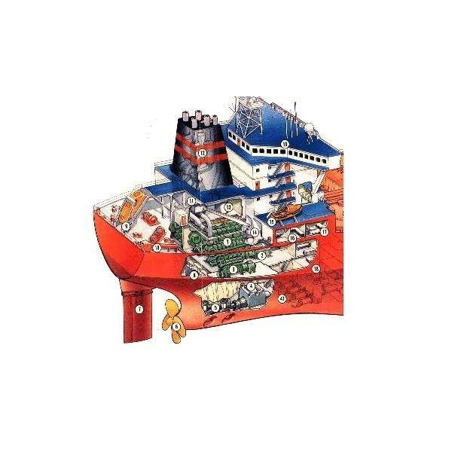
Quantum
Repair/replacement or defective part?
Multiple causes?
Pre-existing damage DOL?
Reasonable cost of repairs

Slide 7

Roles of Experts
Battles of the experts
Confidentiality/Privilege

Slide 8
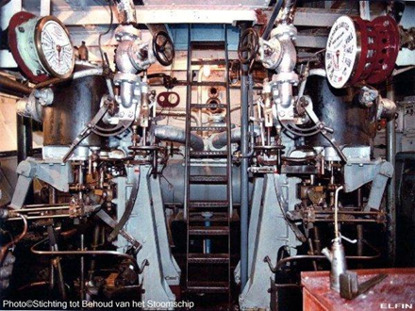
Evidentiary Issues
Access/availability
Preservation/spoliation

Slide 9

Dispute Resolution
Choice of law
Forum selection
ADR?

Slide 10
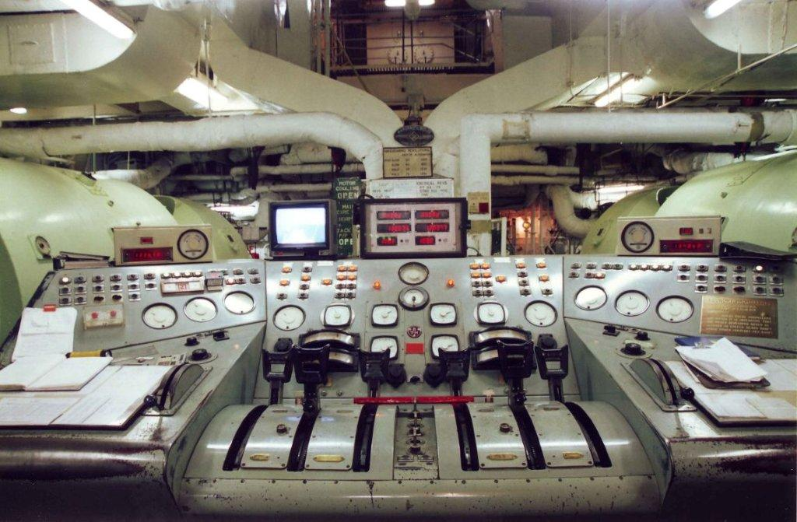
Subrogation and Recovery
Causation
Wear and tear?
Latent defect?
Multiple causes

Slide 11

Types of Claim
Breach of contract
Breach of warranty
Tort

Slide 12
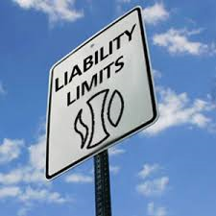
Quantum
Recoverability/forseeability
Limitation of liability?

Slide 13

Evidentiary Issues
Preservation
Spoliation

Slide 14
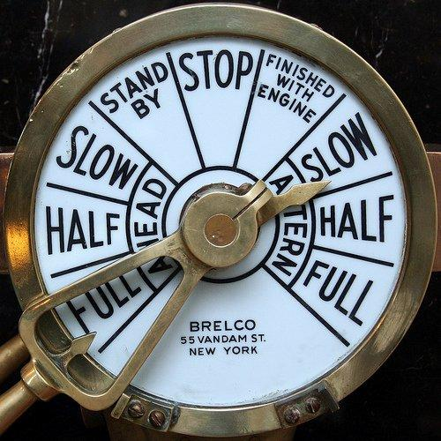
Dispute Resolution
Choice of law
Forum selection/jurisdiction

Slide 15
