Slide 1
Repair or Replace: Alternative repair methods for major engine casualties
IMCC
September 23, 2015
Roy Strand
Chief Operating Officer
Goltens Worldwide
Maarten Jeronimus
Vice President
Goltens Europe

Slide 2

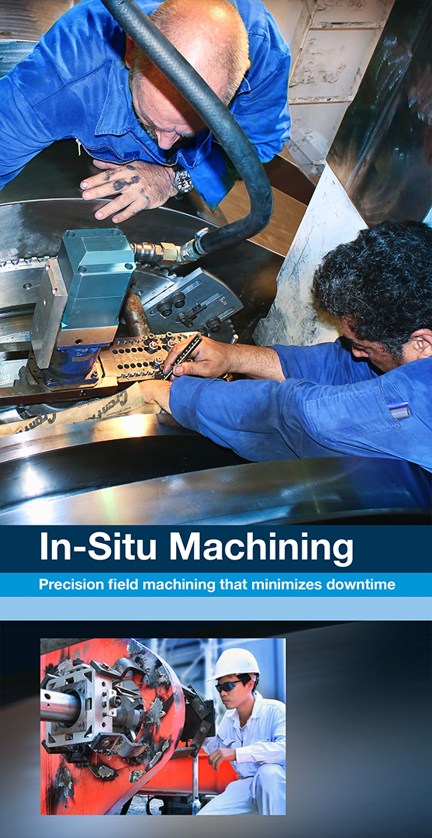
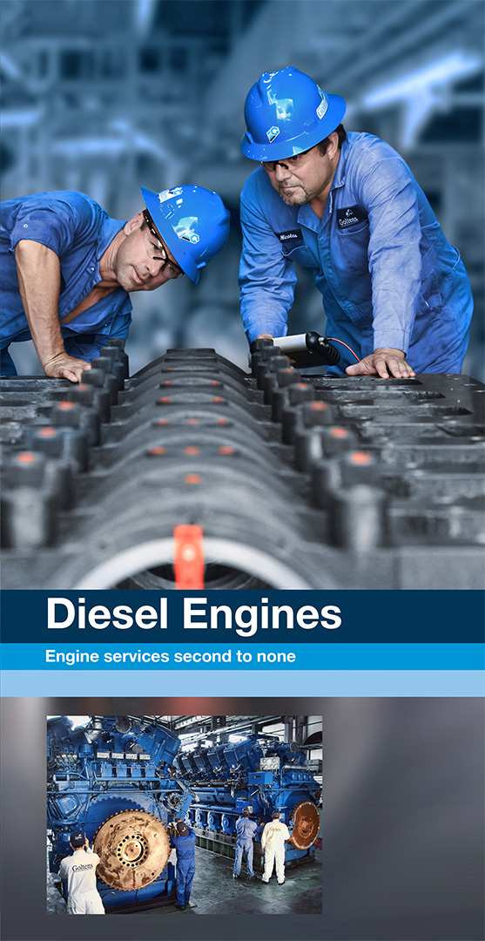
About Goltens
3 business areas
1,300 employees
30,000 projects a year
3,300 customers
Notes:
Goltens is a global, independent, specialist service provider focused on minimizing asset downtime for our customers while controlling associated costs
Established in 1940 in Brooklyn NY
~1,300 employees globally
Provide a full range of on-site and workshop diesel repair and reconditioning services for Marine, Offshore, Stationary Power and Industrial Markets
We service 3,000 customers annually conducting over 30,000 projects a year
Our focus is always on Presence, Precision and Response

Slide 3
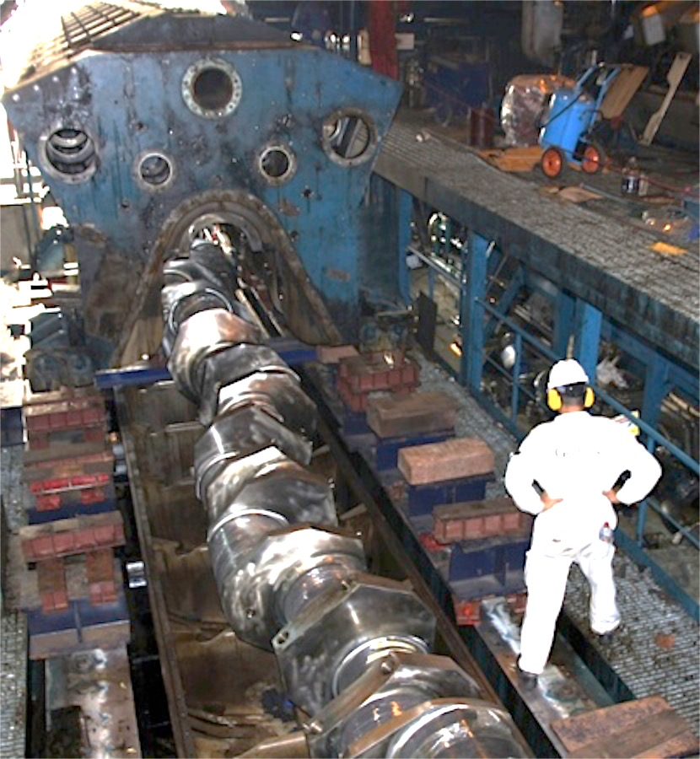
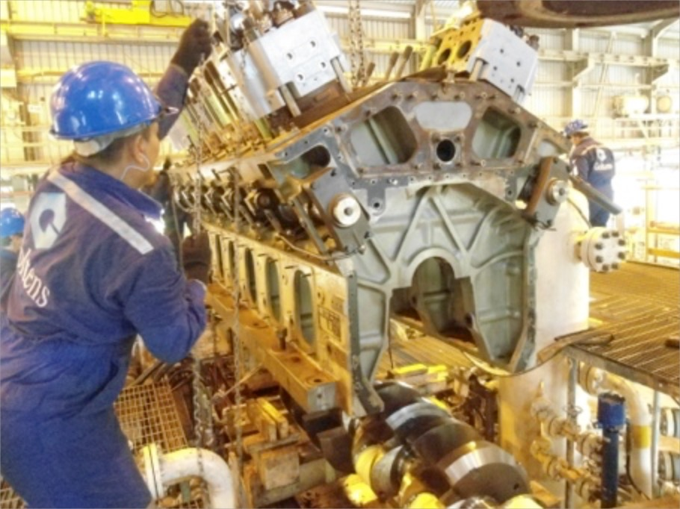
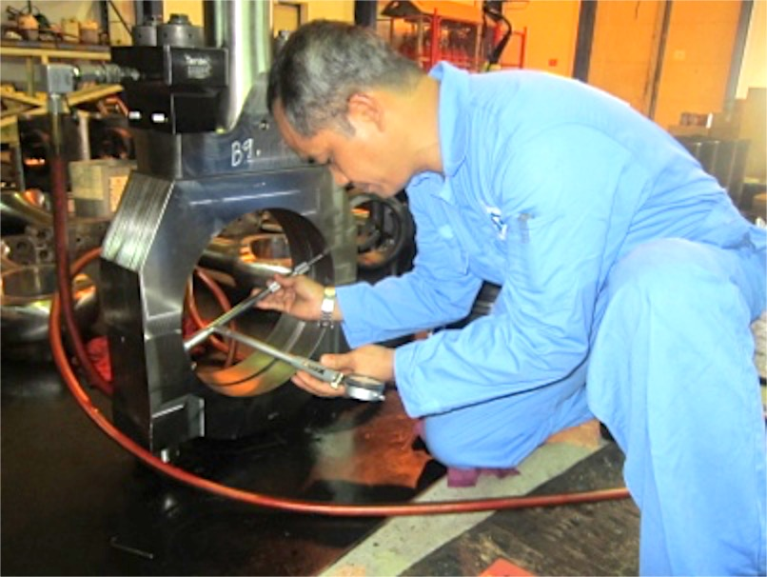
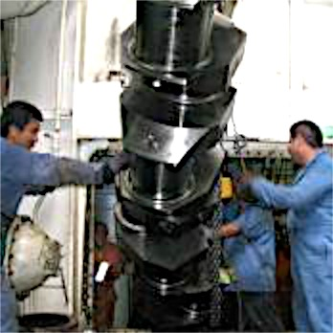
Diesel Engine Specialists
Troubleshooting and diagnostics
Afloat repairs and maintenance services
Machine shop, overhaul and reconditioning services
Notes:
Afloat Repairs and Maintenance Services:
Troubleshooting and Diagnostics
On-site casualty repairs
Routine overhauls and maintenance
Crankshaft & Block replacements
Complete engine installs
In-Situ Machining
Laser alignment and chocking
Electrical, Electronic, Automation & Control Services
Machine Shop, Overhaul & Reconditioning Services
Fuel injectors, nozzles, valves & pumps
Centrifugal casting of White Metal Bearings & stern tubes
Connecting rods
Exhaust valve spindles, seats
and cages
Governors/Speed Controls
Crankshafts
Cylinder liners & Piston crowns
Turbochargers
Cylinder heads / covers
Heat exchangers
Service pumps

Slide 4
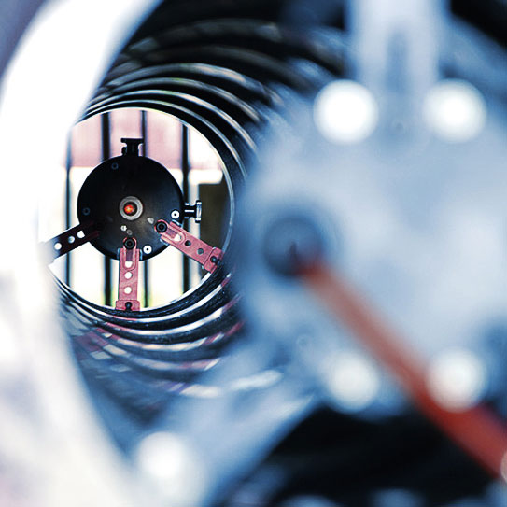
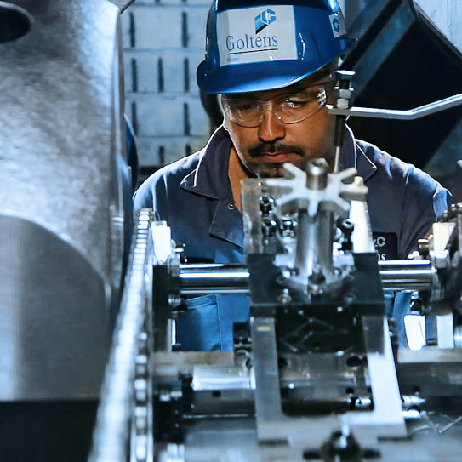
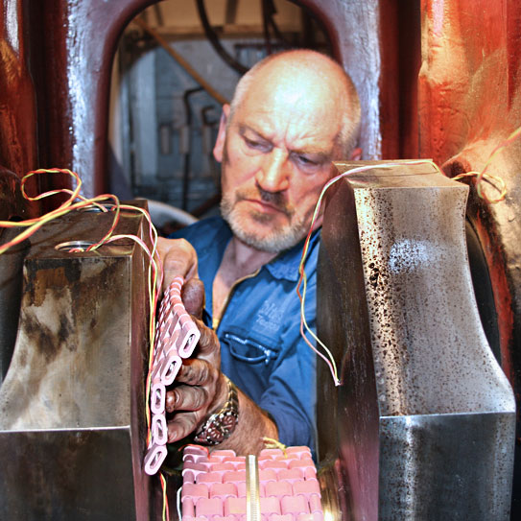
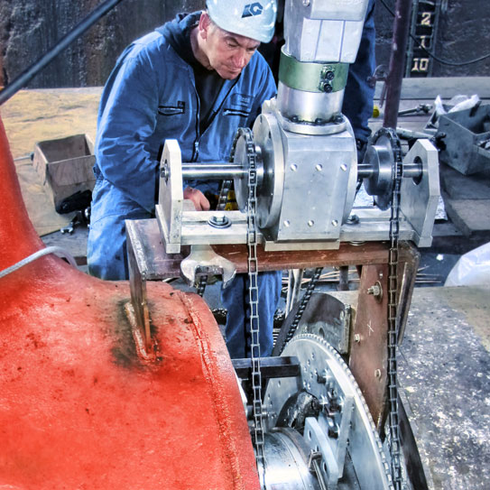
In-Situ Machining
Crankshaft repairs
Metal stitching
Line boring
Boring of stern tubes
Surface machining
Laser Alignment
Notes:
Crankshaft Repairs
Crankshaft Journal Machining
Crankshaft Journal Annealing (GL, LR, IRS approved) – to reduce excessive hardness
Crankshaft straightening/untwisting
Metal Stitching of engine blocks/bedplates
Line boring of engines (multiple and single bore)
Boring of Stern Tubes for vessels
Large and small scale surface machining (flange facing and XYZ milling)
Laser Alignment services

Slide 5
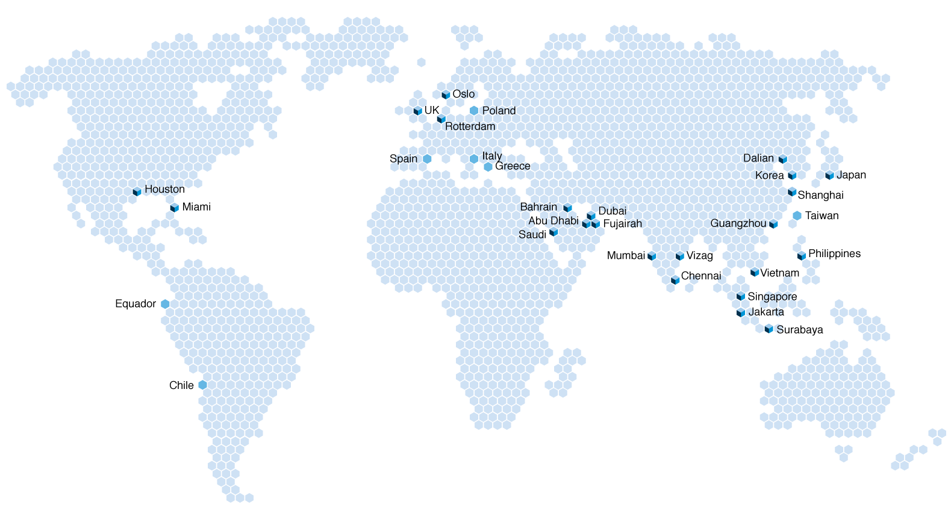
About Goltens
25 locations in 15 countries
Strategic locations worldwide
World ship traffic concentration
Notes:
Operate over 25 locations in 15 countries
INDUSTREIS SERVED:
Marine
Offshore Oil & Gas
Stationary Power (Diesel, Natural Gas and Steam)
Petrochemical/Refineries
Mining
Shipyards/Shipbuilding (Commercial and Military)
Hydro-Electric Power
Wind Power
Manufacturing/Other Industrial

Slide 6
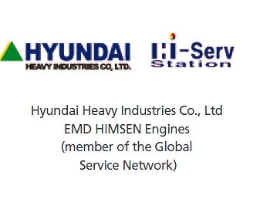

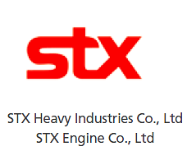



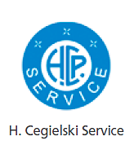




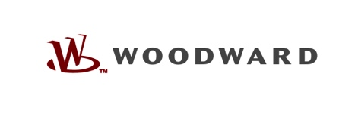

Diesel Engine Specialists
All medium and slow speed engines
Main propulsion
Auxiliary engines
Stationary engines
Skid mounted generator sets
Retrofit and new installations
Note: Not all locations are authorized by all manufacturers
Notes:
Goltens’ diesel engine service cover the full range of diesel engines and many engine makers and manufacturers trust Goltens:
All medium and slow speed engines
Main propulsion
Auxiliary engines
Stationary engines
Skid mounted generator sets
Retrofit / new installations

Slide 7
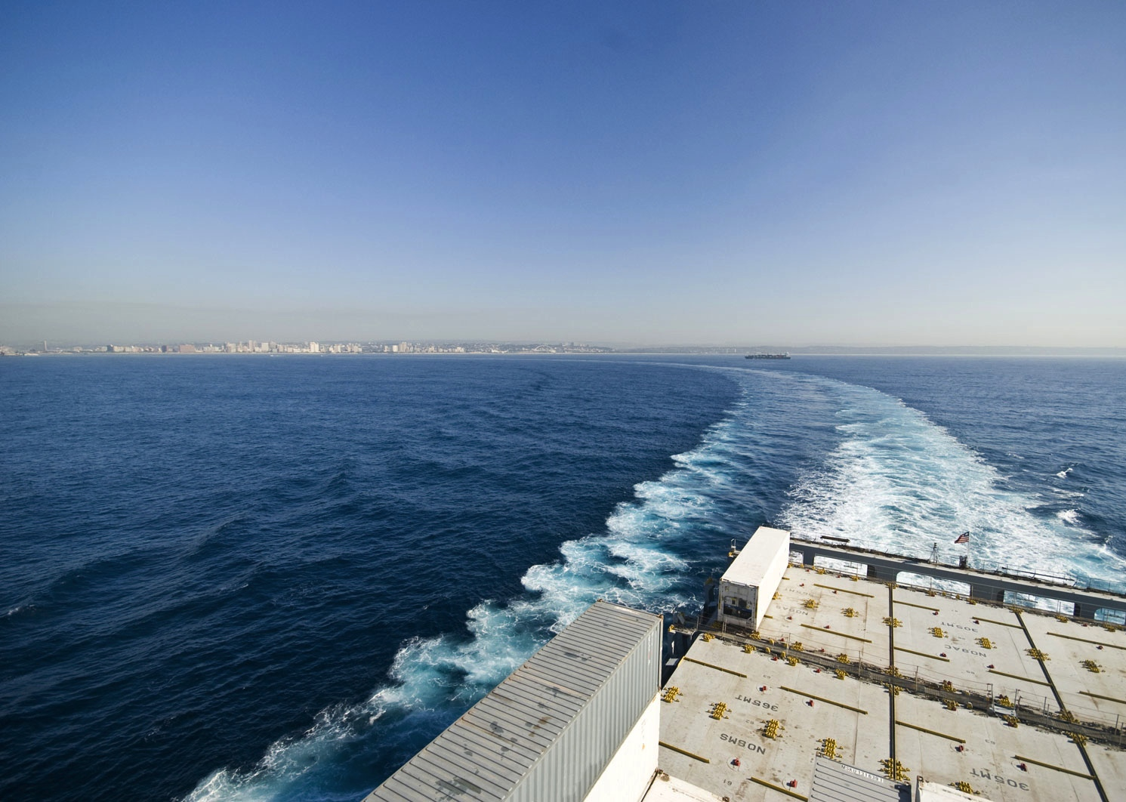
A different perspective
Focused on minimizing asset downtime
Not carrying stock
Focus on repair, not replacement
Notes:
We are purely service driven & focused on minimizing asset downtime for our customers
We are not carrying stock that we need to turnover
Our focus is on repair / not on replacement

Slide 8
Our objective is to provide insight into…
Alternative repair methods
Alternative sourcing for major components
Factors that are driving insurance-related repair costs
Cost effective alternatives are available
Second opinions are not always pursued
Notes:
Provide insight into alternative repair methods for major engine and crankshaft casualties as well as insight into alternative sourcing for major components that cannot be repaired.
Highlight areas that are not presently approved or are resisted in the Marine marketplace that are driving insurance related repair costs and can be addressed
Highlight behaviors that are driving higher insurance related repair costs

Slide 9
Stakeholder interests
Owner
Restore to operation
Minimize down time
OEM/
Maker
Loss of Hire Underwriter
An informed
decision
Class
Hull & Machinery Underwriter
Repair provider
Notes:
Owners – Interested in minimizing down time of the vessel, obtaining quality repairs and optimizing associated repair costs
If insurance is paying, (depending on deductible and loss of hire insurance) the Maker is chosen
If owner is paying behavior is almost always different
Class – Interested in ensuring repairs are completed in a safe and orderly manner – minimizing risk
OEM/Maker –
Interested in restoring the owner to operation
Controlling the competitive environment - Leads to increased cost for customer/insurance
Hull & Machinery Underwriter – Interested in ensuring repairs are carried out in a cost effective manner limiting downrange risks (pay for the repair only once)
Loss of Hire Underwriter – minimize off hire time

Slide 10
Stakeholder interests
Owner
Restore to operation
Minimize down time
OEM/
Maker
Loss of Hire Underwriter
Safe and high quality repair
An informed
decision
Class
Hull & Machinery Underwriter
Repair provider
Notes:
Owners – Interested in minimizing down time of the vessel, obtaining quality repairs and optimizing associated repair costs
If insurance is paying, (depending on deductible and loss of hire insurance) the Maker is chosen
If owner is paying behavior is almost always different
Class – Interested in ensuring repairs are completed in a safe and orderly manner – minimizing risk
OEM/Maker –
Interested in restoring the owner to operation
Controlling the competitive environment - Leads to increased cost for customer/insurance
Hull & Machinery Underwriter – Interested in ensuring repairs are carried out in a cost effective manner limiting downrange risks (pay for the repair only once)
Loss of Hire Underwriter – minimize off hire time

Slide 11
Stakeholder interests
Owner
Restore to operation
Minimize down time
OEM/
Maker
Loss of Hire Underwriter
Safe and high quality repair
An informed
decision
Class
Hull & Machinery Underwriter
Cost effective solution
Limit downrange risk (pay once)
Repair provider
Notes:
Owners – Interested in minimizing down time of the vessel, obtaining quality repairs and optimizing associated repair costs
If insurance is paying, (depending on deductible and loss of hire insurance) the Maker is chosen
If owner is paying behavior is almost always different
Class – Interested in ensuring repairs are completed in a safe and orderly manner – minimizing risk
OEM/Maker –
Interested in restoring the owner to operation
Controlling the competitive environment - Leads to increased cost for customer/insurance
Hull & Machinery Underwriter – Interested in ensuring repairs are carried out in a cost effective manner limiting downrange risks (pay for the repair only once)
Loss of Hire Underwriter – minimize off hire time

Slide 12
Stakeholder interests
Owner
Restore to operation
Minimize down time
OEM/
Maker
Loss of Hire Underwriter
Safe and high quality repair
An informed
decision
Preference for repair or replacement
depend on who is paying
Class
Hull & Machinery Underwriter
Cost effective solution
Limit downrange risk (pay once)
Repair provider
Notes:
Owners – Interested in minimizing down time of the vessel, obtaining quality repairs and optimizing associated repair costs
If insurance is paying, (depending on deductible and loss of hire insurance) the Maker is chosen
If owner is paying behavior is almost always different
Class – Interested in ensuring repairs are completed in a safe and orderly manner – minimizing risk
OEM/Maker –
Interested in restoring the owner to operation
Controlling the competitive environment - Leads to increased cost for customer/insurance
Hull & Machinery Underwriter – Interested in ensuring repairs are carried out in a cost effective manner limiting downrange risks (pay for the repair only once)
Loss of Hire Underwriter – minimize off hire time

Slide 13
Stakeholder interests
Owner
Restore to operation
Minimize down time
OEM/
Maker
Loss of Hire Underwriter
Safe and high quality repair
An informed
decision
Preference for repair or replacement
depend on who is paying
Class
Hull & Machinery Underwriter
Cost effective solution
Limit downrange risk (pay once)
Repair provider
Makers want to control the competitive environment
Notes:
Owners – Interested in minimizing down time of the vessel, obtaining quality repairs and optimizing associated repair costs
If insurance is paying, (depending on deductible and loss of hire insurance) the Maker is chosen
If owner is paying behavior is almost always different
Class – Interested in ensuring repairs are completed in a safe and orderly manner – minimizing risk
OEM/Maker –
Interested in restoring the owner to operation
Controlling the competitive environment - Leads to increased cost for customer/insurance
Hull & Machinery Underwriter – Interested in ensuring repairs are carried out in a cost effective manner limiting downrange risks (pay for the repair only once)
Loss of Hire Underwriter – minimize off hire time

Slide 14
Cost drivers
Owner
Preference for repair or replacement
depend on who is paying
OEM/
Maker
Loss of Hire Underwriter
Makers want to control the competitive environment
An informed
decision
Inconsistent application of standards in
Marine vs. Stationary markets
Class
Hull & Machinery Underwriter
Repair provider
Notes:
Inconsistent application of standards by Makers in the Marine market vs. the Stationary market
Resistance to well proven techniques for repair resulting in costly and unnecessary replacements
Class inclination to agree with Maker recommendations
It is often unclear who is responsible for setting the standard – the maker will say “it can’t done because this is not class approved” and often class will say “it is not a recommended repair by the maker” – no one is asking “why?”

Slide 15
Cost drivers
Owner
“It can’t be done because this is not class approved”
Preference for repair or replacement
depend on who is paying
Why?
OEM/
Maker
Loss of Hire Underwriter
Makers want to control the competitive environment
“It is not recommended repair by maker”
An informed
decision
Inconsistent application of standards in
Marine vs. Stationary markets
Class
Hull & Machinery Underwriter
Class inclined to agree with maker recommendations
Repair provider
Notes:
Inconsistent application of standards by Makers in the Marine market vs. the Stationary market
Resistance to well proven techniques for repair resulting in costly and unnecessary replacements
Class inclination to agree with Maker recommendations
It is often unclear who is responsible for setting the standard – the maker will say “it can’t done because this is not class approved” and often class will say “it is not a recommended repair by the maker” – no one is asking “why?”

Slide 16
Cost drivers
Warranty threats
Owner
Preference for repair or replacement
depend on who is paying
OEM/
Maker
Loss of Hire Underwriter
Makers want to control the competitive environment
An informed
decision
OEM “authorization”
issues
Inconsistent application of standards in
Marine vs. Stationary markets
Class
Hull & Machinery Underwriter
Class inclined to agree with Maker recommendations
Repair provider
“Captive” repair market for major casualities
Not seeking second opinions and
competitive bids in the process
Notes:
“Captive” Repair Market for major casualties
Early maker involvement often keeps other cost efficient options and capable service providers out of the competitive picture
Underwriters or owners not seeking second opinions from the maker or competitive bids in the process
Warranty threats - some Makers argue that they cannot or will not provide warranty if service is provided by non “authorized” firms
Authorization issues - Lack of OEM “authorization” limits the underwriters’/ customers’ ability to selectively engage expert specialist firms to compete for all or portions of the work

Slide 17
Crankshaft Damage and Causes
Surface scoring
Heat cracks on crankpin/main journal
Dented/pitted journal surface
Journal ovality from wear
Surface hardness exceeding maker tolerances
Bent crankshaft
Twisted 2 Stroke crankshaft
Notes:
Crankshaft Failures come in a variety of types:
Surface scoring
Heat cracks on crankpin/main journal
Dented/pitted journal surface
Journal ovality from wear
Surface hardness exceeding maker tolerances
Bent crankshaft
Twisted 2 Stroke crankshaft

Slide 18
Common Causes
Poor oil quality maintenance
Loss of lubrication oil pressure/subsequent overheat
Seizure of components causing excess force and damage (often beyond the crankshaft)
Engine over speed
Bearing failure
Accidental contact during handling/maintenance
Hydraulic lock in combustion space
Misalignment between crankshaft and coupling to generator or shafting
External force on shafting (i.e. grounding)

Slide 19
In-Situ Crankshaft and Journal Machining
Proprietary tooling
Journal diameter 180-1080 mm
All lengths
Engaged to salvage over
400
crankshafts per year globally
Notes:
Using Goltens proprietary tooling, we have the capability to repair journals with diameters from 180mm to 1080mm on all journal lengths
For journals > 175mm in length Goltens can machine with single point cutting tools
Depending on the radius diameter can cut from fillet to fillet in a single continuous cut without changing bit or position
For large material removal Goltens utilizes milling heads
Goltens is engaged to salvage over 400 crankshafts per year around the Globe

Slide 20

Single Point Crankshaft machining

Slide 21
In-Situ Crankshaft Annealing
(Hardness Removal)
Annealing of crankpins to reduce hardness and salvage otherwise condemned shafts
Standard, well proven process
Class approved by
  DNV-GL
  LR
  IRS
Successfully annealed
150
crankshafts over the past 6 years
Notes:
Using Goltens proprietary tooling, we have the capability to repair journals with diameters from 180mm to 1080mm on all journal lengths
For journals > 175mm in length Goltens can machine with single point cutting tools
Depending on the radius diameter can cut from fillet to fillet in a single continuous cut without changing bit or position
For large material removal Goltens utilizes milling heads
Goltens is engaged to salvage over 400 crankshafts per year around the Globe

Slide 22
A sampling of salvaged shafts
BERGEN B35:40V12**
BERGEN BRM8
BERGEN C25:33L9P
BERGEN D35/40V12AG
BERGEN KVG16
BERGEN KVG18**
COLT PIELSTICK 10PC4.2V
COLT PIELSTICK PC2.5
DEUTZ 12M640*
DEUTZ 5BV8M698
DEUTZ 6SVM640
MAK 16CM32**
MAK 453
MAK 551
MAK 6M20*
MAK 6M453
MAK 8M20*
MAK 8M32**
MAK 8M552
MAK 8M601
MAK 9M32*
MAN B&W 12V52/55
MAN B&W 16U28LH-4*
MAN B&W 16V40/54
MAN B&W 18V40/45
MAN B&W 5L28/32**
MAN B&W 6L28/32**
MAN B&W 6L48/60
MAN B&W 7L40/45**
MAN B&W 7L48/60D*
MAN B&W 8L23/30
MAN B&W 8L27/38
MAN B&W 8L28/32*
MAN B&W 8L32/40
MAN B&W 9L28/32H
MAN B&W 9L32/40
MAN B&W V9V40/54*
MITSUBISHI KU30B**
MITSUBISHI MAN 14V40/45A
MITSUBISHI MAN V9V40-54
NIIGATA 16V32CLX
PIELSTICK 12PC2-5V*
PIELSTICK 14VPC4**
PIELSTICK SEMTPC2V12
SULZER 12ZV40/48*
SULZER 16ZAV40S**
SULZER 18ZAV40S
SULZER 6AL25/30*
SULZER 8ZAL40**
SWD / WARTSILA 6TM410
SWD / WARTSILA 8L280**
SWD / WARTSILA 8TM620
WARTSILA 16V46
WARTSILA 18V32**
WARTSILA 18V38
WARTSILA 18V46**
WARTSILA 6L32*
WARTSILA 6L46C
WARTSILA 9L32
WARTSILA 9L46B
*Engine Type has been successfully annealed twice
** Engine Type has been successfully annealed 3 or more times

Slide 23
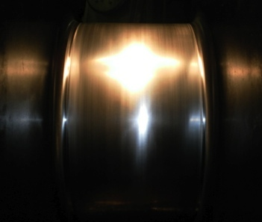
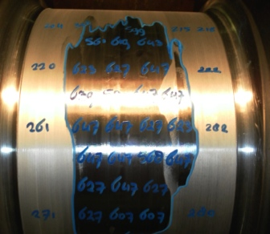
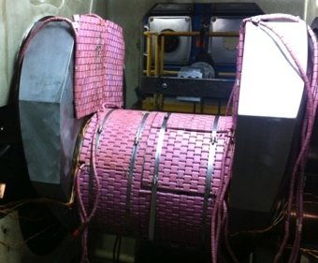
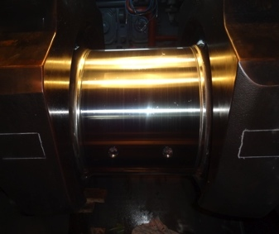
Crankshaft Annealing
The process
Factory Tempered State
  Hardness 250-350 HB
Crankshaft Casualties
  Uncontrolled heat and cooling result in hardness of 600 to 700+HB
Annealing the Shaft
  Molecules realign to a state consistent with its original ductility and hardness when it was delivered from the factory
Post Annealing
  Machined to finish diameter and surface polished to a finish of 0.03Ra or better
Notes:
Factory Tempered State: Unhardened crankshafts generally have a hardness in the range of 250-350HB (hardness Brinell)
Metal Characteristics:
Homogenous grain structure with a hardness that provides desired strength, rigidity, resistance to wear, corrosion and impact.
Crankshaft Casualties:
During a bearing failure, a crankshaft absorbs an incredible amount of heat. Emergency stopping of the engine introduces an uncontrolled cooling or quenching that often results in areas of excessive hardness in the range of 600 to 700+HB
Metal Characteristics:
Oftentimes, this hardness goes deep into the metal and without annealing would result in the condemnation of the crankshaft.
Annealing the Shaft:
Heat is applied to the shaft in a tightly controlled manner above its critical temperature and held for a period related to shaft diameter. Cooled in an equally controlled manner.
Metal Characteristics:
Once metal reaches the critical temperature, the molecules realign to a state consistent with its original ductility and hardness when it was delivered from the factory. Hardness levels are reduced to within acceptable parameters within maker tolerances.
Post Annealing:
Once the shaft is cooled the surface of the journal is rough with scale from oxidation of the metal during the annealing process. The shaft must then be machined to finish diameter and machine polished to the required finish.
Metal Characteristics:
The surface of the journal now has an acceptable hardness across the entire surface of the pin and the surface has been polished to a finish generally of 0.03Ra or better.

Slide 24
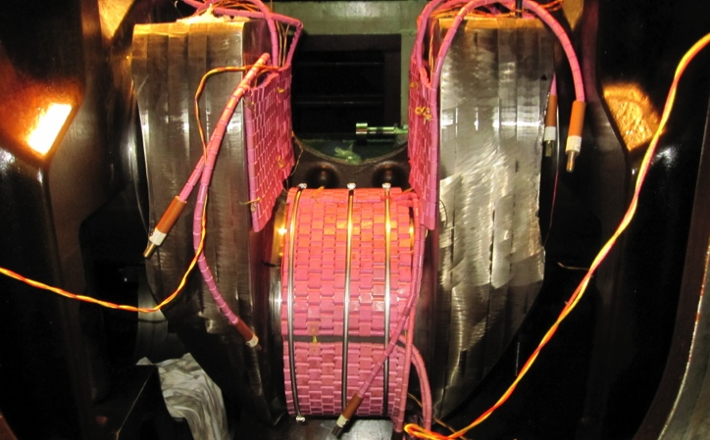
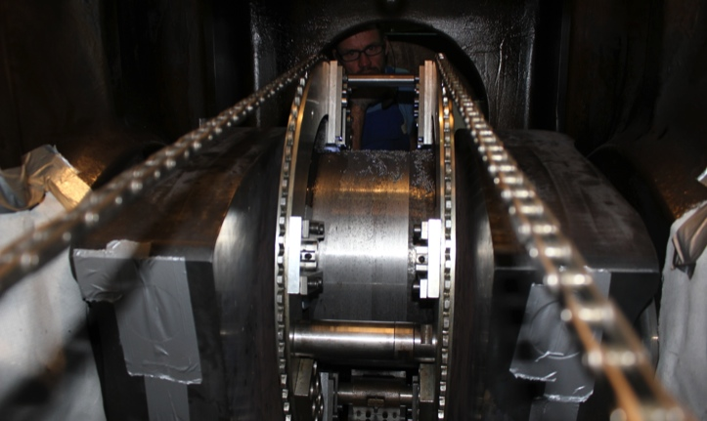
Annealing Case Study
MAN B&W 6L48/60
415mm
Crankpin journal badly damaged by bearing failure
Crankshaft condemned by the maker, cost to replace above
1.5M USD
Salvaged with a class approved permanent repair, cost approx.
150K USD
Major reduction in downtime
Notes:
Vessel/Location: Container Ship / Turkey
Engine Type: MAN B&W 6L48/60
Casualty: Crankpin journal badly damaged by bearing failure
Extent/Impact of Casualty: Surface cracks, Hardness >700 Brinnel (Maker limit 350 Brinnel), Slight bend in the shaft
Maker’s Position: The engine maker had condemned the shaft as annealing is not recommended by them and peening is not class approved
Goltens informed the underwriter/owner that we could reduce the hardness with annealing and likely salvage the shaft at -5mm.
Goltens worked with GL on the repair process and straightening was also approved
Machined Crankshaft to remove cracks prior to heat treatment
Annealing completed over 36 hrs
Post annealing hardness reduced to below 300HB
Crankshaft was peened to restore straightness
Crankshaft machined to final undersize of 410mm
Result:
Crankshaft condemned by the maker was salvaged with a class approved permanent repair
Repair cost ~$150K USD vs >$1.5M USD to replace
Major reduction in downtime

Slide 25
Crankshaft Straightening and Twisting
Methods:
Annealing
Machining
Peening
Cold Straightening
Hot / Cold Process
Notes:
Methods for Straightening Crankshafts
Annealing – removal of hardness by heat treatment often removes some or all of the runout in the bent crankshaft without peening
Machining – removal of hardness by machining also restores the shaft straightness to some degree
Peening -Requires a skilled technician with knowledge of the proper application of force. Machining of crankshaft is always required after peening.
Cold Straightening - Requires the application of hydraulic pressure with the crankshaft resting in appropriate V blocks at selected points (not done In-Situ)
Hot / Cold Process – for removing twists in 2 stroke crankshafts

Slide 26
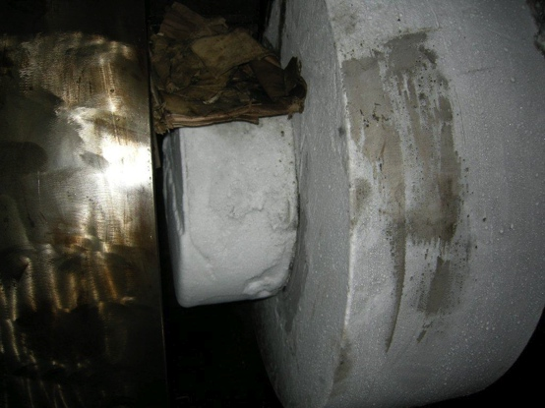
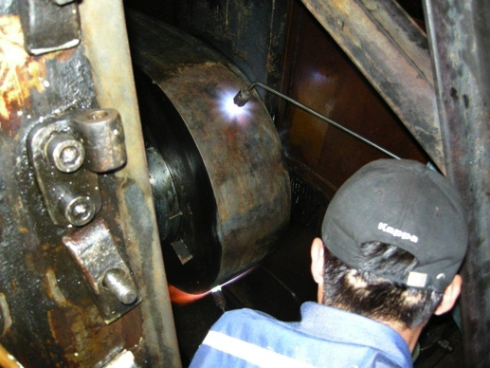
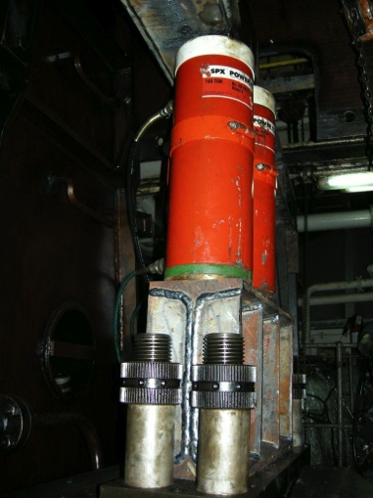
Case Study
Sulzer 8RND68
Untwisting Crankshaft
Piston casualty in one cylinder and hydraulic lock in another
Not a common repair, Goltens has done this ~10 times the past decade
Proposal was accepted against competition from MAN
Crankshaft slippage was corrected within 5 days
Engine was rebuilt and restored to full operation
  Crankshaft purchase and costly disassembly/reassembly, transport and extensive off-hire was avoided
Notes:
Case Study – Untwisting Sulzer 8RND68 Crankshaft
Not a common occurrence/requirement
Goltens had done this ~10 times in the past decade
Hot and Cold process of twisting the crank web back to original position using hydraulic jacks and fixed locking points.
Honing and Polishing of associated main journals is required after untwisting
Readjustment of engine timing is always required
Vessel/Location: Golden Merchant / Busan, South Korea
Engine Type: Sulzer 8RND68
Casualty: Engine experienced a piston casualty in one cylinder and hydraulic lock in another. The crankshaft was found to have twisted/slipped in 3 positions by 21.4mm, 20.4mm and 9.0mm.
Extent/Impact of Casualty: Vessel was forced to disable two pistons and run on six cylinders at dramatically reduced speed.
Goltens was contacted by the owner to determine if we could restore the crankshaft to acceptable limits without removing the shaft
Goltens’ proposal was accepted against competition from MAN
Results:
Crankshaft slippage was corrected to within acceptable tolerances within 5 days
Required crankshaft machining/polishing was completed and engine was rebuilt and restored to full operation
Replacement crankshaft purchase and costly disassembly, transport and reassembly and extensive off-hire was avoided

Slide 27
Metal Stitching Repairs
For cast components, metal stitching is often the only repair method
Welding of cast pieces is not generally an option
Goltens stations around the world maintain an expertise in metal stitching repairs
Notes:
Metal Stitching of Cast Components
When cracks appear or major pieces break free from a cast piece, metal stitching is often the only reasonable method to repair the damage and salvage what is otherwise likely a condemned component or major piece of equipment.
Welding of cast pieces is not generally an option and can cause more damage to the piece being welded.
Goltens stations around the world maintain an expertise in metal stitching repairs.

Slide 28
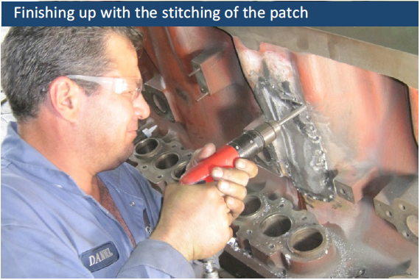
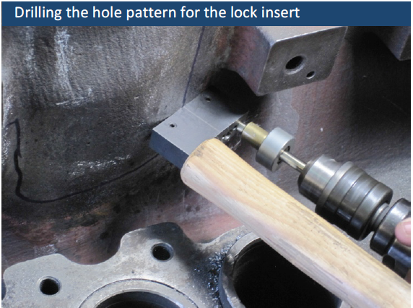
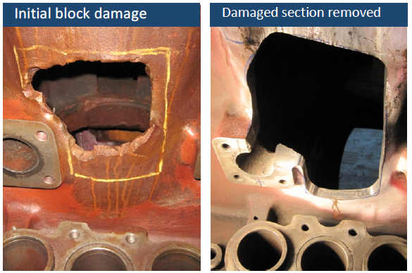
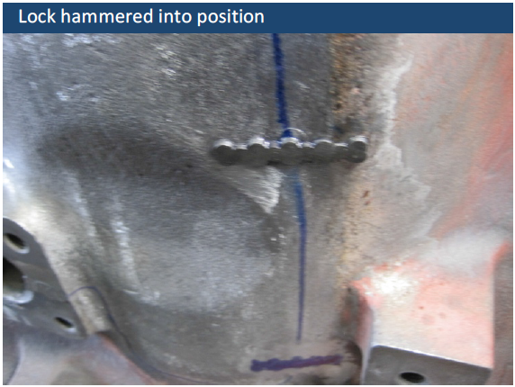
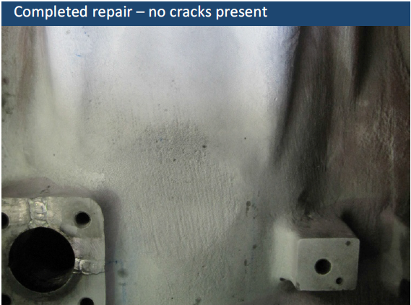
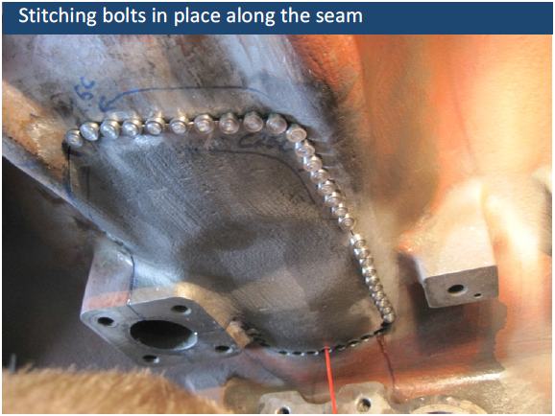
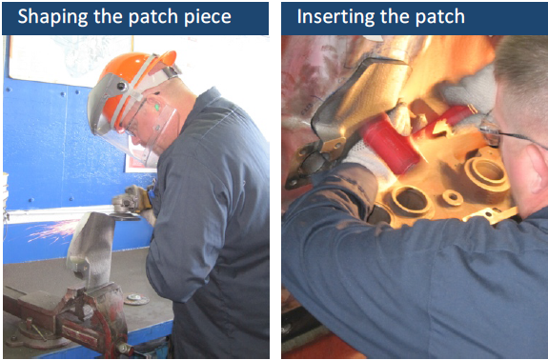
Case Study
MaK 12M282
Engine Block Metal Stitching
Drilling the hole pattern for the lock insert
Stitching bolts in place along the seam
Broken connecting rod resulting in severely damaged engine block
Goltens recommended harvesting replacement pieces from a condemned block and stitching them into the block
Cost savings for repair compared to replacement more than
500K USD
  Class approved permanent repair
  No multi-month delay due to OEM manufacturing replacement block
Initial block damage
Damage section removed
Lock hammered into position
Finishing up with the stitching of the patch
Completed repair – no cracks present
Shaping the patch piece
Inserting the patch
Notes:
Case Study- MaK 12M282 Engine Block Metal Stitching
Vessel/Location: Broken connecting rod resulting in severely damaged engine block
Engine Type: MaK 12M282
Casualty: Broken connecting rod resulting in severely damaged engine block
Extent/Impact of Casualty: Mutiple fractures/punctures in block exterior and liner landing surfaces
Complicating Factors: OEM could not supply replacement block in reasonable timeframe or cost (multiple months / ~$500K USD)
Goltens recommended harvesting replacement pieces from a condemned block and stitching them into the block for a permanent, class approved repair.
The Results:
Class approved permanent repair
No multi-month delay due to OEM manufacturing replacement block
Cost savings of >$500K USD by repairing vs. replacing

Slide 29
What if the Crankshaft, Block or Bedplate cannot be saved?
100 crankshaft replacements a year all over the world
Block and bedplate replacements routinely performed by all stations
Cross-discipline skill sets
  In-situ line boring
  Diesel
  Metal stitching
  Laser alignment etc.
Single point of service responsibility as an alternative to the OEM
Notes:
Replacement Services
Goltens performs crankshaft replacements on main and auxiliary engines well over 100 times a year all over the world. Block and bedplate replacements are also common and routinely performed by all stations.
Depending on the size, these can be very large undertakings that requires proper planning and execution but it is a fairly routine task for Goltens
Many replacements require cross discipline skill sets (in-situ line boring, Diesel, metal stitching, laser alignment etc.) Goltens provides a single point of service responsibility as an alternative to the OEM.

Slide 30
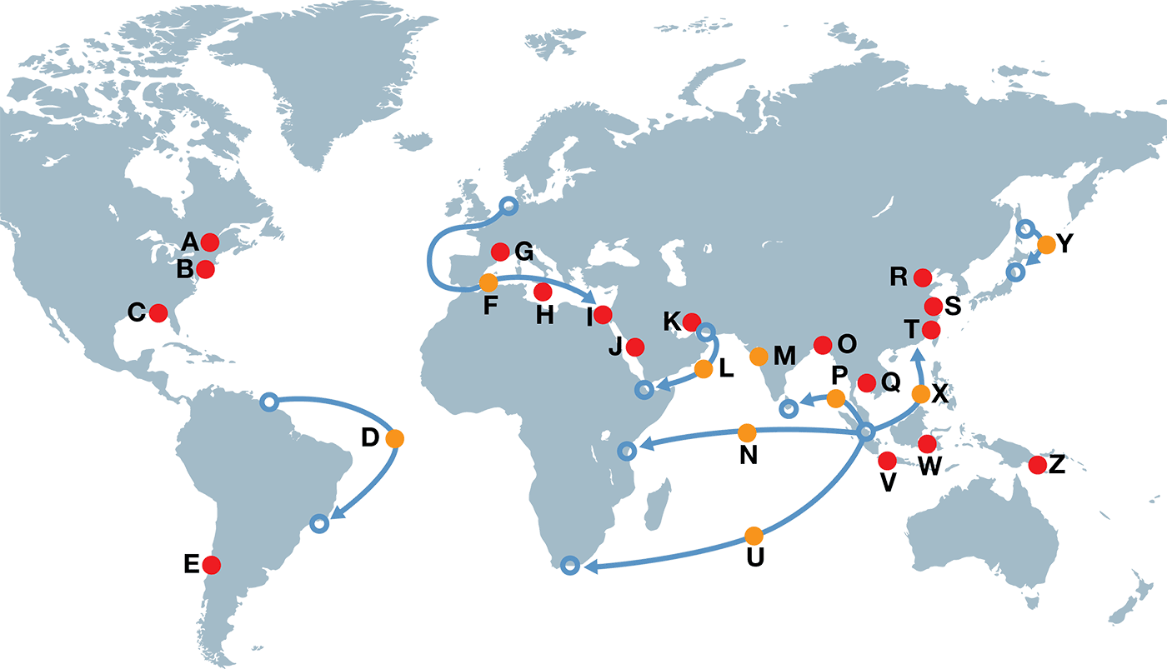

Crankshaft removals and replacements
A small sampling over a 12 month period
A Yanmar 6N 280L
B MaK 6M551AK
C Daihatsu 8PS-26H
D ABC 6
BDXC720–100A
E Yanmar 6ZL-UT
F MAN 6L23/30H
G MAN 6L23/30H
H DEUTZ RBV12M350
I MaK 6M601
J MAN V6 40/54
K MaK 12M43C
L Sulzer 6AL 25
M MAN B&W 5L 23/30
N Yanmar M220AL-SN
O Wartsila 18V46GD
P Yanmar M220 ALSN
Q B&W 6L 23/30H
R MAN B&W 6L27/38
S YANMAR 6M200AL
T YANMAR 6M18AL
U Wartsila 6R32D
V Daihatsu 6PKT16
W Mirrlees Blackstone
ESL 16MK-2
X Wartsila 6L20
Y Bergen B32 40L9A
Z MAN B&W 6L 23/30H
On-shore repair
Voyage repair
Voyage start/end point
Voyage

Slide 31
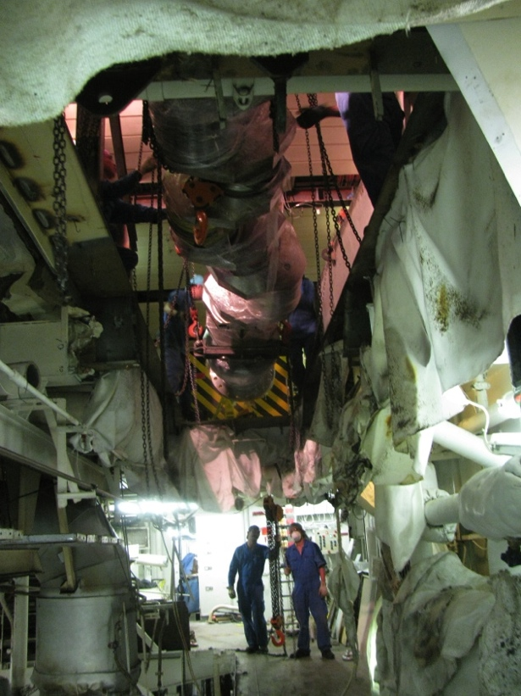
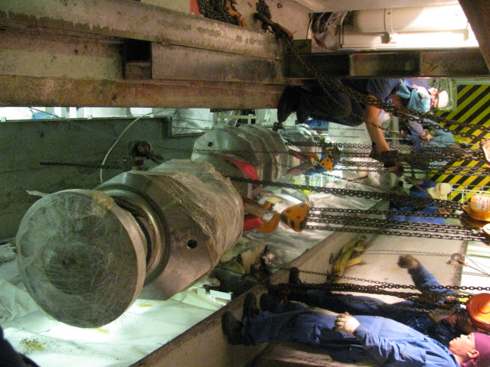
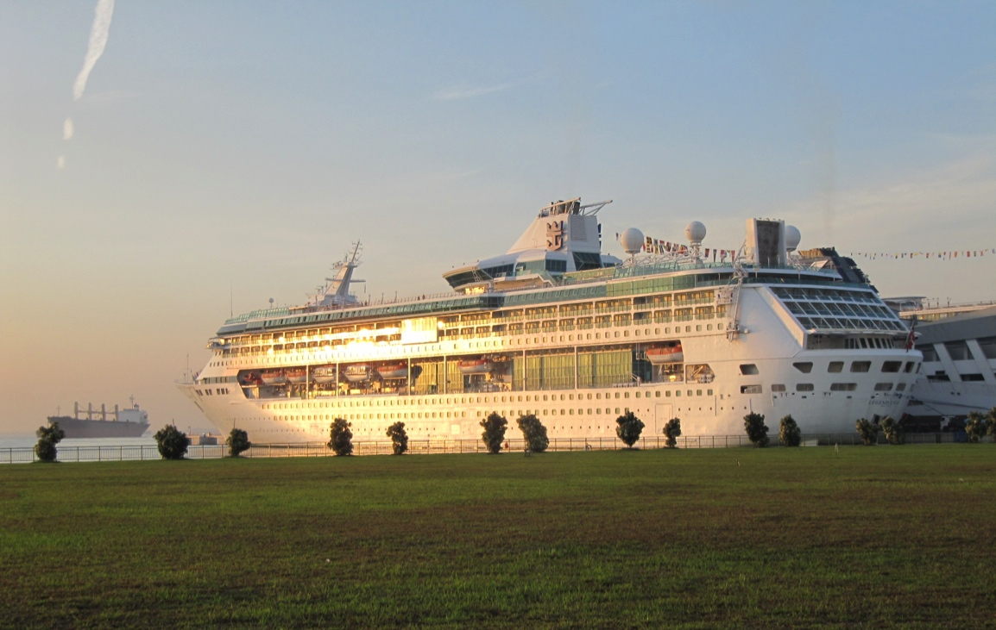
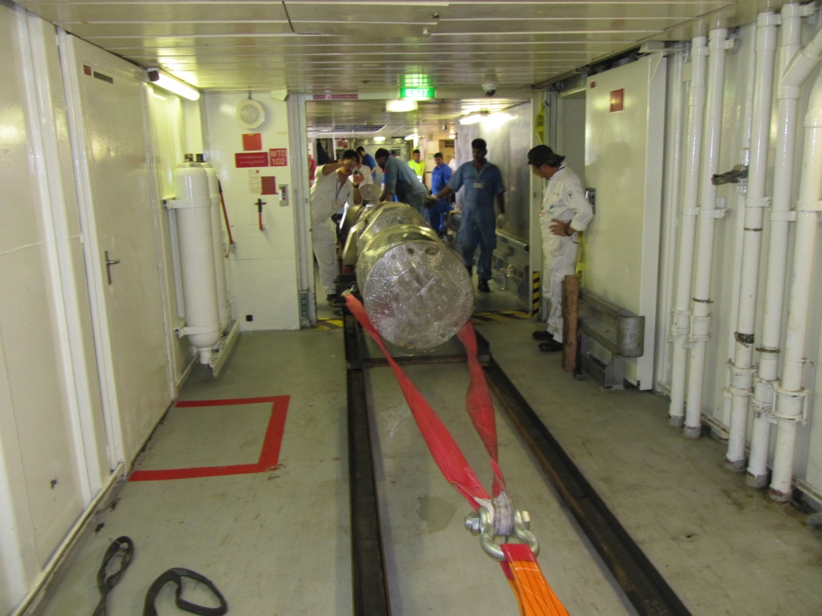
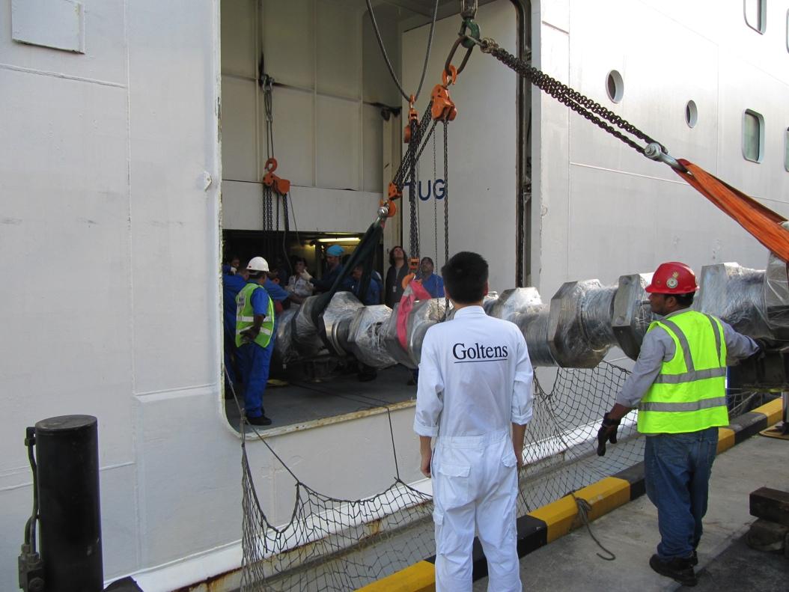
Case Study
Wartsila 12V46
Crankshaft Replacement
9 meter/15 ton crankshaft was onboarded during
10 hour port call
Major crankshaft failure
Cruise ship had full schedule with no options for delay
Engine line boring due to excessive heat transfer
Route, timing and logistics for loading the replacement shaft with zero interruption to the vessel’s schedule
All repairs were approved by vessel’s class DNV
Major savings compared to the OEM
Shaft had to be moved along 80meter passage and lowered through a hole cut in the deck to the engine rooms
Notes:
Case Study – Wartsila 12V46 Crankshaft Replacement
Royal Caribbean cruise vessel experienced major crankshaft failure
Crankshaft was correctly condemned by OEM due to deep cracks
Engine was determined to require line boring due to excessive heat transfer
Cruise ship had full schedule with no options for delay
Goltens evaluated the project and was invited to bid versus the OEM
Goltens performed detailed evaluation of the project to determine route, timing and logisitics for onloading the replacement shaft without interruption to operations
Results:
As a result of careful planning, the job was completed with zero interruption to the vessel’s schedule
All repairs were approved by vessel’s class DNV
Major cost savings compared to the OEM are assumed to have been realized

Slide 32
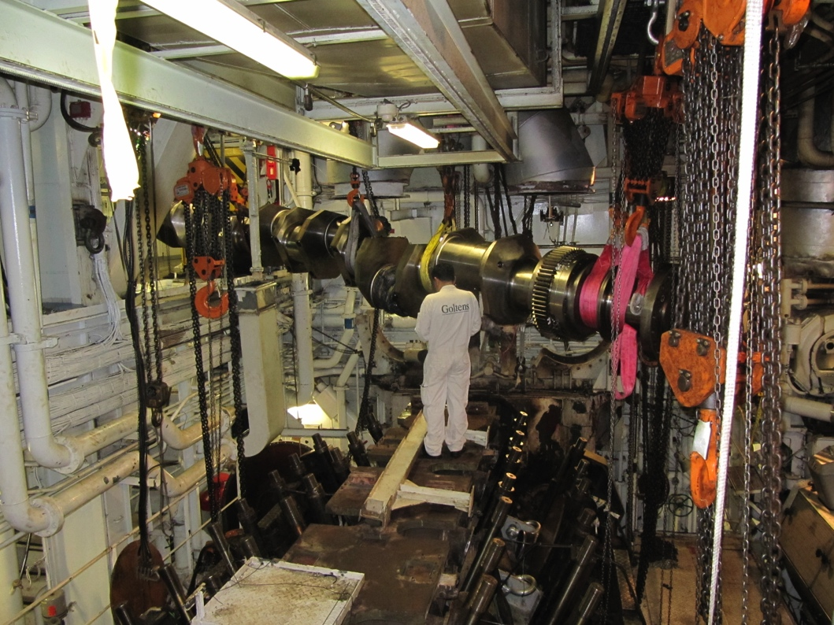
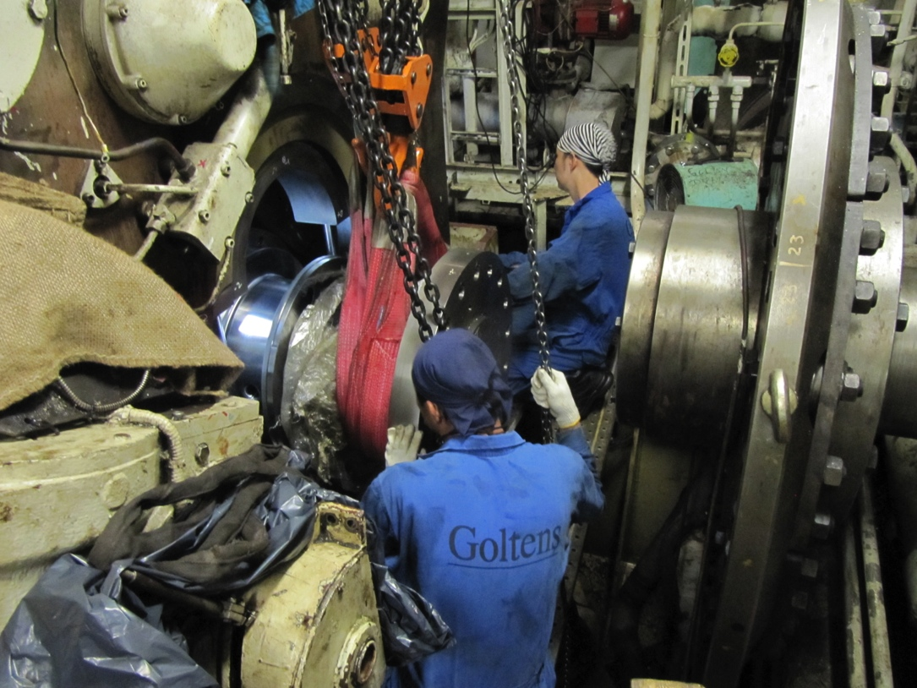
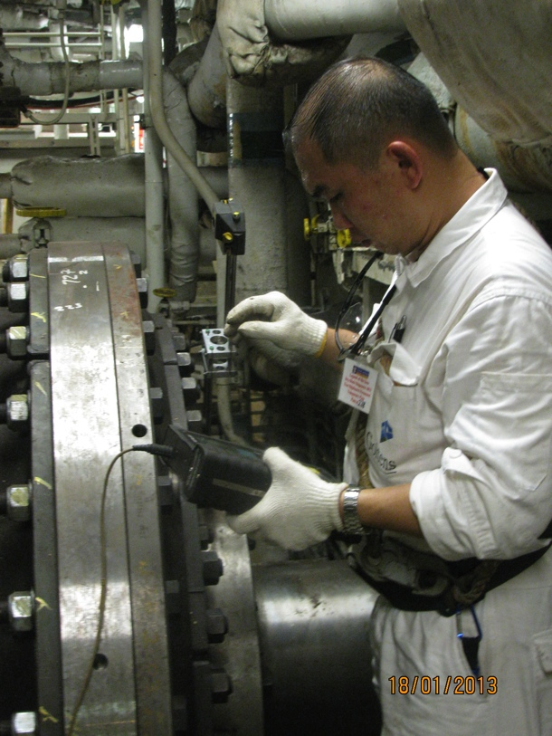
Case Study
Wartsila 12V46
Crankshaft Replacement
Major crankshaft failure
Cruise ship had full schedule with no options for delay
Engine line boring due to excessive heat transfer
Route, timing and logistics for loading the replacement shaft with zero interruption to the vessel’s schedule
All repairs were approved by vessel’s class DNV
Major savings compared to the OEM
Crankshaft was rigged into position and the engine rebuilt, aligned and operationally tested
Shaft was then rigged through the engine room into the engine
Notes:
Case Study – Wartsila 12V46 Crankshaft Replacement
Royal Caribbean cruise vessel experienced major crankshaft failure
Crankshaft was correctly condemned by OEM due to deep cracks
Engine was determined to require line boring due to excessive heat transfer
Cruise ship had full schedule with no options for delay
Goltens evaluated the project and was invited to bid versus the OEM
Goltens performed detailed evaluation of the project to determine route, timing and logisitics for onloading the replacement shaft without interruption to operations
Results:
As a result of careful planning, the job was completed with zero interruption to the vessel’s schedule
All repairs were approved by vessel’s class DNV
Major cost savings compared to the OEM are assumed to have been realized

Slide 33
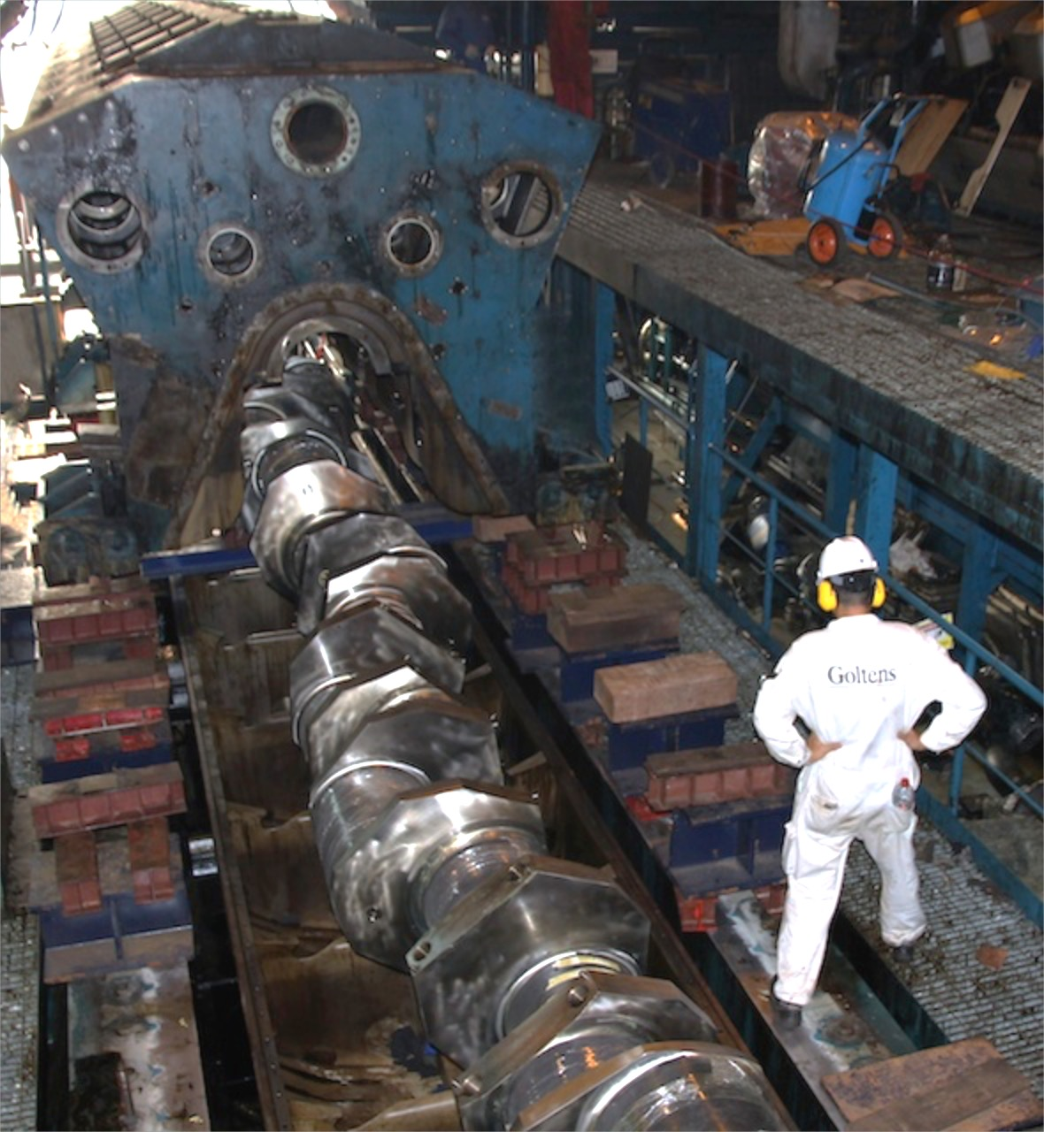
Case Study Engine
Wartsila 12V46DF
Block Replacement
The damaged block was removed from the power house in Bangladesh and the new block was installed, engine reassembled and put into service
Large power plant in Bangladesh suffered major casualty
Insurance underwriter contacted Goltens to propose a repair
Suitable used block in Philippines was overhauled and converted to DF at fraction of the cost of new
Notes:
Case Study – Wartsila 12V46DF Block Replacement
Large powerplant in Bangladesh suffered major casualty resulting in requirement to replace the block
Insurance underwriter contacted Goltens to propose a repair
Goltens located suitable used block in Philippines that could be overhauled and converted to DF at fraction of the cost of new
Timeline and costs were accepted and Goltens was awarded the job

Slide 34
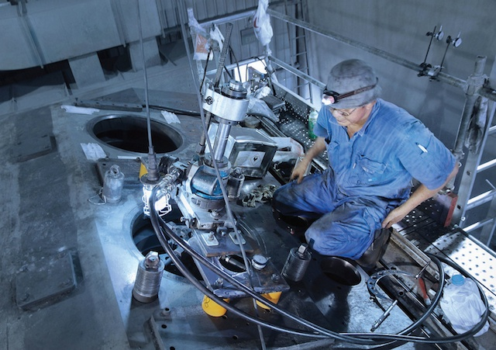
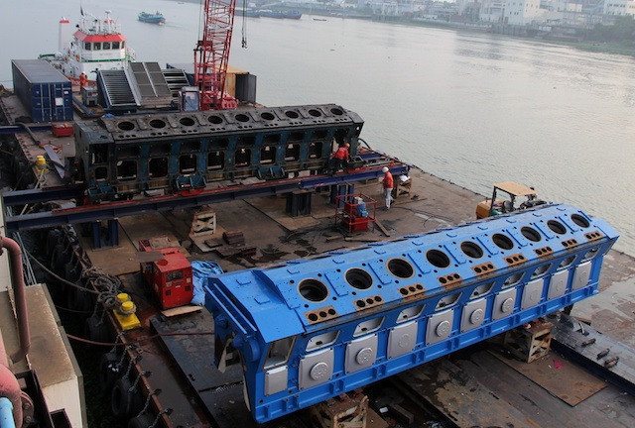
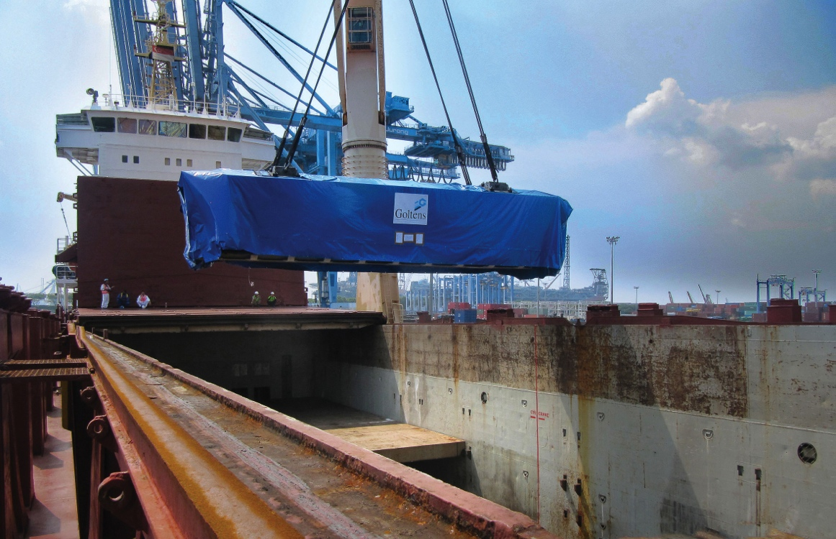
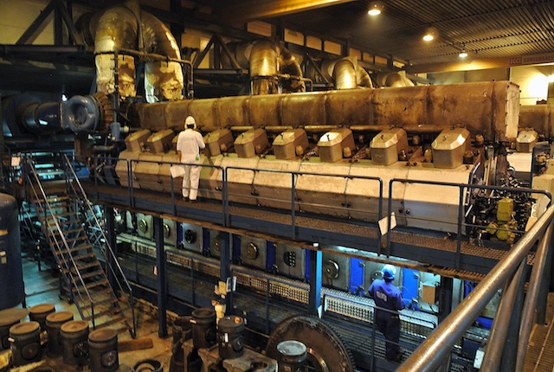
Goltens completely overhauled the block, performed in-situ machining to convert from HFO to GAS and MDO
Goltens located a replacement block in Philippines and completed disassembly and transport to Goltens Singapore for reconditioning and conversion

Slide 35
Alternate Sources for Parts
Second hand, class stamped components
  Crankshafts
  Blocks
  Bedplates
High quality replacement parts
  Pistons
  Con Rods
  Bearings
  Other repair parts
Notes:
Through Goltens’ worldwide network we are very often able to source secondhand, class stamped components at a fraction of the cost of new from the OEM:
Crankshafts
Blocks
Bedplates
Additionally, Goltens can supply high quality, replacement engine spares for a wide range of engine types.
Pistons
Con Rods
Bearings
Other repair parts

Slide 36
Warranty
Insurance
Goltens will match the warranty provided by the engine manufacturer parts and services
Goltens will provide the same warranty for its repairs whether the maker or Goltens supplies the spares
Goltens is fully insured with a $20M Marine General Liability policy that covers consequential damages resulting from our work
Notes:
Warranty - Goltens will match the warranty provided by the engine manufacturer for the parts it supplies and the services it performs.
Goltens will provide the same warranty for its repairs whether the maker supplies the spares or Goltens supplies
Insurance - Goltens is fully insured with a $20M Marine General Liability policy that covers consequential damages resulting from our work

Slide 37
Conclusions/Questions
Goltens is eager to work with insurance underwriters to continue to provide viable repair alternatives in casualty restoration.
Cost effective alternatives are available in many cases for repairs and parts but second opinions are not always pursued.

Slide 38
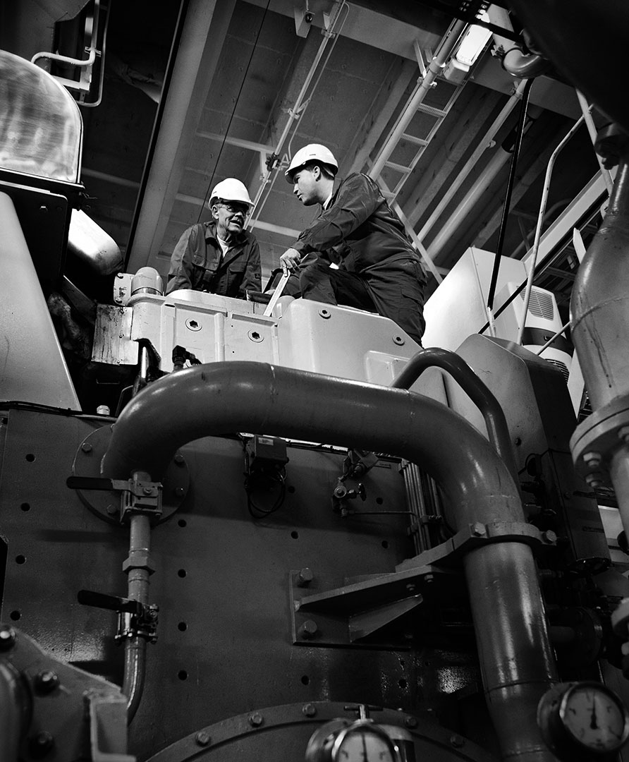

Presence
We are right where you need us
Reponse
We’re always reared up to respond
Precision
We get it right the first time
www.goltens.com

