Slide 1
IMCC Dublin IUMI Conference 2015
Dieter Berg
Munich Re, IUMI President

Slide 2
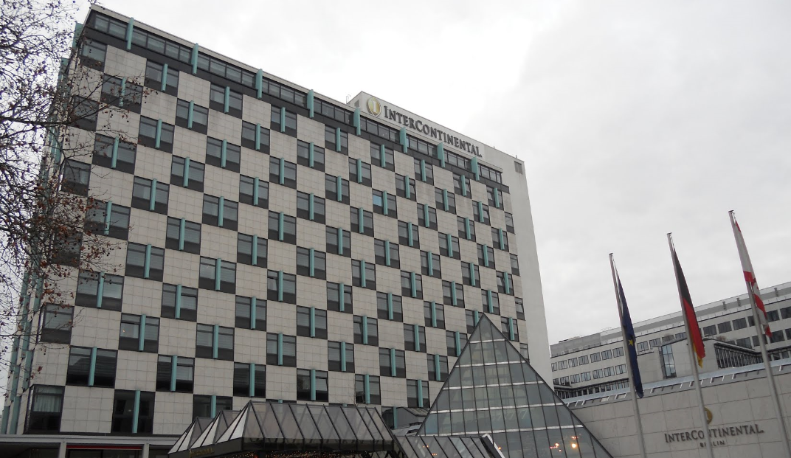
IUMI conference 2015 – Berlin
602 delegates
52 speakers
37 member associations (total 48)
SIMI as new member
IUMI Professional Partners (total 19)
Affiliate organizations (total 18)
IMCC represented in Berlin

Slide 3
Common theme
Challenges for marine insurance
“… external factors such as technical, financial and human issues are key drivers of our business and together they are creating a new standard for our industry…
That is what led us to choose this theme for the 2015
Berlin Conference… ”
Technical, Financial & Human Factors – is there a new normal ?

Slide 4
Challenges for the insurance industry The President´s view
Challenges for marine insurance The President´s view
Technological challenges:
mega construction projects
ultra large container vessels
renewable energies
cyber risks / digitalization
Market cycle
Impact of the global finance industry
Cargo accumulations:
car carriers &
car storage
climate change/
arctic sailing
12

Slide 5
IUMI 2015 – main topics
Facts & Figures
Digitalisation & Cyber Threats
Offshore Energy Workshop
Cargo Workshop
Ocean Hull Workshop

Slide 6
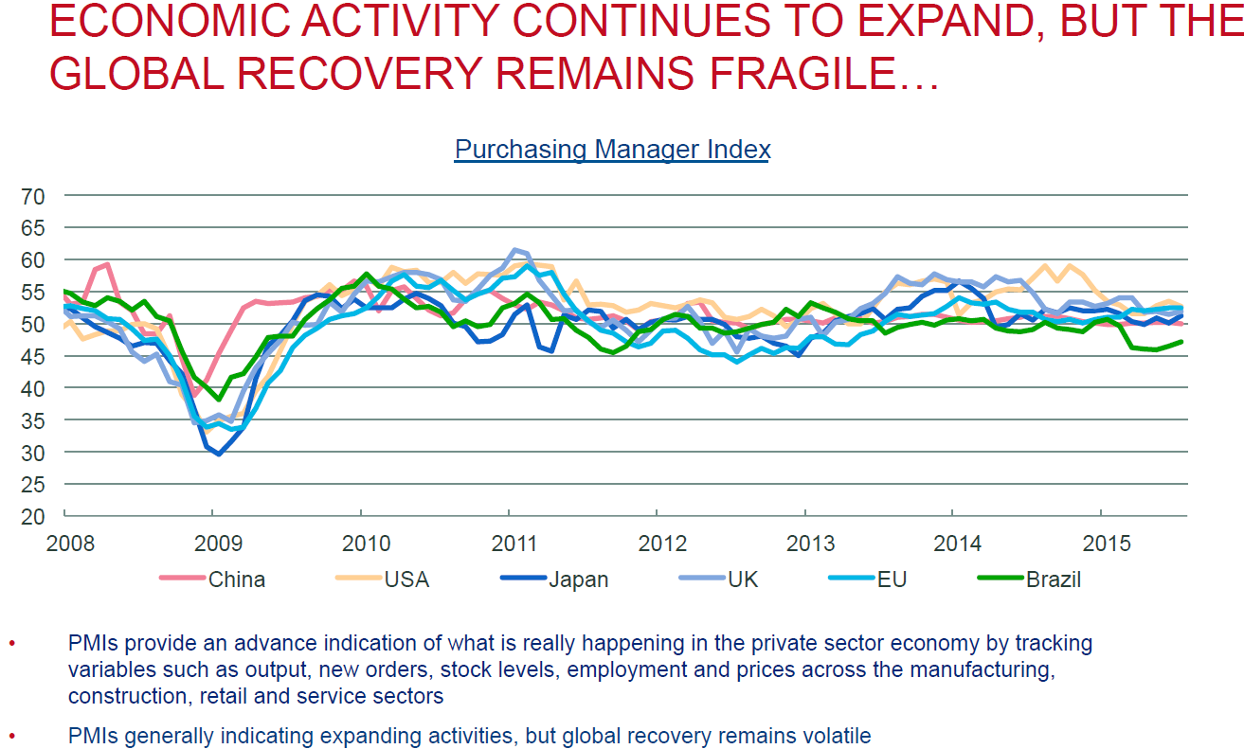
IUMI statistics

Slide 7
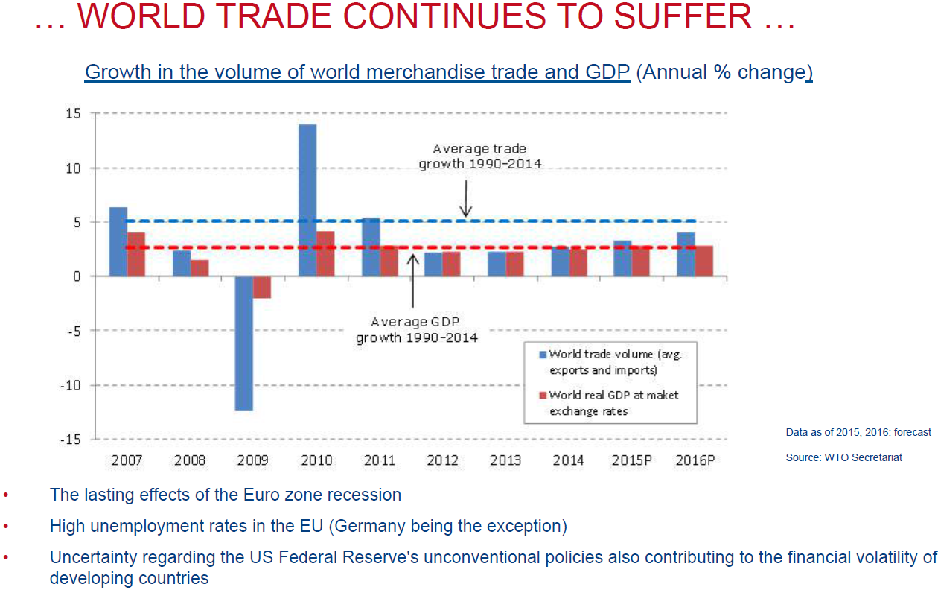
IUMI statistics

Slide 8
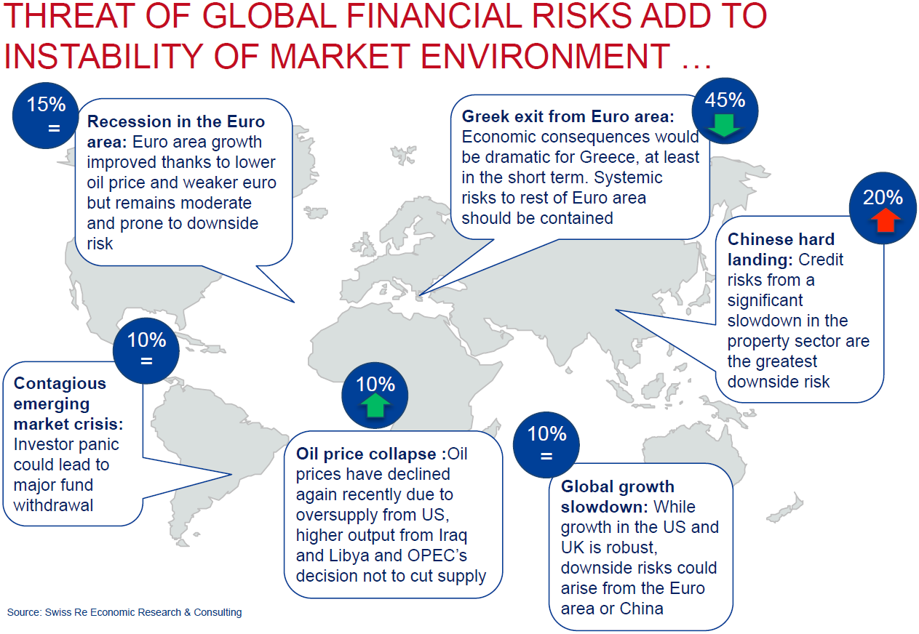
IUMI statistics

Slide 9
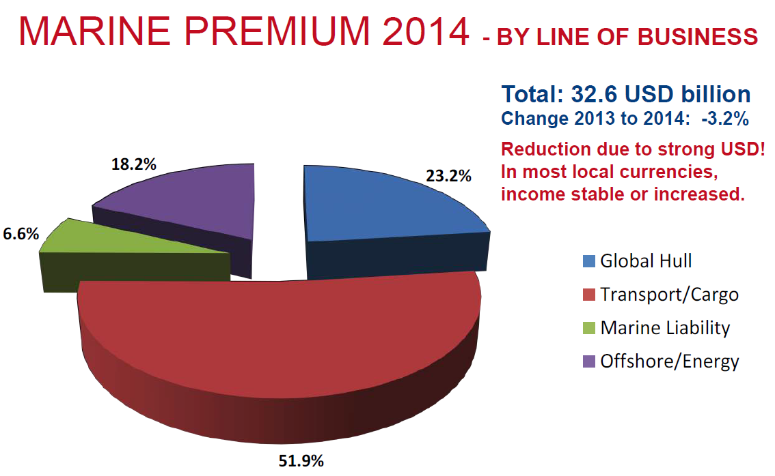
IUMI statistics

Slide 10
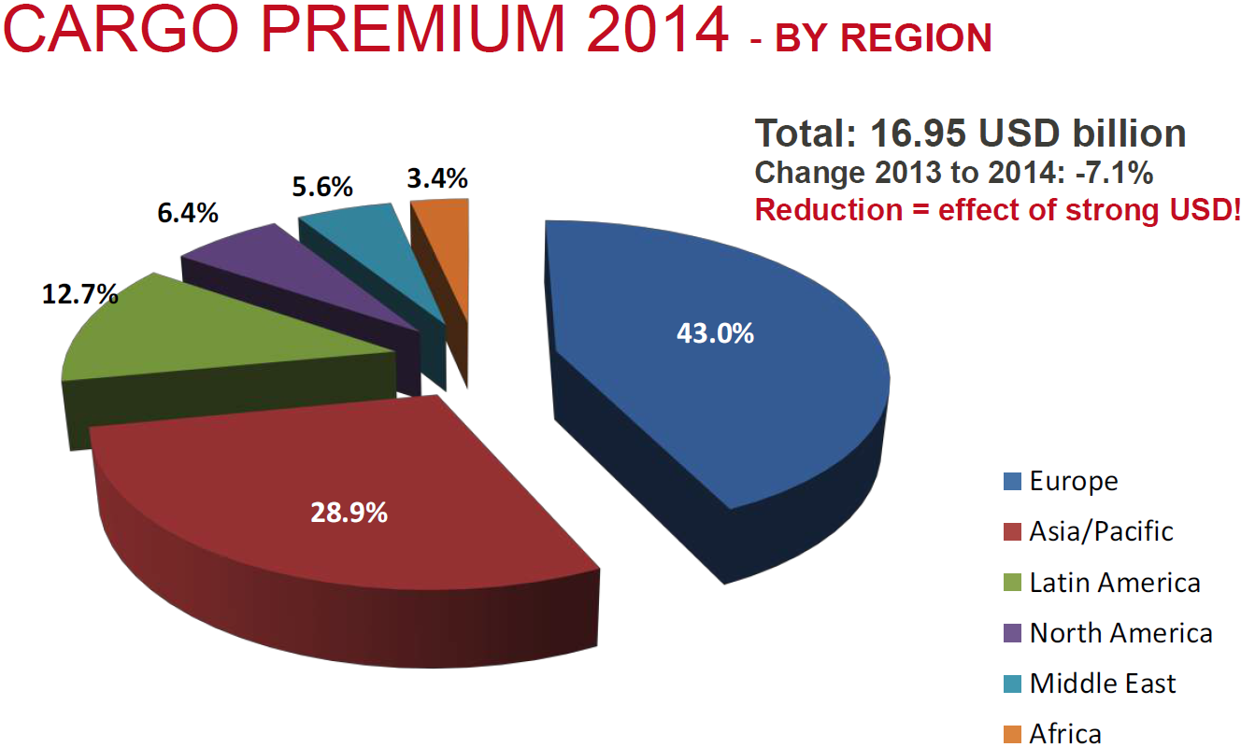
IUMI statistics

Slide 11
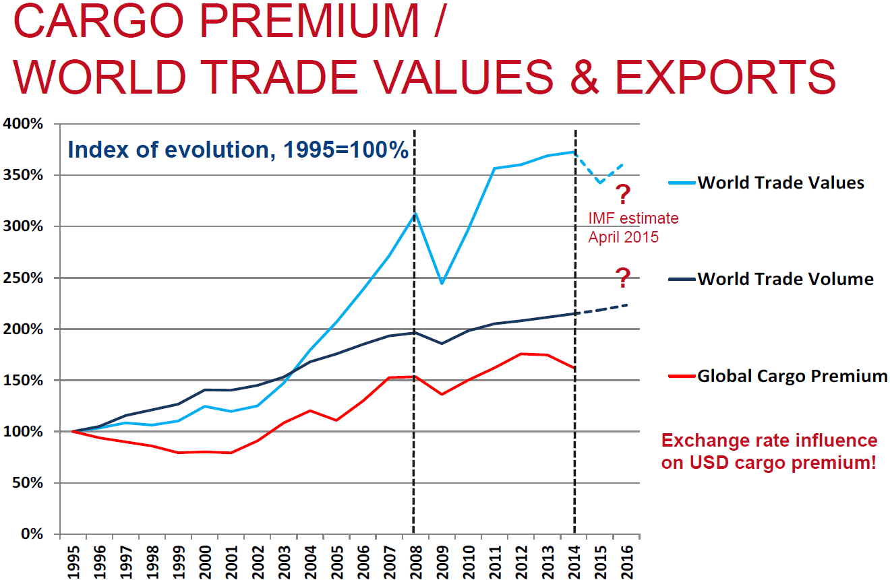
IUMI statistics
Source (World Trade Volume & Values): IMF, World Economic Outlook, April 2015

Slide 12
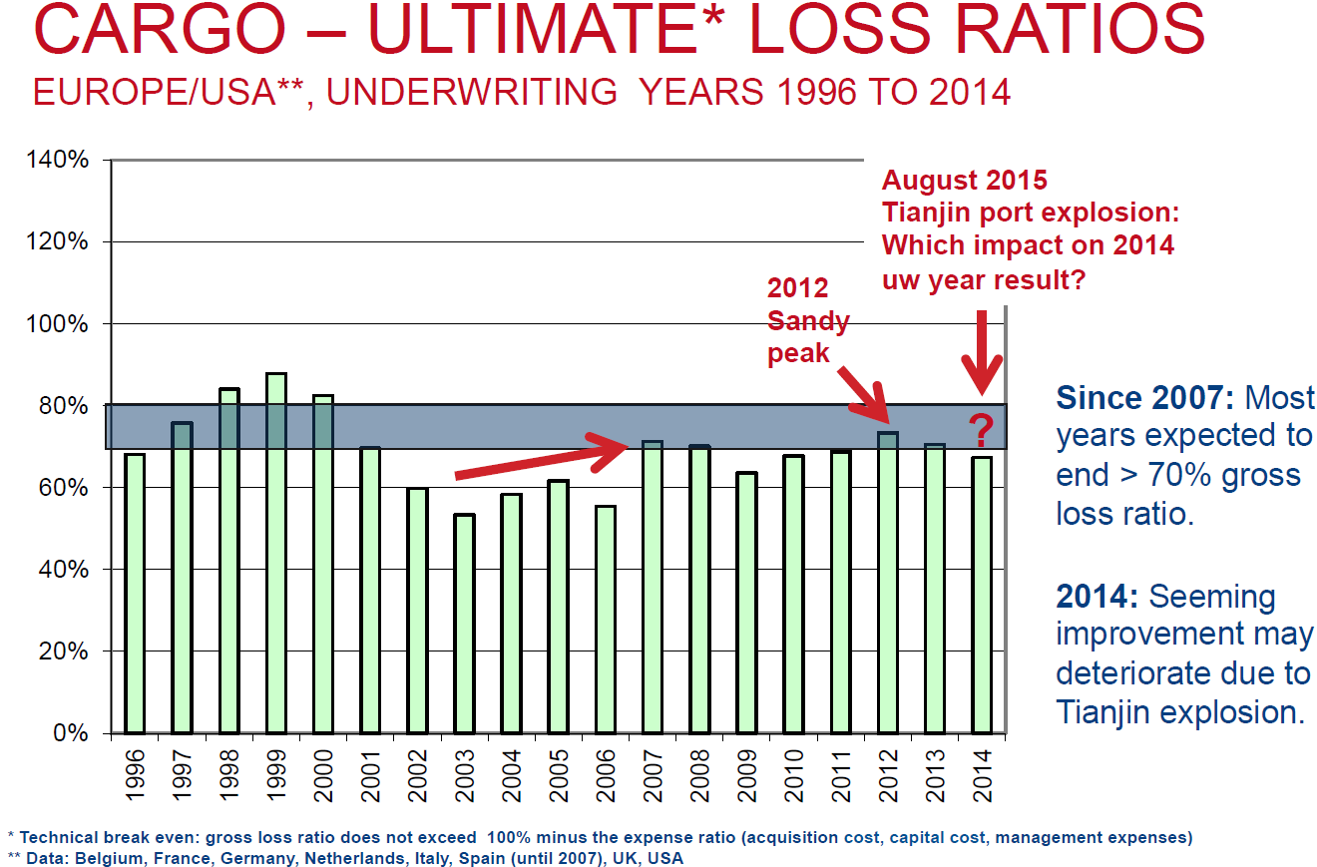
IUMI statistics

Slide 13
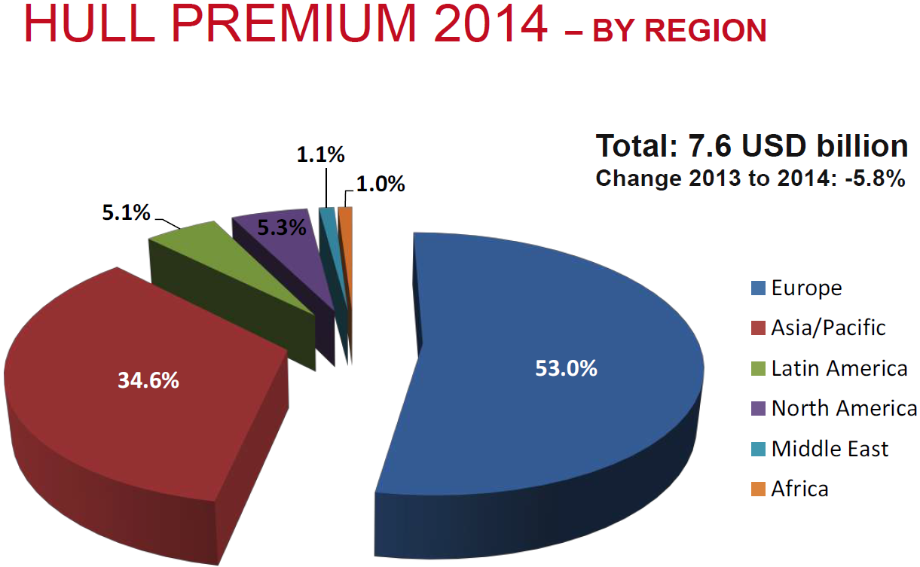
IUMI statistics

Slide 14
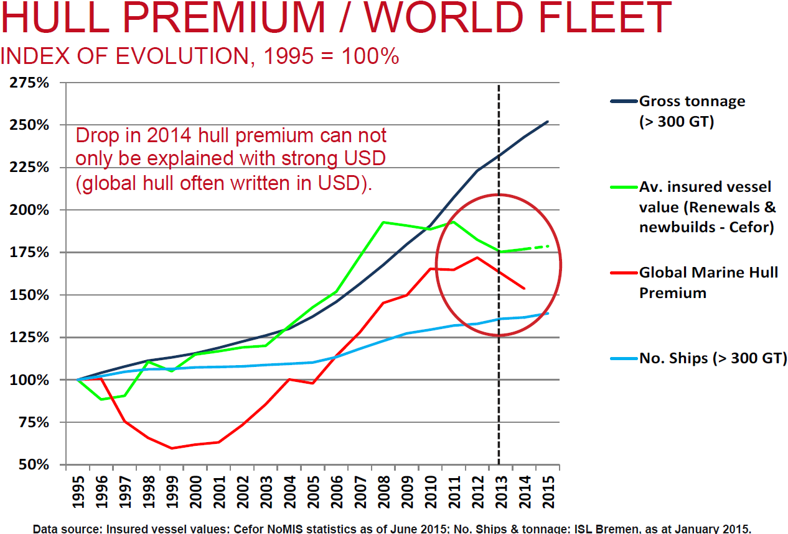
IUMI statistics

Slide 15
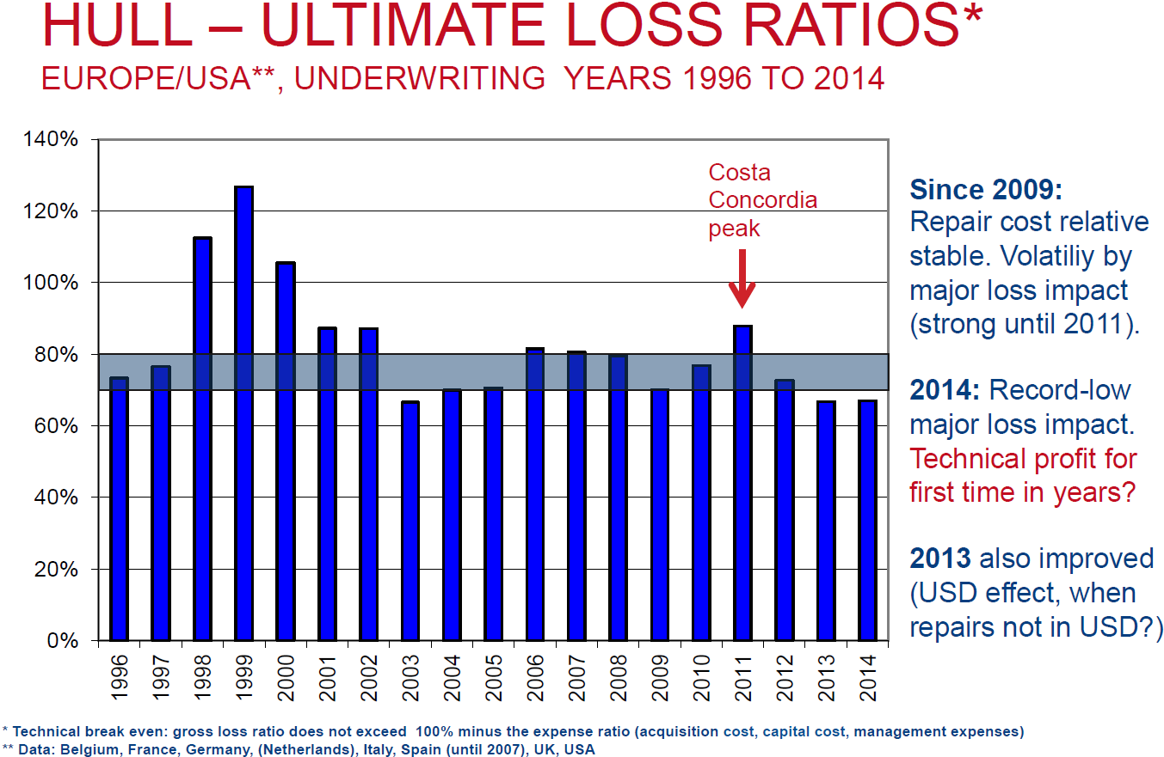
IUMI statistics

Slide 16
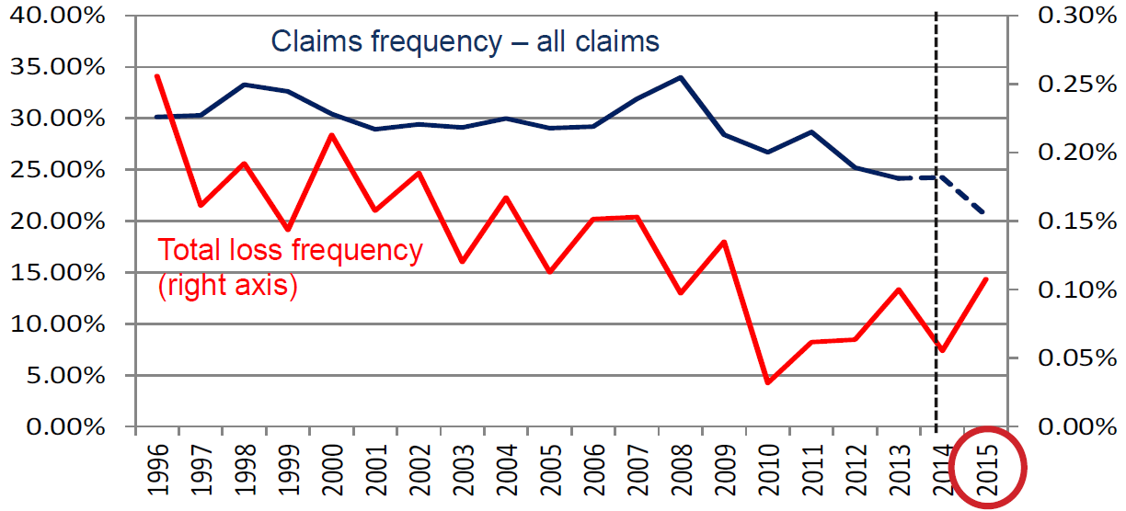
IUMI statistics
Claims Frequency as of june 2015 Cefor nordic marine insurance statistics
2014: Next to no total loss impact
Total loss frequency: Long-term positive trend – but do we see a new increase in 2015?

Slide 17
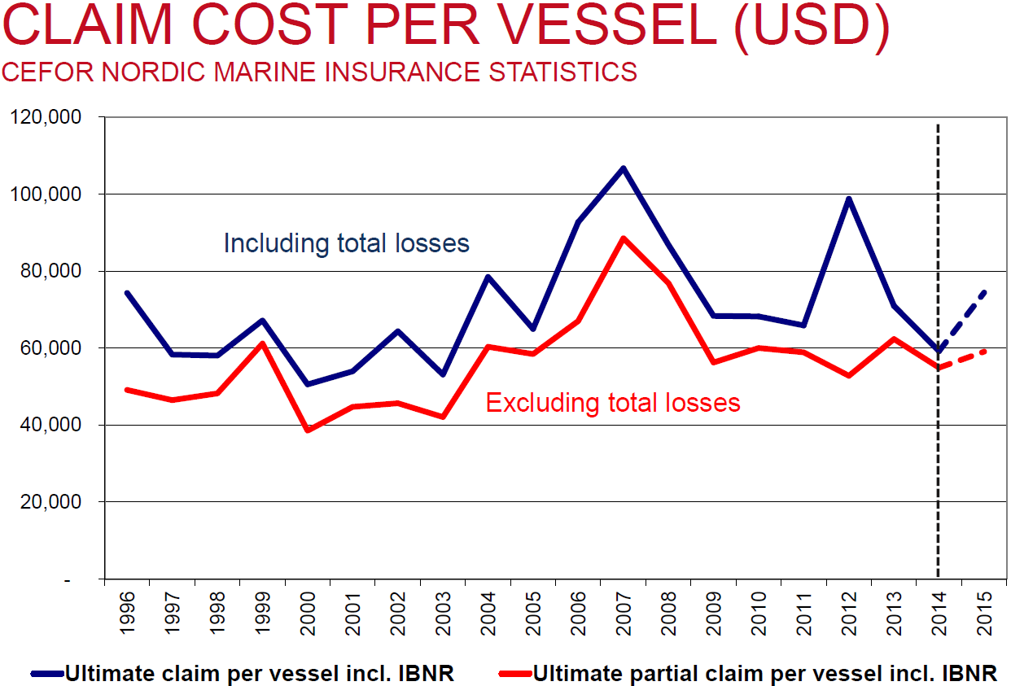
IUMI statistics
2014: Next to no total loss impact
2015: Renewed total loss impact
Excluding total losses: Claim cost per vessel stable since 2009

Slide 18
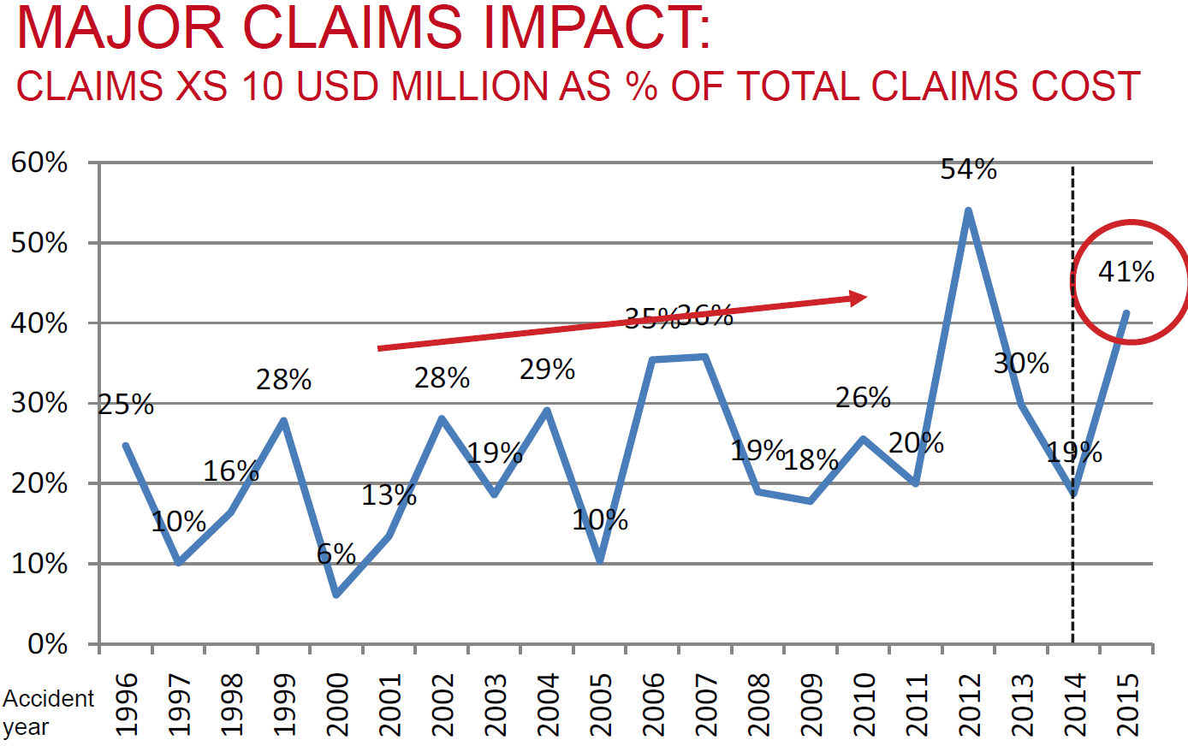
IUMI statistics
2015: Renewed impact of major claims
Source: Cefor Nordic Marine Statistics as of June 2015 (claims costs reflect 100% of each vessel)

Slide 19
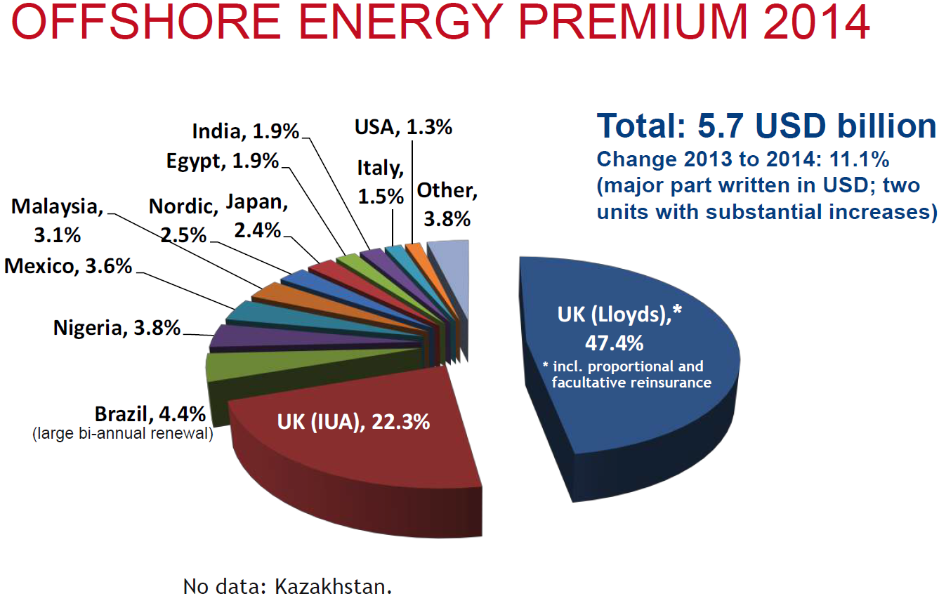
IUMI statistics

Slide 20
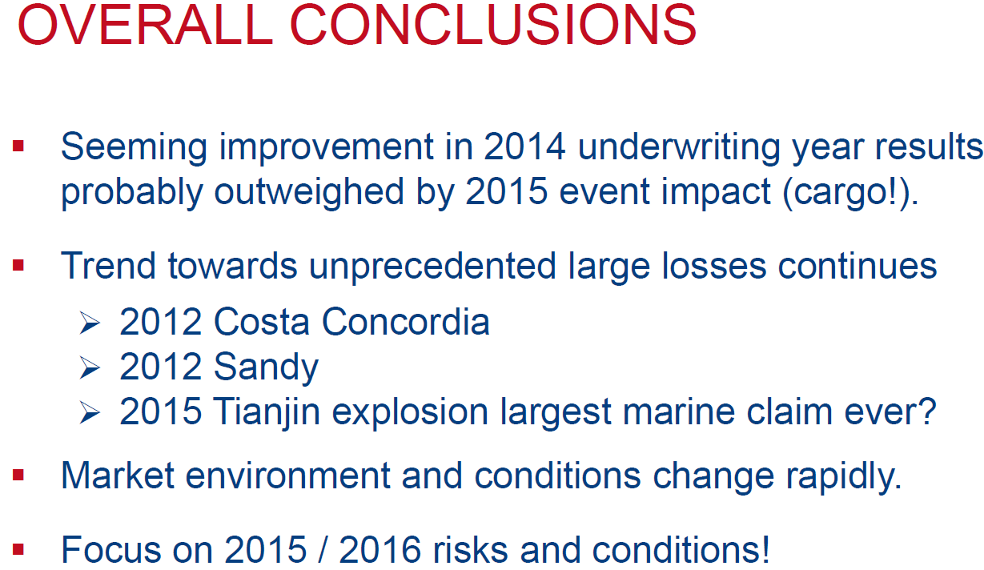
IUMI statistics

Slide 21
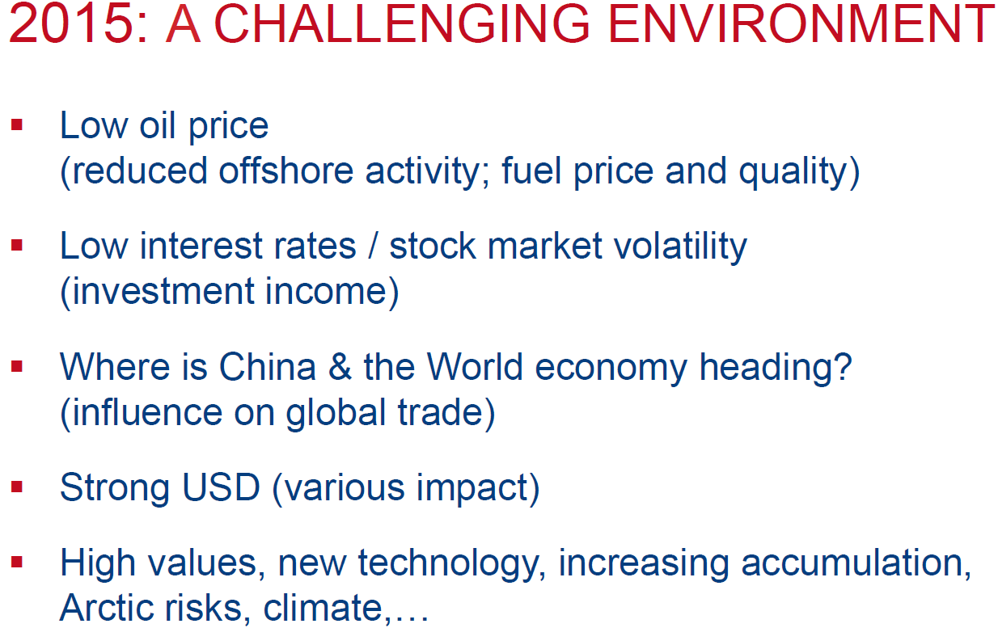
IUMI statistics

Slide 22
Challenges for marine Insurance External drivers of our business - technological
.... can underwriters keep pace with the rapid technological
developments?
Technological challenges
New complex technologies :
Cyber threat, digitalization, big data
Super-large container vessels and car carriers
Complex oil and gas drilling
Mega construction projects

Slide 23

Digitalization & Cyber Threats for shipping and offshore industry
Shipping electronic
Navigation
Identification
Communication
eNavigation
Unmanned vessels
Technological challenges:
Cyber
Image: Andersson18824 / Wikimedia Commons
Tracking of containers (Antwerp case)
Storage of container
Cooling of goods
Intelligent logistics
Ports
and logistic
facilities
Ballast management
Production management
Drilling management
Offshore
platforms

Slide 24
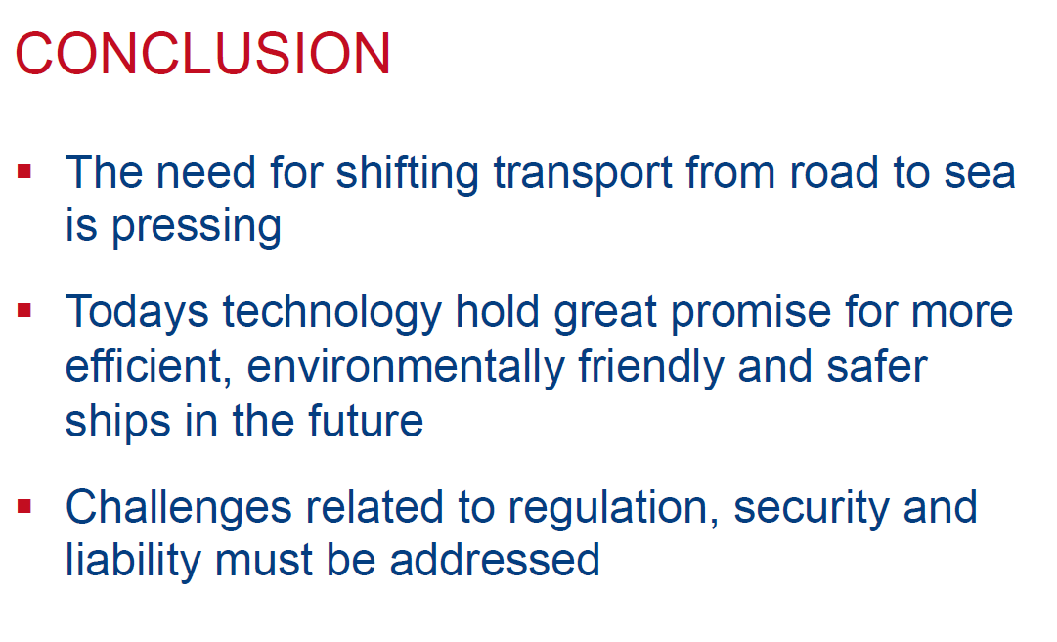
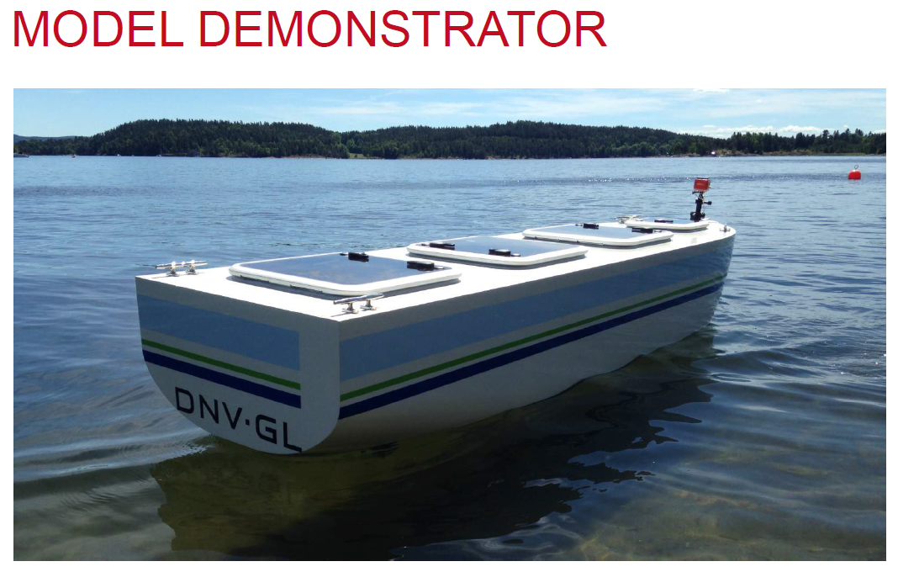
Digitalization & Cyber Threats for shipping and offshore industry
Shipping electronic
Unmanned vessels
Technological challenges:
Cyber
Image: Andersson18824 / Wikimedia Commons

Slide 25
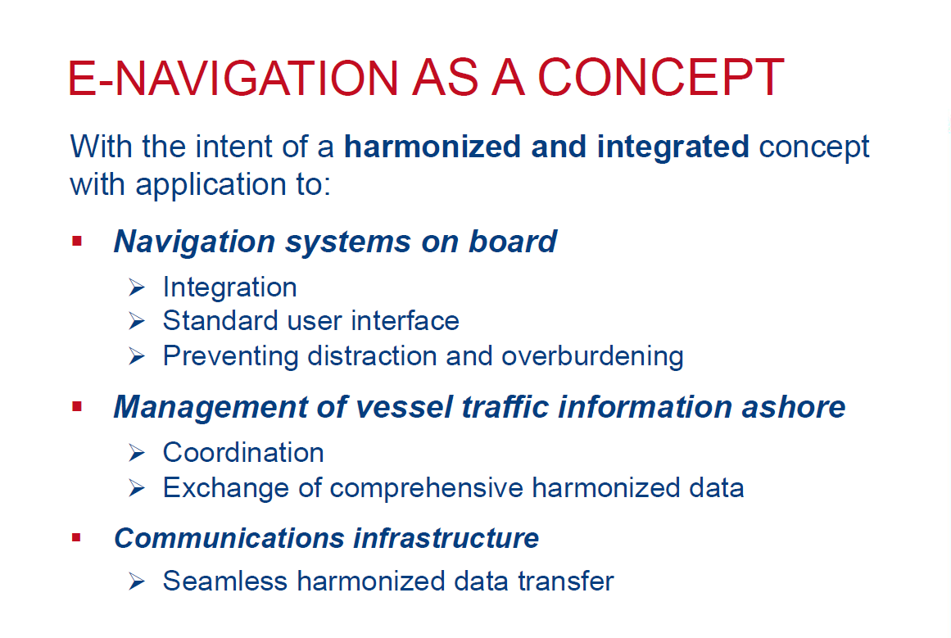
Digitalization & Cyber Threats for shipping and offshore industry
Shipping electronic
eNavigation
Technological challenges:
Cyber
Image: Andersson18824 / Wikimedia Commons

Slide 26
Digitalization & Cyber Threats for shipping and offshore industry
Shipping electronic
eNavigation
Unmanned vessels
Technological challenges:
Cyber
Image: Andersson18824 / Wikimedia Commons
Connected ships are coming earlier than expected
Vulnerability of vessel software / IT
eNavigation will lead to increased data exchange:
ship to shore and ship to ship
Autonomous navigation remotely controlled from shore

Slide 27
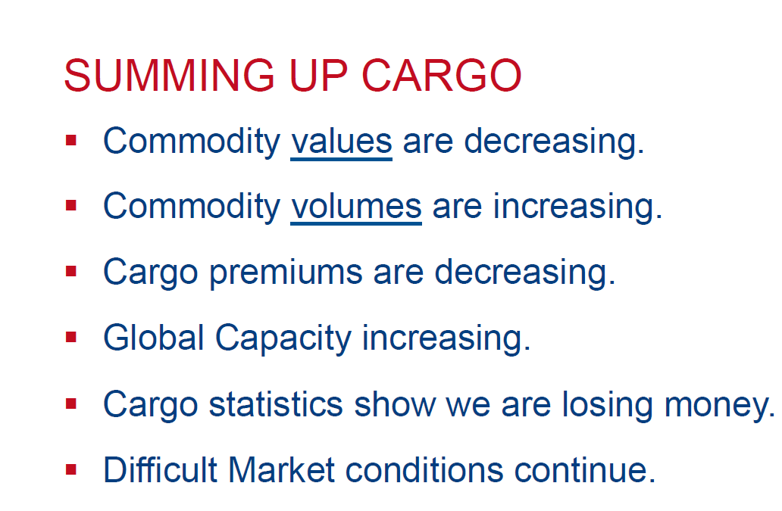
Cargo Workshop

Slide 28
Cargo Workshop
Storage risk exposure
- risk assessment methods
- assessment factors
Misappropriation
Fake Carriers & freight site fraud

Slide 29
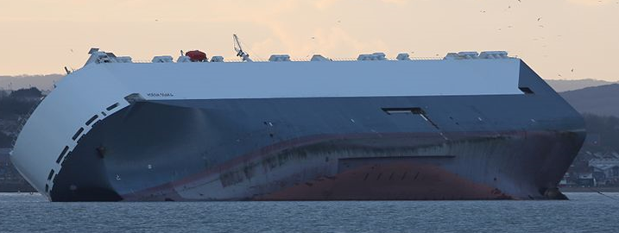
Challenges for marine insurance accumulation risks in automotive policies
01/2015 Hoegh Osaka ⇨ 1400 Range Rover+Jaguar, $ ..... mill cargo loss ?
04/2014 Asian Empire ⇨ 4600 Kia+Hyundai, $ 130 mill cargo loss
12/2012 Baltic Ace ⇨ 1400 Mitsubishi, $ 35 – 50 mill cargo loss
07/2006 Cougar Ace ⇨ 4812 Mazda, $117 mill cargo loss
12/2002 Tricolore ⇨ 2871 new cars/trucks, $ 60 mill cargo loss
10/2002 Hual Europe ⇨ 4000 cars lost
Technological challenges: Car carriers
Inherent risks of car carriers
High deck superstructures
Stability problems
Loading ramps
Quick water ingress
Challenges
Image: Geni2015 / Wikimedia Commons

Slide 30
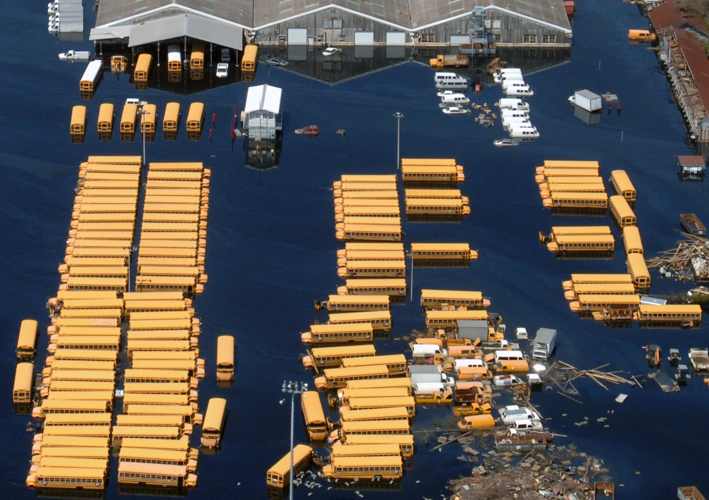
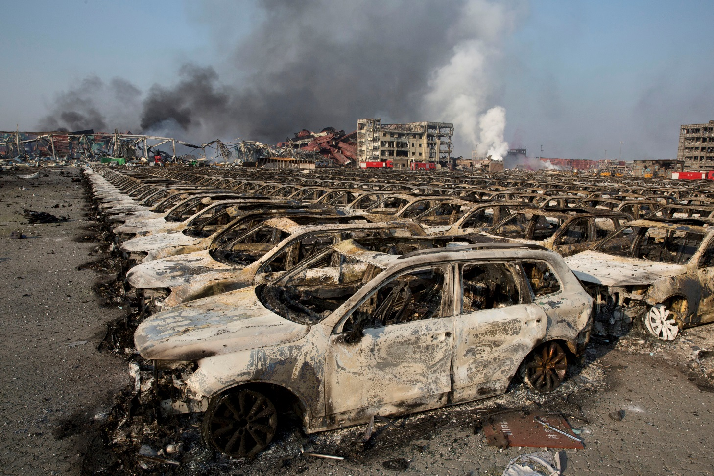
Accumulation risks in automotive policies catastrophe exposure to automobiles in ports and storage areas
Technological challenges: Car storage
Flooding / storm surge / tsunami
Superstorm Sandy: Biggest marine cat loss > $ 3 bn.
Port of NJ: 16.000 new autos + 3.000 trucks total loss
$ 650 mill total automotive loss
Hail
Open car storage
Correlates with storm and flood
Europe: 20 hail events with marine losses since 2004
Influence of climate change
Image: Jocelyn Augustino , FEMA Photo Library / Wikimedia Commons
Fire / explosion / terrorism
Fire following earthquake
Man-made losses
Tianjin: >18.000 cars, 1000´s containers, warehouses ?
Wikimedia Commons / Oregon Department of Transportation
Accumulation control & risk management !
Image: picture alliance / AP Photo / Ng Han Guan

Slide 31
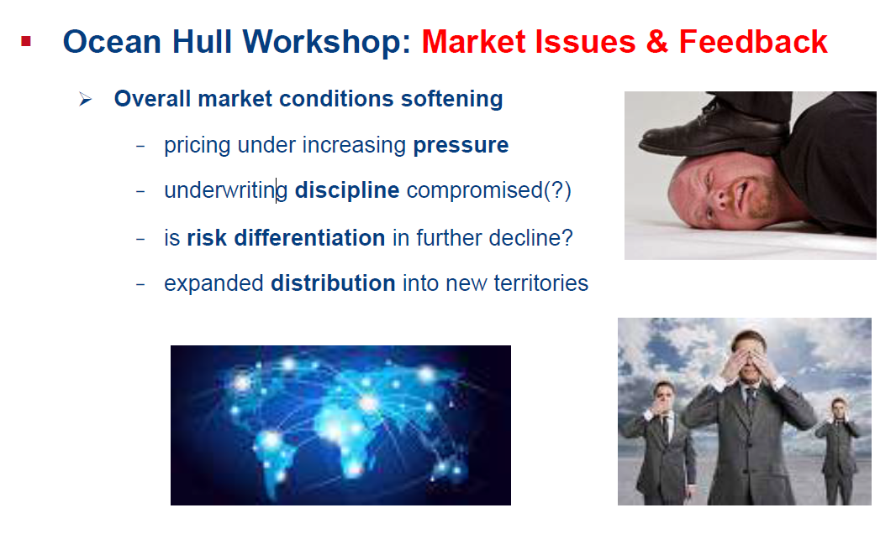
Ocean Hull Workshop

Slide 32
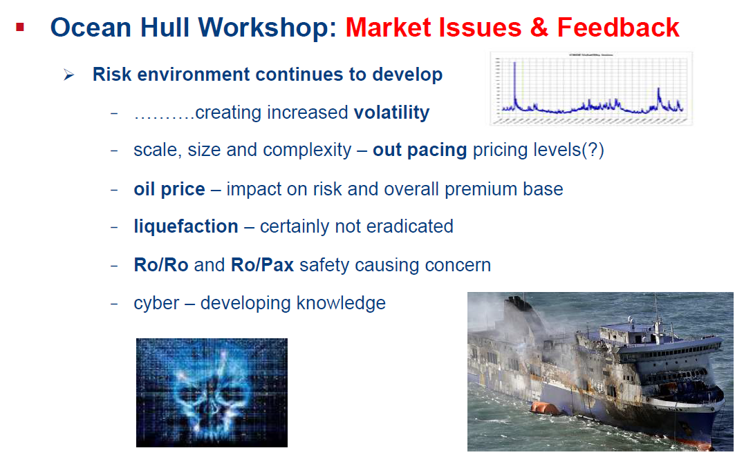
Ocean Hull Workshop

Slide 33
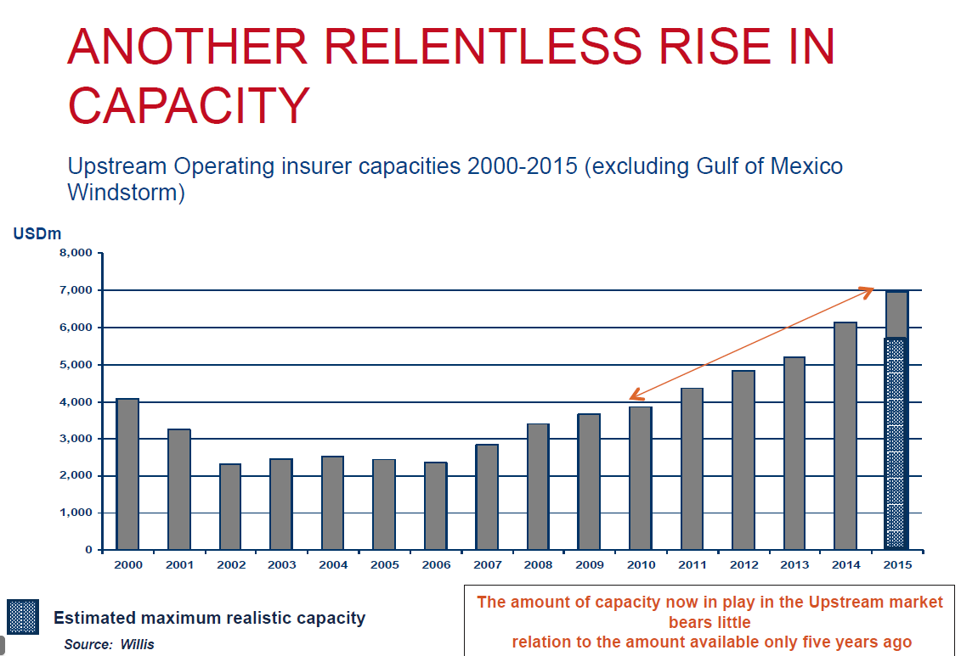
Offshore Energy Workshop

Slide 34
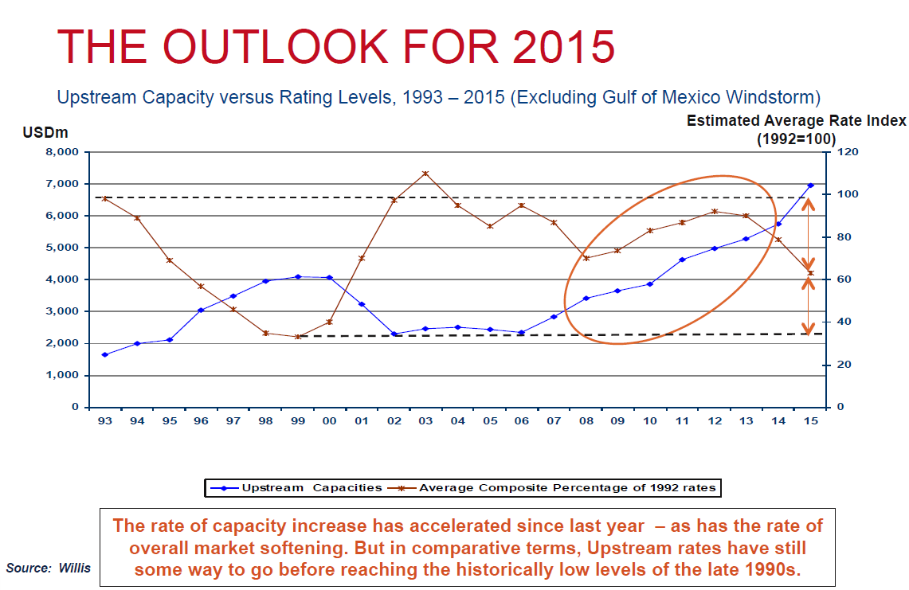
Offshore Energy Workshop

Slide 35
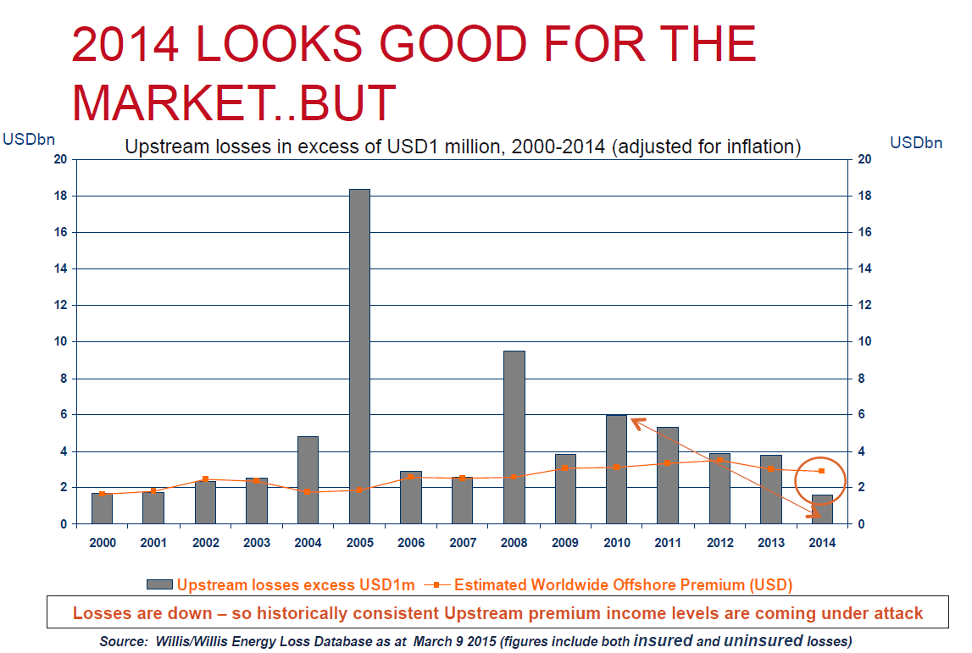
Offshore Energy Workshop

Slide 36
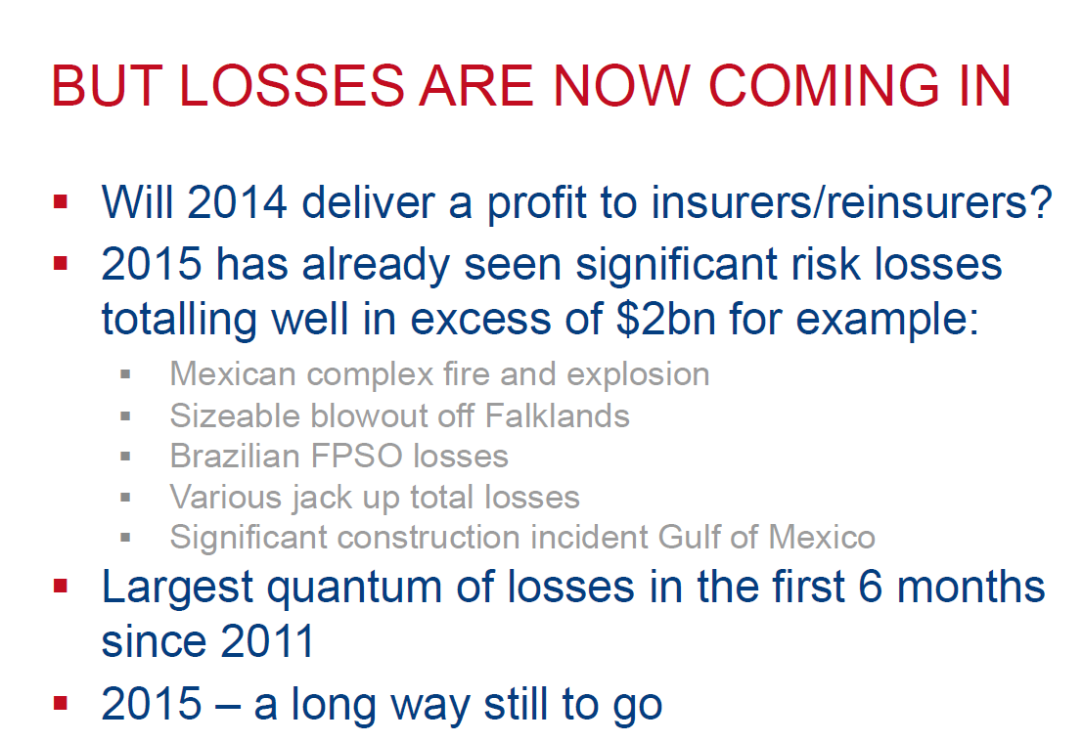
Offshore Energy Workshop

Slide 37
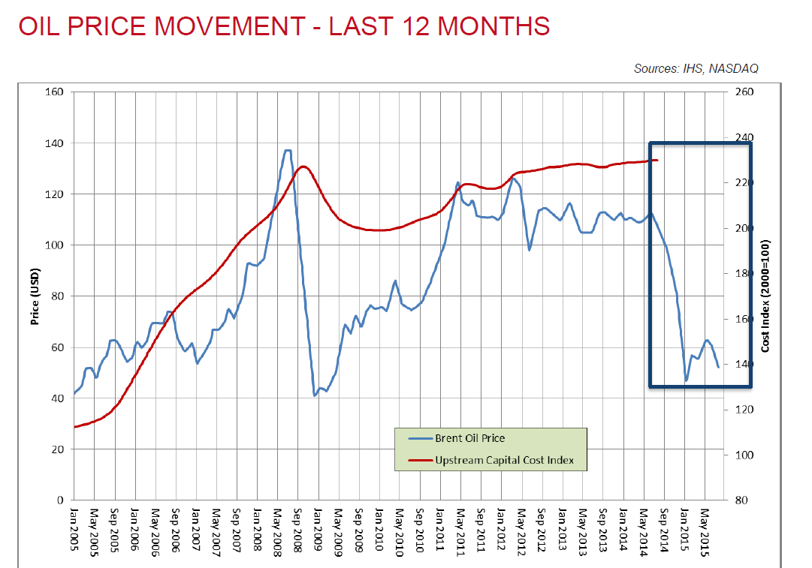
Offshore Energy Workshop Oil Price Volatility – The Impact!
Oil company options to CAPEX reduction:
Future risk when oil prices recover and activities escalate
loss of personal
loss of contractors and fleets
Change in contracting strategy
pass management risk to contractors

Slide 38

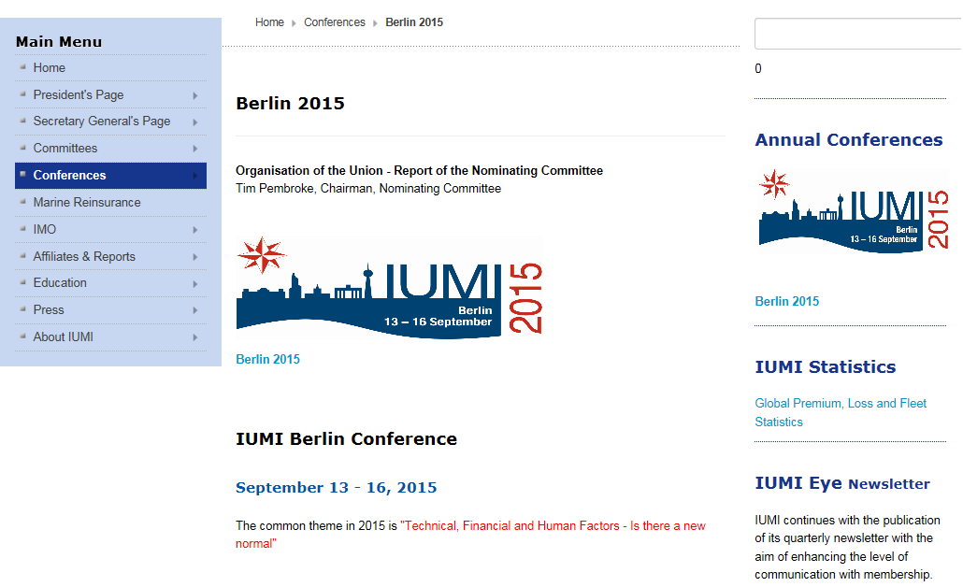
Have a look at the IUMI website:

Slide 39

Thank you for your attention !

