Slide 1
Error 404: H&M Cover Not Found
Rod Johnson, Marine Manager/Alex Davis, Partner

Slide 2
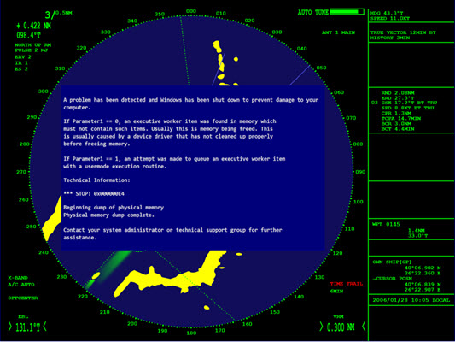
What’s coming up………….
The perceptions and the reality of the risk
How cyber crime, and cyber criminals operate
The consequences of a marine cyber attack
The vulnerabilities of ships to attack
Effective defences

Slide 3
How big and how near is the risk?
Today – it’s foreseeable, and comprehensible but not proximate.
Tomorrow – the risk is real, because of the rate of adoption of communications technology.
A spectacular attack is more likely for energy than shipping today but that will spread as autonomy and automation spread.
No estimate of loss or underwriting risk for hull and machinery, no claims history.

Slide 4
Consequences of cyber crime
Data loss.
Data destruction.
Denial of service.
Damage to systems.
Theft, fraud, misrepresentation.
Uninsured financial loss (reputation, market position, consumer trust, consequential loss).
A cascade of losses across a sector.

Slide 5
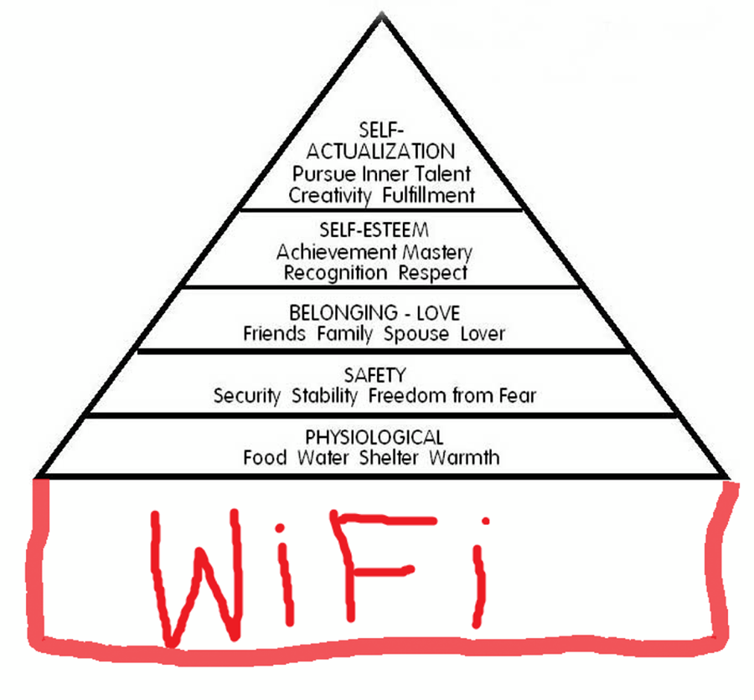
Cyber crime is a people issue

Slide 6
Who are the cyber criminals?
Specialist knowledge
Specialist equipment
Individuals or small groups for hire
Individuals or small groups with a cause
State based operatives
Operating extrajudicially
Feared or revered
Opportunistic
Misaligned motivations and skewed perceptions

Slide 7
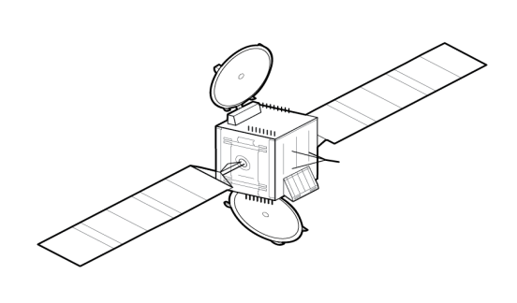







The risk drivers for shipping
Ships increasingly sophisticated.
Multiple connections, different risks.
Social media
Condition monitoring, asset tracking and SCADA.
E Navigation
People
Cascades

Slide 8
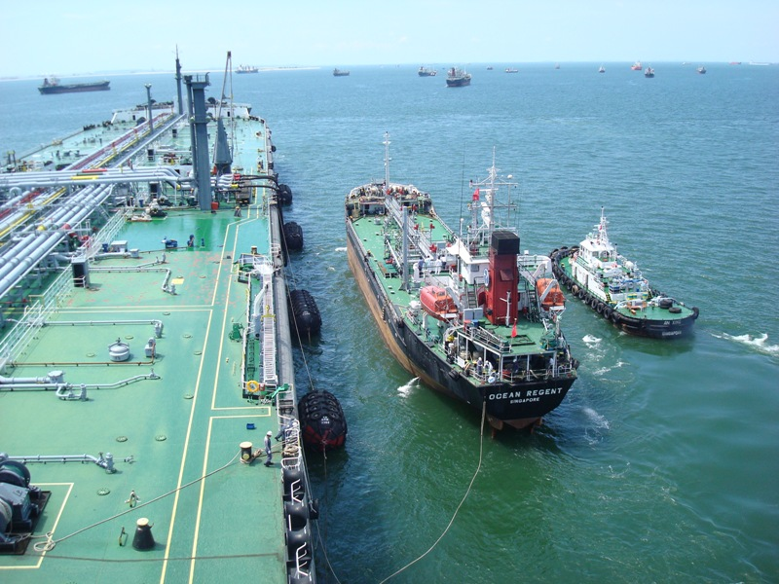
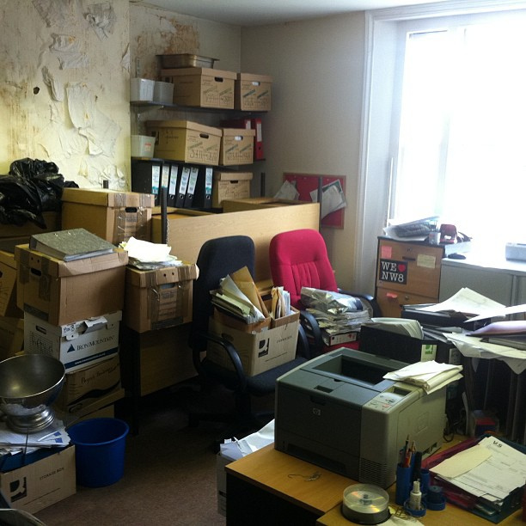
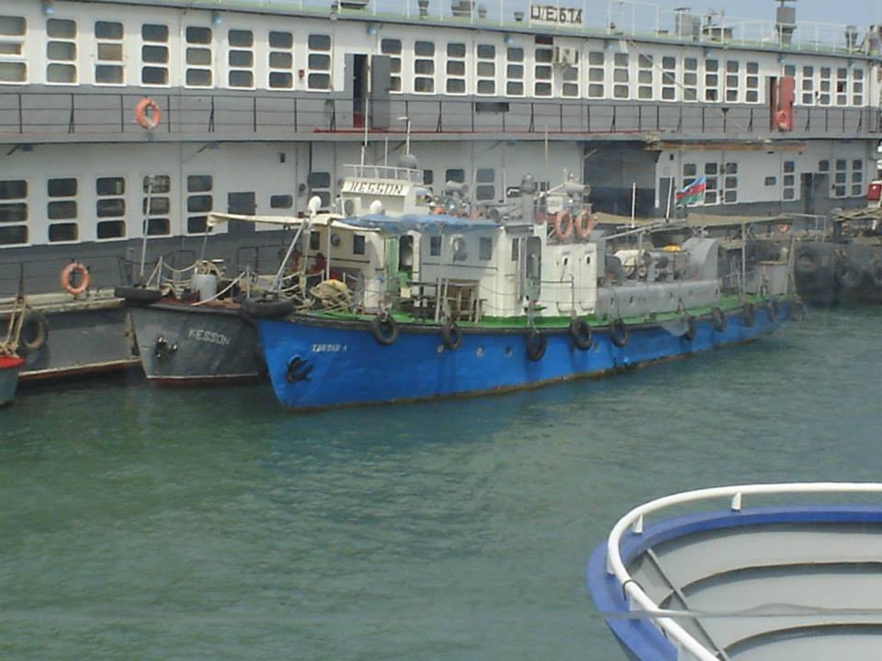

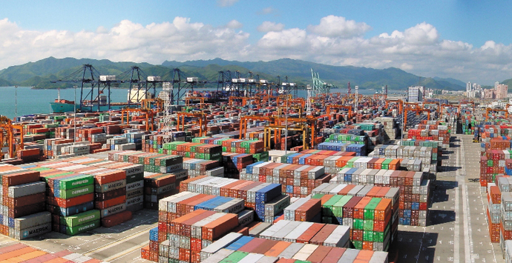
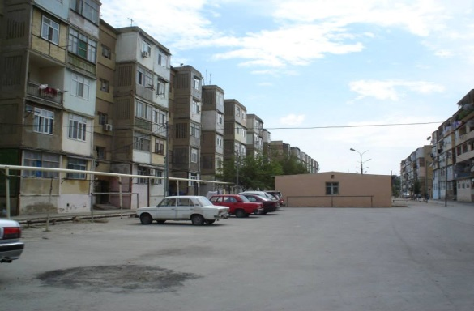
The cascade effect of cyber crime
Freight forwarders
Charterers sub contractors
Sub sub contractors
Your head office
Terminal operators
And who else?

Slide 9
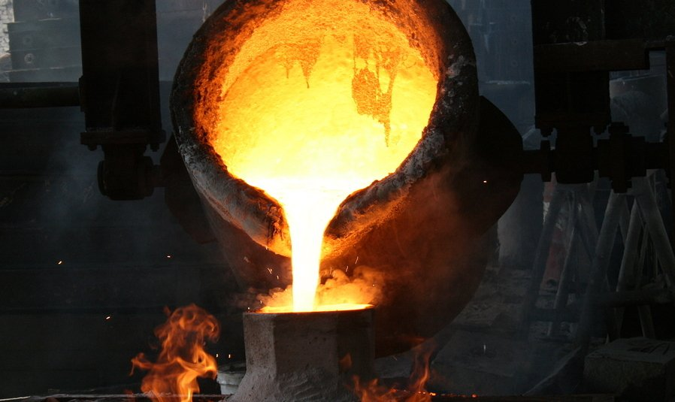
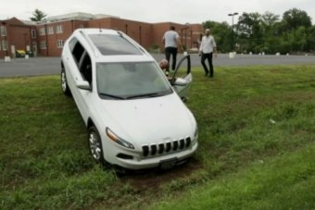

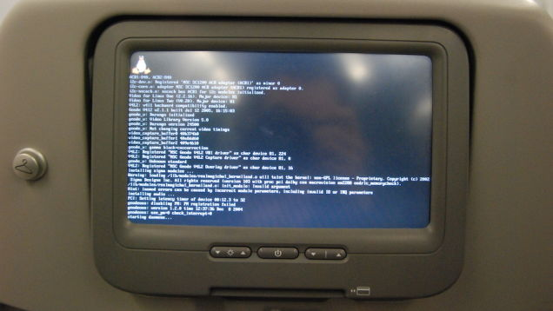
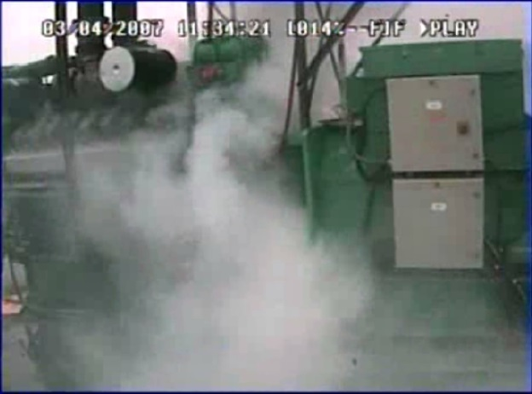
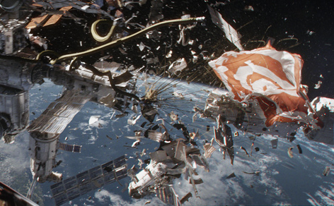
Examples of kinetic cyber attacks
German steel mill, Jeep, pacemakers, airliners, powerplants, the ISS (not really)

Slide 10
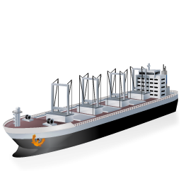
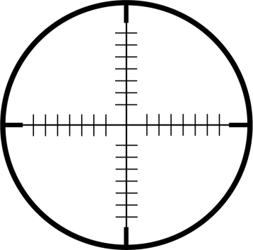


How cyber criminals operate
Reconnaissance – use of OSINT.
Persistence – waiting for a lapse.
Will try to get inside a “secure” perimeter undetected.
Knowledge of the target – required for sabotage.
Insider risk – use of HUMINT, malware, trojans.
Delivery system – files, portable media, breakdowns in security procedures.
Rely on long detection period – could be 140 days.
Rely on jurisdictional boundaries to hide or move proceeds of crime.
Reconnaissance
Identification
Execution

Slide 11
What harm could realistically be done?
Disabling systems
Affecting or controlling systems
Masking the nature of cargo placed on board
Damage to the environment
Damage to equipment or property
Disruption to business continuity

Slide 12
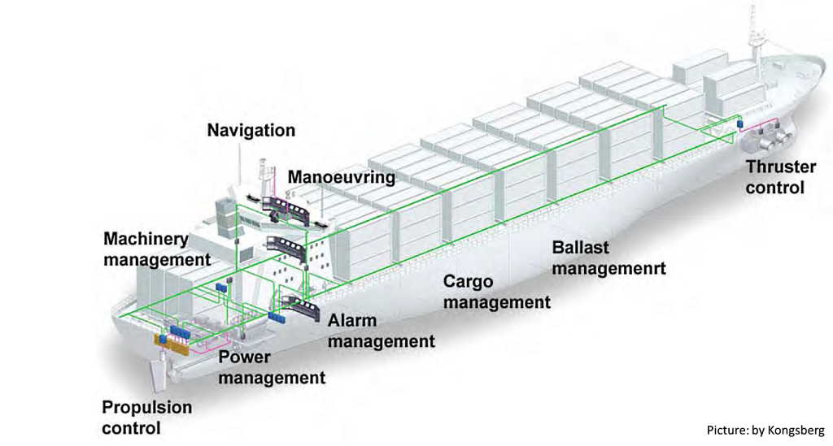
Systems currently amenable to automation

Slide 13












System architecture – near future
VSAT
Fleet BB
WiFi
4G
PC
PC
Below deck unit
4G Router
Modem
Shore WiFi unit
Bridge VLAN
Engine room VLAN
Access controller
WAN controller
Firewall
MAC Bridge
Crew VLAN
Admin VLAN
PC
PC
PC
PC
PC
PC

Slide 14
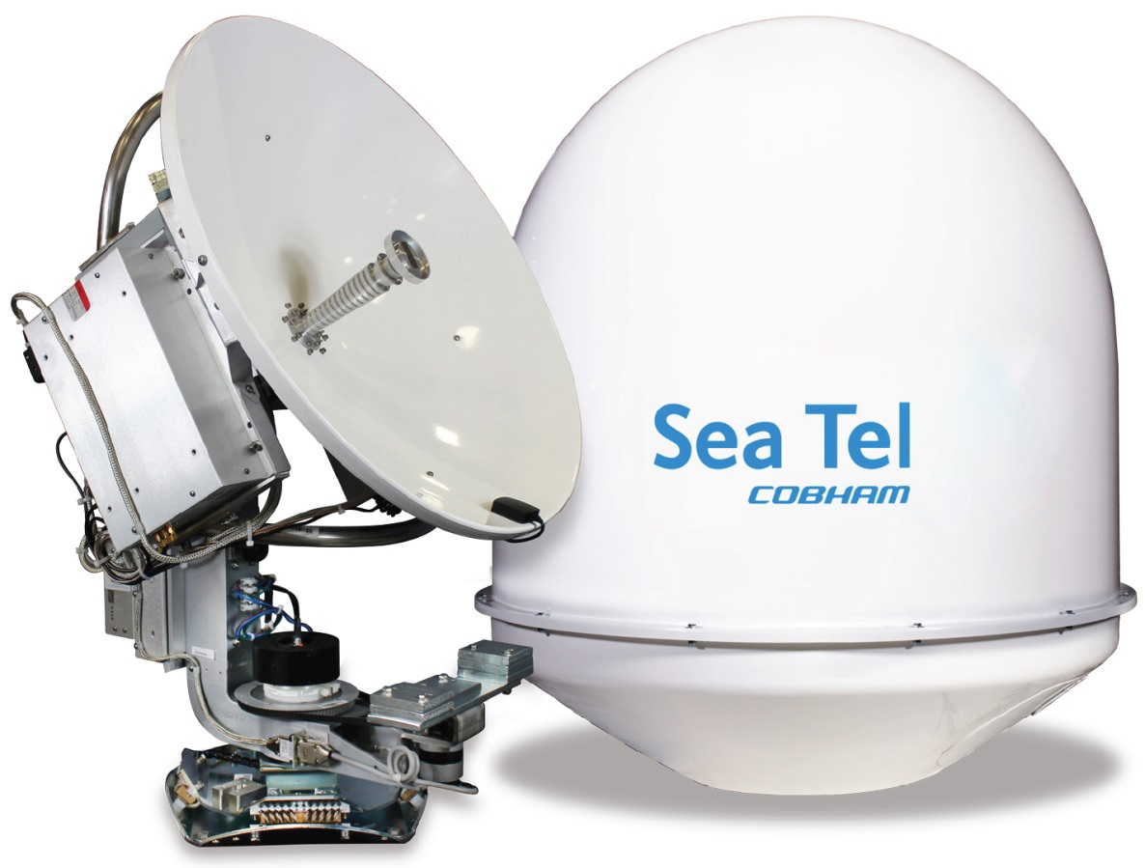
VSAT
A stabilized antenna with a dish smaller than 3 meters. The majority of VSAT antennas range from 75 cm to 1.2 m.
Data rates range from 4 kbit/s up to 4 Mbit/s; some upgraded modules can reach speeds of up to 16 Mbit/s.
Access satellites in geosynchronous orbit.
Transmit/receive narrowband data (point-of-sale transactions, polling or RFID data, SCADA), or broadband data (Internet access, VoIP or video).
Prone to signal degradation in heavy rain.

Slide 15
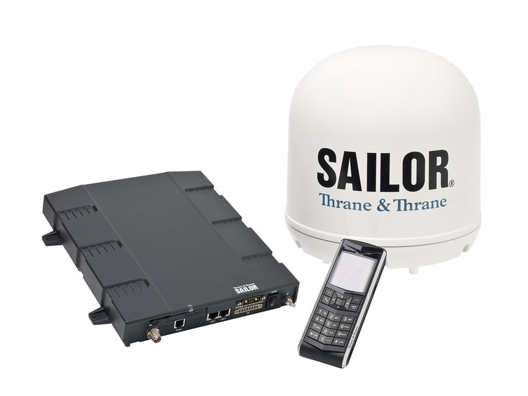
INMARSAT Fleet Broadband
A maritime global internet, telephony, SMS texting and ISDN network capable of up to 432 kbit/s speeds (FB 500) using small dish antenna.
Uses three I-4 geosynchronous satellites.
Reliable in any weather conditions.
An always-on connection for email and internet access, real-time electronic charts and weather reporting.
Up to nine telephone lines for calls to terrestrial and mobile networks.

Slide 16
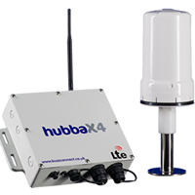
4G and WiFi
4G broadband works over existing mobile networks when in coverage.
Capable of providing up to 100Mbps download speeds, using 4G, 3G and 2G mobile network frequencies with a built-in modem.
Antenna for external mobile broadband. Can create a WiFi hotspot.

Slide 17
Effective defences - technical
Inventory of authorised devices and software.
Secure configurations for hardware and software on mobile devices, laptops, workstations, and servers.
Secure configurations for network devices such as firewalls, routers, and switches.
Malware defences.
Application software security (patch control).
Wireless access control (passwords).
Data recovery capability (disaster recovery).
Limitation and control of network ports, protocols, and services.
Secure network engineering.
Physical security of critical hardware and cable runs.

Slide 18
Effective defences – people and systems
Security skills training appropriate to job description.
Controlled use of administrative privileges and passwords.
Account monitoring and control, including sniffing and white listing.
Physical media controls and policies.
Incident response and management.
Penetration tests and red team exercises.
Continuous vulnerability assessment and remediation.
Links to HR policies and procedures.
Employee vetting.
Access control on board and in the office.
Compliance with external standards ISO 27001/2, NERC 1300, ISA/IEC-62443.
Solid links to ISPS and ISM.

Slide 19
Demonstrating due diligence
Joint Hull Committee 2015/05 Standard
Look at both technical and people defences
Find the links between defences, and understand how they interact
Look for gaps
Get good advice
Don’t lose your way in the Fog of More.

Slide 20
Institute Cyber Attack Exclusion Clause CL380 10/11/03

Slide 21
CL 380
Is it fit for purpose?

Slide 22
Wording – CL 380
1.1
Subject only to clause 1.2 below, in no case shall this insurance cover loss, damage, liability, or expense…
directly or indirectly caused by, or contributed to by, or arising from,…
the use or operation, as a means for inflicting harm, of any computer, computer system, computer software programme, malicious code, computer virus or process or any other electronic system

Slide 23
Wording – CL 380
1.2
Where this clause is endorsed on policies covering risks of war, civil war, revolution, rebellion, insurrection, or civil strife arising therefrom, or any hostile act by or against a belligerent power, or terrorism or any person acting from a political motive, Clause 1.1 shall not operate to exclude losses (which would otherwise be covered) arising from the use of any computer, computer system or computer software programme or any other electronic system in the launch and/or guidance system and/or firing mechanism of any weapon or missile

Slide 24
Analysis
A 2003 wording!
CL 380 is incorporated into the majority of marine, energy and reinsurance insurance policies
Usually by way of habit, rather than specific knowledge
The scope of this exclusion has not been tested in the courts – there is no case law providing guidance on its interpretation
To analyse, need to deconstruct the clause into its constituent parts and construe it on the basis of existing authorities that have dealt with analogous wordings

Slide 25
Analysis
“in no case shall this insurance cover loss, damage, liability, or expense”
Unequivocal language - the exclusion is intended to remove all cover for a cyber-attack
Seemingly leaving the Assured completely uninsured for cyber attack damage

Slide 26
Analysis
“directly or indirectly caused by, or contributed to by, or arising from”
Causation of loss – The standard position is based on the doctrine of proximate cause i.e. the “real” or “dominant” cause. However, parties can displace this assumption if clear words are used
The CL 380 wording displaces this assumption

Slide 27
Analysis
“directly or indirectly caused by, or contributed to by, or arising from”
The courts have interpreted “directly or indirectly” to mean that “a more remote link in the chain of causation is contemplated than the proximate and immediate cause”
However, the chain of causation stops at the point at which the event ceases to be the cause of the loss and becomes an item of history
In summary; even if the cyber-attack indirectly causes the damage, the loss will be excluded in its entirety

Slide 28
Analysis
“directly or indirectly caused by, or contributed to by, or arising from”
“Contributed to” – wording anticipates scenarios where there are competing causes of the loss
The courts may borrow the concept of “material contribution” used in tort – i.e. in the presence of numerous causative events, did the cyber attack materially contribute to the damage? A question of degree. If yes, the loss will not be covered in its entirety
Underwriters are in a very strong position regarding causation, which reflects the Market’s unease and lack of familiarity with cyber risk

Slide 29
Analysis
“the use or operation, as a means for inflicting harm, of any computer, computer system, computer software programme, malicious code, computer virus or process or any other electronic system”
The motive of whoever causes the damage is crucial – malice
What is the burden of proof?
Civil?
Criminal?

Slide 30
Analysis
On this basis, if a virus (even malicious?) is uploaded by mistake, without intention to inflict harm and causes damage, the loss will not be excluded by CL380
Cyber loss, not cyber damage
intention to inflict the particular harm in question or an intention to inflict harm generally?
If the culprit is not identifiable, how do we ascertain his state of mind?
How do we define malicious code?
Considerable uncertainty

Slide 31
Analysis
Doctrine of Contra Proferentem – any ambiguity in the interpretation of CL380 will be construed against the person seeking to rely upon it
Does failure to act as a prudent uninsured help?
Note: underwriters may have a "duty to defend" under the policy in question

Slide 32
Analysis
Bottom line: this segment of the exclusion brings with it considerable uncertainty and therefore litigation risk.
Underwriters may well find themselves in a situation where the exclusion does not work
Not really a surprise; drafted in 2003!
Market nervous about cyber risk
Heads in the sand

Slide 33
Analysis
What is the answer?
Take out the requirement for intent?
Is that what the Market wants?
Need to identify the specific threat to enable Underwriters to make clear what risk they wish to assume and what they wish to exclude.

Slide 34
Analysis
Brokers have proposed Cyber Gap cover
What is needed is a Market-adopted solution:
Identify the threat
Draft a new all-embracing exclusion clause
Encourage assureds to “buy-back” specific cover for specific, identified threats
Currently being considered with the JMCC

Slide 35
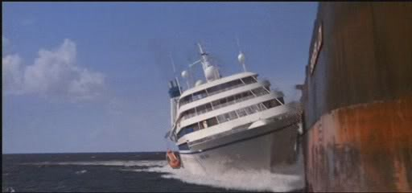
The end. Questions?

