Slide 1

What happens next
An educational comedy in one act

Slide 2

Ships involved
Ship A
Ship B
Bulk carrier
ITC 1/10/83 with ¾ RDC
Deductible USD 100,000
GA Absorption of USD 150,000
International Group P & I entry
LOH (Nordic Plan) USD 12,000/day
Excess 14 days
Bulk carrier
ITC 1/10/83 with ¾ RDC
Deductible USD 100,000
GA Absorption of USD 150,000
International Group P & I entry
No LOH insurance

Slide 3
Vessel A - losses suffered
Physical damage totalling USD 1M
GA USD250,000 (50% ship, 50% cargo)
USD 450,000 in loss of use (30 days @ USD15,000)
Total overall losses for Vessel A – USD 1.7M

Slide 4
Vessel B - losses suffered
Temporary repairs allowable in this case as GA expense and costing USD 60,000
Additional GA expenses of USD 40,000 (of which ship’s share is 60%)
Loss of use USD 80,000 (8 days @USD10,000)
Permanent repairs done at next routine drydocking USD 250,000
Total overall losses USD 430,000

Slide 5
Vessel A position
Hull policy
Physical loss of USD 1M is not all recoverable as part is unrecoverable bottom painting – but USD 980,000 is
Vessel pays USD 125,000 for their 50% share of GA
Total claims USD 1,105,000 less deductible of USD 100,000 – net claim USD 1,005,000
Cargo - USD 125,000 as their share of GA
LOH policy – 30 days less excess of 14 days = USD 192,000 (16 days x USD 12K/day)
USD1,322,000 - total

Slide 6
Vessel A shortfall
USD 100,000 H & M deductible
USD 20,000 - amount not paid by H & M
USD 90,000 shortfall in LOH payout (cover USD 12K/day but hire USD 15K/day)
USD 168,000 – excess period under LOH
USD 378,000 – total

Slide 7

Single liability
Ship A pays ship B USD 215,000
Ship B pays ship A USD 850,000
Net payment is USD 635,000 from Ship B to Ship A
Ship A
Ship B

Slide 8
Vessel A position
Hull policy
Physical loss of USD 1M is not all recoverable as part is unrecoverable bottom painting – but USD 980,000 is
Vessel pays USD 125,000 for their 50% share of GA
Total claims USD 1,105,000 less deductible of USD 100,000 – net claim USD 1,005,000
Cargo - USD 125,000 as their share of GA
LOH policy – 30 days less excess of 14 days = USD 192,000
USD1,322,000 - total

Slide 9
Vessel A shortfall
USD 100,000 H & M deductible
USD 20,000 - amount not paid by H & M
USD 90,000 shortfall in LOH payout (cover USD 12K/day but hire USD 15K/day)
USD 168,000 – excess period under LOH
USD 378,000 – total

Slide 10
Hull insurer recovery
USD 552,500 – being 50% of their USD 1,005,000 original payout
So what happens to the other USD 300,000 ish?

Slide 11
Other recoveries
Shipowners USD 10,000 (50% bottom painting)
Cargo USD 62,500 (50% of their GA)
LOH insurers USD 96,000 (50% of their payout)
Shipowners USD 129,000 (50% of the difference between LOH sum insured and actual hire)

Slide 12
A’s costs
US$80,000 – lawyer’s charges.
US$15,000 – survey fees (wp survey of vessel B).
US$5,000 – Club correspondents charges.
US$100,000 – in total

Slide 13
Categories for allocation
General costs/testing or ascertaining liability.
Recovery.
Defence.

Slide 14
Example split of the lawyers’ costs
Total cost USD 80,000
Split
US$50,000 – testing liability
US$15,000 – recovery
US$15,000 - defence

Slide 15
Testing liability split
Agreed claim of A = US$1,700,000 - ppn of TL costs = $39,906
Add to recovery costs
Agreed claim of B = US$430,000 – ppn of TL costs = $10,094
Add to defence costs
Total USD 50,000

Slide 16
Lawyers costs splits
Recovery = $54,906
Defence = $25,094
$80,000

Slide 17
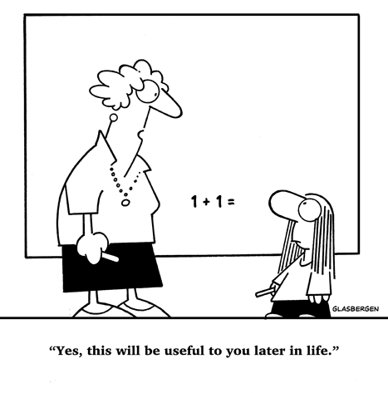
Paul as a schoolboy!

Slide 18
Thank you!

