Slide 1

Playing by the Local Rules
Ben Macfarlane (www.finnross.com)
Clark Zhou (www.yatsonlaw.com)

Slide 2

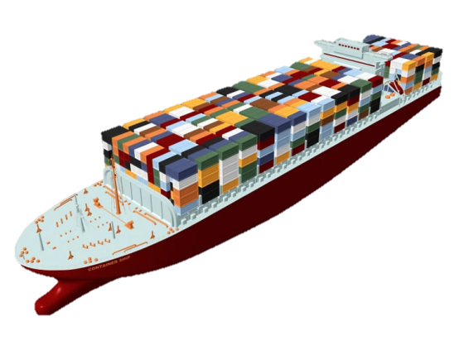
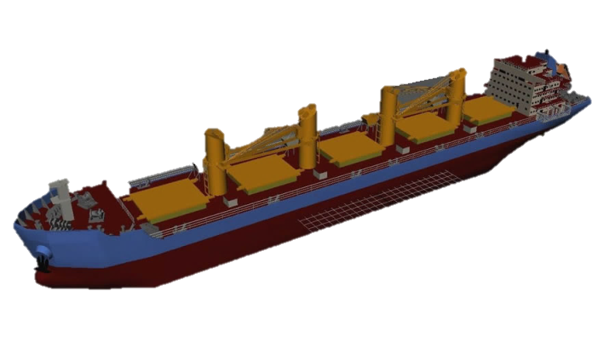
Ship Collision in the South China seas

Slide 3
The Scenarios
There is a collision between MV” Hong Kong” (16,200 T) and MV
“Guangzhou” (35,000T) in the South China Seas in Chinese
territorial waters
Each vessel was 50% to blame for the collision
The P and I Clubs for both vessels are English. Both vessels are
registered in Panama

Slide 4
The Scenarios
The MV Hong Kong Loss or Claims Bill:
1.Vessel damage: USD 5M
2.Hire: USD 2M
3.Cargo damage: USD 10M
4.Coastguard Salvage & Clean-Up: USD 10M
2.Each vessel was 50% to blame for the collision.
TOTAL: USD 27M

Slide 5
The Scenarios
MV Guangzhou Loss or Claims Bill:
1.Vessel damage: USD 8M
2.Hire: USD 5M
3.Cargo damage: USD 16M
TOTAL: USD 29M

Slide 6
The Scenarios
In one scenario the parties agree to litigate in England. In the other, the Guangzhou is arrested at her next port of call in China and the proceedings begin in China

Slide 7


ENGLAND
CHINA

Slide 8
The Questions
What is the time limit for bringing these claims both in England and China?

Slide 9
The Questions
Can that limit be extended by agreement?

Slide 10
The Questions
How do you stop the time limit from running (by issuing or serving the Claim Form)?

Slide 11
The Questions
How is the limitation of liability (Ship’s Limitation) calculated both under English and Chinese law?
China: 167,000 SDR (300 to 500T)
167 SDR (501 to 30k T)
125 SDR (30,001 to 70k T)
83 SDR (70,001 T Up)
England: Post 8.06.2015
1,510,000 SDR (up to 2k T)
604 SDR (2001 to 30k T)
453 SDR (30,001 to 70k T)
302 SDR (70,001 T Up)

Slide 12
The Questions
If Coast Guard claims MV Hong Kong for salvage and clean-up costs, MV Hong Kong cannot limit liability, but when MV Hong Kong takes recovery claim against MV Guangzhou, MV Guangzhou can limit liability
China: Yes
England: Yes

Slide 13
The Questions
Where there are cross-claims as in this case, how are they calculated and at what stage is limitation applied?
China: (1) Calculate total loss (27m+29m= 56m)
(2) Each Party’s share of Liability = 50% = 28m
(3) Deduct loss from Liability= “HK”: 28m-27m=1m
“GZ”: 28m-29m=-1m
(4) “HK” Pays 1m “GZ” receives 1m
(5) Apply Ship’s Limitation for the “HK” to the balance (1m)
England: Same

Slide 14
The Questions
Can I engage a lawyer for this case, on “no cure no pay” or “contingency fee” in England v. in China?

Slide 15
The Questions
What law will be applied to Collisions in England and China?
China: Normally law of place of collision but if both from same flag state then
law of flag state
England: Normally law of place of tort (China) but in this case English law
would normally be agreed with English Jurisdiction. Hence the 1910
Collision Regulations would apply

Slide 16
The Questions
How will the evidence be presented in England and China? Does particular evidence hold greater weight with the Court? What about expert evidence?

Slide 17
The Questions
Cultural aspects of managing the cases in England and China, how do they differ?

Slide 18
The Questions
Assuming no security has been given but that there are assets of the paying party either in England or China, how easy will it be to enforce an English Judgment in China or a Chinese Judgment in England?

Slide 19
Thank You
General guidance only. Seek legal opinion when issue arises

