Slide 1

Chairman’s opening remarks
Keith Jones

Slide 2
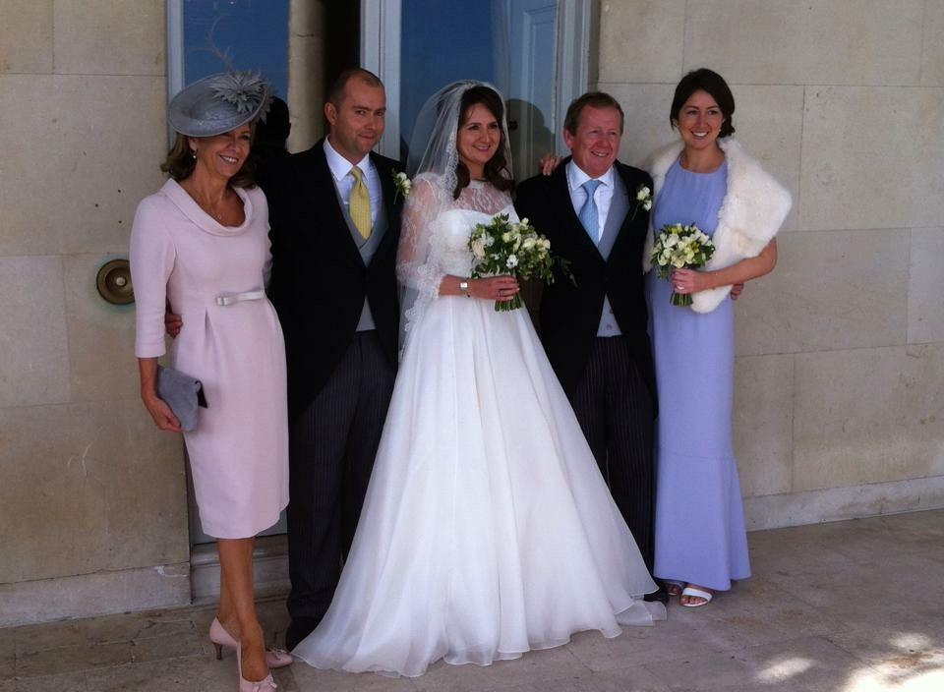

Slide 3
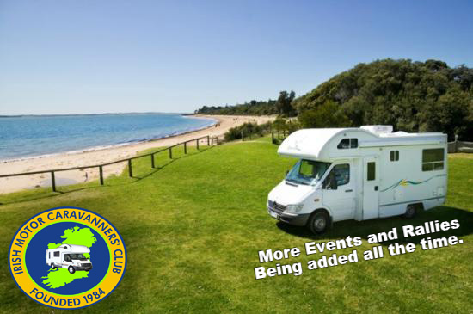
Welcome to IMCC : The Irish Motor Caravanners’ Club

Slide 4








































IMCC 2015 : THANK YOU TO ALL OUR SPONSORS

Slide 5
Strategy Group
Ann Waite AW Marine and Organiser Charlotte Warr Sarnia Training and Organiser Keith Jones IMCC Chair Deirdre Littlefield Past Chair Andrea Papaioannu Swiss Re Corporate Solutions and representing Italian Market Andrew Bardot International Group of P&I Clubs David Pusiak Catlin and representing London Lloyd's Market Eileen Fellin XL Group and representing US Market Frédéric Denèfle CESAM Johan Kahlmeter The Swedish Club and representing Cefor Market John Mace International Group of P&I Clubs Lars Lange IUMI Secretary General Massimo Canepa IUMI Paul Warren Allianz Global Corporate & Specialty and representing London Company Market Viggo Kristensen Cefor Tom Upton Markel and representing IMCC U35s subcommittee

Slide 6
Special guests
Dieter Berg – President of IUMI
Dieter Schwampe – President German Maritime law Association
Andrew Paton – Chairman of AAA
Jonathan Spencer – President of AMD

Slide 7
2015 U35s winner
Felipe Garcia – Swiss Re

Slide 8
Argentina
Australia
Barbados
Canada
Colombia
Denmark
Finland
Germany
Greece
Hong Kong
Italy
Norway
Poland
Singapore
South Africa
Spain
Holland
Sweden
Switzerland
Turkey
United Arab Emirates
UK
USA

