Slide 1

“The future starts today, not tomorrow”
FUTURE
Next exit

Slide 2
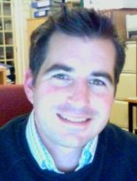
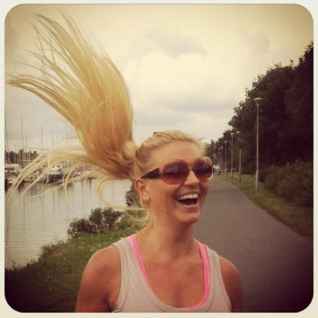
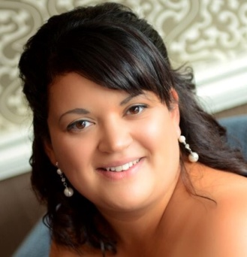
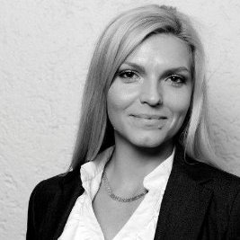
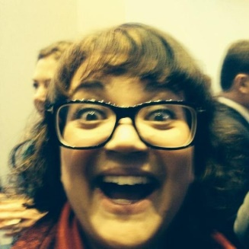
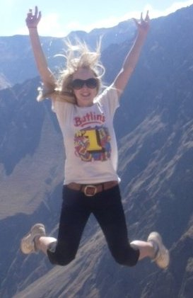
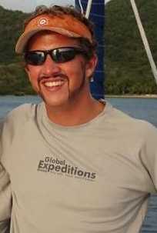
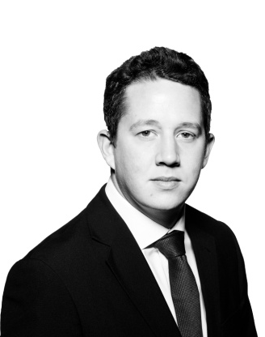
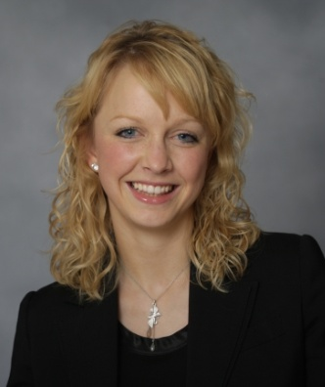
The Panel
How we see ourselves….
How you may see us…
Laura Borz
Norwegian Hull Club
Donna Edwards
Howden Group
Tristan Miller
Harvey Ashby
Thomas Upton
Hiscox Underwriting Ltd.
Elle Young
Ince & Co.

Slide 3
How would you describe the younger generation?
Does new talent need to be attracted to the market?

Slide 4
How can talent continue to be attracted to the market?

Slide 5
Should a degree be a requirement?
Should more apprenticeship schemes be run?

Slide 6
What is the future of Marine Claims?

Slide 7
Are you inspired to stay in Marine Insurance?

Slide 8
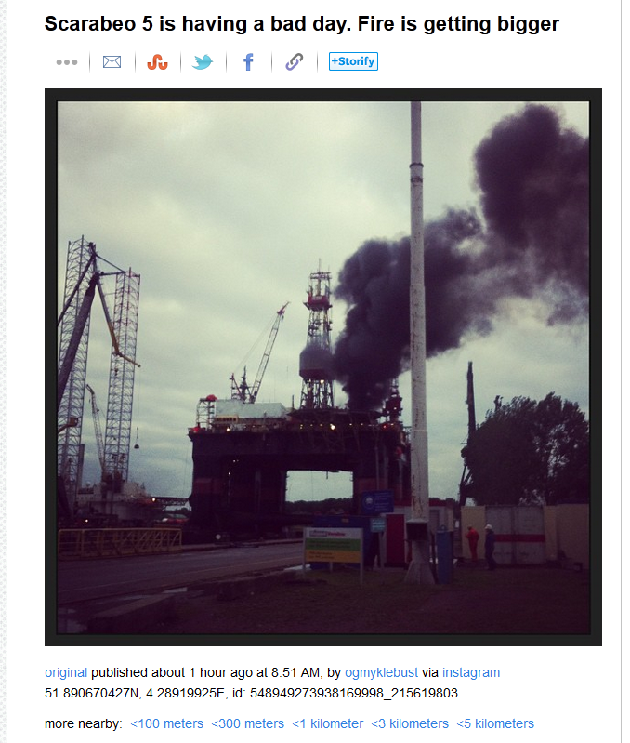
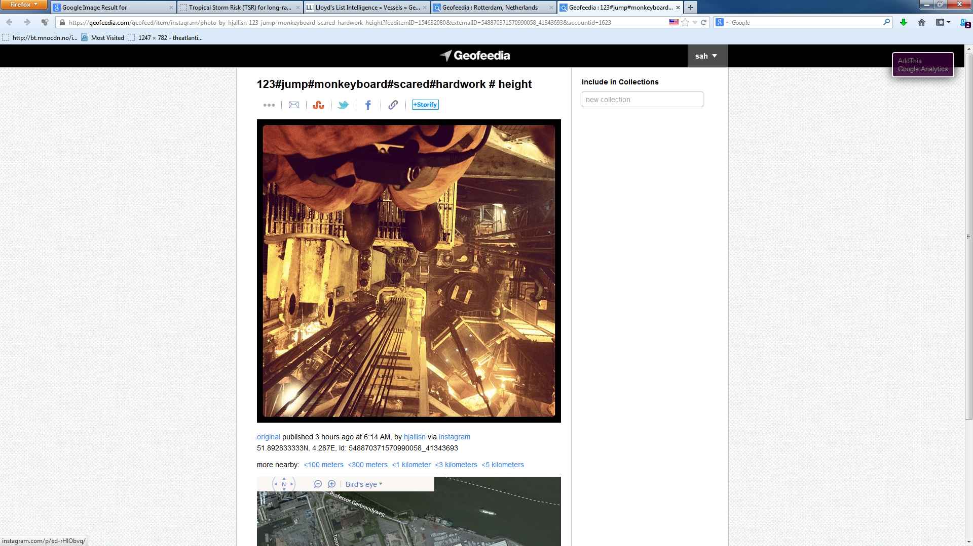
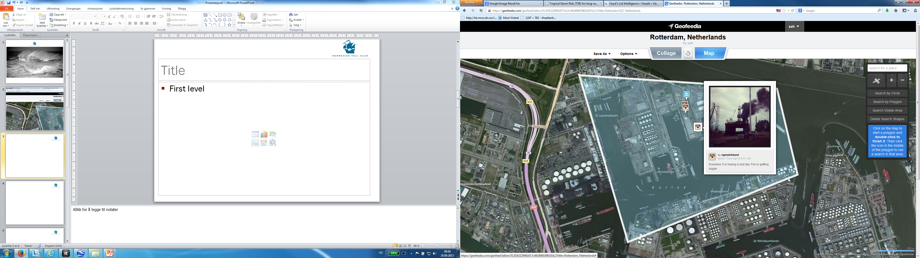
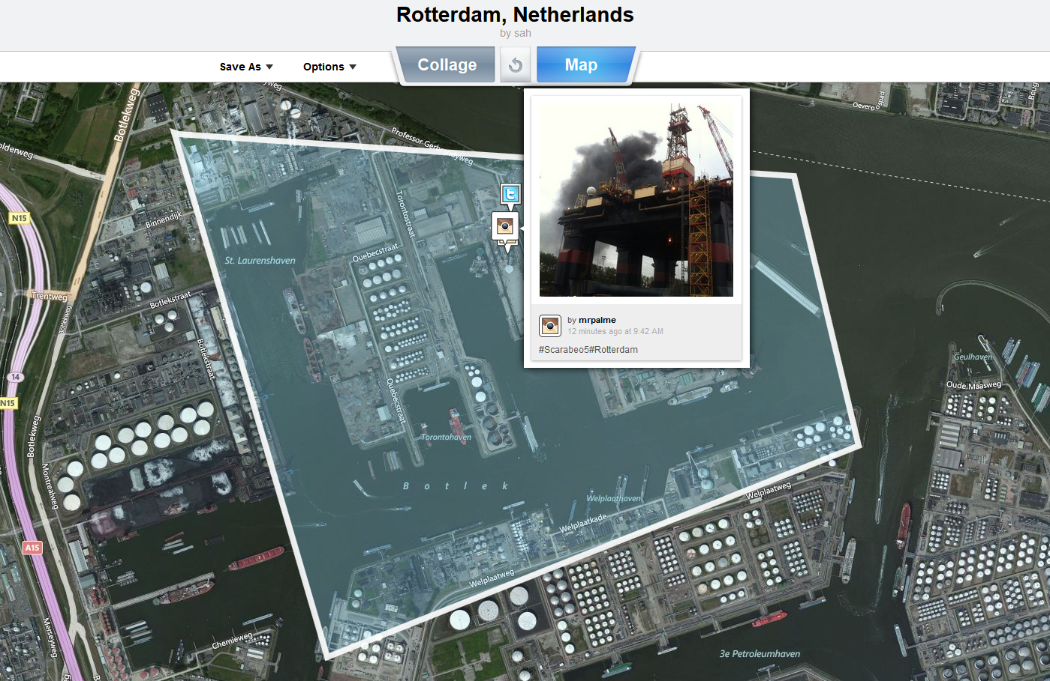
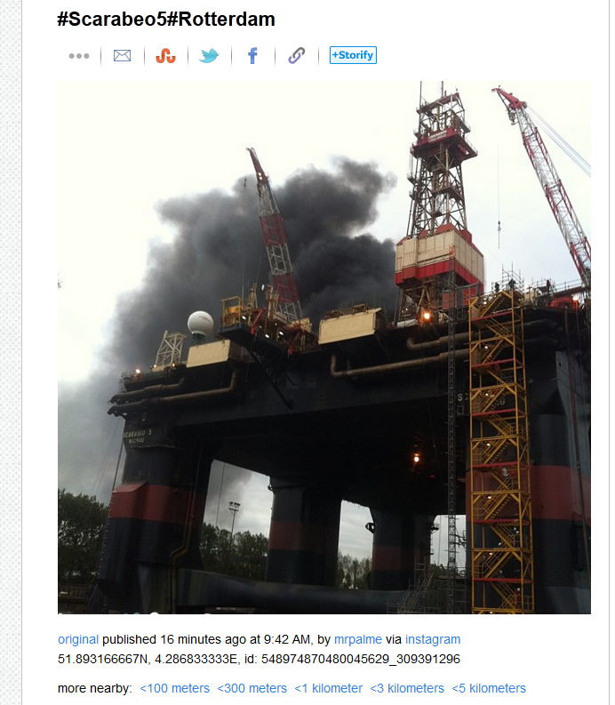
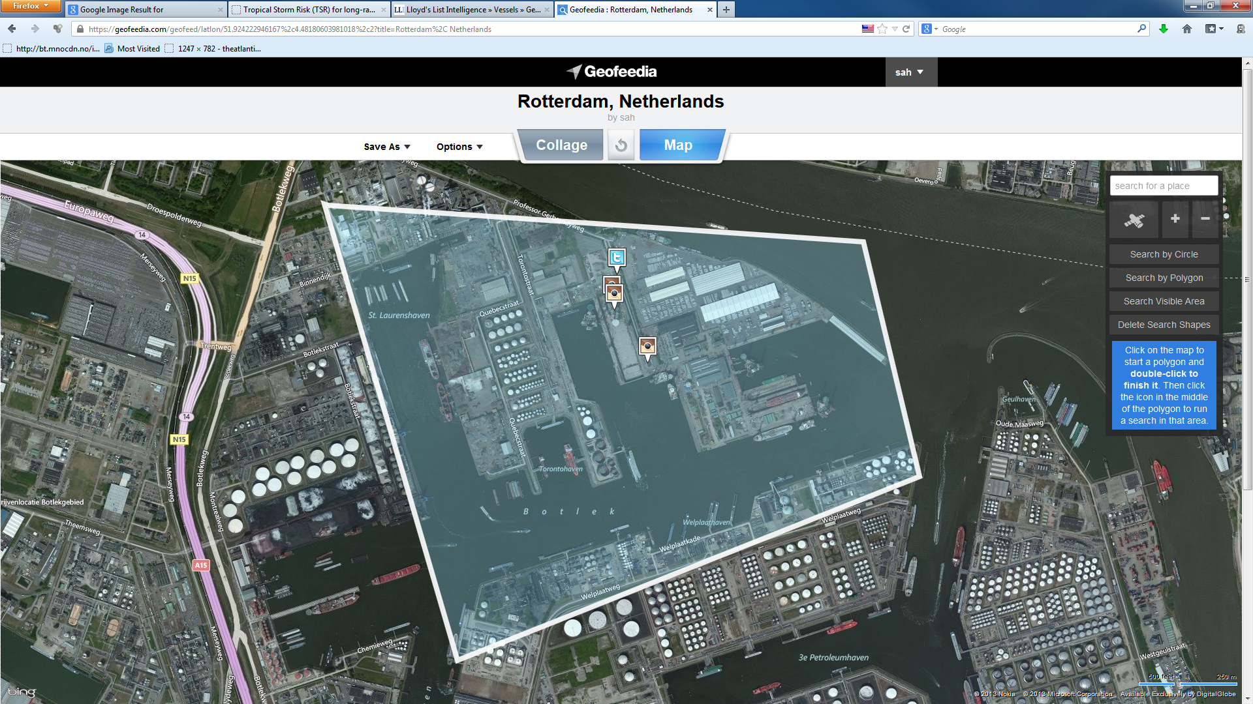
What is the future of marine claims?
Missing Crew Member Detected...
Scarabeo 5 fire after 5 minutes...

Slide 9
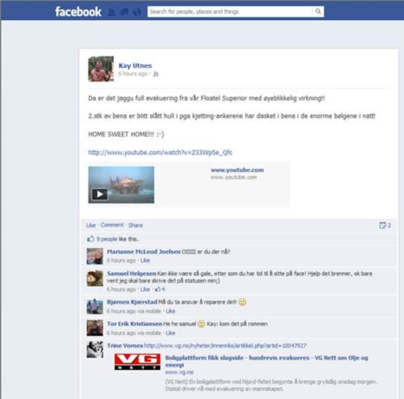
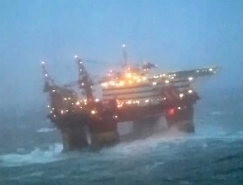
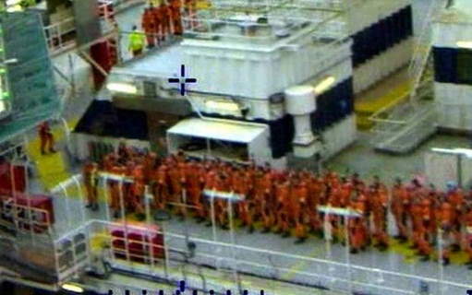
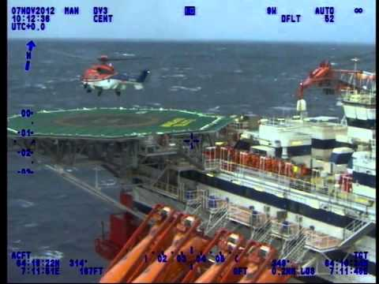
Evacuation of Semi sub.

Slide 10
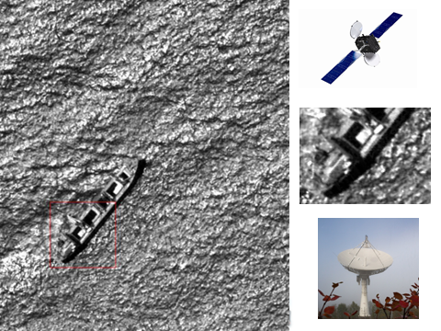
Using SATs for images of Hi-Jacked vessel in Gulf of Guinea

Slide 11
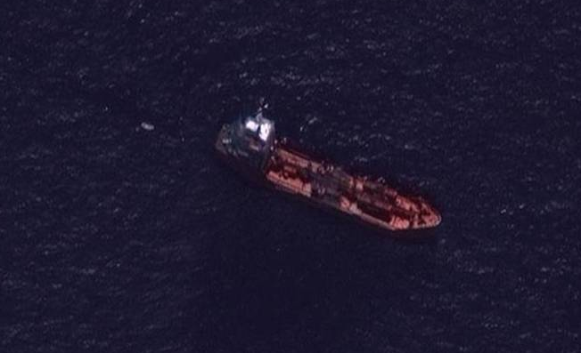
Using SATs for images of Hijacked vessel in Indian Ocean

Slide 12
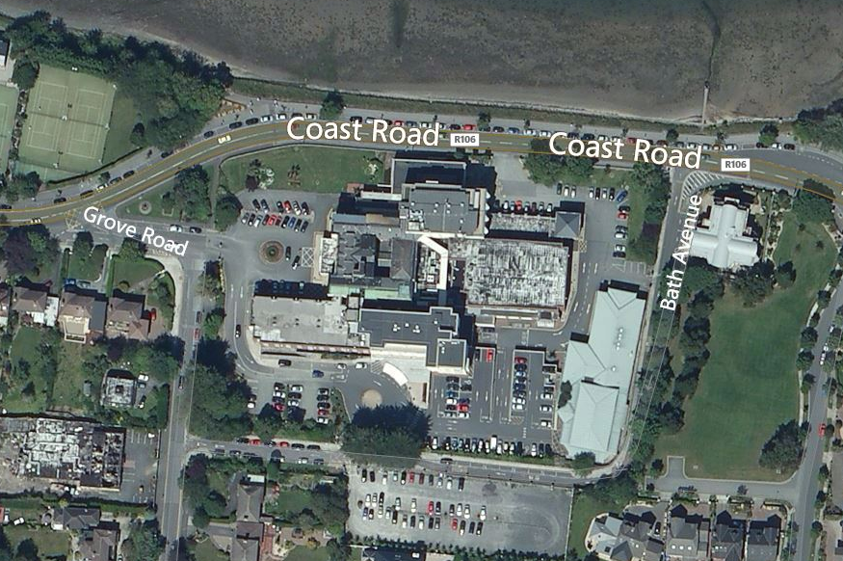
Does it look familiar…….?

Slide 13
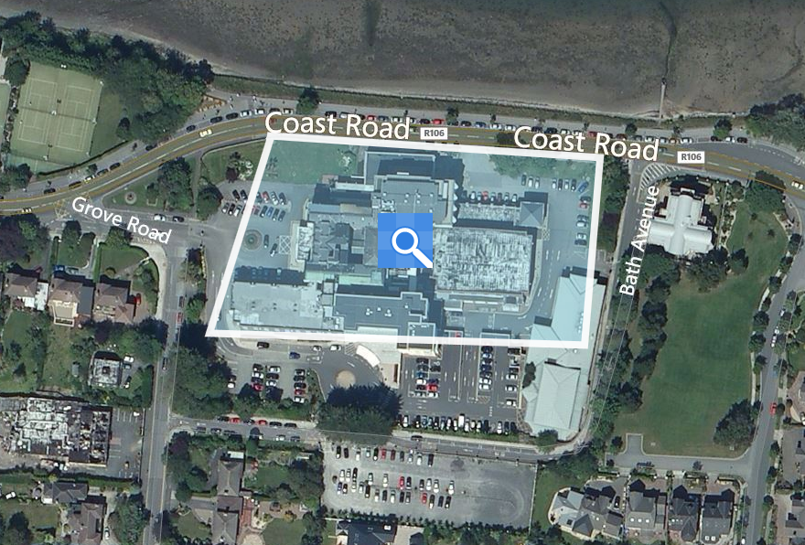
Are you starting to sweat…….?

Slide 14
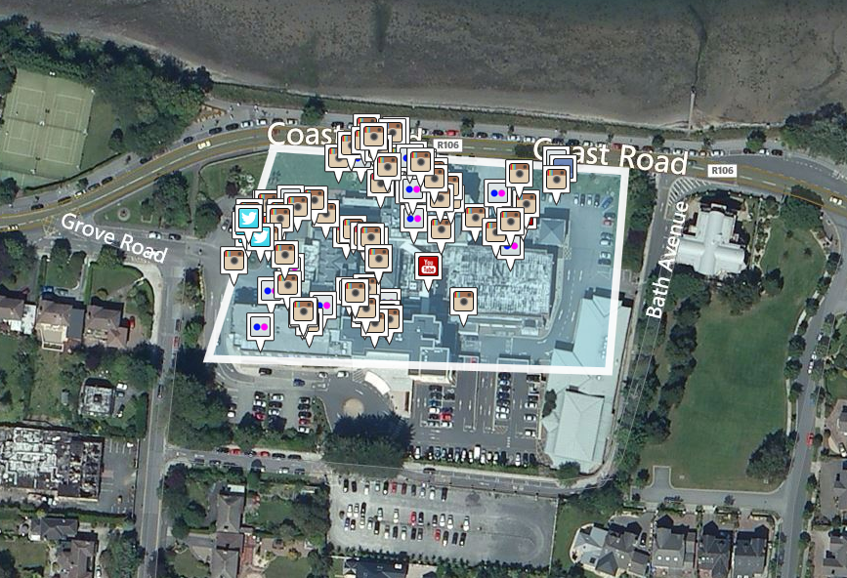
Are you still sitting comfortably…….?

Slide 15
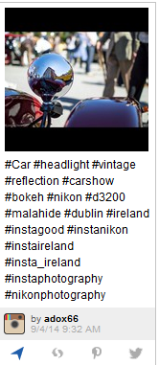
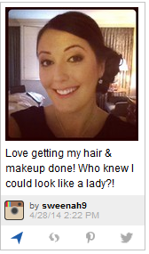
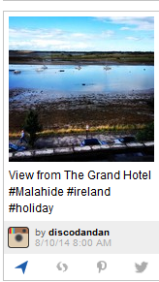
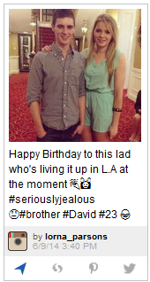
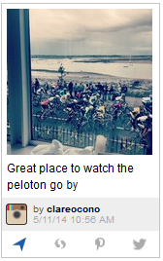
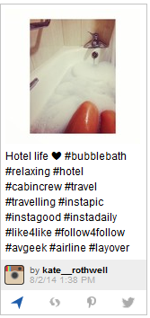
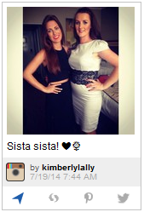
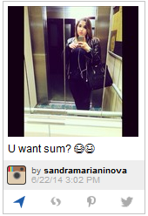
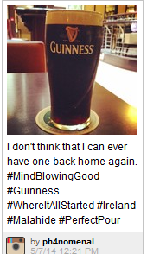
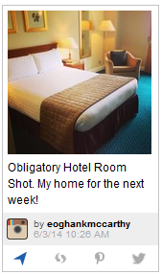
Breathe out c;

Slide 16
Where is the future for marine claims?
  Geographical regions

Slide 17
Is there sufficient training available?

Slide 18
Which is more important; Experience or Ability?
Is there sufficient budget for training and courses?

Slide 19
How can the older generation help?

Slide 20
Are you now more inspired to help and motivate the younger generation?

