Slide 1
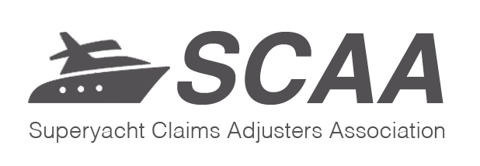

Superyacht Claims Adjusters Association
The Same, but different

Slide 2
Why needed
Yacht business becoming more mature
Customer base completely different from commercial hull business
Desire to develop best practice in the claims arena worldwide

Slide 3
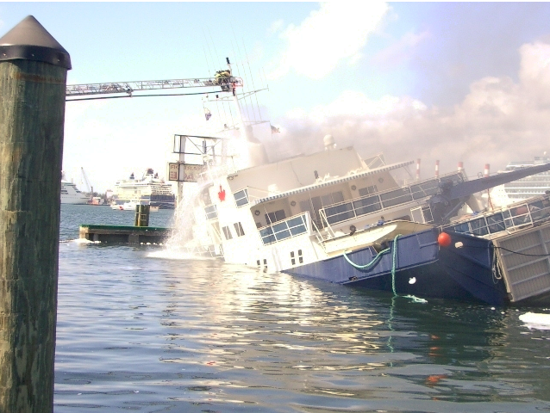

Slide 4
Story so far
Initial working group set up
Representing London and Nordic markets
Together with some experts
Potential interest list drawn up to circulate gauging interest
First general meeting set for Oct 2014

Slide 5
Executive committee
Morten Jacobson – Norwegian Hull Club
Alison Shreeves – Amlin
Jamie Gardiner - Ace
Kevin Allmond – Brit
Ben Lind – AIG
Damien Murtagh – RSA
Charlotte Warr – Sarnia Training
Simon Langridge
Paul Marks – Travelers
Nick Smith – Charles Taylor Adjusting

Slide 6
Areas of focus
Insurance and Interpretation
Technical and Research
Training
Promotion

Slide 7
So what?
Get involved
Membership is for those adjusting yacht claims – either in insurers or under delegated authority
Affiliate membership for service providers/brokers etc.
Current membership stands at approximately 140

Slide 8
Next Steps
Work moving forward on training ideas
Making sure all interested parties are on the mailing list – send CJW a note if you want to be added
Looking at options for best practice documents that work for the business!
Forging links with other bodies
AAA, IMCC, Superyacht Association etc

