Slide 1
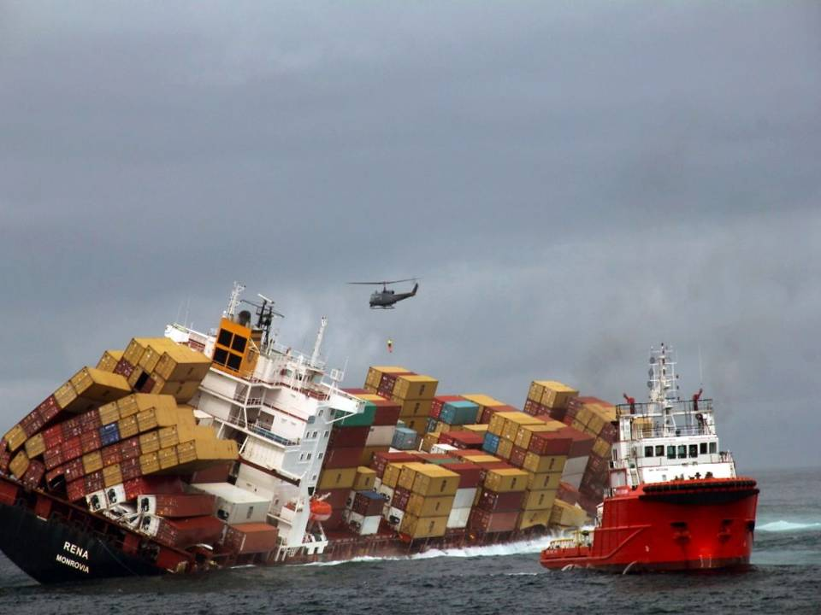
Claims Reserving
Brian Sales – CNA
Graeme Temple – Braemar Salvage Association
Neil Hawkins – JLT Energy & Marine Claims
Paul Warren – Allianz
Jonathan O’Hara – Aspen Insurance
IMCC 2014

Slide 2
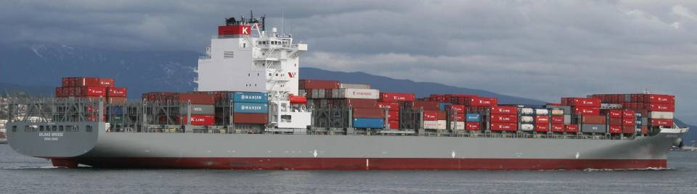
IMCC 2014
Claims Reserving
Who, What, Where, When, Why and How
Brian J. Sales
Assistant Vice President
CNA - Marine
Notes:
2

Slide 3
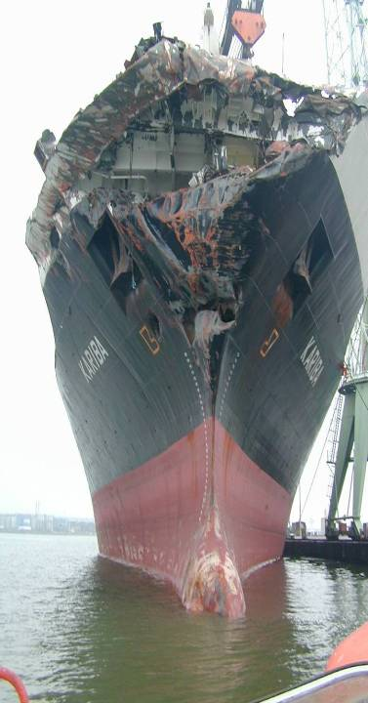
WHO?
Who uses reserves?
Underwriters
Brokers
Corporate Management
Finance
Actuaries

Slide 4
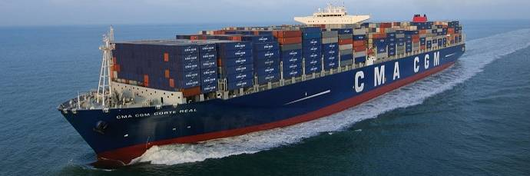
WHAT?
What makes up a reserve?
Loss/Physical Damage
Liability
Sue & Labor costs
Salvage costs and expenses
Legal Fees
Experts
Miscellaneous Expenses

Slide 5
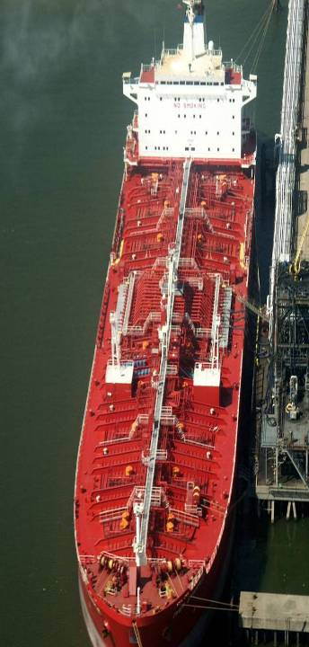
WHERE?
Where does the information come from?
Assured
Broker
Surveyor
Repair Yard
Average Adjuster
Attorney

Slide 6
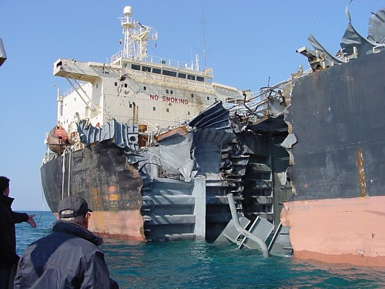
WHEN?
When Should the reserve be set up?

Slide 7
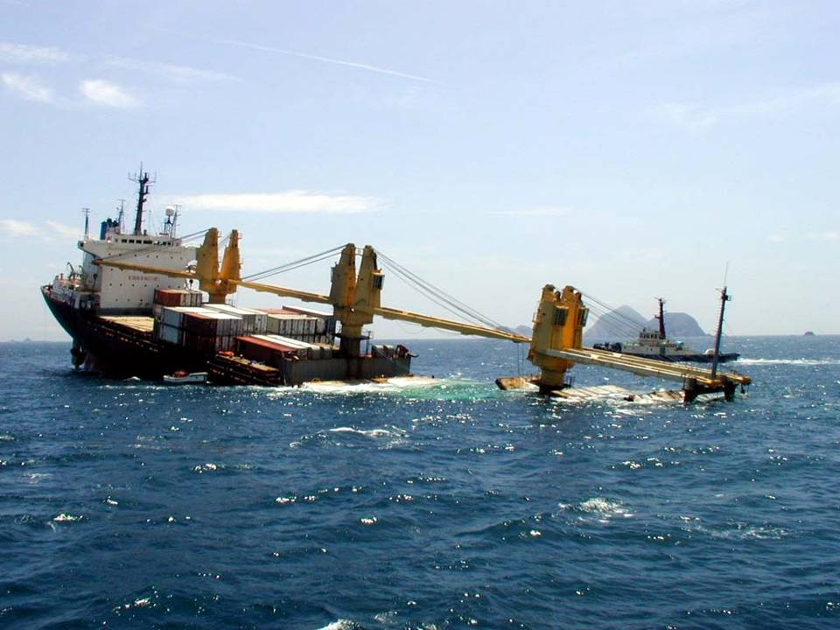
? Audience Questions 1 & 2

Slide 8
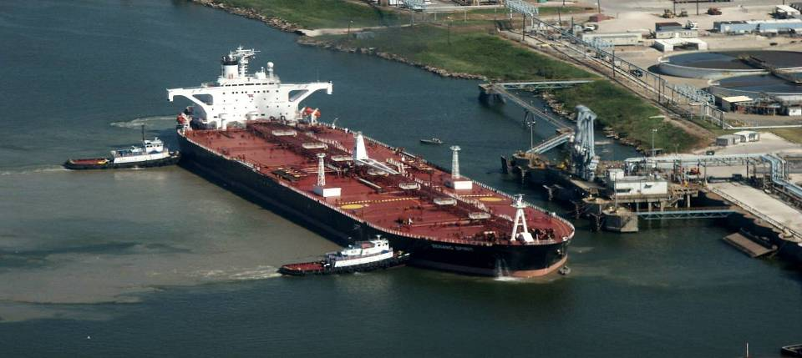
WHY?
Why do we need them?
Why is an accurate reserve important?

Slide 9
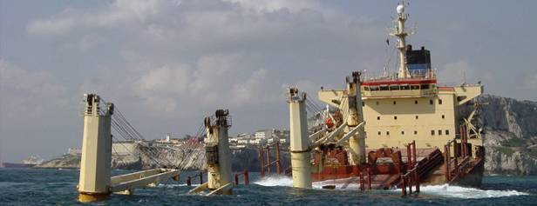
Reserving its all about the numbers.

Slide 10
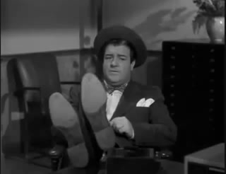

Slide 11
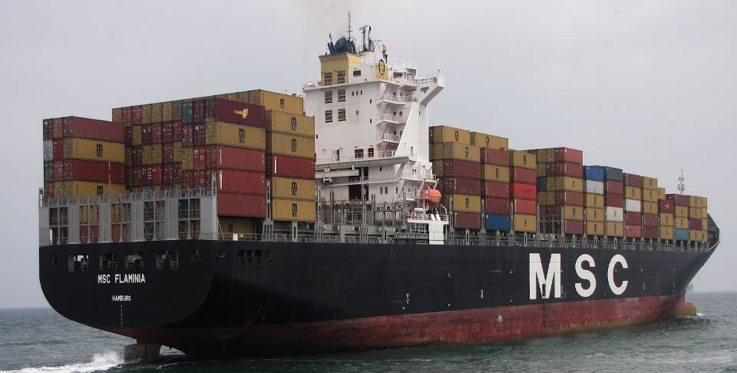
HOW?
So how do we go about setting up a proper reserve?

Slide 12
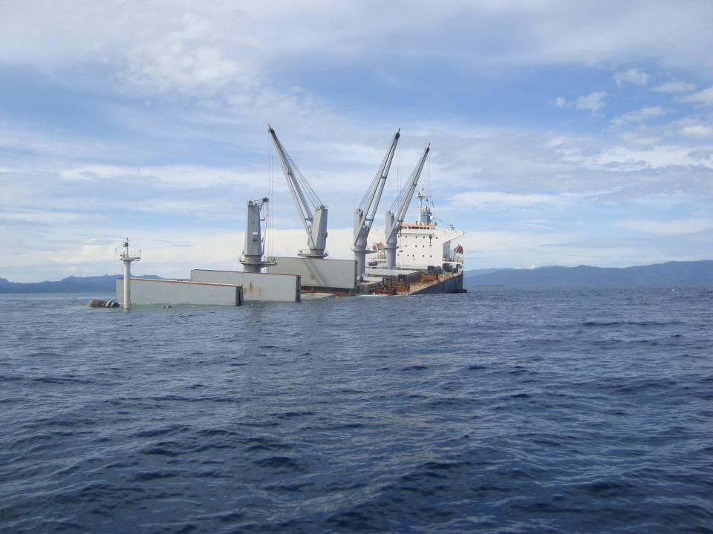

IMCC – Dublin 2014
Claim Reserving
The Surveyor’s Perspective
Graeme Temple – Braemar Salvage Association
Regional Director

Slide 13
Challenges for Owners after Casualty
In the aftermath casualty the Owners are faced with a number of pressures which impact on estimated repair cost and the Underwriter’s reserve:
Commercial pressures and slim profit margins – get the vessel back in operation
Variance in the quality of repairs from place to place – Owners want a good quality repair
Often geographically difficult or remote locations and restricted repair options
Local Authorities imposing costly restrictions (towage, pollution, repair) vessel is often unwelcome

Slide 14
Challenges for Owners after Casualty
In the aftermath casualty the Owners are faced with a number of pressures which impact on estimated repair cost and the Underwriter’s reserve:
Local cultural variances and facilitation for expediting services – vessel as good as held hostage
Conforming to Class requirements and keeping cost proportionate with casualty damage
Availability of large critical spares – OEM components often have to be made and not “off the shelf”
OEMs imposing costly repair options especially for maintaining warranty if applicable.

Slide 15
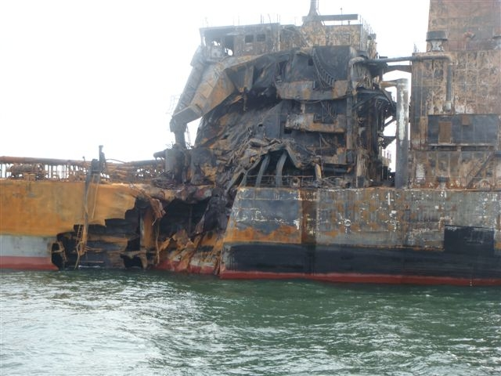

Demands of a Surveyor - Beginning

Slide 16

Demands of a Surveyor - Beginning
Report accurate cost estimate within 24 to 48 hours if at all possible
Estimate too high the Owner may be tempted to make the repair fit the estimate (often the Owner gets the reports)
Estimate too low the Underwriter’s Reserve may later escalate and they are not happy either.
Insurer
Adjuster
Surveyor
Assured
Broker

Slide 17
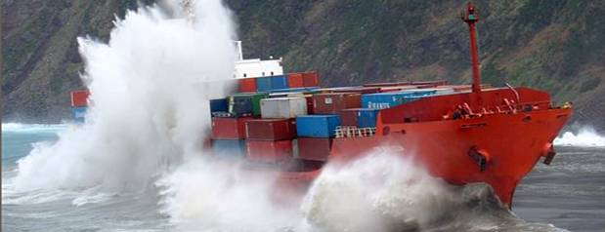
Demands of a Surveyor - Subsequent
Further damage is often discovered during close up inspection after the first inspection (especially machinery)
Important to update the Underwriter of any subsequent cost changes early.
Determine what you think is casualty related, average related or Owners work

Slide 18

Demands of a Surveyor - Subsequent
A stubborn surveyor can feel reluctant to change original estimates seeing this as a “failure” and entrenched adversarial attitudes can then prevail
A “slack” surveyor, if he does not keep track of cost variation can at the end of the process face frustrated Underwriter’s questions on reasons for the escalation of cost.

Slide 19

Types of Evidence Required
Certification (Class or Statutory)
Documents Historic (Maintenance Records)
Documents Contemporaneous (Log books)
Documents Procedural (ISM)
Documents Technical (shell expansion, cross sections, machinery drawings)
Quotations 3 off
Photographic
Oral (statements)
Physical (damaged components)
The Captain is often not always able or wants to help

Slide 20
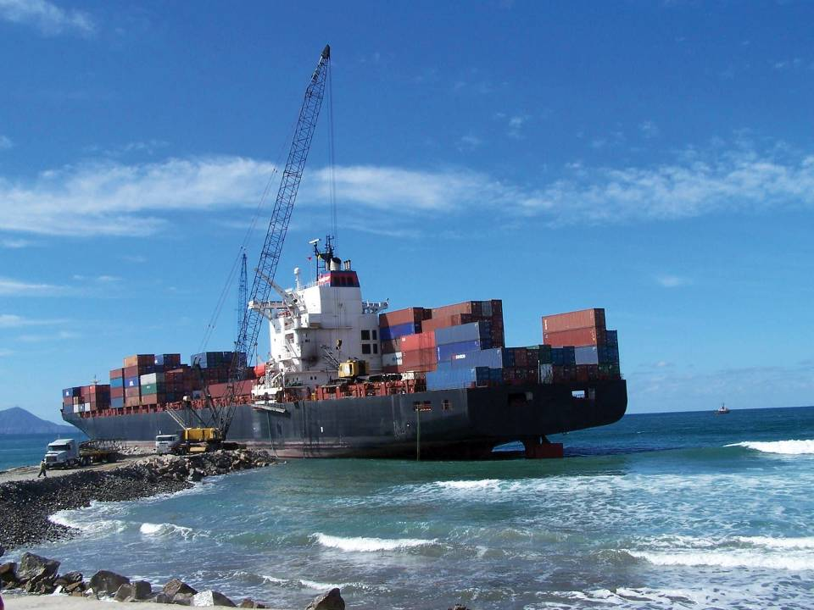
? Audience Question 3

Slide 21
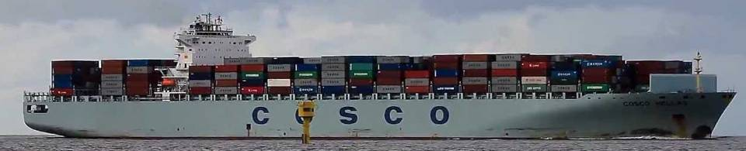
Demands of a Surveyor – Keeping Independent
The surveyor must make his own independent calculation and not base it on solely on information provided by Owners
You may get three quotes, but are they competitive based on your experience?
The surveyor is not aware of policy details this keeps him objective
Remembering his independent and objective role in determining “fair and reasonable and attributable”

Slide 22
Assisting Factors for the Surveyor
The challenges for the Owner invariably becomes a challenge for the surveyor:
Good communication from start to finish between Owners and Surveyors
Attend within a very short time of the casualty occurring to explain the “rules of engagement”
Full access to all damaged parts not always possible early in a casualty
Attend with all interested parties especially Owners and Class
Engaged in all early negotiations and drawing up of specifications.

Slide 23
Assisting Factors for the Surveyor
Attendance at initial meeting with yard to agree repair scope and costs
Access at critical stages of any long repair process (especially if POA is requested)
Attendance at settlement of invoice with yard for final inspection and negotiation
Experienced surveyors and company support with historic case files for quotations and invoices available
Worldwide technical assistance, multi-disciplined workforce and continuity of service (no surveyor knows it all)
For the cost approval process supporting invoices have to be presented organised, itemised, clear, original.

Slide 24
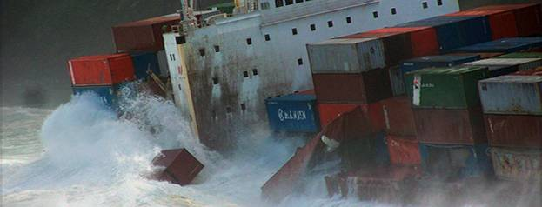
Assisting Factors for the Surveyor
Other Common Problems/ Pressures
Chasing Owners for updates rather than Owners keeping surveyor informed
Getting original documentation in support of cost and causation is becoming increasingly difficult (often we get quotes / spreadsheets / bank transfer slips / no letter head) etc, etc
Some pressure to keep survey costs down and attendance times proportionate with the casualty

Slide 25
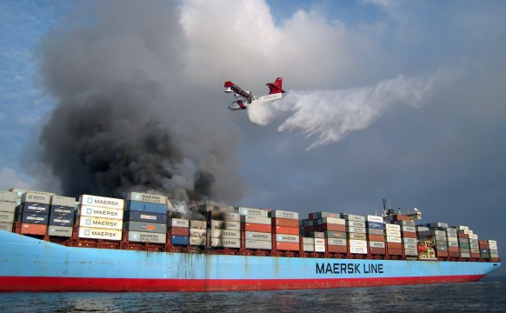
? Audience Question 4

Slide 26
Quotations - General
In many parts of the world it must be recognised, that often agreed rates and prices can ultimately be a matter for negotiation
Tariffs can mean very little in a repair scenario and in some areas not easy for the surveyor to get for “insurance repairs”
Shipyards are often reluctant to send surveyors tariffs as these can often be perceived as a tool which can be used against an Owner
However for an Owner in a “maintenance” environment quotations are readily available

Slide 27

Quotations - General
Shipyard availability: if the yards are busy they will often send out a speculative and inflated offer
Personal relationships: a large fleet and regular customer will often be able to negotiate significant discounts from yards they regularly use – does the Underwriter enjoy this benefit?
Owners’ work may have been planned and should be fully disclosed from the start of repairs
Some shipyards have alliances and quotations can be non competitive.

Slide 28
Quotations - General
At least 3 competitive quotations should normally have been obtained in advance of the ship entering a shipyard for repairs
Have repairers actually visited (accuracy of quote)?
Are the quotes speculative (they may not even want the work)?
Has there been collusion between the yards to set the price high?
Are the yards technically competent in the type of work required?
Do they have the correct scantlings and quality and Class approved steel required?
Normalising quotations is a time consuming process but important “apples for apples”
For insurance repairs discounts are rarely found.

Slide 29
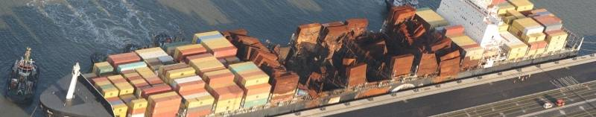
Quotations - Discount
Are underwriters benefiting from discounts being offered in respect of damage repairs?
Very rarely. Owner’s costs usually will attract discounts, many superintendents will ensure this to keep the Owner’s budget down.
Our ex-superintendent staff will tell you this
In China, yards routinely give 35-40% on general services but only occasionally an overall discount on the final invoice for insurance work.

Slide 30
Quotations – Negotiations
In the pre- repair process if we are not involved in prior negotiations we cannot ensure that reasonable rates are used:
It is not unusual for the Owners to place a ship in a yard and commence work before a surveyor is instructed – so no time to have any early impact on the process
In China we seldom see full original quotations any more. Yards give to Owners in Excel (.xlsx) format, allowing subsequent editing by some
Our staff ex-superintendents tell us Owners always get competitive quotes for any work they do
Often the first time we see any cost is when the invoices arrive on a surveyor’s desk for approval
We then have to ask numerous questions which can be seen as being obstructive
We have to be able to answer Underwriter’s questions after our approvals.

Slide 31
Quotations – Other Challenges
Emergency repairs often attract an increased premium as it is assumed insurers are paying
Invariably for some shipyards the perspective on quotes changes accordingly
General services are usually easy to quantify but non routine works can attract increased prices and costs can be difficult to control
Non-routine: some anti-pollution measures, tank cleaning, hull distortion contingencies, hatch cover repairs, container or cargo removal, storage and bulbous bow replacement etc.
Repairs not specified in agreed quotes will often attract an increased premium.

Slide 32
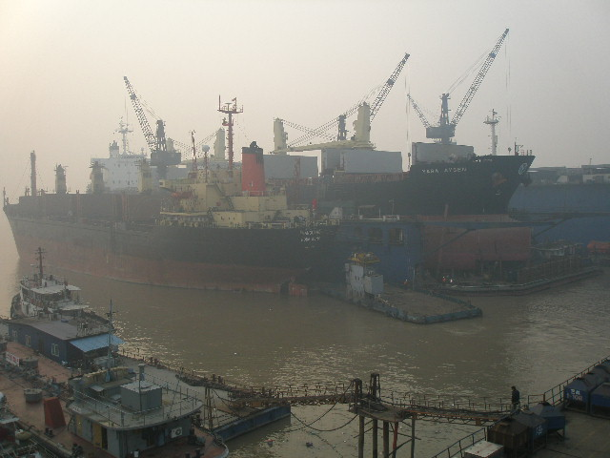
Quotations (6) – Large Steel Repairs

Slide 33
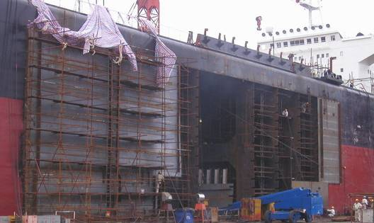
Quotations – Large Steel Repairs
For significant sized repair projects the Owner should normally seek an agreement on a lump sum figure
Owners should not proceed solely on the basis of unit prices unless obvious savings are available
Proceeding on the basis of unit prices can leave the Owner open to a significant escalation of costs and many ship yards could lack incentive to finish the work on time and within budget

Slide 34
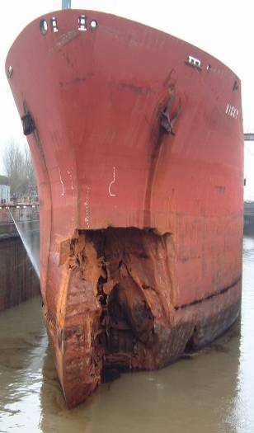
Quotations - Large Steel Repairs
Generally, the replacement of large quantities of steel should be in the form of large prefabricated structures (cutting expensive dry-docking costs)
Keeps the yard able to use the dock for original scheduled customers
Some of the uplifts and painting costs can also be reduced (e.g.steel replacement in a dry-dock can attract a 40% uplift, tank painting costs can be significantly higher than hull painting costs).

Slide 35
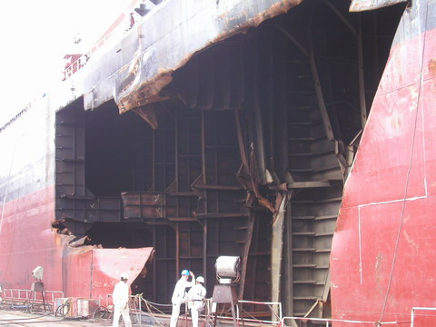
Quotations - Large Steel Repairs
Structures can be more easily fabricated remotely in convenient locations, will attract lower steel prices and consequently the rates and overall cost per kg should be lower
Some yards such as those China do not give values for scrap.

Slide 36
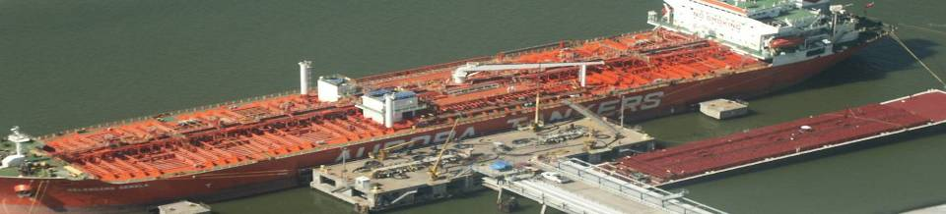
Quotations - Large Steel Repairs
Base steel prices can look competitive but there may be disproportionate uplifts for, curvature, high tensile, in tank work, in dock work, etc.
Is the cost inclusive of Class certification, painting, welding, scaffolding, testing?
Supervision: although Chinese Shipyards are regarded as cheap, additional cost can be incurred in the provision of Owner’s supervisory services

Slide 37
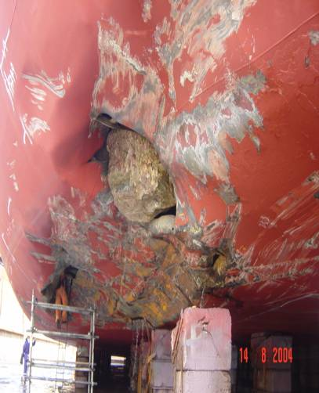
Repair Period
Supervision:
Additional ships personnel
To monitor each repair area
Work closely with Class
Requires daily meetings and coordination
Additional superintendents sometimes needed

Slide 38
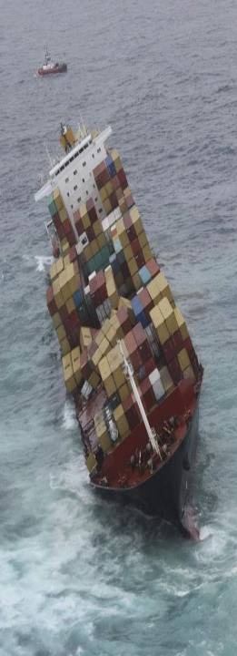
Repair Period
Attention to detail essential:
Examine everything in detail
Take nothing for granted
Take the time to discuss this with the yard managers
Try to pin them down can be elusive
Morning meetings
Be present at all testing

Slide 39
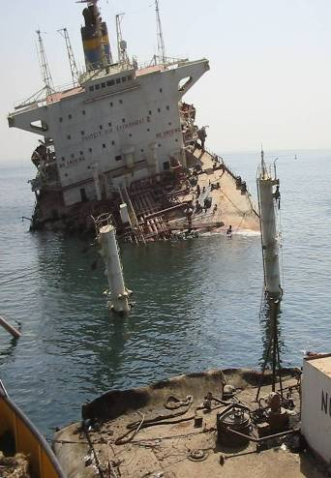
Repair Period
Experience essential:
To understand the working practices
To understand the culture
To understand the language
To protect the Owner’s / Underwriters Interests

Slide 40
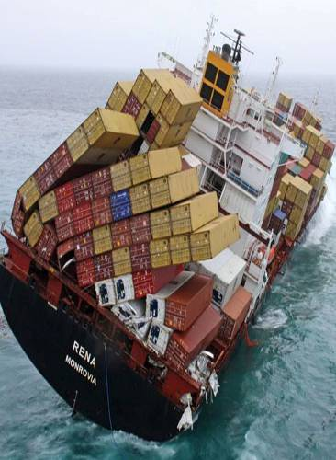
Repair Period
Quality control:
Ship yard quality control should be monitored closely don’t take their word for it
Weld quality
Materials specifications –avoid local equivalent materials
Painting quality

Slide 41
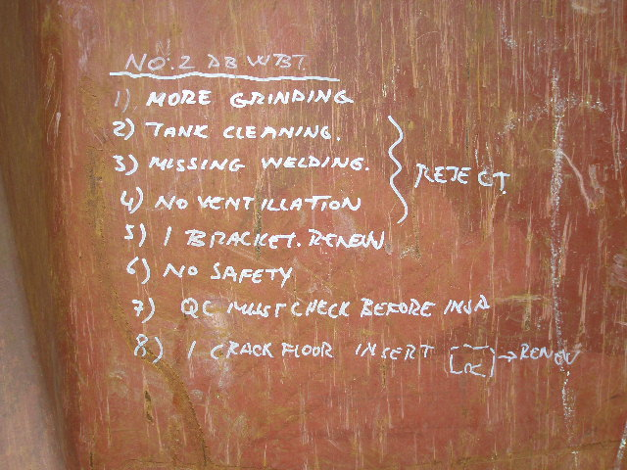

Typical Superintendents Notes

Slide 42
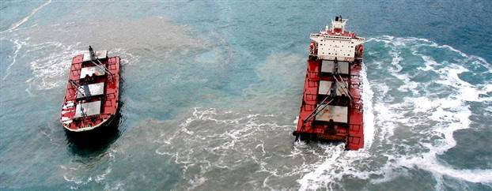
Repair Period
Testing and Commissioning:
This is the last opportunity to ensure quality
Pressure testing – attend all tests
Quality of welding - check every inch of weld

Slide 43
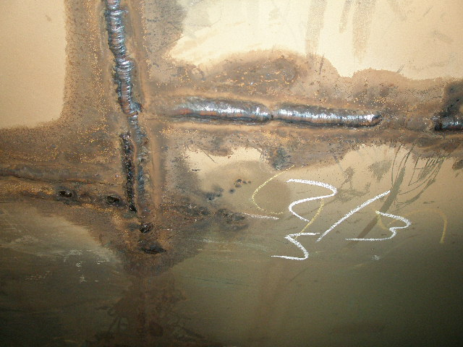
Inspect Every inch of weld

Slide 44
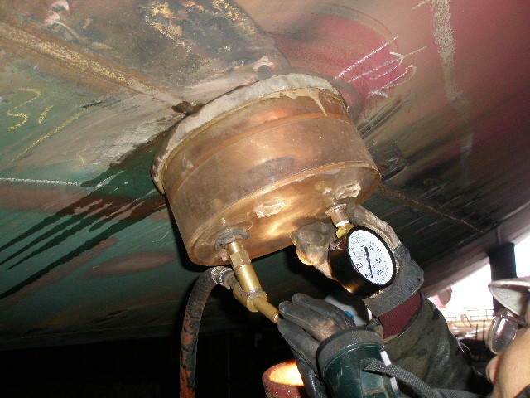
Vacuum testing

Slide 45
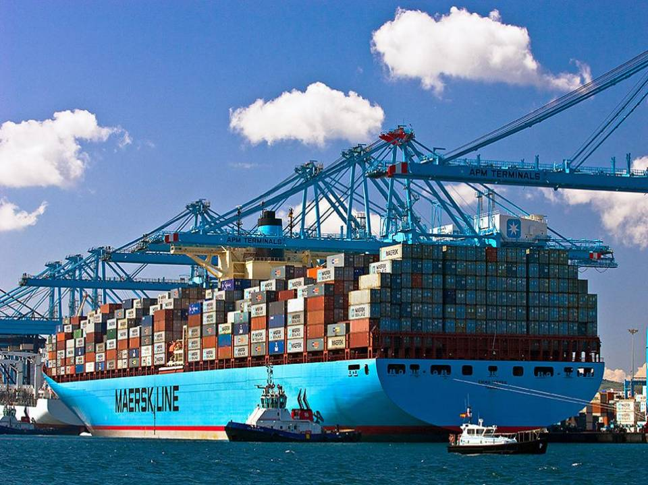
? Audience Question 5

Slide 46
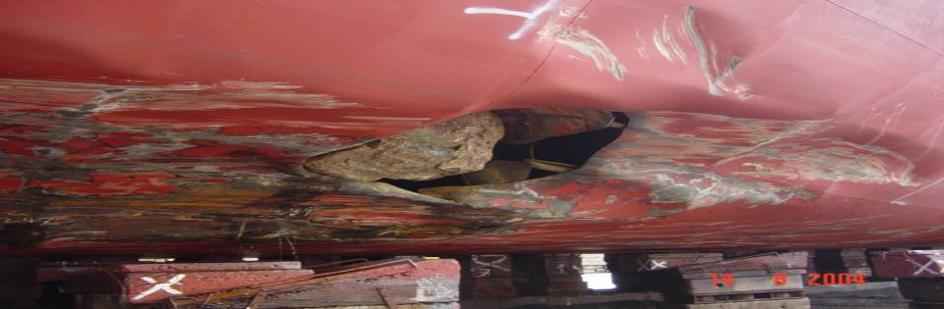
Typical Scenario
“MV XXXXXXXXX” with extensive underwater damage requiring 1000 tonnes of steel replacement.
Performed in Asia
Took 32 days – steel replacement rate 31 tonnes/day
Where 15-20 is regarded as good

Slide 47
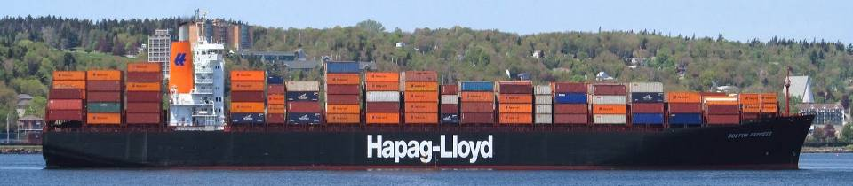
Typical Scenario
Superintendent was threatened with arrest because of the pollution threat on arrival
The anti pollution deployment for docking cost USD 250,000 for three hours work
Disposal of fuel tank water was not possible by normal means because non eco-friendly dispersant had been used during salvage

Slide 48
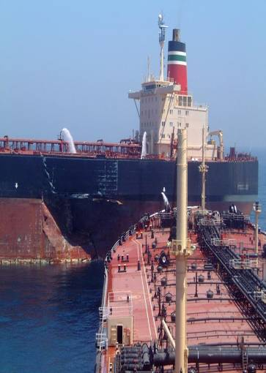
Typical Scenario
Quality was barely satisfactory in the end but required a lot of supervision
25% Over budget
The correct steel was not available 1 to 2mm @10% extra
Charged top steel rate for using scrap for faring plates
Additional damage items charged at a premium

Slide 49
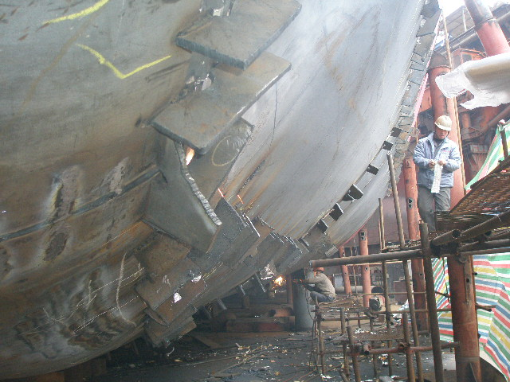
Typical Scenario – faring plates charged at a premium from scrap taken from the ship

Slide 50
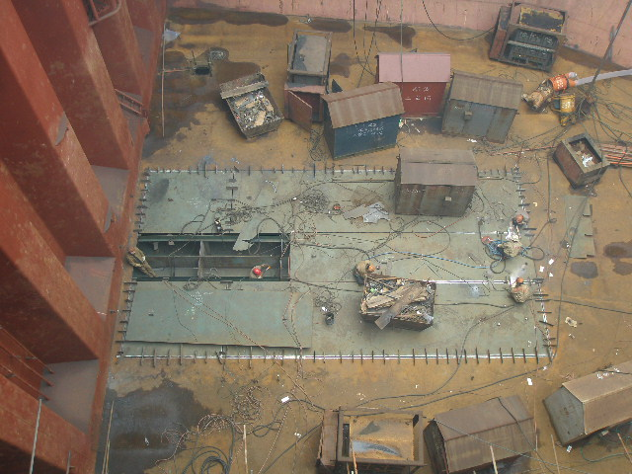
Typical Scenario
Damaged cargo hold tank tops
Additional cost as not spotted at beginning
or distorted during bottom steel replacement
Extra cost at a premium

Slide 51
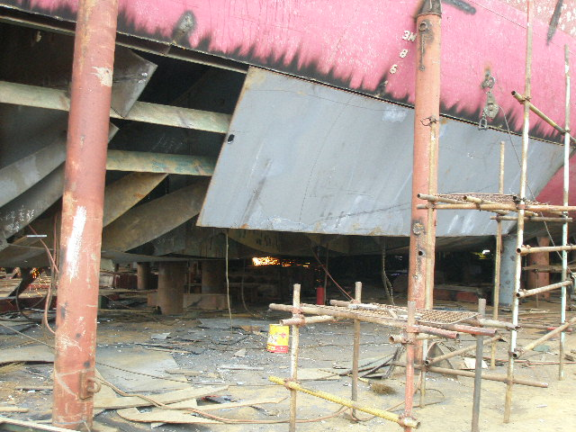
Typical Scenario
Hull support required for structural support extra cost

Slide 52
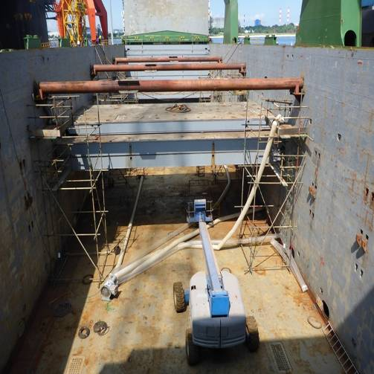
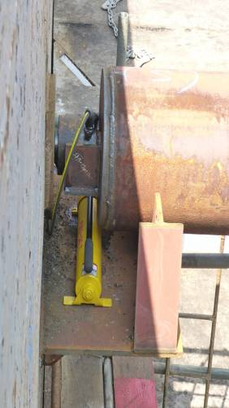
Hull Distortion and Special Tools

Slide 53
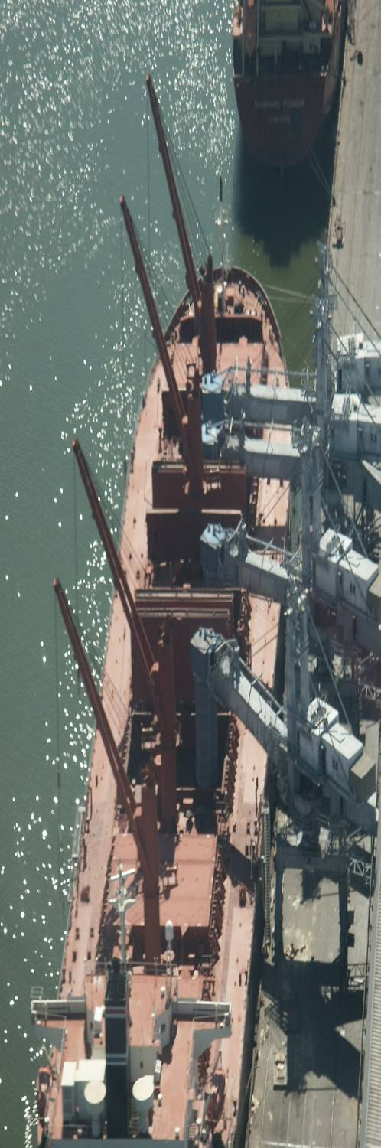
Negotiations and sail off
This is where the diligence in supervision pays off and no unnecessary surprises
There is always an element of negotiation
Often the senior yard managers are not involved
If staged payments on account are agreed then timing and communication are essential
so that the funds are in place.
A deposit will have at least 50% will have to be paid first before the ship can sail or superintendent depart

Slide 54
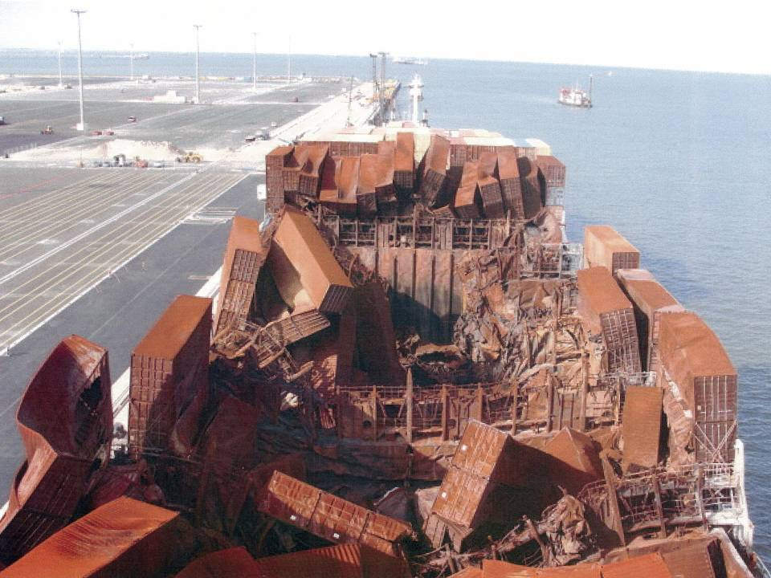
? Audience Question 6

Slide 55
Aftermath – Review and Reserve
When invoices or quotations are presented to a surveyor, he will compare the rates charged with competitive rates for the same yard or other typical yards in the area
If costs incurred are excessive, we make a comparison with fair and reasonable rates and without prejudice disallow the excess. This is where experience and a good historical database can help
The underwriters make the final decision as to whether they want to pay the full costs incurred or only the costs we regard as fair and reasonable
The surveyor’s job is also to update the principal on any additional costs that may arrive later so this should form part of the review process – no surprises at the end of a process the Underwriter thinks is complete.

Slide 56
Key Points
Good communication is essential from casualty date onwards to set out the rules of engagement
Surveyor should also be involved at start of quoting to negotiations and settlement at point of repair to encourage transparency
The surveyor has to see the critical stages of the repair
Some undiscovered casualty damage can manifest itself well into a repair so some allowance should be made
Attend with Class (beginning especially and get recommendations)
Be present for delivery of critical components and commissioning
Review of Invoices becomes less problematic given the above
“Fair, Reasonable and Attributable”

Slide 57

Claims Reserving The Broker’s Perspective
IMCC – Dublin 2014
Neil Hawkins
Partner
Energy & Marine Claims
Notes:
57
57

Slide 58
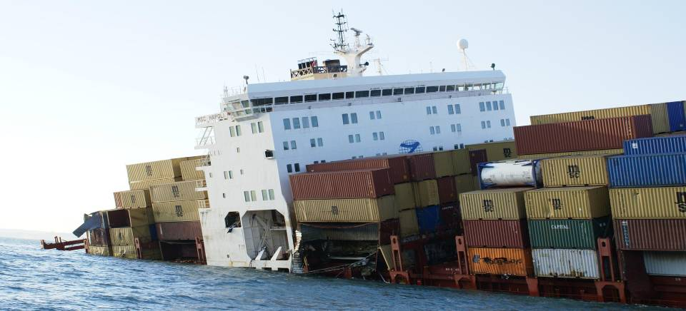
The Broker’s Role
Responsibilities
58

Slide 59
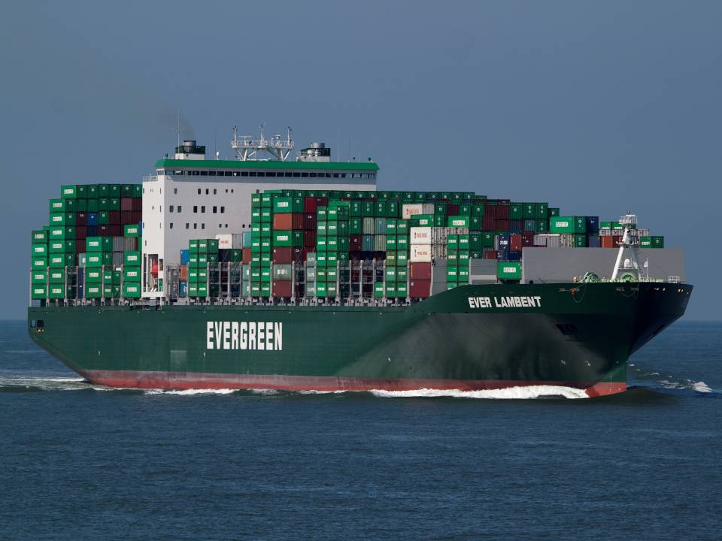
? Audience Question 7

Slide 60
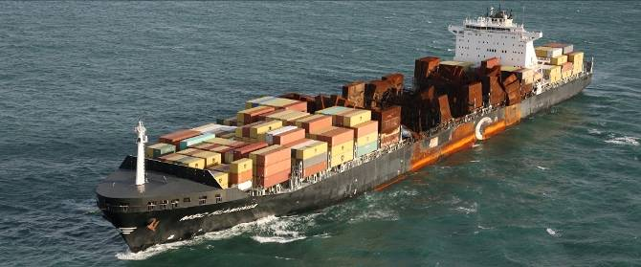
The Broker’s Role
Observations

Slide 61
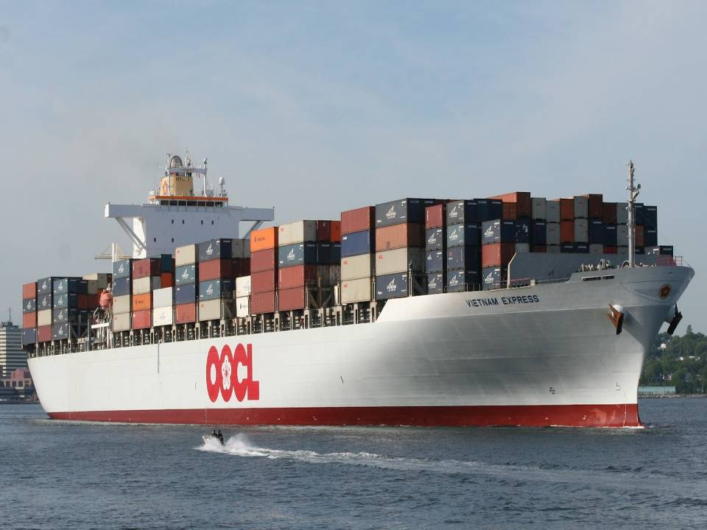
? Audience Question 8

Slide 62
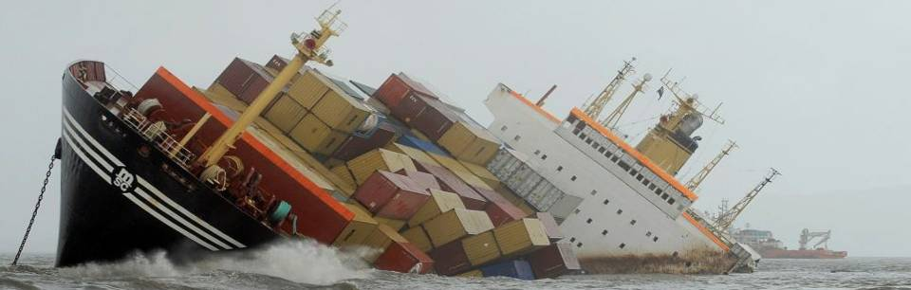
The Average Adjuster’s Role
Can the average adjuster assist in setting the correct reserve?
Why not used more often?
62

Slide 63
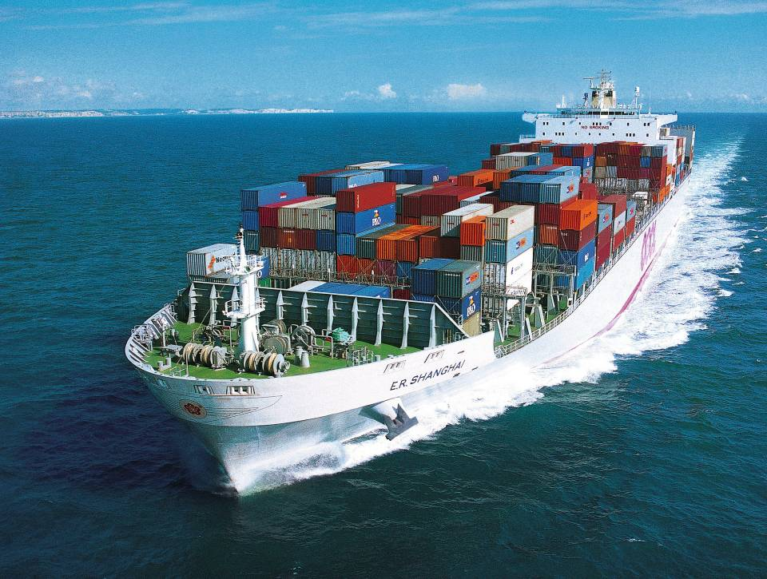
? Audience Question 9

Slide 64
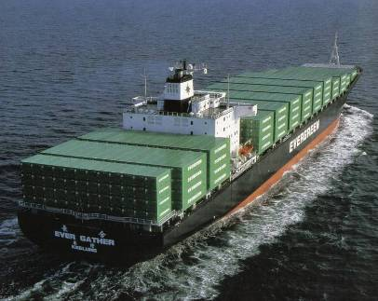
Allianz Global Corporate & Specialty SE London Hull & Machinery Reserving Philosophy
Reserving
Most Likely Outcome
Paul Warren
Dublin / 25th September 2014
Notes:
64

Slide 65

Table of contents
Information Received & Coverage Check
Restrictions to Accurate Reserving
Most Likely Outcome
Increased Accuracy in Reserves
Monitoring and Reporting
Summary
© Copyright Allianz 04/11/14
Notes:
65

Slide 66
AGCS London Hull & Machinery Reserving Philosophy
Information Received
Insured
Broker
Surveyor
Lawyer
Adjuster

Slide 67

Claims Handler checks claim against policy
Cause
Cover afforded, clauses
Application of Deductibles
Standard, AMD & AAD
Determines Reserve
© Copyright Allianz 04/11/14

Slide 68

How Long ?
© Copyright Allianz 04/11/14

Slide 69

Art, Science or Experience?
© Copyright Allianz 04/11/14

Slide 70

Restrictions to setting accurate reserves (up to 2008)
Surveyor’s reserve only for repair costs
Excludes
Superintendent’s Costs
Agency Costs
Adjuster’s fees
Surveyor’s fees
Specifications and Quotes obtained by Owners
No Feedback or update from Adjuster during Adjustment process
© Copyright Allianz 04/11/14

Slide 71

Most Likely Outcome
To avoid surprises/fluctuations in the figures
Provide a more accurate initial and follow up reserves
Help actuaries and auditors
Minimise the bad news to Underwriters and Senior Management
© Copyright Allianz 04/11/14

Slide 72

Heads of Claim
Particular Average
Surveyors
Estimated repair costs
Fee reserve
General Average (including Salvage)
Surveyors and Lawyers
Estimated GA costs
Hull’s Proportion of Salvage Award
© Copyright Allianz 04/11/14

Slide 73

Heads of Claim – Part 2
Collision Liability
Surveyors and Lawyers
WP survey of T/P vessel – PA estimate
Estimated repair cost for Insured Vessel
Apportionment of Liability
Anticipated legal costs for both sides
Surveyor’s fees
© Copyright Allianz 04/11/14

Slide 74

? Audience Question 10

Slide 75

? Audience Question 11

Slide 76

Increased Accuracy in Reserve Setting
Change in AGCS Reserving Philosophy
Good communication from the start
Clearer instructions to surveyors regarding what’s included within reserve
Request for surveyor to be involved with the repair process, including drawing up specifications and quotes
Surveyor’s estimate to take into account quotes obtained
Additional amount added for Superintendent’s, Agency, Adjuster’s fees
Surveyors copying in Insurers on cost approval correspondence
Request update from Adjuster with regard to likely final claim amount
© Copyright Allianz 04/11/14

Slide 77

Other Aspects
Regular Reviews
All Claims
Large Claims > € 500 k our share
Non Movement Reports/Aged O/S
Potential Recoveries
Not taken into Account
Internal/External Auditors
Senior Management
Underwriters
© Copyright Allianz 04/11/14

Slide 78

Summary
Reserve for all components of claim
Set reserve as soon as is reasonable
Most Likely Outcome
Keep Reserve up to date/Regular Reviews
Follow up with Surveyors and Adjuster to maintain accurate reserve
Potential Recoveries not taken into account
© Copyright Allianz 04/11/14

Slide 79

Reserving - an art or science? A US perspective
Presented by Jonathan O’Hara
Aspen Insurance
Aspen Insurance Holdings Limited
Notes:
79

Slide 80

Reserving – a battle between claims, actuarial and underwriting?

Slide 81

General migration of Blue Water to London Market with few US based interests remaining
US Market primarily Brown Water

Slide 82

Policies generally smaller exposures and carried by one or two insurers rather than subscription based
Hull and P&I typically form part of a package written by the same underwriter

Slide 83

Typical Hull Losses

Slide 84

Typical (non personal injury) P&I losses

Slide 85

Claims risks of package policy covering both Hull and P&I

Slide 86
THANK YOU
Notes:
86

Slide 87

Questions & Discussion

Slide 88

When you are following an overseas market does the leader provide documentation to support the reserve?
If the Leader is asked for documentation for a reserve is it forthcoming?

Slide 89

With the pressure to post a timely reserve and/or get an idea of the size of a loss should the surveyor give underwriters an early estimate before he has all the facts/details or should he wait until he is more confident in the reserve?

Slide 90

Do you feel the average adjuster has a responsibility to provide updated information to underwriters to help them keep accurate reserves?

Slide 91

As an agent of the assured what is the brokers role in the reserving process?

Slide 92

Thank You

