Slide 1
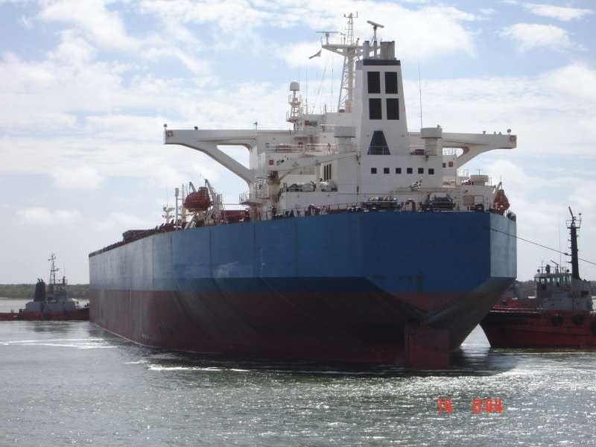
IMCC 2014 – Crew Negligence Session – MV WIMBLEDON

Slide 2
1. PARTICULARS OF VESSEL
Name : M.V. "WIMBLEDON“
Type : Bulk carrier
Port of Registry : SINGAPORE
Call Sign : A123BC
IMO No. : 1234567
GT / NT / DWT : 82,828 / 52,525 / 151,151
Built : 1992 / A Shipyard
LOA / B / D : 280.00 m / 42.00 m / 26.30 m
Classification : Class
Owners : Owners
Managers : Managers
Main Engine : Eng 9cyl 90cm / 2 Stroke / Direct Drive
Power : 40,840 kW / 54,745 bhp
Turbocharger : Turbo type 1A
Surveyed At : Singapore by Mark McGurran on 1st January 2014

Slide 3
2. BACKGROUND
The Global Maritime Singapore office receives a call from our London office, late on a Friday afternoon, informing us of a new instruction. The instruction has come from a claims broker who was informed of a loss by the assured. Following confirmation from lead H&M underwriters that Global Maritime were to be appointed, the claims broker has confirmed with leading underwriters our instructions as follows:
MV WIMBLEDON has sustained main engine damage and is currently a drift whilst on passage from Hong Kong to Singapore. She will be met by a tug and towed to Singapore for assessment of damages and repairs. The vessel Technical Manager is on his way from Europe to Singapore to meet the vessel and he can be contacted on +555636987423 and the local ship’s agents in Singapore are Agents Ltd, person in charge Mr. Lee can be reached on +6578654321.
Your instructions are to attend on onboard the vessel on behalf of H&M underwriters and report on nature, extent and cause of damage and to estimate cost of repairs and to monitor permanent repairs. Underwriters are also interested to know what terms have been agreed for the salvage operation. Please confirm receipt of these instructions and provide details of attending surveyor.
Following communications with the Technical Manager and agents, arrangements are made to attend on board at Singapore Eastern Special Purpose Anchorage via launch. The Technical Manager has arranged for a local engine repair company to also be in attendance to explore repair options.

Slide 4
QUESTIONS TO DELEGATES
Is this claim payable under The Plan? (yes, no, don’t know, not enough info yet)
Is this claim payable under ITC? (yes, no, don’t know, not enough info yet)

Slide 5
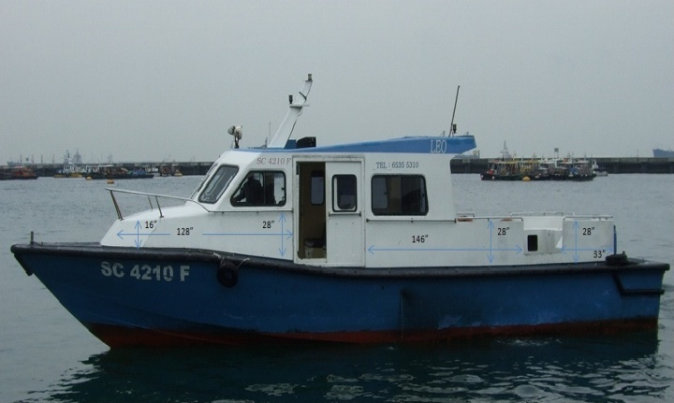
3. LAUNCH RIDE
During our launch rides out to vessels, often accompanied by Class, technical managers and repair technicians we, as attending H&M surveyors, are presented with a unique opportunity to talk with a captive audience. No one has anywhere to run off to on the small launch so we often find out a great deal about the situation during this time where they are not distracted by the many people and problems on the vessel that will require their attention once we get on board.
In this instance a relief Chief Engineer is also on board the launch.

Slide 6
3. LAUNCH RIDE
From discussions with the technical manager I find out the following:
The vessel has only been under the management and ownership of the current managers and owners for 6 months
No planned maintenance or engine maintenance records are available prior to the time when the current managers took over the vessel
The main engine had been running fine with no excessive fuel consumption until the failure of a piston crown and turbo charger damage prior to arrival Hong Kong 2 weeks ago
This piston crown was replaced with a spare that was already on board
During the call in Hong Kong the turbo charger was rebuilt and another piston was also replaced as part of the implemented planned maintenance system
The vessel suffered catastrophic main engine failure on route from Hong Kong to Singapore and had to be towed to Singapore
Bunker analysis & main engine lube oil has been carried out and results received and all are within spec
Cylinder lube oil storage tanks contents lube oil analysis results show high water content

Slide 7
4. ATTENDANCE ONBOARD
Once onboard and through the required security checks I introduce myself to the Master and explain the reason for my attendance and identify the parties that I represent.
I ask to meet with the Chief Engineer but am told that he is not available and am shown to the engine control room where I meet the 2nd Engineer who takes me into the engine room to show me the damage.
The Technical Manager is busy dealing with Agents, the Repair Technician and the Master so he does not accompany us.

Slide 8
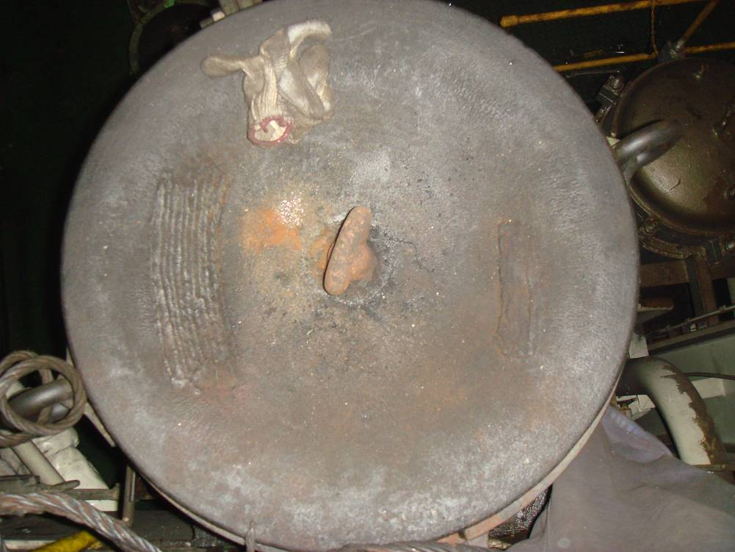
5. NATURE & EXTENT OF DAMAGE
This part of our instruction is often the most straight forward, we would identify and record all damage that is presented to us by the ship’s crew and/or Attending Technical Manager and any damage we note during our inspection of the machinery in question.
The following damage is noted:
No. 3 unit piston crown failed, center of crown burnt out.
A weld repair attempted by crew is visible, piston kept on onboard as an emergency spare

Slide 9
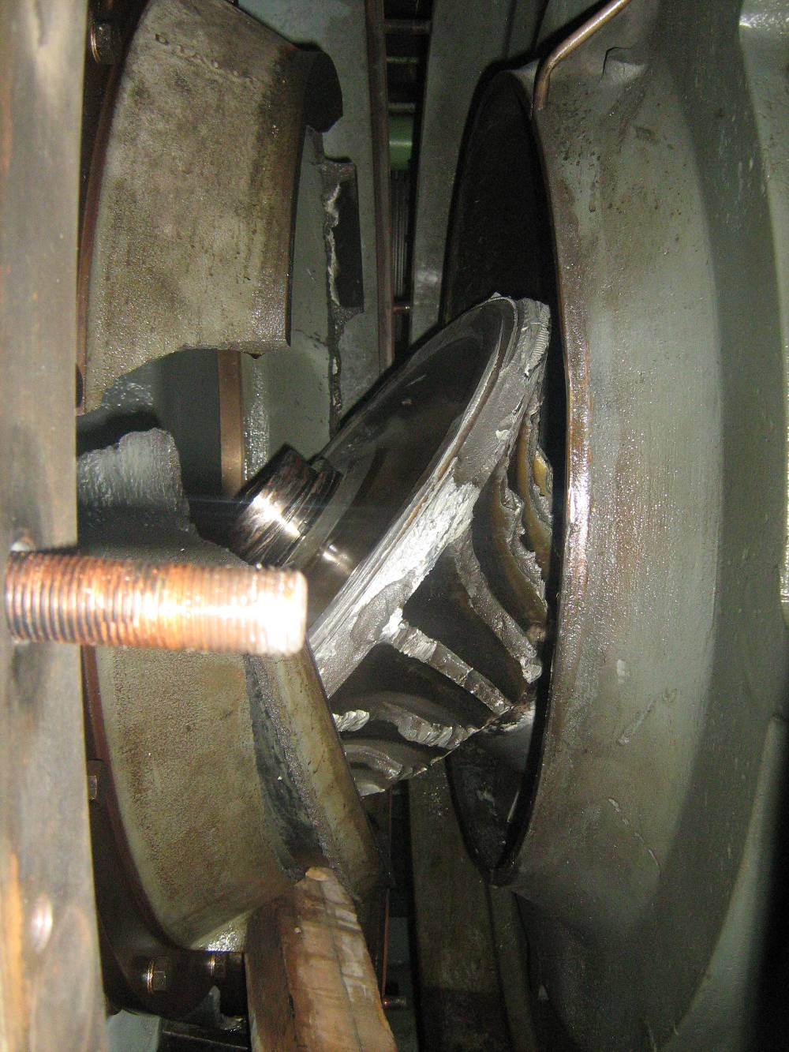
5. NATURE & EXTENT OF DAMAGE
Turbo charger rotor and casing destroyed

Slide 10
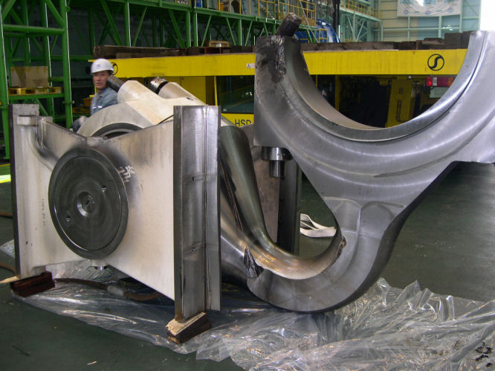
5. NATURE & EXTENT OF DAMAGE
No. 6 unit connecting rod deformed and bottom end bolts failed

Slide 11
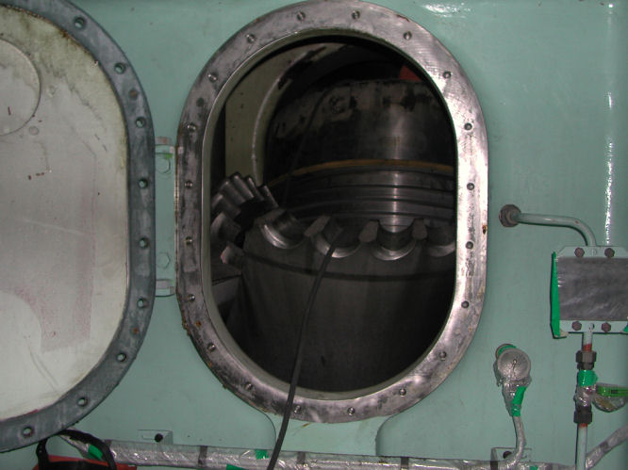
5. NATURE & EXTENT OF DAMAGE
No. 6 cylinder liner cracked in half in way of ports

Slide 12
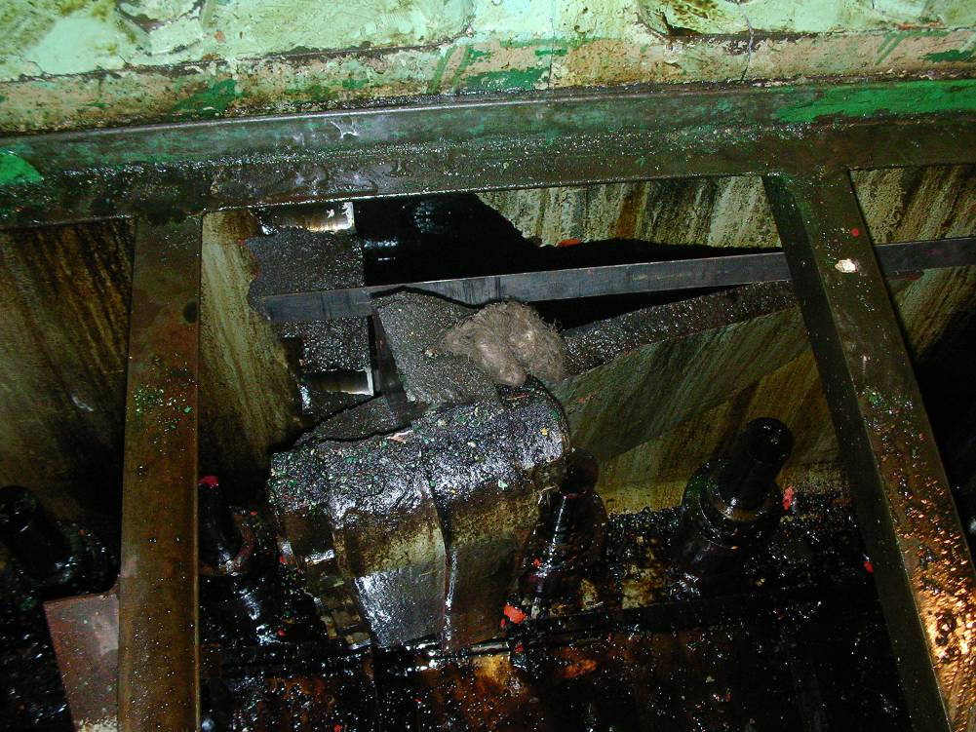
5. NATURE & EXTENT OF DAMAGE
Main engine bedplate in way of No. 6 unit was found holed beneath floor plate level

Slide 13
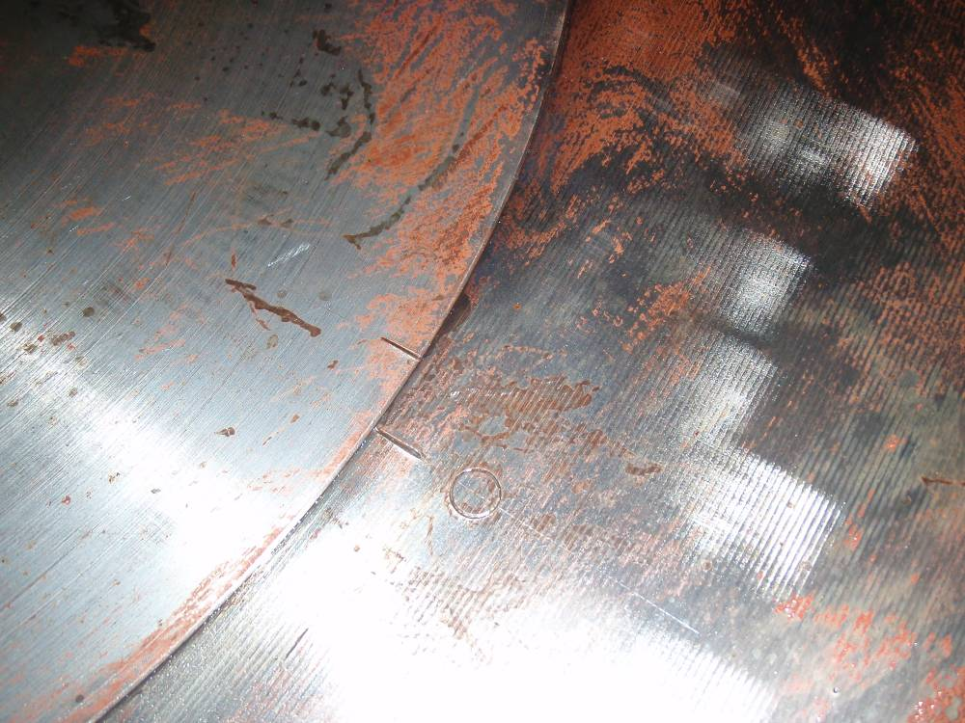
5. NATURE & EXTENT OF DAMAGE
The crankshaft at No. 6 unit had slipped from its original position by 18 mm between the main journal and crank web

Slide 14
6. CAUSE
To establish the cause of any incident we utilise the following techniques:
Collection and review of physical evidence (as above establish nature and extent of damage)
Review of contemporaneous documents (log books, alarm printouts etc)
Interview of crew to collect contemporaneous accounts
Review of planned maintenance if damage is in relation to machinery
Review of other documents and information (such as lube/fuel analysis results & ships certificates)
In this case the engine log book showed the vessel proceeding towards Hong Kong with the main engine operating within all the usual various but normal parameters.
The engine room alarm printer showed that the high turbo charger exhaust gas inlet temperature alarm activated; which was closely followed high scavenge air temperatures across the engine. The turbo charger high vibration alarm then sounded.

Slide 15
6. CAUSE
The following was learned from my discussions with the 2nd Engineer who was in the engine room at the time of the first incident:
The turbocharger began to surge wildly and he took the decision to stop the engine, so after informing the bridge the engine was stopped so that investigations could be carried out. The engine and deck log books confirmed this course of events.
It was found that the piston crown of No.3 unit had failed allowing piston cooling oil into the cylinder and causing a fire in the exhaust trunking of the engine. This in turn appeared to have caused the turbo charger to overspeed resulting in it being destroyed.
The piston of No.3 unit was replaced with a spare already on board and the turbocharger was blanked off to allow the vessel to proceed to Hong Kong. Once in Hong Kong the turbo charger was rebuilt with a new rotor and casing parts delivered in Hong Kong as arranged by the technical manager with the assistance of a local turbo charger workshop. Also in Hong Kong, No.6 piston was replaced with a spare on board as part of the new vessel management planned maintenance system.

Slide 16
6. CAUSE
The second engineer reported that whilst the vessel was under tow they received on board the analysis results of the contents of the cylinder lube oil storage and service tanks and that all the cylinder oil on board contained high levels of water. When asked if it was routine on board the vessel to drain the storage and service tanks of water he replied that the tanks were fitted with drain cocks but there was not a practice on board of doing so and that no requirement was listed in the planned maintenance system.
The following was learned from my discussions with the 3rd Engineer who was in the engine room at the time of the second incident:
The vessel departed Hong Kong with repairs complete and made way for Singapore. During the passage to Singapore there was an explosion around the lower level of the main engine around the middle section. The engine automatically shut down on crankcase high oil mist. These events are confirmed in the engine log book and alarm printer.
The 3rd engineer confirmed that he had not been draining the cylinder lube oil tanks for water.

Slide 17
6. CAUSE
Upon investigation the damage recorded above was noted. It was apparent that there had been a catastrophic seizure of No.6 unit which had resulted in the bending of the connecting rod, the damage to the crankcase, the failure of the cylinder liner and the slip in the journal to web mating of the crankshaft. Due to the severity of the damage, the engine was deemed inoperable by the Chief Engineer and the tow of the vessel to Singapore was arranged by Owners.
At this stage I asked the 3rd Engineer to take me to the Chief Engineer so that I could record his version of events. I was informed that the Chief Engineer of the vessel at the time of the incident had been signed off the vessel today. I asked the technical manager if I could speak with him but was informed that he no longer worked for the company.

Slide 18
6. CAUSE
The planned maintenance system on board the vessel only stretched back as far as six months prior to the incident. No records were available prior to this time as the vessel was managed by a different company and no records were handed over. The running hours for the individual components of the main engine were therefore unknown. The new managers had implemented a system of staggered running hours for the components and had begun overhauling all components systematically.
By the time I attended the vessel in Singapore, the engine had been stripped down and the pistons had been removed and separated from the piston rods. It was apparent that the piston crowns of No.3 and No.6 unit had high levels of manufacturing debris and swarf within their cooling and lubrication channels.

Slide 19
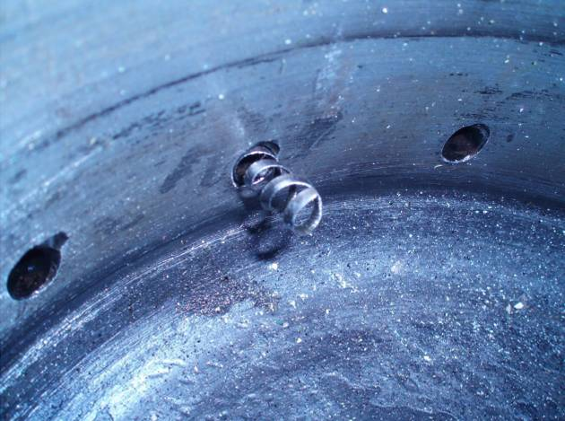
6. CAUSE
Manufacturing swarf in piston crown cooling and lubrication channels

Slide 20
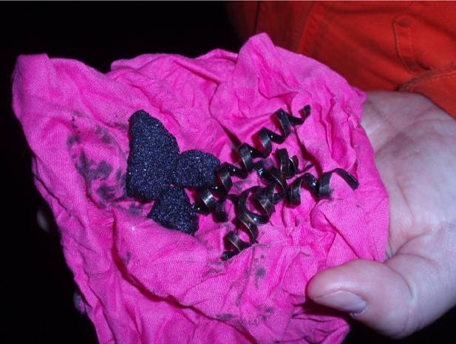
6. CAUSE
Typical debris and swarf removed from piston crowns

Slide 21
QUESTIONS TO DELEGATES
Is it ok to use non original manufacture parts? (yes, no, yes if class approved)

Slide 22
6. CAUSE
Upon inspection is was noted that the piston crowns that were fitted to No.3 and No.6 units did not carry any Class approval stamps and no paperwork could be found on board to determine the source of these parts. The piston crowns that came from all other units, including the failed one removed from No.3 prior to Hong Kong all did have Class approval stamps.
This manufacturing swarf and debris could have cause blockages in the entire lubricating oil system for the main engine including the piston cooling for No.6 unit. This may have led to a catastrophic piston seizure which caused the connecting rod to become so severely deformed, the cylinder liner to crack radially and fail, and the connecting rod bolt was thrown through the crankcase at the lower level below the floor plates. The seizure of the piston also resulted in the crank web of No.6 unit slipping 18mm.
It is also possible that the piston seized due to the high levels of water in the cylinder lubricating oil, or a combination of the two.

Slide 23
QUESTIONS TO DELEGATES
Is this claim payable under The Plan? (yes, no, don’t know)
Is this claim payable under ITC? (yes, no, don’t know)
Does the cause = crew negligence? (yes, no, don’t know)

Slide 24
QUESTIONS?
Any questions or comments on the scenario of for any of the speakers?

Slide 26
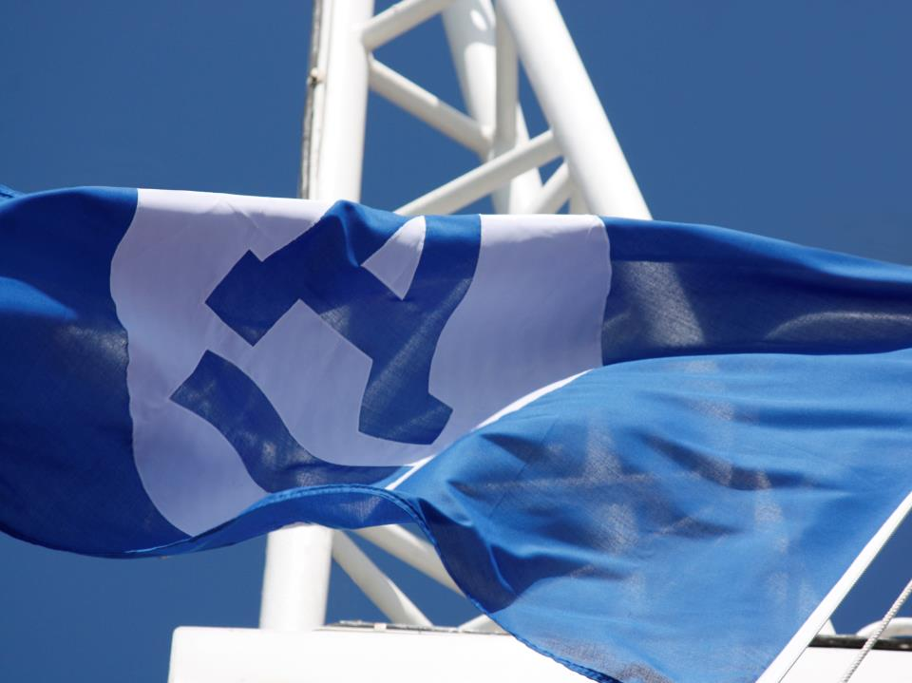
Ardmore Shipping Corporation
Crew Negligence
Steve Malone, Marine & Insurance Manager

Slide 27
Disclaimer
This presentation contains certain statements that may be deemed to be “forward-looking statements” within the meaning of applicable U.S. federal securities laws. All statements, other than statements of historical facts, that address activities, events or developments that Ardmore Shipping Corporation (“Ardmore” or the “Company”) expects, projects, believes or anticipates will or may occur in the future, including, without limitation, statements about future operating or financial results, global and regional economic conditions and trends, pending vessel acquisitions, the Company’s business strategy and expected capital spending or operating expenses, competition in the tanker industry, shipping market trends, the Company’s financial condition and liquidity, including ability to obtain financing in the future to fund capital expenditures, acquisitions and other general corporate activities, the Company’s ability to enter into fixed-rate charters after the current charters expire and the Company’s ability to earn income in the spot market, and expectations of the availability of vessels to purchase, the time it may take to construct new vessels and vessels’ useful lives, are forward-looking statements. Although the Company believes that its expectations stated in this presentation are based on reasonable assumptions, actual results may differ from those projected in the forward-looking statements.
Factors that might cause or contribute to such a discrepancy include, but are not limited to, the risk factors described in the Company's filings with the Securities and Exchange Commission (the "SEC"). This presentation is for information purposes only and does not constitute an offer to buy or sell securities of the Company. For more complete information about the Company, the information in this presentation should be read together with the Company 's filings with the SEC which may be accessed on the SEC website at www.sec.gov.

Slide 28
Fleet List
PRODUCT TANKERS
CHEMICAL TANKERS
NAME | SIZE (DWT) | DELIVERED | BUILT
IN OPERATION
ARDMORE SEAVANGUARD | 49,998 | 2014 | Korea
ARDMORE SEAVANTAGE | 49,998 | 2014 | Korea
ARDMORE SEAVALIANT | 49,997 | 2013 | Korea
ARDMORE SEAVENTURE | 49,998 | 2013 | Korea
ARDMORE ENDEAVOUR | 49,997 | 2013 | Korea
ARDMORE SEATRADER | 47,141 | 2002 | Japan
ARDMORE SEAMASTER | 45,840 | 2004 | Japan
ARDMORE SEAFARER | 45,744 | 2004 | Japan
ARDMORE SEAMARINER | 45,726 | 2006 | Japan
ARDMORE SEALEADER | 47,463 | 2008 | Japan
ARDMORE SEALIFTER | 47,472 | 2008 | Japan
ON ORDER
SPP Hull S-1162 | 50,300 | 2Q15 | Korea
SPP Hull S-1163 | 50,300 | 3Q15 | Korea
SPP Hull S-1171 | 50,300 | 3Q15 | Korea
SPP Hull S-1172 | 50,300 | 4Q15 | Korea
TOTAL | 15 Vessels | 5 Years Average Age ⁽¹⁾
NAME | SIZE (DWT) | DELIVERED | BUILT
IN OPERATION
ARDMORE CENTURION | 29,006 | 2005 | Korea
ARDMORE CALYPSO | 17,589 | 2010 | Korea
ARDMORE CAPELLA | 17,567 | 2010 | Korea
ON ORDER
HMD Hull H-2480 | 37,000 | 4Q14 | Korea
HMD Hull H-2481 | 37,000 | 1Q15 | Korea
FKA Hull N-2062 | 25,000 | 4Q14 | Japan
FKA Hull N-2063 | 25,000 | 1Q15 | Japan
FKA Hull N-2065 | 25,000 | 3Q15 | Japan
FKA Hull N-2067 | 25,000 | 4Q15 | Japan
TOTAL | 9 Vessels | 3 Years Average Age ⁽¹⁾
Average age at December 31, 2015, after all vessels are delivered

Slide 29
What is Crew Negligence?
A failure to follow correct procedures
A failure to follow instruction
Blatant disregard for regulations
Incompetence on behalf of qualified individuals
Incompetent personnel onboard (is this Owner’s Negligence)
Unqualified personnel onboard (will this include Cadets as by their nature they are unqualified)

Slide 30
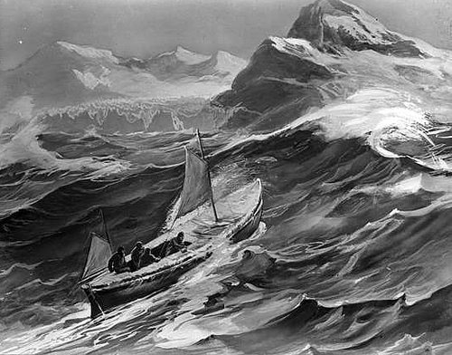
Have we taken Professionalism out of the Industry?

Slide 31
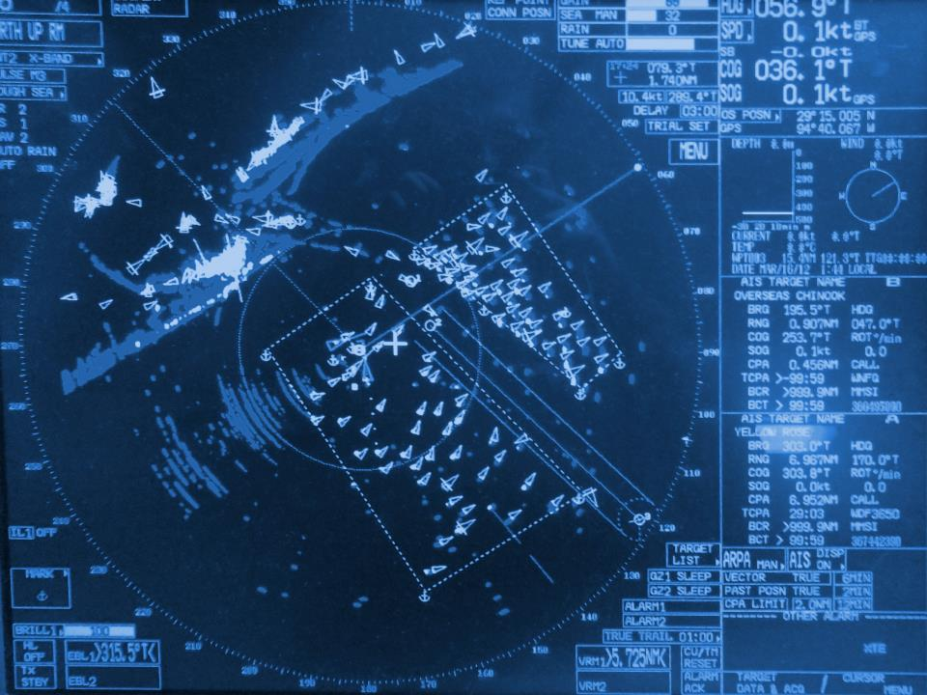

What We Promote Onboard:
People who are Empowered
Self confident
Act ethically
Think ‘we’
Accept accountability
Achieve results
Focus on the customer
Take measured risks
Innovate

Slide 32
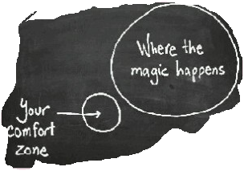
What We Don’t Promote:
People who are Powerless
Insecure
Blindly follow
Thinks them vs. us
‘That’s not my job’ attitude
Perform tasks
Focus is on ‘me’
Protect themselves
‘Coast’ in their job

Slide 33

Effective Communication is the Key to a successfully run fleet

Slide 34
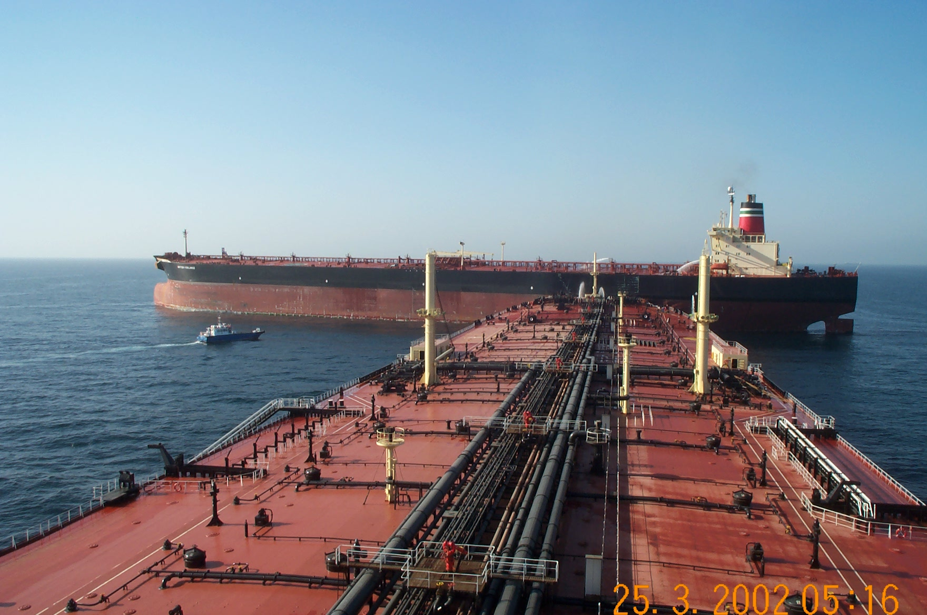
Effective Communication is the Key to a successfully run fleet
2002

Slide 35
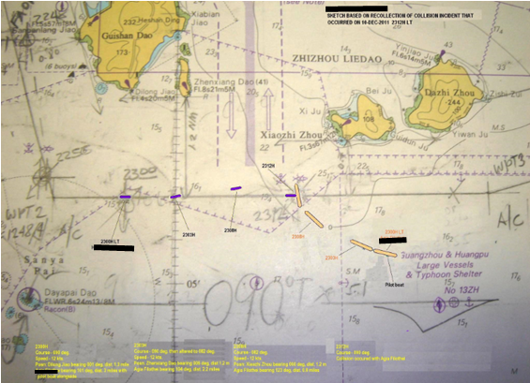
Effective Communication is the Key to a successfully run fleet
2012

Slide 36
How to Remove Crew Negligence
Establish a direct link with all crew sailing onboard
Maintain accountability coupled with transparency in the entire company
The ‘no blame’ culture doesn’t work
Take early and decisive action to remove incompetent personnel
Abide by the 80/20 rule when making decisions
Develop a dynamic and workable HSEQ system
Off the shelf ‘one system fits all’ safety systems are not feasible
Flexibility in the management of the Safety System is crucial
Move away from a tick box industry
Give back ownership for making decisions to the personnel onboard (micro managing doesn’t work)
Develop trust and respect between the office and the vessel

Slide 37

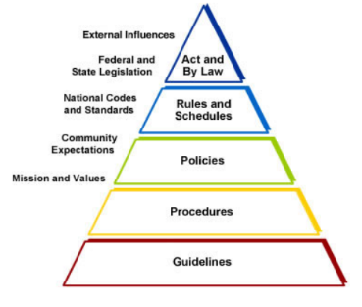
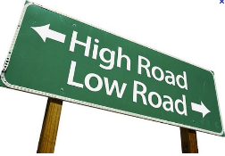






Slide 38
Crew or Owner Negligence?
Vessel loads fuel offshore US Gulf from a supply barge
Fuel samples are landed onto the barge for delivery ashore and analysis
Delay in landing samples for two weeks as barge remained offshore
Vessel sailed towards Argentina after bunkering and had to commence burning the recently loaded bunkers within 5 days
After 2-3 days on fresh bunkers problems arose with one A/E this was stopped and examined, a second A/E developed problems within one day on new fuel.
Fuel off spec/contamination was suspected and the M/E , A/E where changed over to the more expensive LSFO
Suppliers dispute off spec fuel as the sample confirmed to ISO 8217
Sample failed on expanded testing ‘chemical components’

Slide 39
Crew or Owner Negligence?
Potential damage could easily exceed deductible
Vessel initially had only one operational A/E so port entry was not possible
Towage into the port was considered, with the M/E and one A/E running the vessel is not a casualty so where does the liability lie.
Vessel regained two operational A/E by express flying and delivering additional engine stores to the vessel, who covers this cost
Port entry was successfully completed and the voyage completed as per voyage orders

Slide 40
Crew or Owner Negligence?
Is this incident considered Crew Negligence, Owner Negligence or Neither?
The Vessel needed to burn untested fuel
Was the owner required fuel reserves sufficient
To increase fuel reserves as a blanket requirement this will lock out potential cargo in draft restricted ports thereby restricting the vessels tradability.
If fuel conforms to the ISO standard and fails on an expanded testing regime is the fuel still on-spec
By breaking procedures was the C/E negligent
By ordering the burning of the fuel was the owner negligent

Slide 41
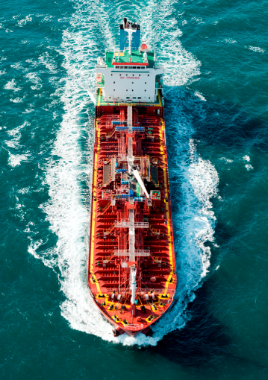
“It is not the ship so much as the skillful sailing that assures the prosperous voyage” – George William Curtis

Slide 42
