Slide 1
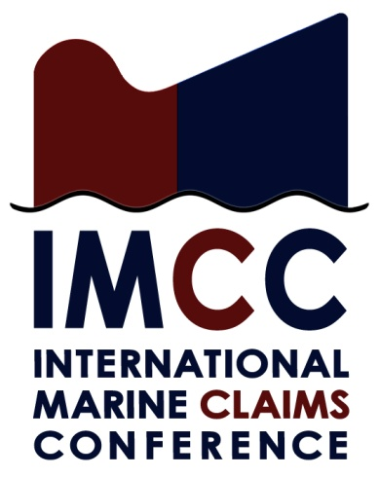
IMCC Tales of the unexpected
Nightmare in the daylight

Slide 2
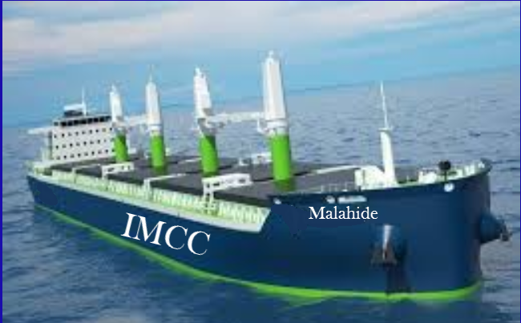
MV Malahide

Slide 3
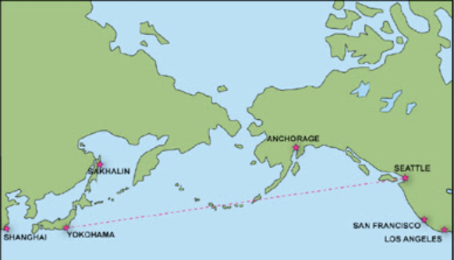
Aleutian Islands

Slide 4

Who knows where?

Slide 5
Pop up slot 1

Slide 6
Commercial & Salvage Proposal
Behalf Titan Maritime LLC / Crowley Marine Services
Tug : “Invader class” 7,200 Bhp, 75 tons bollard pull
Daily Hire Rate Usd 32,500 per day pro rata exclusive fuel and lubes
Delivery / Redelivery Seattle
Contract - Basis Bimco “Towhire 2008” Agreement with amendments - naming and waiver of subrogation
Minimum Hire period : 6 days hire
Alternatively
Lloyds Standard Form of Salvage Agreement “No Cure - No Pay” (LOF 2011) Incorporating Scopic . Titan Maritime LLC to utilise owned tonnage and additional local resources at their disposal. Leading members of the ISU (International Salvage Union), having built up experiences from operating in the region over many years. Also undertaken numerous hazardous and difficult cases, including refloating the “Costa Concordia”.
Towage & Salvage l London

Slide 7
Commercial Proposal
Behalf Millennium / Harley Marine, submitted as brokers only
Tug : “Millennium Falcon” 4,400 Bhp, 56 tons bollard pull
Daily Hire Rate Usd 40,000 per day pro rata inclusive fuel and lubes
Delivery / Redelivery Seattle
Contract - Basis Bimco “Towhire 2008” Agreement
Minimum Hire period : 6 days hire payable in any event Past projects & cases
Subject availability, further details
Towage & Salvage l London

Slide 8
Alternative Proposal
Behalf T & T Salvage
Team : 4 man salvage team comprising Senior Salvage Master, Naval Architect & Divers
Delivery / Redelivery Seattle
Contract - Basis Bimco “Wreckhire Agreement
Provision of any additional equipment @ cost plus 25 per cent uplift, handling fee
Bonus to be negotiated upon conclusion of services
Alternative Proposals :
Svitzer Salvage / Resolve Marine Group / Mammoet Salvage would invariably be prepared to offer basis Lloyds Standard Form of Salvage Agreement “No Cure - No Pay” (LOF 2011) Incorporating Scopic . Both of former parties would look to utilise resources under partnership for their provision of West Coast services under their OPA 90 compliance for their customers. Smit Salvage would be prepared to offer LOF 2011 and may also have hard-ware i.e. owned equipment in the region.
Towage & Salvage l London

Slide 9
Pop up slot 2

Slide 10
Why LOF Works
Response without delay
No time for contract negotiations
Encourages preservation of ship and cargo values
Known mechanism for dispute
Arbitration
Owner and cargo share in costs
Other alternatives
Bimco Wreckhire
Downside: Prolonged contract negotiations, less flexible than LOF

Slide 11
Personal bunker pumping and refilling time

Slide 12
Pop up slot 3

Slide 13
Pop up slot 4

Slide 14
SCOPIC Benefits & Risks
Benefits
Safety Net for Salvors
Guarantee to recover costs
Encourages Salvor Response when values are low
Provides Consensus Rates
Keeps the salvor on the job
Risks
25% Penalty

Slide 15
SCOPIC PENALTY CLAUSE
5
4
P&I Club Pays
SCOPIC
3
USDm
Lof
Art. 13 Award
Paid by Property Interests
Remuneration based upon App. A (including 25% uplift); from when salvor invokes SCOPIC Say invoked on day 10
25% of
diff rebated
Recalculate as if invoked day 1
2
SCOPIC
Say invoked on day 10
Unnecessary
1
Example 1
Example 2

Slide 16
Pop up slot 5

Slide 17
SCOPIC and the SCR
Captain Keith Hart
Hart Marine Consultants Ltd.

Slide 18
Background
Developments in casualty management linked to developments in Lloyd’s Open Form (LOF) Salvage Agreement

Slide 19
LOF
Originally a commercial contract for salving property, with reward being a proportion of the value of the salved property “Article 13”
No cure – No pay
Primarily a matter for the vessel’s owners and their H&M Insurers
Assisted by surveyors from SA or SCUA
All about values and costs
Technically salvable vessels could become wrecks

Slide 20
LOF 80
LOF 80 Introduced “Safety Net” – salvors could recover expenses incurred in helping to prevent pollution from laden tankers
Still primarily a matter for owners and H&M
Still primarily about values and costs
Expenses uplifted by 15%

Slide 21
LOF 90
LOF 90 Introduced “Article 14” – extended “Safety Net” beyond laden tankers
Still primarily a matter between owners and H&M Insurers
Still primarily a matter of values and costs,
However
Maximum uplift on expenses increased to 100%
“Article 14” awards funded by P&I Clubs
P&I Clubs were not directly involved in operations
Subjective assessment of risk to the environment

Slide 22
LOF 2000
Introduced Special Compensation P&I Club’s Clause (SCOPIC)
Mechanism for compensating salvors for their efforts to salve property and prevent environmental damage when salved fund inadequate for an Article 13 Award
Still a “Safety Net”: Not intended to be a primary basis for commercial salvage.
Article 13 Awards diminished by 25% of amount they exceed SCOPIC remuneration

Slide 23
SCOPIC BACKGROUND
Need for on board representation
Shipowner’s Casualty Representative
Special Representative
Misunderstandings in SCR terminology
Special Casualty Representative

Slide 24
SCOPIC BACKGROUND
The SCOPIC Committee
3 from IG - 3 from ISU
3 from ICS - 3 from IUMI
Independent Chairman
Administered by Lloyd’s Salvage Arbitration Branch
Attended by SCR’s representative

Slide 25
SCOPIC BACKGROUND
The SCOPIC Scheme
Full details published on the Lloyd’s Salvage Arbitration Branch website
LOF 2011
SCOPIC CLAUSE
3 Appendices
2 Codes of Practice
Salvage Guarantee Form

Slide 26
SCOPIC PRESENT
SCR Guidelines
3 Appendices
5 SCR Digests
Data from Guidelines and Digests compiled into single document
SCR Guidance Notes

Slide 27
SCOPIC PRESENT
Changes in 2011
Lloyd’s Standard Salvage and Arbitration (LSSA) Clauses Updated
SCOPIC Clause and Appendices amended
LOF 2011 issued
Changes in 2014
SCOPIC Clause and Appendices amended

Slide 28
SCOPIC PRESENT
The SCR Panel
Candidates apply to SCOPIC Committee
Initial vetting by Sifting Committee
Need support of at least one of bodies on SCOPIC Committee
Need appropriate CV
Need to be physically fit for role
Need to be independent of parties to salvage contract
Disciplinary Procedure

Slide 29
SCOPIC Present
Who are the SCRs?
Currently 46 on the SCR Panel
38 Master Mariners
5 Naval Architects
3 Marine Engineers
Varied backgrounds and practical experience
25 Marine Consultancy/Surveying Background
21 ex Salvors

Slide 30
SCOPIC Present
Where are the SCRs based?
12 in UK
12 in Northern Europe
10 in Far East
6 in North America
6 in Southern Hemisphere

Slide 31
SCOPIC PRESENT
The SCR’s Duty
“The primary duty of the SCR shall be the same as the Contractor, namely to use his best endeavours to assist in the salvage of the vessel and the property thereon and in so doing to prevent and minimise damage to the environment”.
Appendix B, paragraph 2 of SCOPIC

Slide 32
SCOPIC PRESENT
Responsibilities
“The Salvage Master shall at all times remain in overall charge of the operation, make all final decisions as to what he thinks is best and remain responsible for the operation.”
Appendix B, paragraph 3 of SCOPIC

Slide 33
SCOPIC PRESENT
The Relationship between the Salvage Master and the SCR
“The SCR shall be entitled to be kept informed by or on behalf of the Salvage Master or (if none) the principal contractors’ representative on site (hereinafter called "the Salvage Master"). The Salvage Master shall consult with the SCR during the operation if circumstances allow and the SCR, once on site, shall be entitled to offer the Salvage Master advice.”
Appendix B, paragraph 4 of SCOPIC

Slide 34
SCOPIC Present
Key Elements of the SCR’s Role
Assisting the Salvor to develop and implement a Salvage Plan that meets the involved parties’ requirements
Monitoring the assets deployed by the Salvor
Reviewing Salvor’s Cost Sheet
Communicating and Reporting
Liaison with Special Representatives

Slide 35
SCOPIC PRESENT
An SCR should
Establish good working relationship with all involved parties
Be closely involved with all elements of the operations
Be proactive, particularly when not content with any element or planned element of the operation
Be an effective communicator
Be fair

Slide 36
SCOPIC Present
An SCR should NOT
Attempt to be the Salvage Master
Adopt a partisan position against any of the parties involved in the operation
Issue “Private and Confidential” reports to limited parties
Give or provide evidence on non-salvage issues

Slide 37
SCOPIC Present
How successful has SCOPIC been?
IG’s Wreck Removal Study found that, in the cases studied, the SCRs had worked well
Since the inception of SCOPIC
LOFs Reported to Lloyd’s = 1,375
Of these:
SCOPIC Incorporated = 438 (31.9% of LOFs)
SCOPIC Invoked = 311 (22.6% of LOFs)
SCOPIC Awards = 7 (2.3% of SCOPICs)
(The last award was published in 2008)
(With thanks to Lloyd’s and Kevin Clarke)

Slide 38
SCOPIC Present
The SCOPIC / SCR System has worked pretty well to date, and is certainly an improvement on the previous “Article 14” claim regime.
The perceived merit of the SCR system is one of the factors influencing the discussions regarding the potential utilisation of Property Salvage Consultants (PSCs) on LOF cases where SCOPIC is not invoked.

Slide 39
SCOPIC Future
Some thoughts
SCOPIC has generally worked well in the cases I have been involved with
The System is still evolving
There are still the normal commercial tensions
SCOPIC resulted from negotiations and thus is a compromise
All parties need to abide by both the letter and spirit of agreement

Slide 40
SCOPIC Future
Some thoughts
Degree of mistrust of SCOPIC arising from cases of “mission creep” into expensive wreck removal operations. However,
LOF SCOPIC allows work to progress whilst alternative contract is put in place.
Risk can be mitigated by effective casualty management, which benefits from having an SCR on site

Slide 41
SCOPIC Future
Some thoughts
SCOPIC is scalable, hence ought to be able to cope with “megaship” casualties
Maintaining a panel of suitably experienced SCRs will be a challenge
Experience largely rests with less than half the panel
Salvage/Casualty management industry demographics
A more formal approach to training may be required

Slide 42
SCRs can’t leap tall buildings,

Slide 43
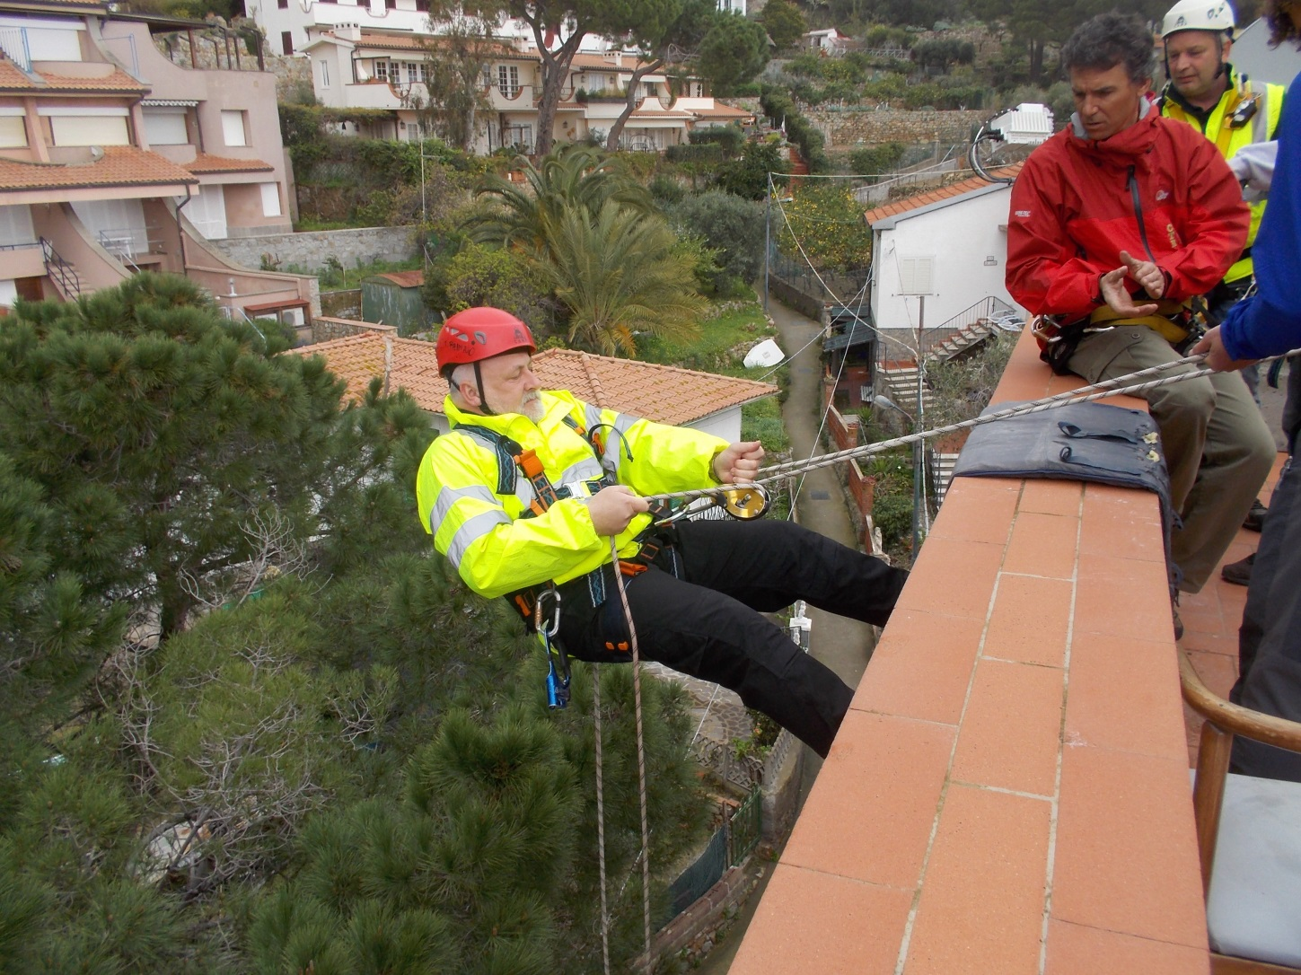
… but they can get down from the top of them!

Slide 44
THANK YOU for your attention! Captain Keith Hart

Slide 45
Lunch and photo time

Slide 46
Pop up slot 6

Slide 47
Pop up slot 7

Slide 48
Constructive Total Loss (CTL)
ITC 1.10.83 - As per Clause 19 – 100% of hull Insured Value
Nordic Plan – 80% of either the Insured Value or Market Value
ADS-DTV – 100% of Insured Value
AIHC – 100% of Insured Value with added twist of not being able to include items used in CTL calculations in Sue and Labour claim
CTL can also be used when talking of a Commercial Total Loss
Part of my 2014 Address to AAA meeting which will go onto the conference website.

Slide 49
CTL cont’d
ITC Clause 19 - constructive total loss of the vessel can only be achieved as a result of a single incident or occurrence and the costs of recovery and/or repair must exceed the insured value.
The ITC Clauses have altered the position under the Marine Insurance Act as the policy now provides that costs of recovery and repair need to be taken into consideration for CTL
Few law cases to assist – on-going legal debates as to what can be termed ‘recovery’ and what this includes

Slide 50
CTL cont’d
Marine Insurance Act (M.I.A.) 1906, section 61 “Where there is a constructive total loss the assured may either treat the loss as a partial loss, or abandon the subject-matter insured to the insurer and treat the loss as if it were an actual total loss.”
If he wants a CTL then as per Section 62(1) of the M.I.A. must tender notice of abandonment “Subject to the provisions of this section, where the assured elects to abandon the subject-matter insured to the insurer, he must give notice of abandonment. If he fails to do so the loss can only be treated as a partial loss.”

Slide 51
CTL cont’d
Section 57 M.I.A.
Actual total loss.
(1)Where the subject-matter insured is destroyed, or so damaged as to cease to be a thing of the kind insured, or where the assured is irretrievably deprived thereof, there is an actual total loss.
(2)In the case of an actual total loss no notice of abandonment need be given.
Section 62(3) the notice has to be given by the assured with reasonable diligence after the receipt of reliable information

Slide 52
CTL cont’d
Abandonment - part of process – Owner does not physically abandon vessel to Underwriters - wreck becoming ‘res nullius’ .”
Customary for underwriters to decline to accept the abandonment once given but to agree to place the assured in the same position as if a claim form, had been issued on that day.
Peculiar to English Law, as is the abandonment itself, that the facts on which notice of abandonment may have to be tested are those applying at the date when the legal proceedings were brought, and not those applying at the date of the notice of the abandonment.
Once notice of abandonment has been tendered /correctly given. Underwriters, either expressly or impliedly (M.I.A. Section 62(5)), will accept that the ship or goods can be considered as a CTL and pay a total loss

Slide 53
CTL cont’d
Most claims for constructive total loss of ship are based upon M.I.A. Section 60(2) of the Act which reads:
In particular, there is a constructive total loss—
(ii) In the case of damage to a ship, where she is so damaged by a peril insured against that the cost of repairing the damage would exceed the value of the ship when repaired.
In estimating the cost of repairs, no deduction is to be made in respect of general average contributions to those repairs payable by other interests, but account is to be taken of the expense of future salvage operations and of any future general average contributions to which the ship would be liable if repaired;

Slide 54
CTL cont’d
Question still to be decided is from what date the salvage operations or general average contributions are to be considered future – is it future from the casualty or from the acknowledgement claim form.
Chairman of Association of Average Adjusters, Lord Donaldson, in his address of 1982.
‘The Anita’ – Panamanian Oriental Steamship Corporation v. Wright [1971] 1 WLR 882 – where four notices of abandonment were given to hull underwriters.
Hall v. Hayman (1912) 2 KB 5 - conceded and assumed that the moment for categorising a salvage operation as ‘future’ was when the notice of abandonment was given.

Slide 55
CTL – cont’d
Advice that would generally be given to owners by average adjusters in cases where a vessel is badly damaged, is to tender an abandonment prior to the signing of any salvage agreements - ensuring such an expense is ‘future’.
Costs of recovery – can SCOPIC costs be included to determine if vessel a CTL?
Marine Insurance Act codified the cases prior 1906, in case of doubt, the decisions of the common law cases could no doubt still be referred to for any further assistance required and possible guidance. The provisions of M.I.A. Section 91(2) ‘The rules of common law including the law merchant, save in so far as they are inconsistent with the express provisions of this Act, shall continue to apply to contracts of marine insurance.’

Slide 56
CTL cont’d
Marine Insurance Act 1906 the S.G. (Ship and Goods) form was still very much in use then – wordings tested.
Why abandonment? Communication/Underwriters may have been in a better position to assist with casualties than they are today.
Large sums involved/claims that are likely to fall on subsidiary insurance and/or on reinsuring Underwriters/Leading Underwriters likely to take time for investigation before accepting that a vessel really is a constructive total loss.
If facts prove that the Notice properly given and vessel was a CTL on that date, then Underwriters accept that they are liable not only for the insured value of the vessel but also for additional expenses which the Ship-owner may incur as sue and labour – Section 78 M.I.A.

Slide 57
Pop up slot 8

Slide 58
Pop up slot 9

Slide 59
LEGAL RESPONSE TO WRECK REMOVAL ORDERS
Hal Watson
Chaffe McCall LLP
Houston, Texas

Slide 60
Grupo Protexa, S.A. v. All American Marine Slip
Commercial P&I coverage dispute over whether removal was “compulsory by law”
Court concluded that removal was not compulsory in part because of shipowner’s response to the wreck removal order
Court’s concerns provide a good checklist for how to respond

Slide 61
Factual Background
M/V HUICHOL sank on December 14, 1985
45 miles offshore
150 feet of water
28 crewmen go down with the ship
Wreck is located in the middle of the Bay of Campeche offshore oilfields
Intense pressure from Pemex and deceased workers’ union to get bodies for burial

Slide 62
Legal Framework
Article 86 of the Navigation Law:
If a ship runs aground or sinks in a port, in an area considered as such in terms of the last paragraph of Article 33, or in a general waterway of communication, in a manner that constitutes a navigational obstacle or that affects navigation, it shall be removed within the period set forth by the Navy Department.

Slide 63
Legal Framework
Article 263 of the Means of Communication Law:
Compels the owner of a wreck to remove the vessel if it sinks within a port, or in the vicinity/proximity of a port provided it affects the port.

Slide 64
The Court’s standard for determining whether removal was “compulsory by law”
Would a reasonable owner have concluded that the potential liability imposed by law be sufficiently great in amount and likely to occur to justify the expense of removal?

Slide 65
Protexa’s response to the wreck removal order
Assigned the matter to an in-house corporate lawyer
Lawyer spent 45 minutes reviewing the order
Did not hire technical advisers to review options
Informal presentation to the port captain

Slide 66
Court’s reasons for concluding Protexa did not act reasonably
Inadequate review of the legality of the order
Failure to consider court proceedings
Insufficient consideration of legal sanctions
Failure to obtain proper technical advice
Approached authorities without being armed with legal arguments and arguments based on technical considerations regarding necessity and cost of removal

Slide 67
The Protexa roadmap to proper handling of ROW orders
Get competent maritime counsel involved early
Get competent technical advisers involved early
Consider all your options

Slide 68
What are the options?
Compliance
Approach authorities and attempt to convince them of invalidity or technical impossibility, or to only require steps short of removal
Litigation
Ignore the order

Slide 69
Legal considerations
Is the wreck inside territorial waters?
If the wreck is outside of territorial waters, is there a basis under UNCLOS for the coastal state to exercise jurisdiction
Protection of the environment
Interference with exploitation of the resources of the EEZ

Slide 70
Technical considerations
Is the wreck a hazard to navigation? 33 C.F.R. § 245.20 provides a good example:
(1) Location of the obstruction in relation to the navigable channel and other navigational traffic patterns.
(2) Navigational difficulty in the vicinity of the obstruction.
(3) Clearance or depth of water over the obstruction, fluctuation of water level, and other hydraulic characteristics in the vicinity.
(4) Type and density of commercial and recreational vessel traffic, or other marine activity, in the vicinity of the obstruction.
(5) Physical characteristics of the obstruction, including cargo, if any.
(6) Possible movement of the obstruction.
(7) Location of the obstruction in relation to existing aids to navigation.
(8) Prevailing and historical weather conditions.
(9) Length of time the obstruction has been in existence.
(10) History of vessel accidents involving the obstruction.

Slide 71
Nairobi International Convention on the Removal of Wrecks
Response to the inability of coastal states to require removal of wrecks outside of territorial waters
Considerable concern to countries with shallow waters beyond the territorial sea

Slide 72
Geographic applicability
“Convention area” is the Exclusive Economic Zone 200 nautical miles from the baselines
Allows coastal state to extend Convention to its territorial sea

Slide 73
Exclusions
Measures taken under the Pollution Convention
Warships or other state owned and operated ships not used for commercial purposes

Slide 74
Reporting requirements of the master and operator
Master and operator must report wreck to the “Affected State”
Report to include:
Precise location
Type, size and construction of the wreck
Nature of damage and condition of the wreck
Nature and quantity of the cargo
Amount and type of oil

Slide 75
Locating and marking by the Affected State
Affected State shall used all practicable means to warn mariners and other concerned states
Affected State shall ensure that reasonable steps are taken to mark the wreck

Slide 76
Removal by the owner
Registered owner shall remove a wreck determined to constitute a hazard
If the owner commences removal, the Affected State may intervene only to the extent necessary for safety and protection of the marine environment
Affected State may set a reasonable deadline

Slide 77
Determination of hazard
Type, size and construction of the wreck
Depth of water
Tidal range and currents
Particularly sensitive sea areas
Proximity of shipping routes or established traffic lanes
Traffic density and frequency
Type of traffic
Nature and quantity of cargo and oil onboard and likely damage to the environment

Slide 78
Determination of hazard
Vulnerability of port facilities
Prevailing meteorological and hydrographical conditions
Submarine topography
Height of the wreck above or below the surface at low tide
Acoustic and magnetic profiles of the wreck
Proximity of offshore installations, pipelines, etc.
“Any other circumstances that might necessitate the removal of the wreck”

Slide 79
Liability of the Owner
Registered owner is liable for the costs of locating, marking and removing the wreck unless the casualty that caused the wreck resulted from:
Act of war, or a natural phenomenon of exceptional, inevitable and irresistible character
Act of omission of a third party done with intent to cause damage
Wholly caused by the negligence of authority responsible for maintenance of lights or navigational aids

Slide 80
Limitation of Liability
Convention expressly preserves the right to limit under applicable national law or the 1976 Limitation Convention

Slide 81
Exceptions to owner’s liability
No liability under the Convention to the extent that the liability conflicts with
Pollution Convention
Hazardous and Noxious Substances Convention
Nuclear Energy Convention
Bunker Convention

Slide 82
Compulsory Insurance
Requires the registered owner to carry insurance or other financial security in an amount equal to the limits of liability under applicable national or international limitation regime, not to exceed amounts required by the 1976 Limitation Convention
Requires COFR
Allows direct action to limits of insurance, but allows insurer defense of willful misconduct

Slide 83
Entry into force
Enters into force 12 months after 10 states have ratified, accepted or approved
Will enter into force 14 April 2015, 12 months after Denmark’s ratification
Current adherents:
Bulgaria
Denmark
Germany
India
Iran
Malaysia
Morocco
Nigeria
Palau
United Kingdom

Slide 84
Pop up slot 10

Slide 85
IMCC Dublin 24-26 September 2014 www.igpandi.org

Slide 86
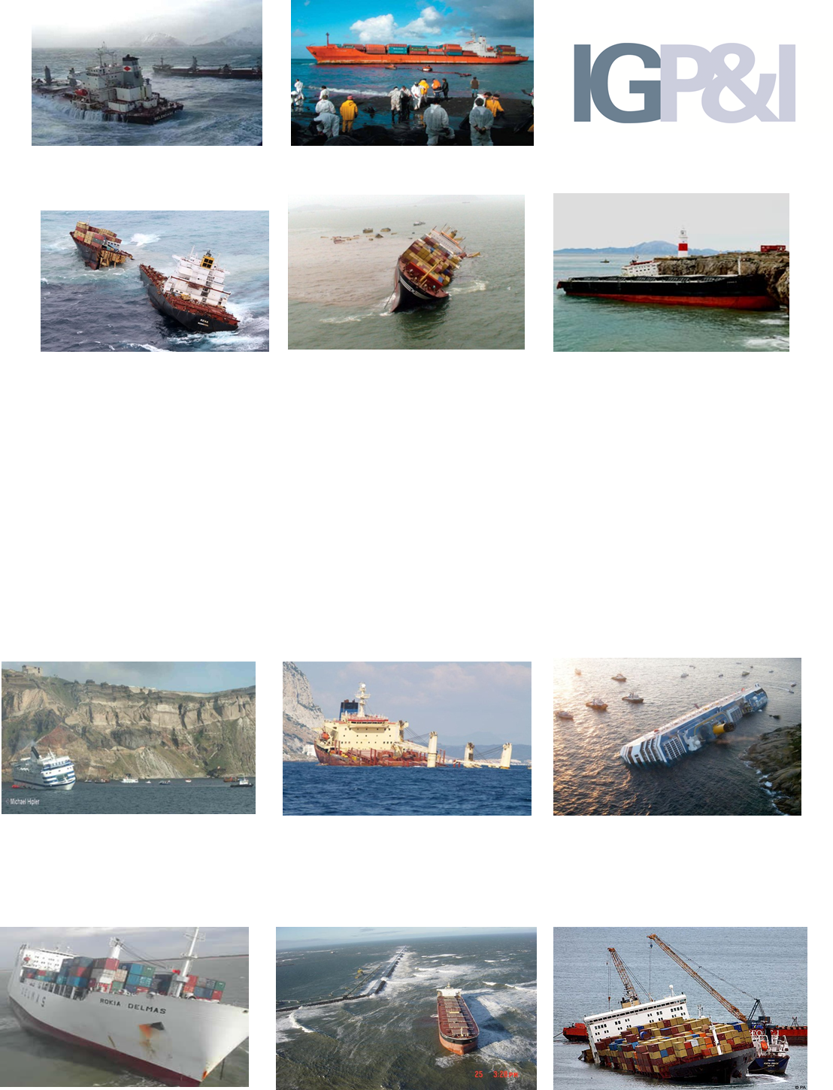
WRECK REMOVAL POST COSTA CONCORDIA –
THE IG PERSPECTIVE

Slide 87
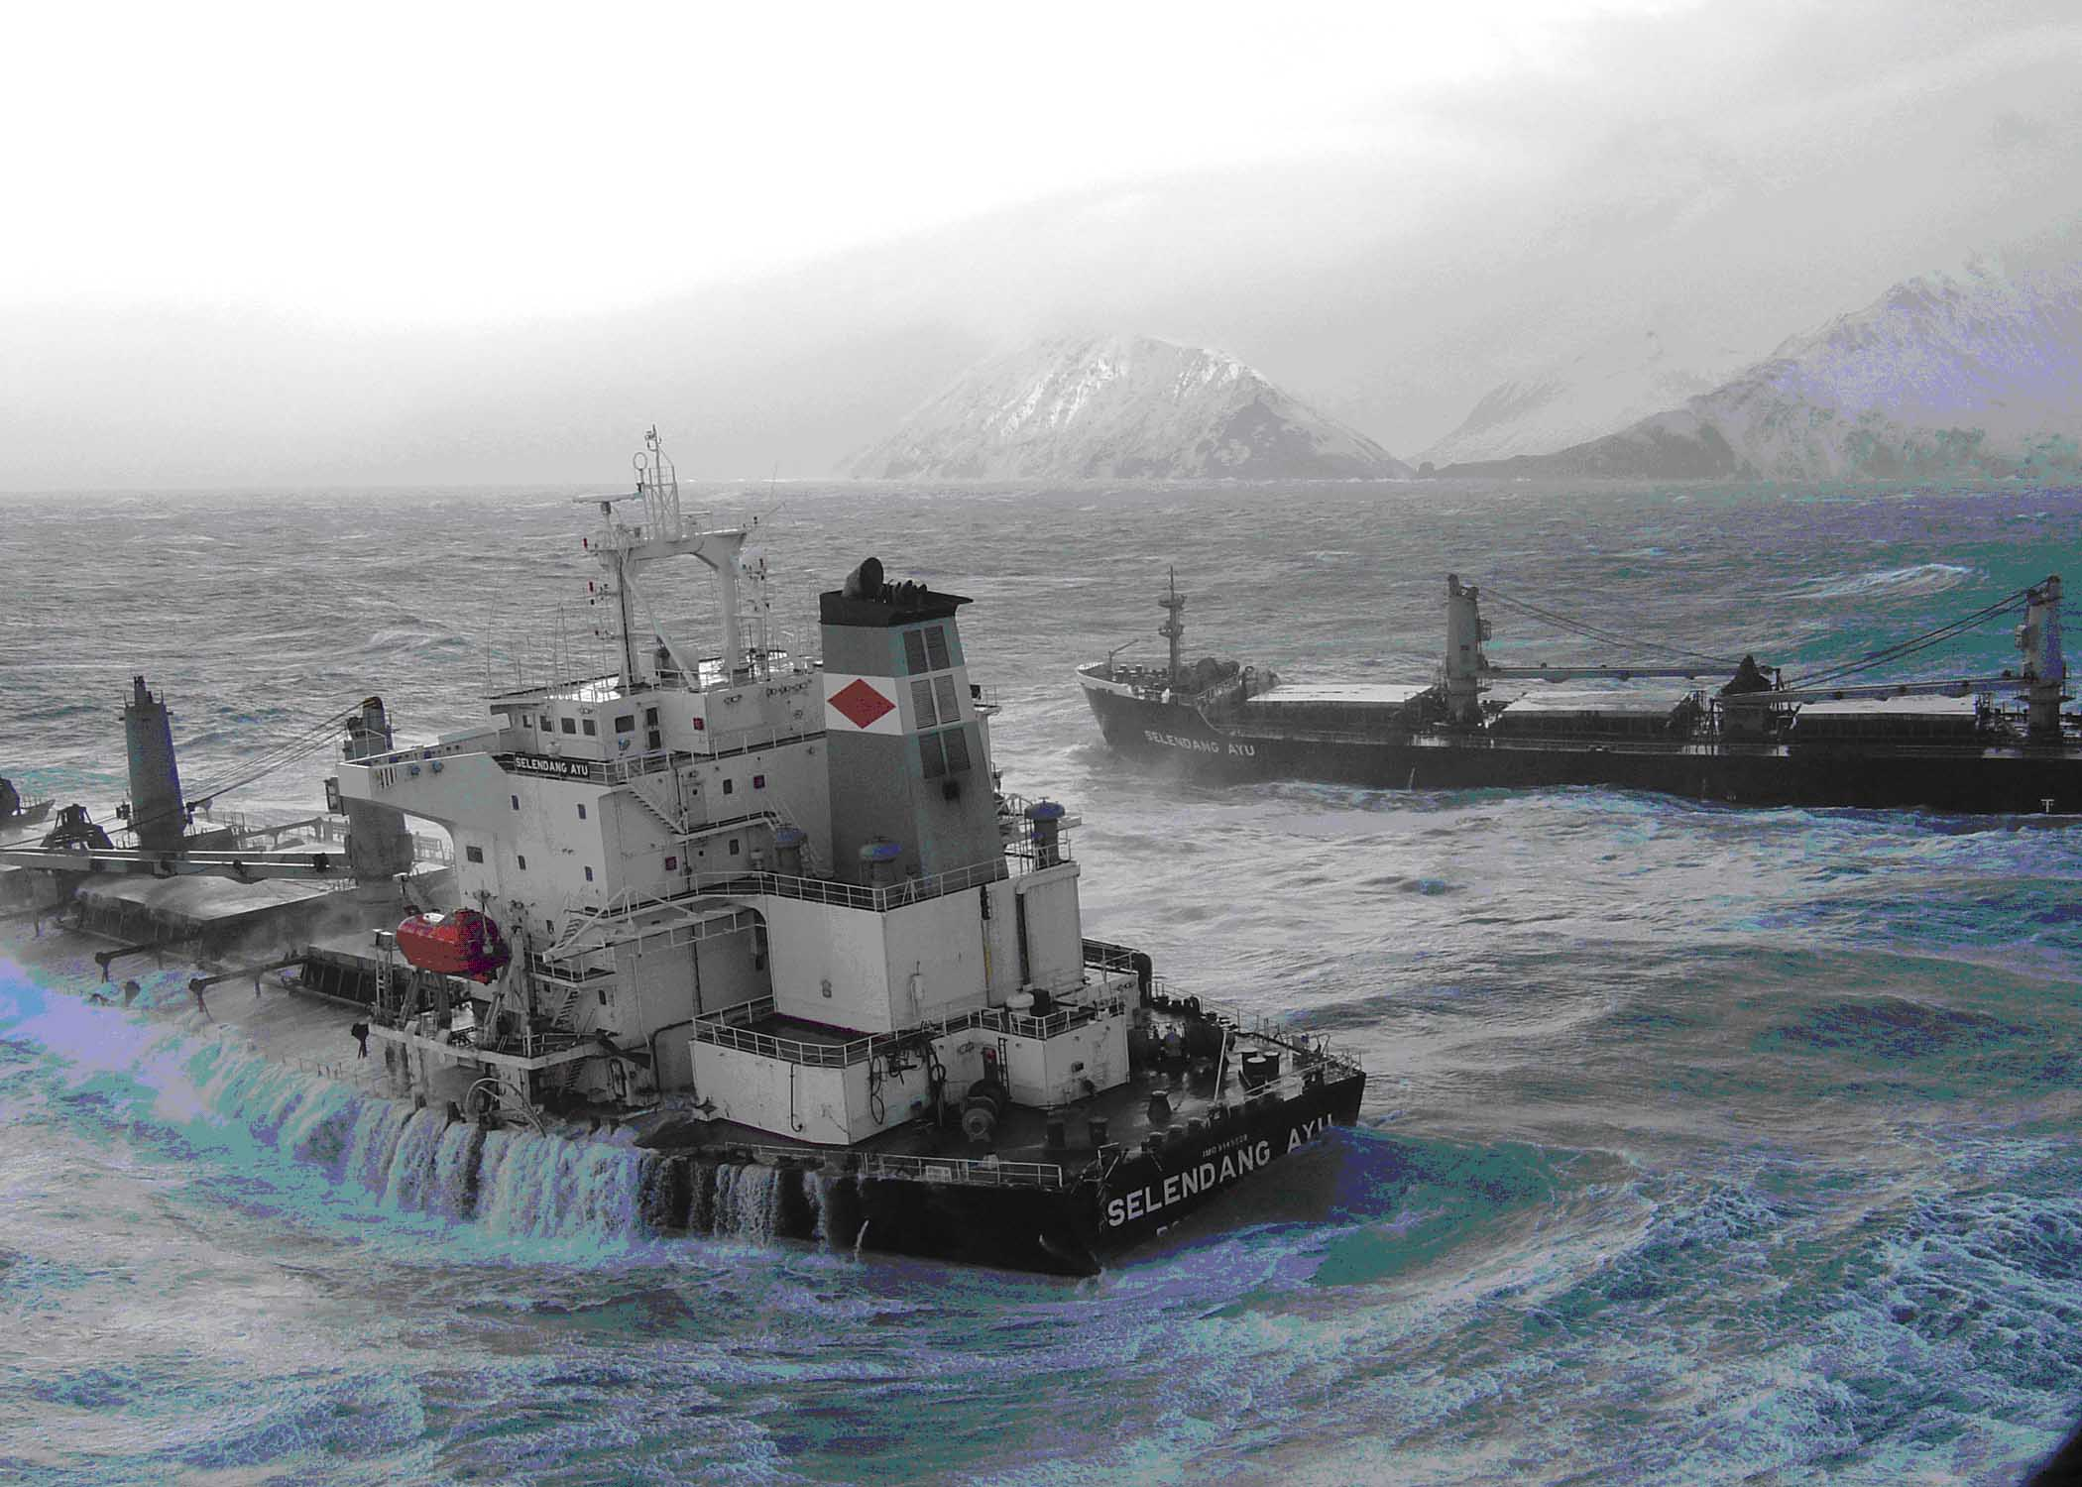
An overview of the IG Large Casualty W/G Review
Findings and conclusions
IG W/G recommendations
What we will not do
COSTA CONCORDIA – a unique case?

Slide 88
OVERVIEW AND FINDINGS OF THE W/G’S REVIEW
Formation and remit of the IG W/G
Location
Contractual arrangements
Performance of Salvage teams and SCR’s in attendance
Bunker Removal
Problematic Cargo
Impact of Government / other authority influence and/or interference in operations

Slide 89
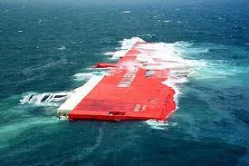
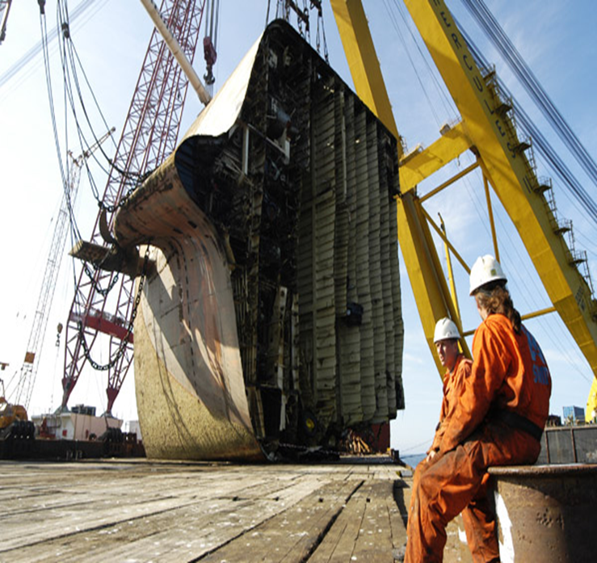
LOCATION
Response Equipment
Weather
Hazard to Navigation
Threat to Environment
Role of Chance
“TRICOLOR” – 14 December 2002

Slide 90
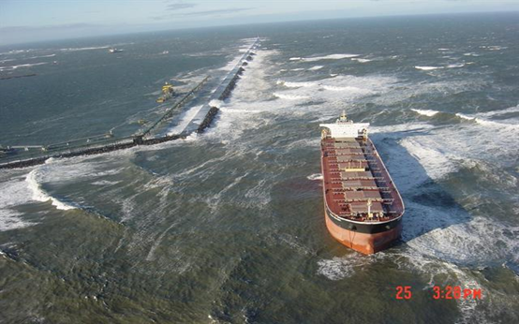
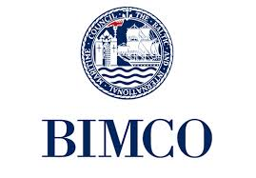


CONTRACTUAL ARRANGEMENTS
Bonus and Penalty Provisions
Operational Planning
Wreck Removal Contracts
“OCEAN VICTORY” – 24 October 2006

Slide 91
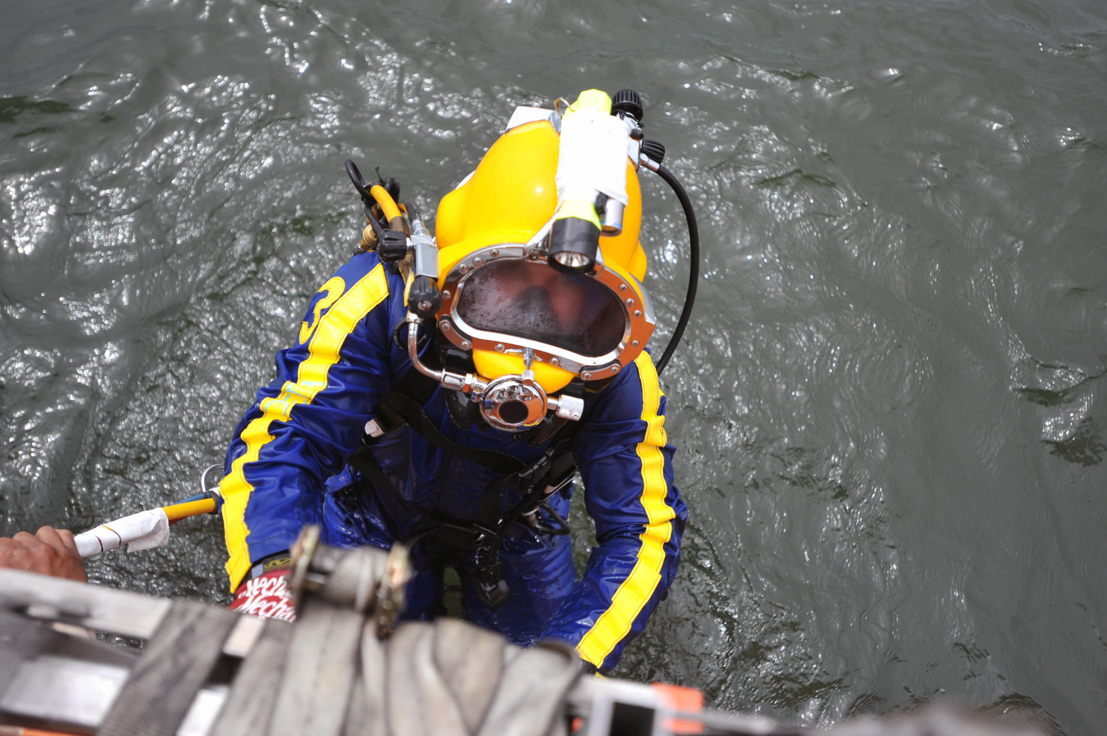
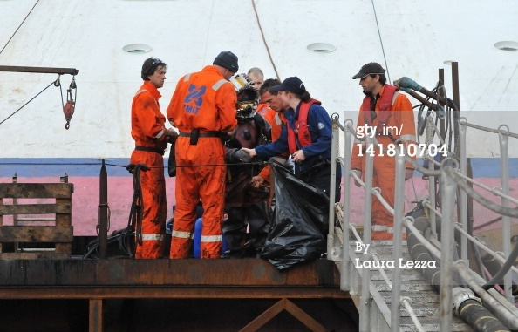
EXPERT COMPETENCE
Salvors
Salvage Masters
Consultants
SCRs

Slide 92
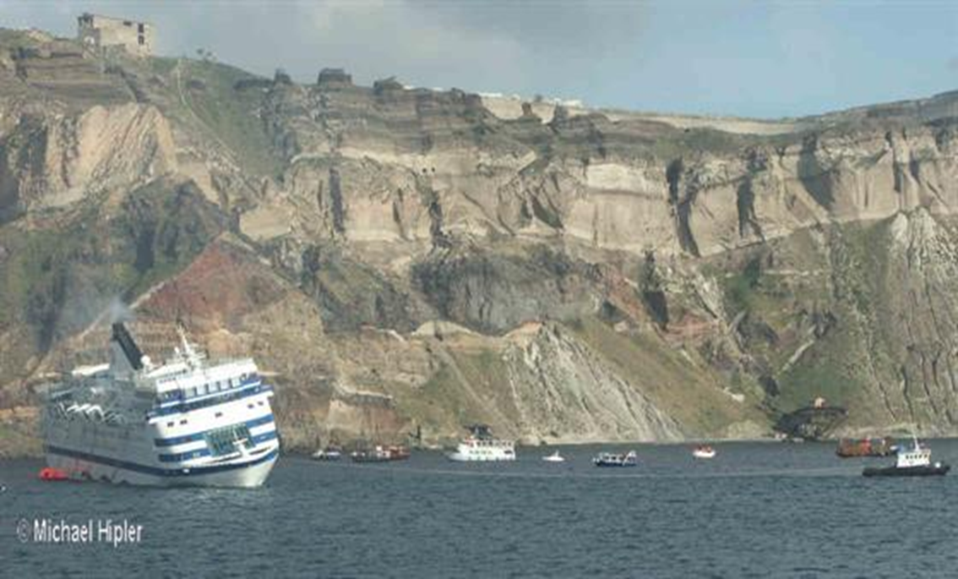
BUNKER REMOVAL
Zero Tolerance
Role of Authorities
Comment
“SEA DIAMOND” – 6 April 2007

Slide 93
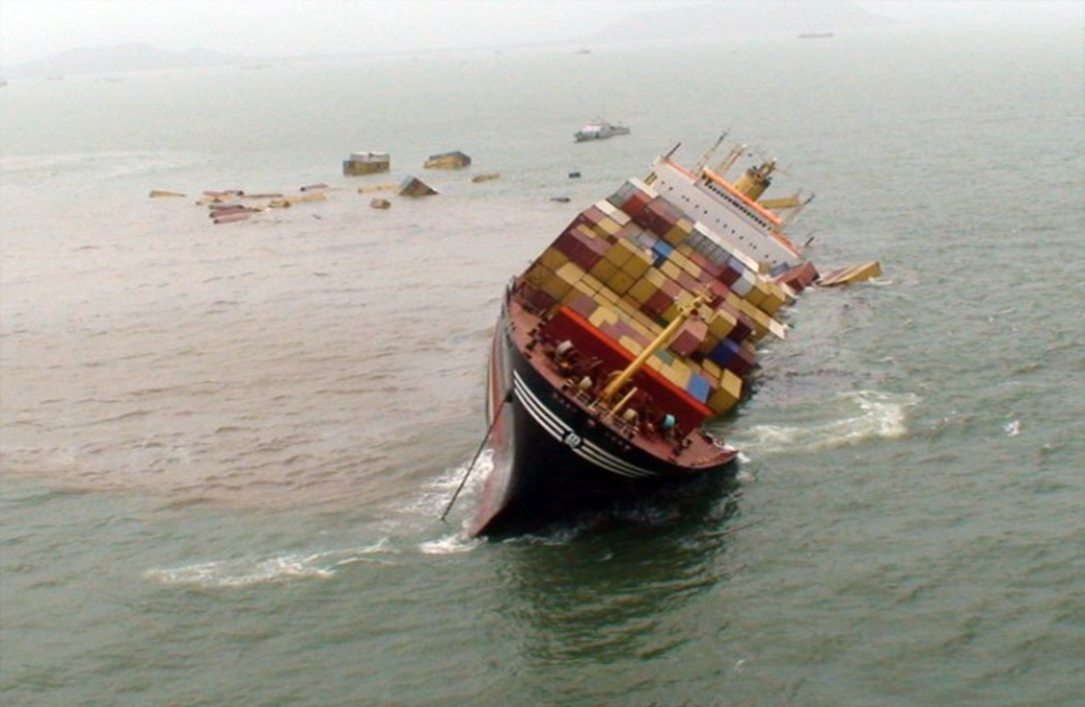
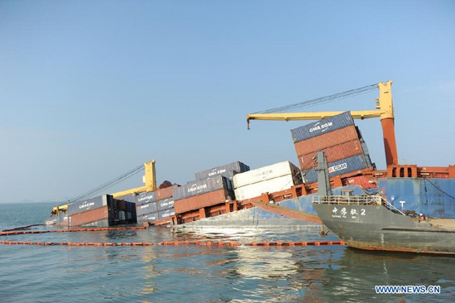
CONTAINERS AND OTHER PROBLEMATIC CARGOES :
Container Retrieval and Removal: Technical Difficulties
Disposal Ashore – Recycling Issues
Other Cargoes
“BARELI” – 15 March 2012
“MSC CHITRA” – 7 October 2010

Slide 94
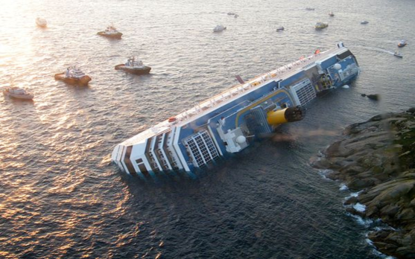
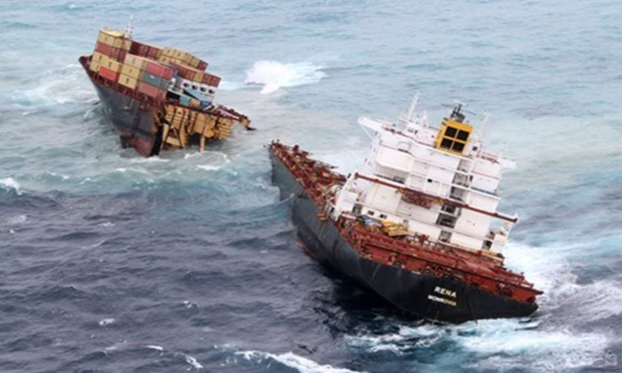
INTERFERENCE OF STATE LOCAL AND PORT AUTHORITIES
“COSTA CONCORDIA”
13 January 2012
INFLUENCE?
“RENA” – 5 October 2011
INTERFERENCE ?

Slide 95
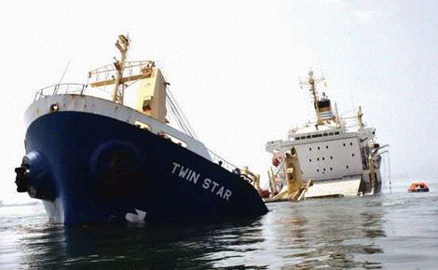
IG W/G RECOMMENDATIONS
Outreach programme
MOU
Current and Planned Engagement
Continued data collection
Termination of SCOPIC

Slide 96
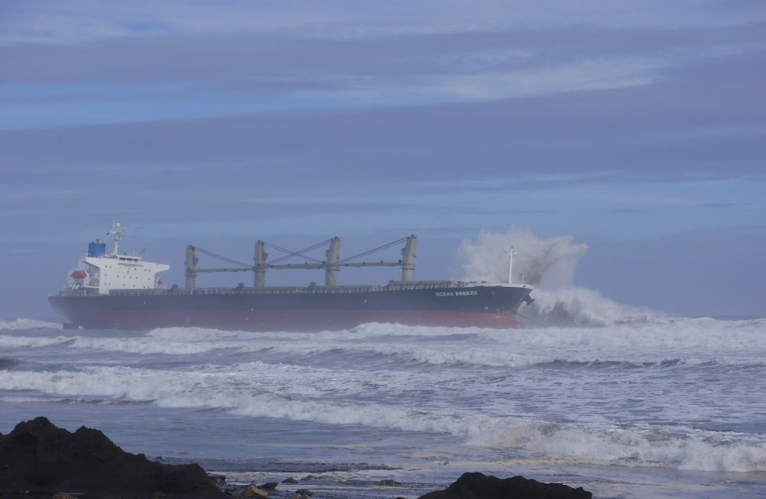
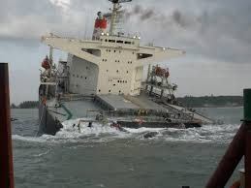
WRECK REMOVAL OPERATIONS POST COSTA CONCORDIA
OCEAN BREEZE - 16 August 2012
SMART – 19 August 2013

Slide 97
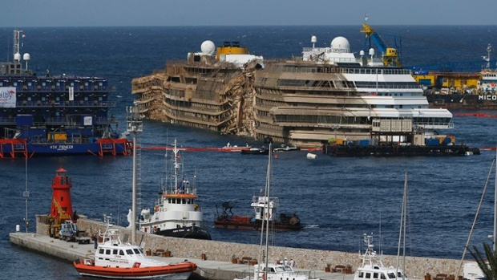
COSTA CONCORDIA – A UNIQUE CASE?

Slide 98
Pop up slot 11

Slide 99
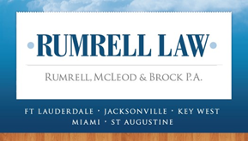
And now we’re in the Florida keys
Lindsey Brock
Rumrell, McLeod & Brock, P.A.
www.RumrellLaw.com

Slide 100
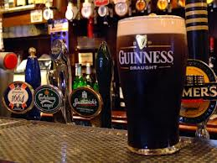
I am all that stands between you and . . .

Slide 101
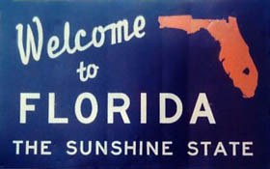

Slide 102
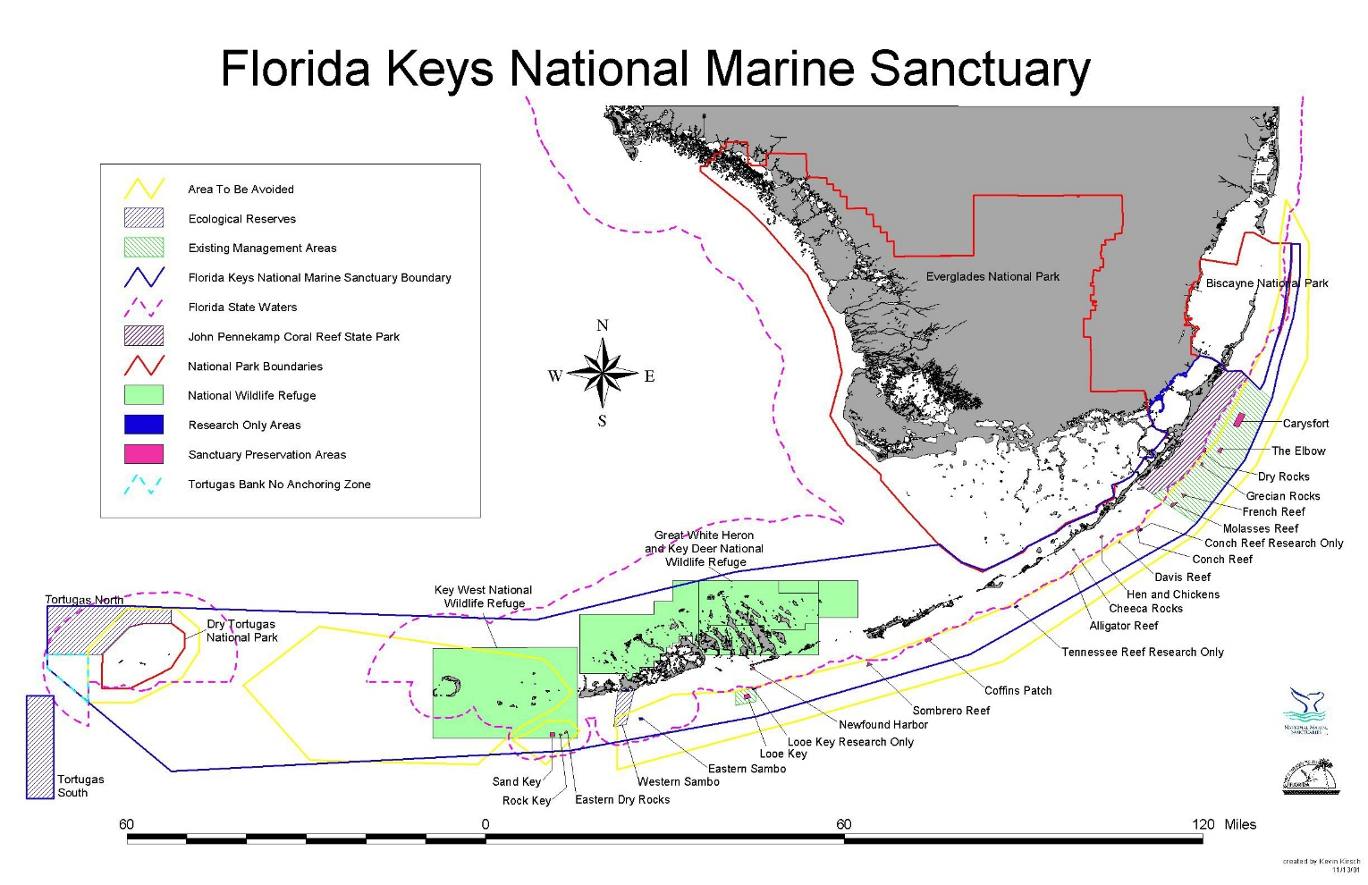

What’s so special about the Florida keys?

Slide 103
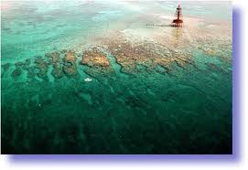
Florida Keys National Marine sanctuary
60 percent of its protected area is located in Florida state waters
Jointly managed by National Oceanic & Atmospheric Association (NOAA) and the State of Florida
NOAA’s primary management partner is the Florida Department of Environmental Protection (FDEP)
Uses a strategy called “marine zoning” for varying levels of protection of habitat, diverse uses and damage assessments
Ecological Reserve Areas
Sanctuary Preservation Areas
Wildlife Management Areas
Existing Management Areas
Special-Use Areas

Slide 104
Who are the players at NOAA?
National Ocean Service – NOS – general oversight on marine environment
Office of Response & Restoration – ORR
charged with responding to oil spills, chemical accidents, and other emergencies in coastal areas
responsible for providing scientific support to the Federal On-Scene Coordinator - FOSC
assesses damage to and restores plants, animals, and environments after a marine or coastal spill
Federal On-Scene Coordinator – FOSC – response oversight on oil spills, chemical accidents, and other emergencies in coastal areas
United States Coast Guard – USCG – FOSC for all marine spills and accidents

Slide 105
How does the OR&R Function?
Assessment and Restoration Division – ARD – that is responsible for evaluating and restoring coastal and estuarine habitats damaged by hazardous waste releases, oil spills, and vessel groundings
ARD comprises NOAA biologists, toxicologists, ecologists, policy analysts, information specialists, attorneys, geologists, environmental engineers, and economists
ARD has developed specific expertise in aquatic risk assessment techniques, contaminated sediment issues, and data interpretation
ARD joined with NOAA's General Counsel for Natural Resources and Office of Habitat Conservation to create the Damage Assessment, Remediation and Restoration Program – DARRP
ARD conducts a Natural Resource Damage Assessment – NRDA – to determine the extent of harm to natural resources and their uses and the appropriate type and amount of environmental restoration required

Slide 106
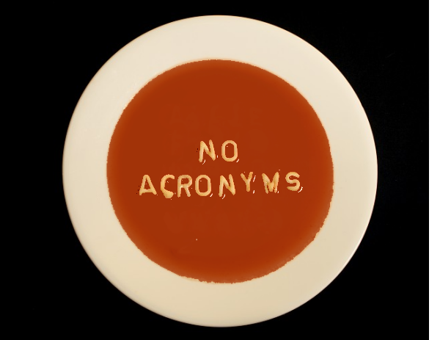
Enough Alphabet soup!

Slide 107
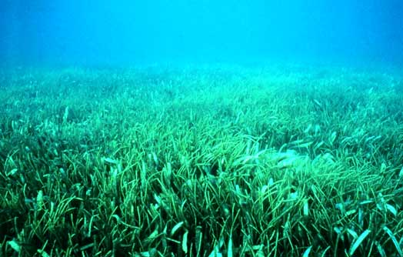

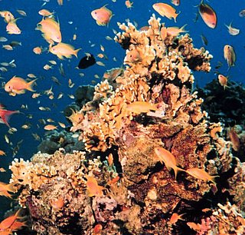
What is protected in the FKNMS?
Marine Protection, Research and Sanctuaries Act, 16 U.S.C.S. 1431 et seq., broadly defines “sanctuary resource” as any living or nonliving resource of a national marine sanctuary that contributes to the conservation, recreational, ecological, historical, research, educational, or aesthetic value of the sanctuary. 16 U.S.C.S. § 1432(8). United States v. Fisher, 977 F. Supp. 1193 (S.D. Fla. 1997).

Slide 108
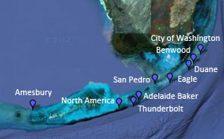
Shipwrecks? That’s what we want to avoid being! What are the odds?

Slide 109
Damages – strict liability
Under the primary restoration component of damages, the government is entitled to recover the cost of implementing its plan to restore or replace the injured resource, or the cost of acquiring the equivalent of the sanctuary resource, if it cannot be restored or replaced
Prop Scar Restoration Program is an appropriate compensatory restoration project that provides seagrass services equivalent to those lost due to the grounding
Habitat Equivalency Analysis assesses size of area and time required for complete restoration. Up to 100 years for 1.5 acres of damage
The cost to restore 1.5 acres of seagrass in 1997 dollars over $560,000 United States v. Fisher, 977 F. Supp. 1193 (S.D. Fla.1997) United States v. Great Lakes Dredge & Dock Co., 259 F.3d 1300 (11th Cir. Fla.2001)

Slide 110
Habitat equivalency analysis
Document and estimate the duration and extent of injury, from the time of injury until the resource recovers to baseline, or possibly to a maximum level below baseline
Document and estimate the services provided by the compensatory project, over the full life of the habitat
Calculate the size of the replacement project for which the total increase in services provided by the replacement project equals the total interim loss of services due to the injury
Calculate the costs of the replacement project, or specify the performance standards in cases where the responsible party will be implementing the compensatory habitat project

Slide 111
How do ship owners respond?
Non Tank Vessel Response Plan – NTVRP – recently into effect 30 January 2014
Self propelled non tank vessels 400 gross tons or more with a capacity of 2,500 barrels or greater must meet the salvage, emergency lightering and marine firefighting requirements
Effective within territorial sea of USA – 12 nm
Vessel owner or operator includes a statement certifying that the NTVRP meets the applicable requirements of 33 CFR 155.1065(b); 33 CFR 155.5065(b)
Implement VRP when “the Master has determined that the resources and personnel available on board cannot meet the needs of an actual or potential incident.”
Salvage Marine Fire Fighting – SMFF – provider should be put on notice immediately
What happens if ship owner improperly implements the VRP?

Slide 112
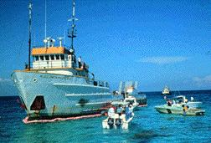
What other laws can apply?
Oil Pollution Act 1990 - 33 U.S.C. § 2701 et seq.
Clean Water Act – 33 U.S.C. § 1251 et seq.
Migratory Bird Act – 16 U.S.C. § 703, et seq.
River and Harbors Act – 33 U.S.C. § 401 et seq.
Ports and Waterways Safety Act – 33 U.S.C. § 1232, et seq.
The Park System Resource Protection Act – 16 U.S.C. § 19 et seq.
Florida Pollutant Discharge Prevention and Control Act – Fla. Stat. §§ 376.011-376.21
In November 1989, the M/V Alec Owen Maitland, ran hard aground on shallow reefs in the Key Largo National Marine Sanctuary, devastating the impact areas, killing or displacing corals, sea fans, and fish, and destroying the physical structure of the underlying reef framework.

Slide 113
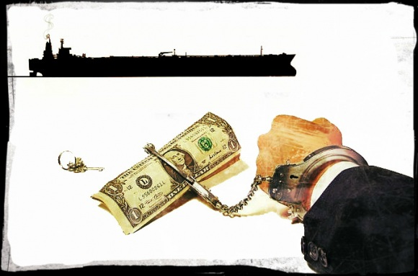
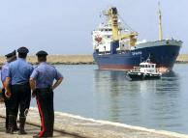
Potential Criminal liability
Act for the Prevention of Pollution from Ships (APPS) 33 USC § 1901
False Statement Act 18 USC § 1001
Conspiracy 18 USC § 371
Obstruction of Justice 18 USC § 1505
Tampering with Witnesses 18 USC § 1512
Sarbanes-Oxley Act of 2002, 18 USC § 1519

Slide 115
Lindsey Brock
Rumrell, McLeod & Brock, P.A.
www.RumrellLaw.com
Special thanks to Lindsay Malen, Titan Salvage & George Chalos, Esq.
for their content from Federal Bar Association
Admiralty Law Committee Seminar
Ft. Lauderdale Florida, August 2014

Slide 116


Slide 117
Illustrious cast
Shipowner – Steve Malone
Hull & Machinery insurer – Paul Cunningham
Salvor – Dan Dettor
Adjuster – Keith Jones
SCR – Keith Hart
Lawyers – Hal Watson & Lindsay Brock
Shipbroker – Keri Libretto
Holding it all together – Charlotte Warr

