Slide 1


IUMI 2014
Hong Kong
Building Expertise for a Changing World
A Short Overview
Massimo Canepa – IMCC liaison at IUMI

Slide 2
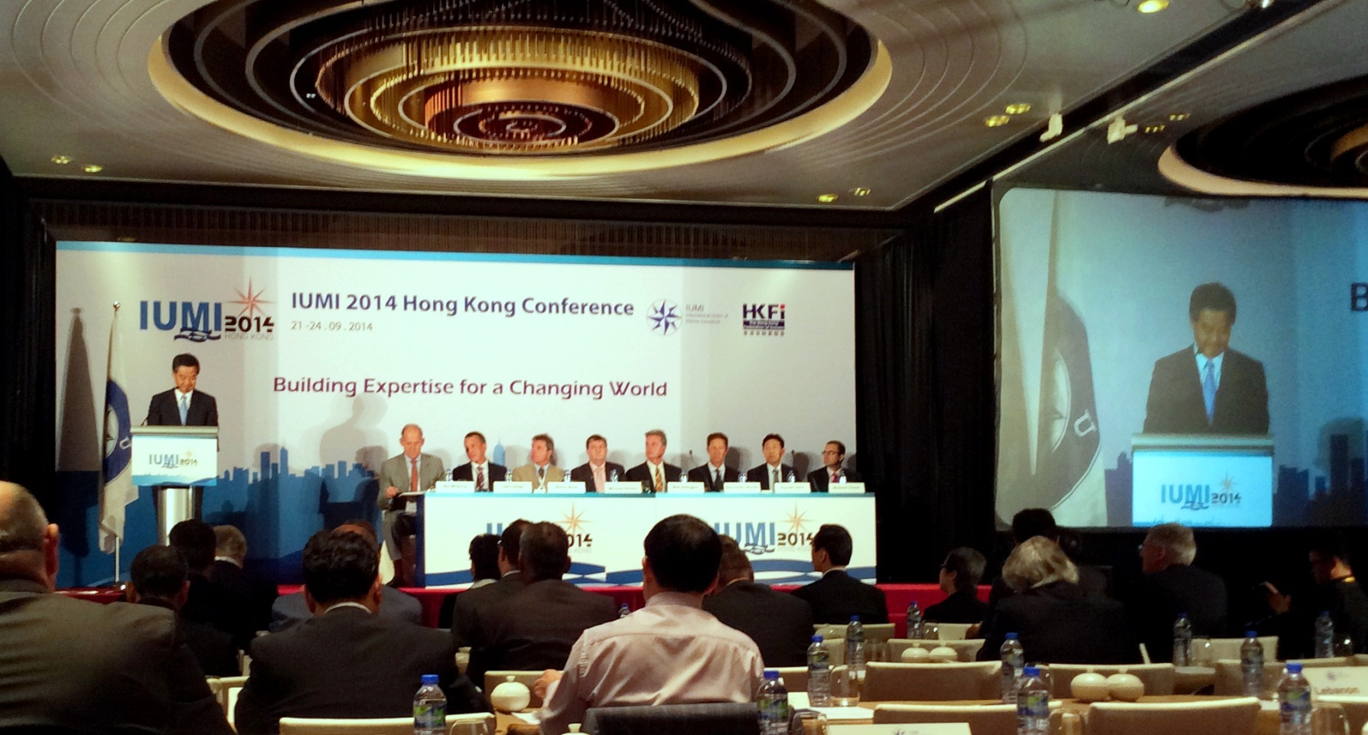
Opening Session
Welcome Address by CY Leung
Chief Executive of HK Special Administrative Region

Slide 3
Key statements
The government is committed to ensuring that Hong Kong remains an international maritime centre.
Marine insurance will be a key contributor.
There are more than 150 insurers, the largest concentration in Asia, of which 88 are authorised to provide marine and cargo insurance,
Seven P&I clubs, the largest cluster outside London.
In the first half of 2014, Hong Kong’s Hull and Cargo insurance gross premiums reached HK$1.8 billion.

Slide 4
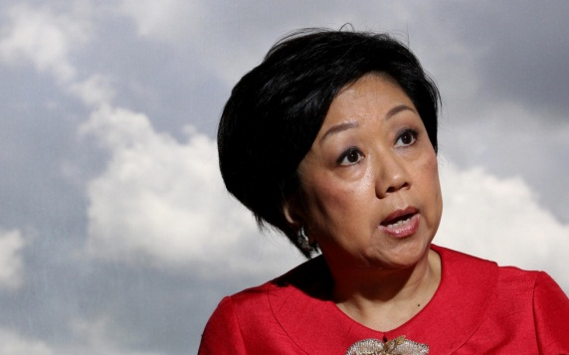
Key Note Presentations
Hon.Laura Cha Chairman of Financial Services Development Council
Shift to Asia and its Implications
Mainland China is the world’s second largest economy
Asia retains 90% of ship order book
25% of global marine premiums are in the Asian Insurance Market
20% of Mainland commercial transactions are in RMB (2010 was 2%)

Slide 5
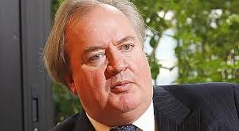
Key Note Presentations
Prof. Dennis Kessler CEO of SCOR RE
Expertise and Management Key Features of Sustainable Growth
Asia dominates in number of shipbuilding yards and energy supply flow.
9 out of 10 largest container ports - 2 of 5 top finance institutions
5 of 5 top shipbuilders - 4 of 5 top shipowners are in Asia.
Evolving risks due to size of ships - complexity need new ways of assessment.

Slide 6
...as Asia is expected to dominate global container flow in 2020..
Forecast 2010 mTEU
(3.5%)
(8.0%)
(4.7%)
3.7
20
(3.0%)
15
(6.7%)
0.7
(4.7%)
2.6
5.2
(4.3%)
4.5
20
64
2.5
(4.3%)
(4.6%)
(6.8%)
(8.8%)
4.4
(3.7%)
26
26
(6.8%)
4.5
2.9
2.9
(10.6%)
(4.0%)
2.7
(7.1%)
(6.7%)
(7.1%)
2.9
5.2
= Asia related¹
(6.9%)
= Europe related¹
Source: BCG container flow forecast model
= Other routes

Slide 7
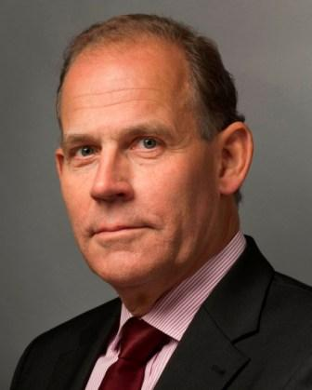
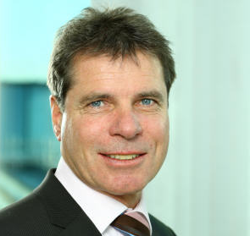
Ole Wikborg Dieter Berg
IUMI Core Competences
Visibility Lobbying – Contacts with Affiliates – Political Forum – Salvage Forum - Contacts with IMO
Statistics Increase and improve the source of information from Members
Education Students - Seminaries
Secretariat Expand compatibly with financial resources

Slide 8
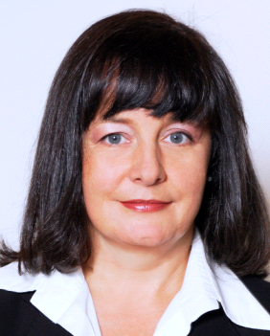
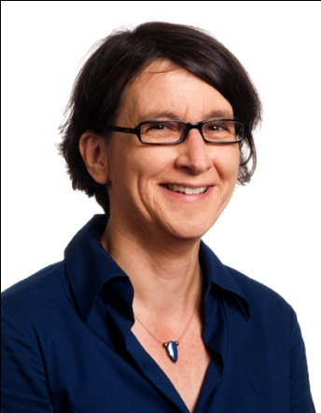
Global Marine Insurance Report 2014
Patrizia Kern
Chairman, Facts & Figures Committee
Head Marine
Swiss Re Corporate Solutions
Astrid Seltmann
Vice chairman, Facts & Figures Committee
Analyst/Actuary @ Cefor

Slide 9
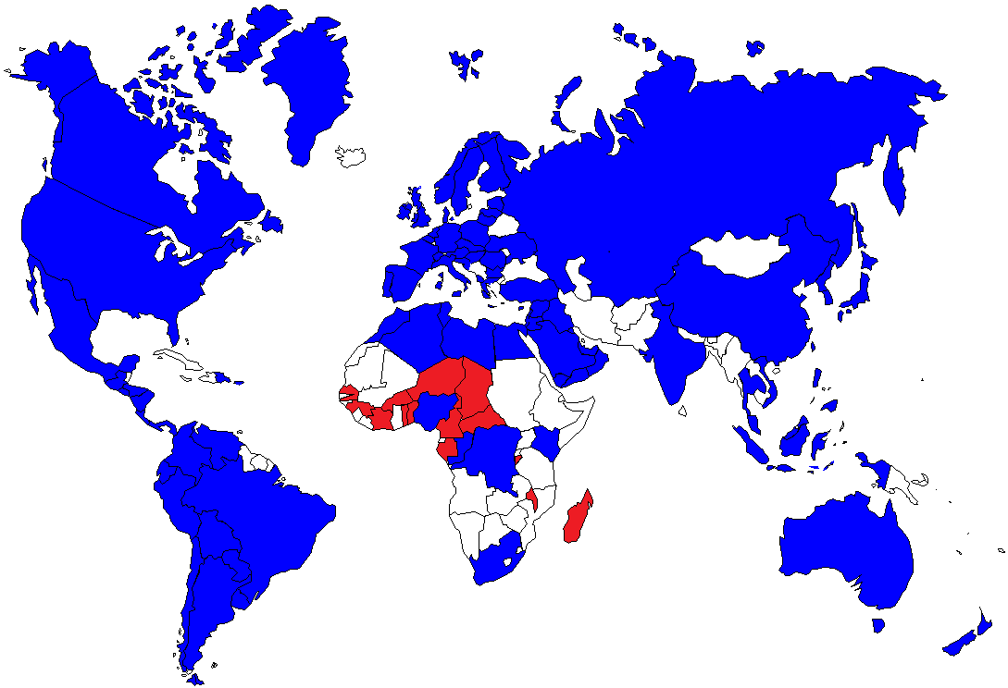
Facts & Figures
Country data collection 2013 Premium
Premium volume of all countries covered in 2013:
34.2 billion USD
9

Slide 10
Marine Premium 2013 - by line of business
Total: 34.2 USD billion
Change 2012 to 2013: -1.7%

Slide 11
Marine Premium 2013 – by region
Total: 34.2 USD billion
Change 2012 to 2013: -1.7%

Slide 12
Marine premium 2008-2013 – as of 2014
UK-IUA
adjusted
2012->2013: - 1.7%
no premium growth
2008: China
2010: non-IUMI Asia
Latin America, Middle East, Africa complete
Global premium:
2012: 34.8 USD bill.
2013: 34.2 USD bill.
(both as of 2014)

Slide 13
Hull Premium 2013 – by region
Total: 8.53 USD billion
Change 2012 to 2013: -0.8%

Slide 14
Hull – Gross* Ultimate Loss Ratio
Europe/USA**, Underwriting years 1996 to 2013
Costa Concordia peak
2011
Strong impact major losses
(Costa Concordia & others)
2012/2013
Less major loss impact as in 2011.
2013
Improvement, but technical result still at loss (18th year).
Technical break even: gross loss ratio not exceeding 100% minus the expense ratio (\20%-30% acquisition cost, capital cost, management)

Slide 15
Hull claims trends
Claim frequency
Down after peak in 2008.
Long-term positive to stable trend.
Total loss frequency
Long-term positive trend.
Repair cost
Down after peak in 2008, stable to decreasing since.
Major losses
Strong impact on 2011 results and other years. First half year 2014: next to none.

Slide 16
Hull portfolio trends
World fleet: continues to grow, especially tonnage
Insured values:
  Renewals: value reduction seems to normalize
  Newbuilds: inflow of high-value vessels continues
Global hull premium: 2012->2013 stagnation

Slide 17
Change in insured values on renewal
Some reduction to be expected due to aging of vessels.
Financial crisis effect
Source: Cefor NoMIS J'une 2014

Slide 18
Summing up Hull
World fleet continues to grow, insured risk increases, global hull premium stays flat.
Claims cost & frequency improve, but major claims risk cannot be judged from one year and follows exposure.
Technical results still at loss (18th consecutive year).
Some improvement, due to reduction in claims cost.

Slide 19
Cargo Premium 2013 - by region
Total: 18.2 USD billion
Change 2012 to 2013: -0.5%

Slide 20
Cargo Premium /
World Trade Values & Exports
Index of evolution, 1995=100%
Upswing in trade continues.
Cargo premium stagnates - but different by region.
Some cycle irregularities due to exchange rates.
Source: World Trade Values: IMF

Slide 21
Cargo – Gross Ultimate Loss Ratio
Europe/USA, Underwriting years 1996 to 2013
2012 Sandy peak
Since 2007: Deterioration of good 2002-2006 results.
2009-2013
2011-2013 start at about 72%.
2012 Sandy affects mainly US.

Slide 22
Summing up cargo
Upswing in trade continues, cargo premium stagnates.
Without Sandy, 2010-2013 show similar loss ratios.
Claims pattern differ in recent years.
Impact of natural catastrophes (Thailand floods, Sandy).
Claim cost unlikely to decrease.
Results differ by region – some do well, some deteriorate.
Future uncertain – difficult conditions continue.

Slide 23
Summing up Conference
A very good IUMI 2014
Very high number of attendees
Interesting presentations well delivered by the speakers
Excellent organisation, despite the inexplicable hiccups of the voting system for the evaluation of presentations
Successful work by the Chairman, Ex-Co and Secretary to strengthen IUMI’s voice in IMO and other key maritime organisations
IMCC may be a precious asset
The conference papers will be available in the IUMI web site www.IUMI.com

