Slide 1

«IUMI 2015» – The Way Forward
International Marine Claims Conference
Dublin, 25th – 27th September 2013
Lars Lange
IUMI Secretary General, Hamburg

Slide 2
Agenda
What is IUMI?
“IUMI 2015”
IUMI 2015: Lobbying
Political Forum
IUMI 2015: Information
IUMI London Conference 2013

Slide 3
1. What is IUMI?
IUMI: International Union of Marine Insurance
IUMI represents national and international marine insurers, no brokers, no P&I Insurance
51 national (marine) insurance associations and 16 IUMI Professional Partners (IPPs)
IUMI considers all issues of interest to the worldwide marine insurance industry
  Lobbying
  Information

Slide 4
Agenda
What is IUMI?
“IUMI 2015”
IUMI 2015: Lobbying
Political Forum
IUMI 2015: Information
IUMI London Conference 2013

Slide 5
2. “IUMI 2015”
IUMI 2015: “more political and more visible”
Moving head office to Hamburg, full time SG, more workforce in the office
  development of capacities
  Increased involvement of member associations
  Increased cooperation with other associations
  More lobbying at IMO, at local authorities like EU and other stakeholders in maritime business
  More Information to membership and third parties

Slide 6
Agenda
What is IUMI?
“IUMI 2015”
IUMI 2015: Lobbying
Political Forum
IUMI 2015: Information
IUMI London Conference 2013

Slide 7
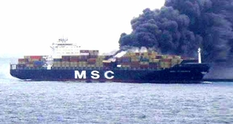
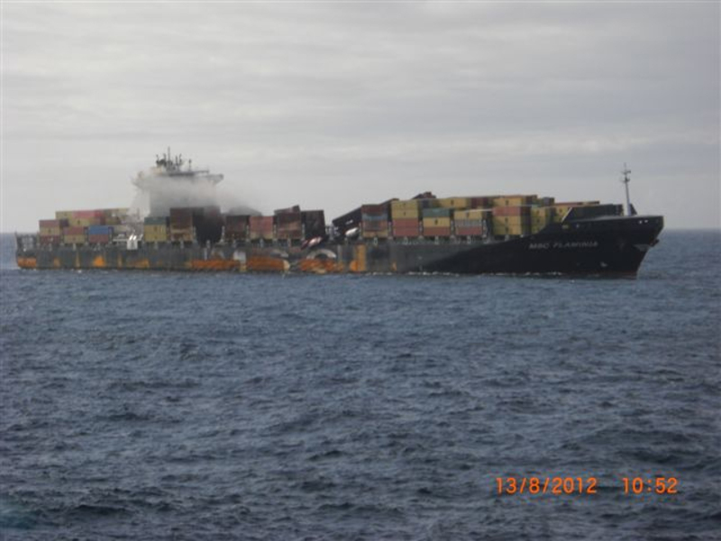
3. IUMI 2015: More Lobbying
MSC Flaminia
Fire Fighting on Container Vessels
Ports of Refuge
Misdeclaration of Content of Containers
General Average cost and time

Slide 8
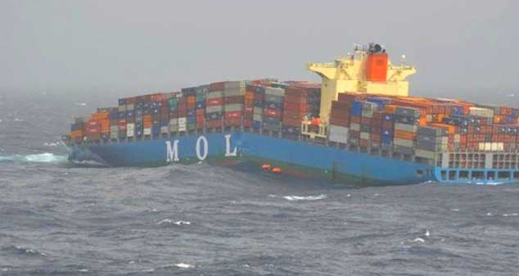
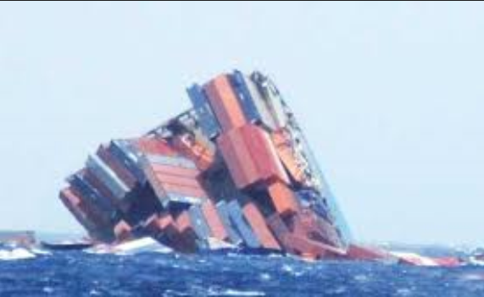
3. IUMI 2015: More Lobbying
MOL Comfort
Declaration of Weights?
Construction of Vessel: high-strength steel?
Salvage?

Slide 9
Agenda
What is IUMI?
“IUMI 2015”
IUMI 2015: Lobbying
Political Forum
IUMI 2015: Information
IUMI London Conference 2013

Slide 10
4. Political Forum
Founded in 2012
10 members:
  7 Secretaries plus Membership,
  President, SG, IUMI IMO Liaison Officer
Recommends Action to the IUMI Executive Committee and the IUMI Technical Committees
„Current Issue List“

Slide 11
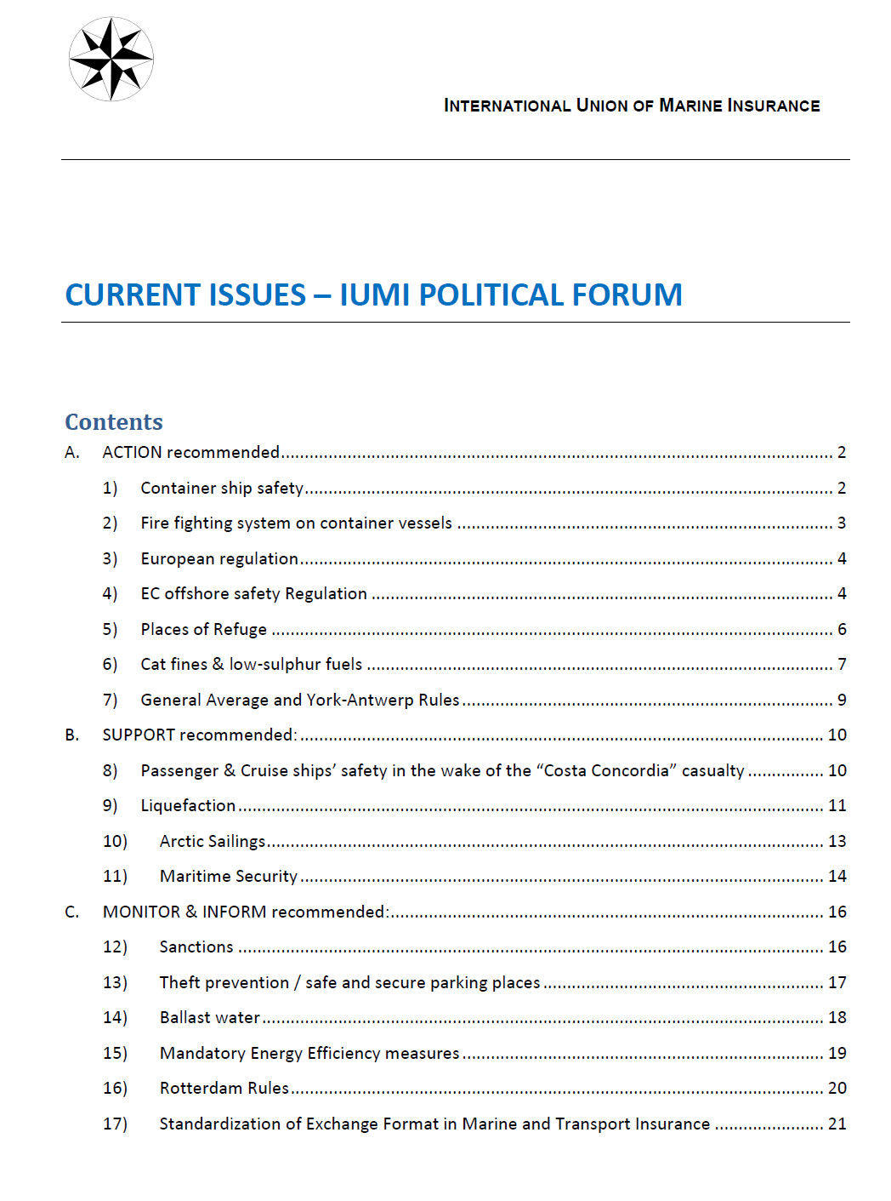
4. Political Forum
Action recommended
Support recommended
Monitor & Inform
Updated very frequently

Slide 12
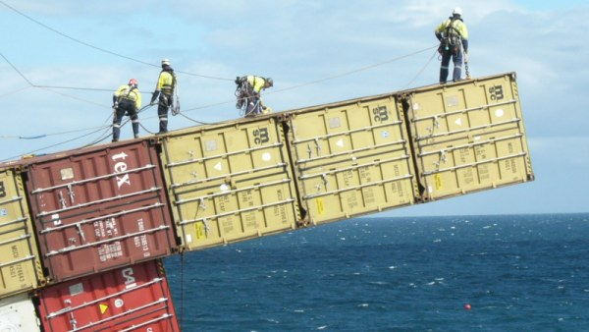
4. Political Forum
Action recommended
Container Ship Safety
Places of Refuge
Cat Fines & Low Sulphur Fuels
GA – YAR

Slide 13
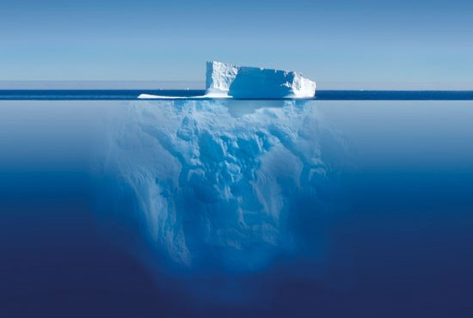
4. Political Forum
Support recommended
Passenger Ship Safety
Liquefaction
Arctic Sailings
Maritime Security

Slide 14
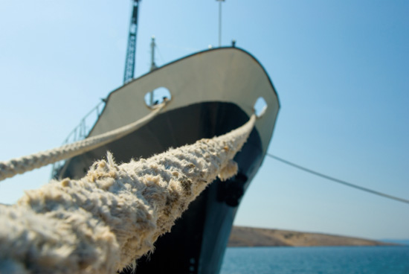
4. Political Forum
Monitor & Inform
Sanctions
Theft Prevention
Ballast Water

Slide 15
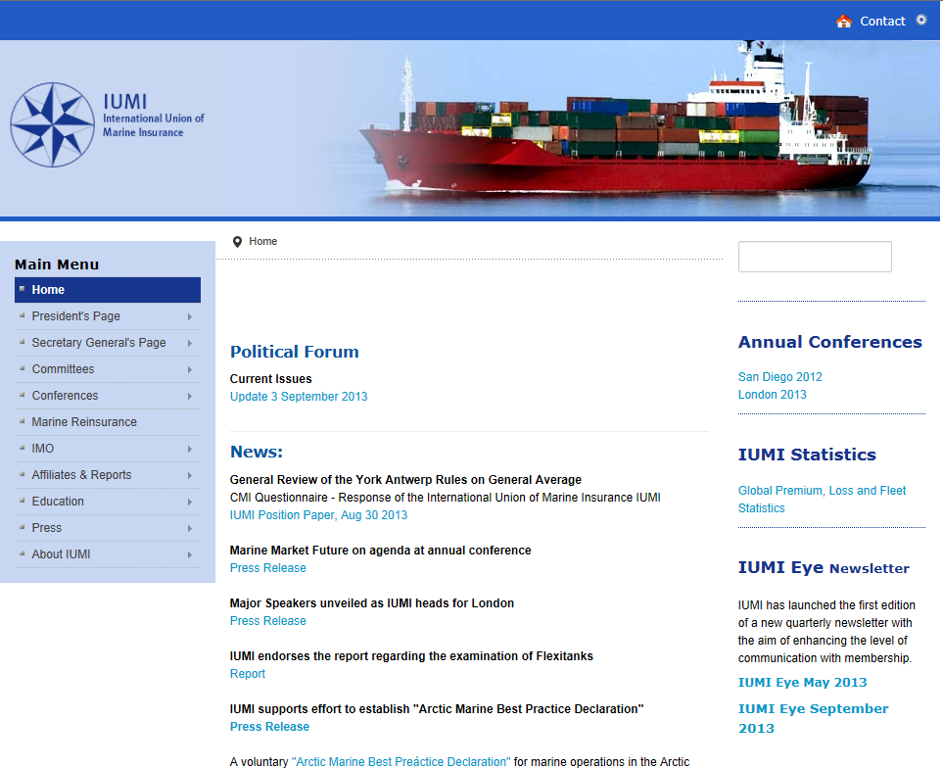
4. Political Forum

Slide 16
Agenda
What is IUMI?
“IUMI 2015”
IUMI 2015: Lobbying
Political Forum
IUMI 2015: Information
IUMI London Conference 2013

Slide 17
5. IUMI 2015: More Information
„IUMI Eye“ Newsletter
Homepage
Press Releases, Position Papers, Interviews
Conference

Slide 18
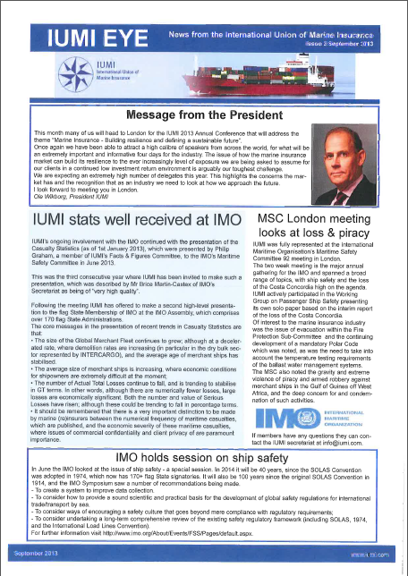
5. More Information: IUMI Eye
                Quarterly newsletter
                Information for both, membership and interested third parties
                www.iumi.com

Slide 19
5. More Information: Homepage

Slide 20
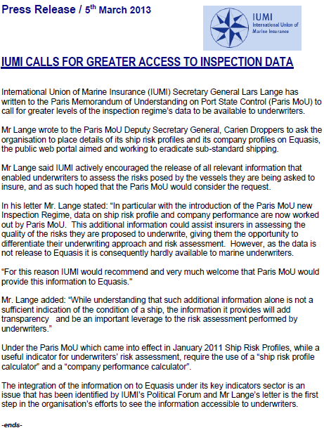
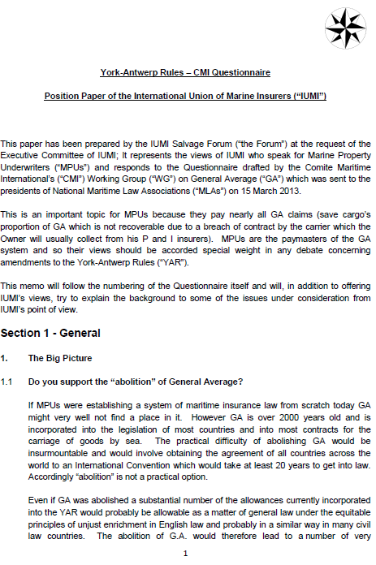
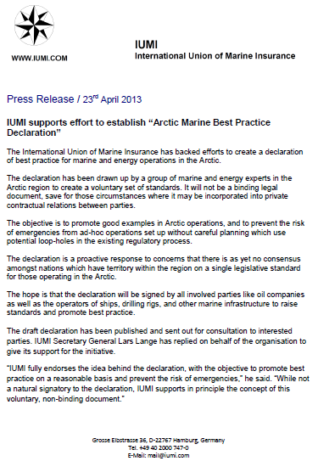
5. Information: PRs, Position Papers

Slide 21
Agenda
What is IUMI?
“IUMI 2015”
IUMI 2015: Lobbying
Political Forum
IUMI 2015: Information
IUMI London Conference 2013

Slide 22
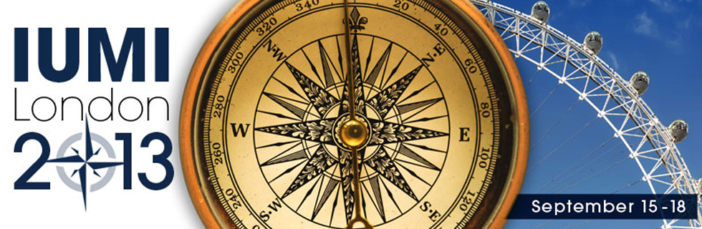
6. IUMI London Conference 2013
Building Resilience and defining a sustainable future“
More than 600 attendees from 46 countries, more than 50 Speakers, more than 25 journalists, 9 Workshops in 3 days
Conference app, interactive voting

Slide 23
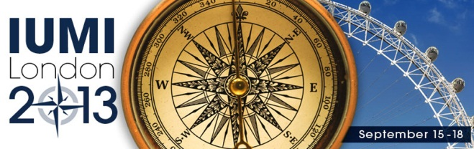
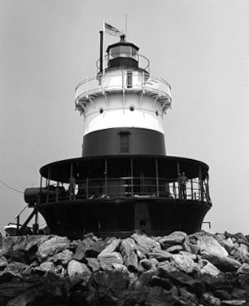
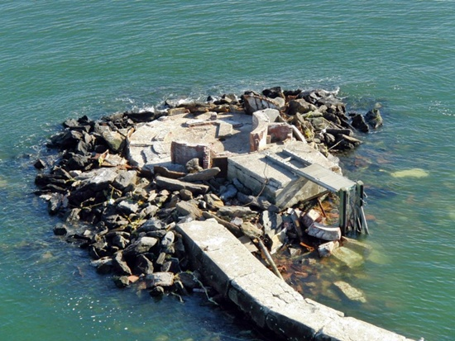
6. IUMI London Conference 2013
Superstorm Sandy
A surveyor’s and Underwriter’s perspective
Modelling Cat Losses in Marine
Data Exchange between Insurers

Slide 24
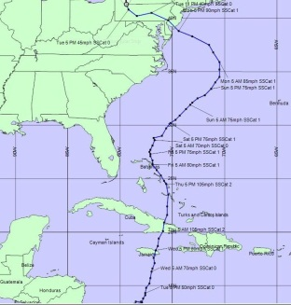
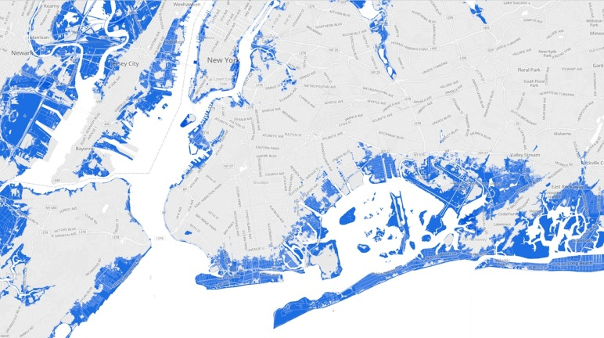
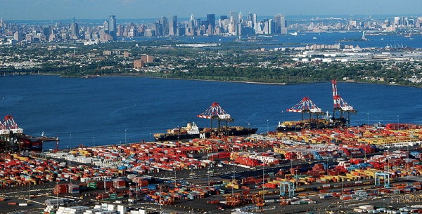
6. IUMI London Conference 2013
Superstorm Sandy
A surveyor’s and Underwriter’s perspective
Data Exchange between Insurers
Modelling Cat Losses

Slide 25

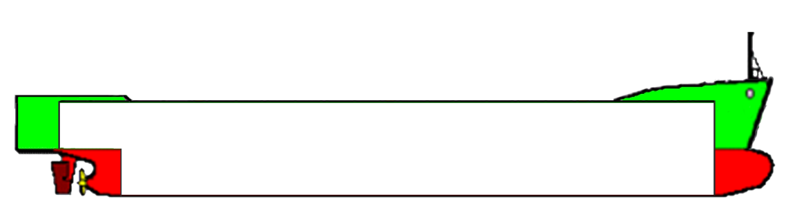




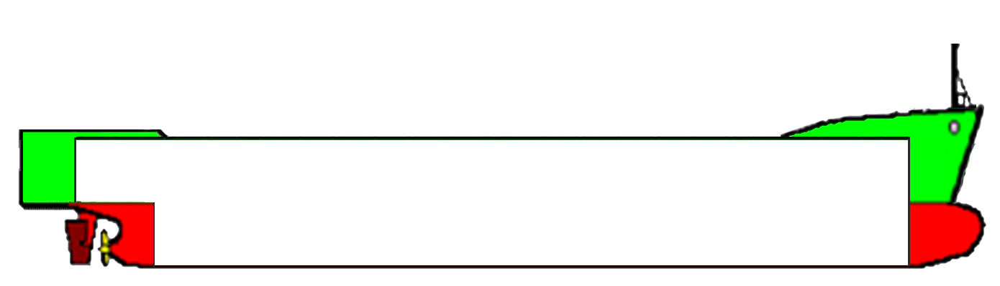

6. IUMI London Conference 2013
MSC Flaminia
Fire Fighting on Container Vessels
Places of Refuge
CO₂
CO₂

Slide 26
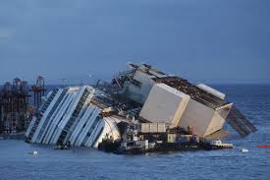
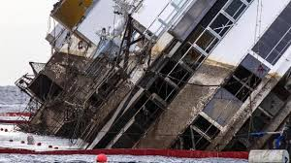
6. IUMI London Conference 2013
Costa Concordia
Removal of Wreck
Salvage Issues
Human Contributions to Marine Casualties

Slide 27
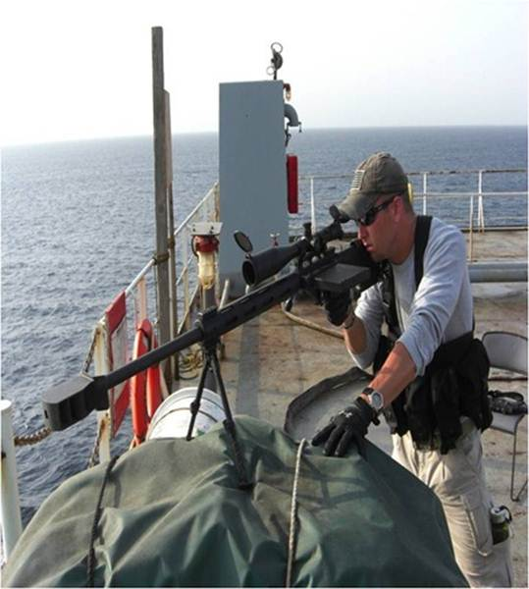
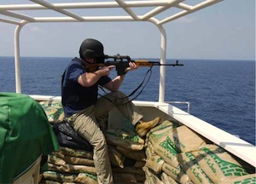
6. IUMI London Conference 2013
Piracy
Piracy in the Gulf of Aden
Piracy in Western Africa
Armed Guards on ships
The “Enrica Lexie” Case

Slide 28
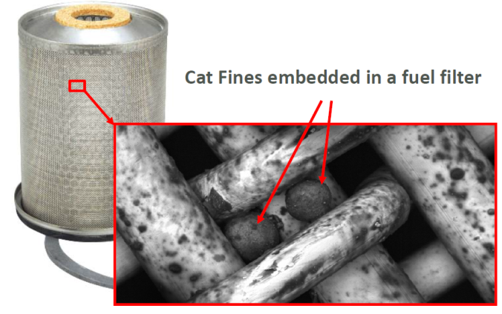
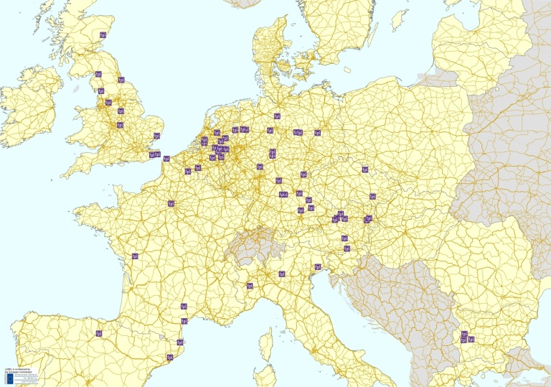
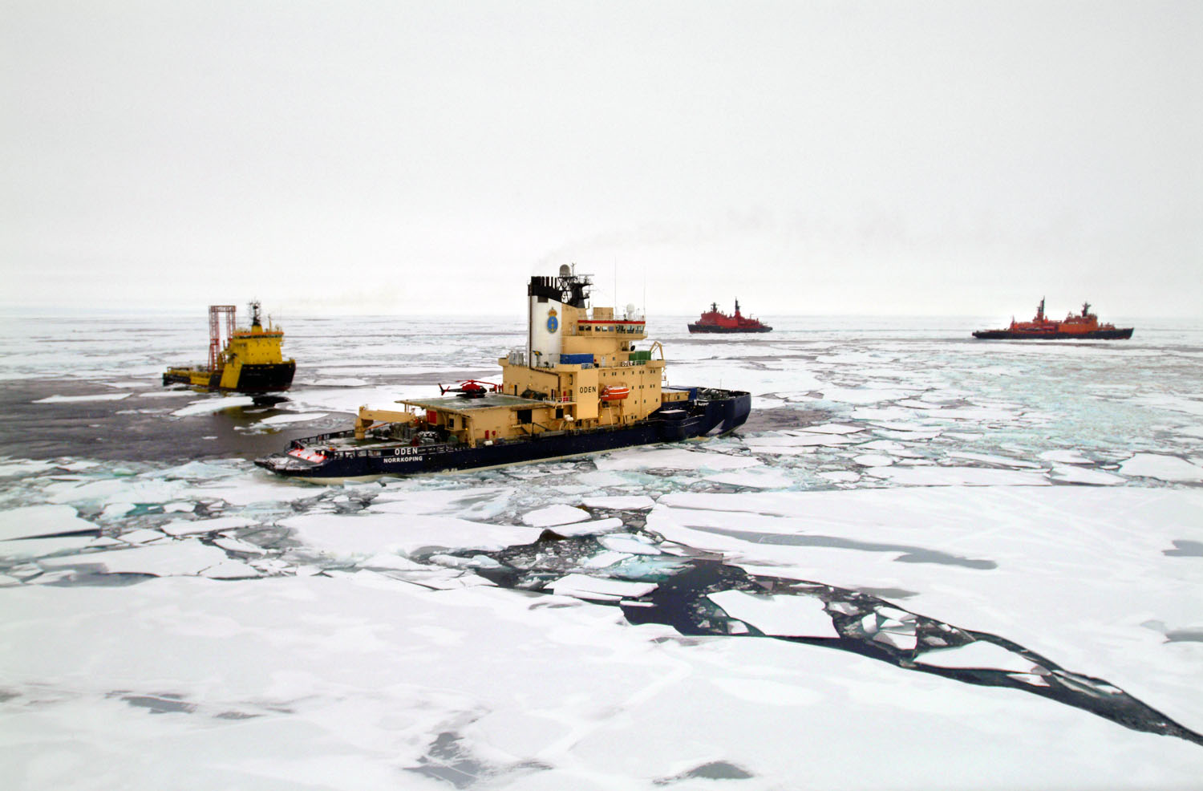
6. IUMI London Conference 2013
… and many more
Cat Fines
Sanctions
Cargo Theft
Arctic Sailing

Slide 29
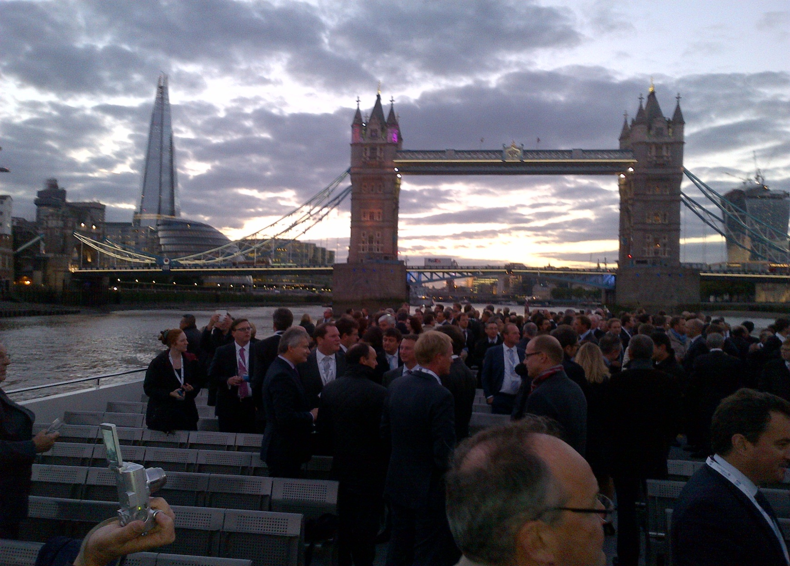
6. IUMI London Conference 2013

Slide 30
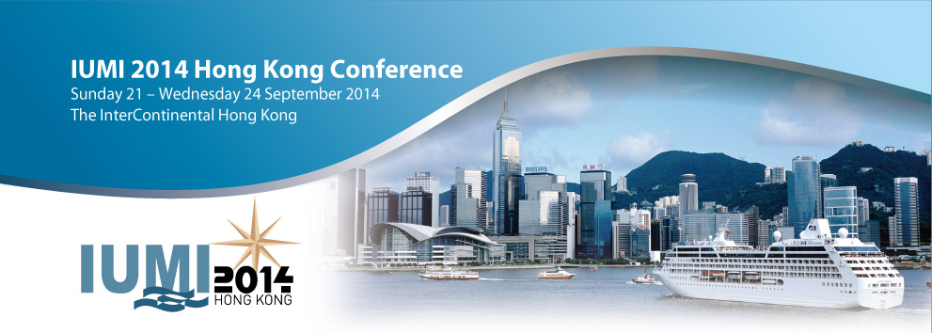
IUMI Hong Kong Conference 2014
Visit IUMI in Hong Kong next year
www.iumi2014hk.com

Slide 31
That‘s it
Lars Lange
Große Elbstraße 36
22767 Hamburg
Germany
+49 – 40 200 747 – 0
lars.lange@iumi.com

