Slide 1
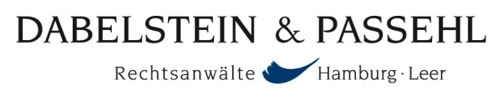



INTERNATIONAL MARINE CLAIMS CONFERENCE 2013
Design oR Latent Defect– A Comparison of Coverage under English, German, Norwegian and US law
Andreas Meidell, Partner, Thommessen
Dieter Schwampe, Managing Partner, Dabelstein & Passehl
Alex Kemp, Associate, Holman Fenwick Willan
Joe Grasso, Wiggin and Dana
John Poulson, Atlantic Marine Associates Inc.

Slide 2
FACTS
25 year-old RoRo vessel
Unusual but not unique shafting arrangement – all parts original
Maintenance and refit performed on vessel in far east yard in 2007
During special survey in 2012, several fractures discovered on two of the components of the shafting arrangement
Repairs attempted, but one fracture found by class to be beyond allowable depth
Vessel had encountered heavy weather, causing some hull buckling, 18 months earlier
“Nuisance fractures” commonly found on these type shafting arrangements

Slide 3
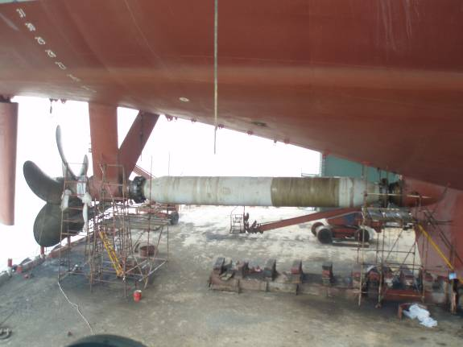
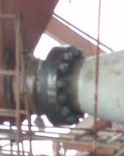

Slide 4
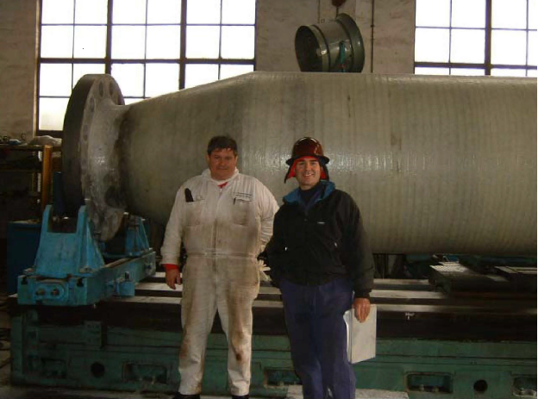

Slide 5
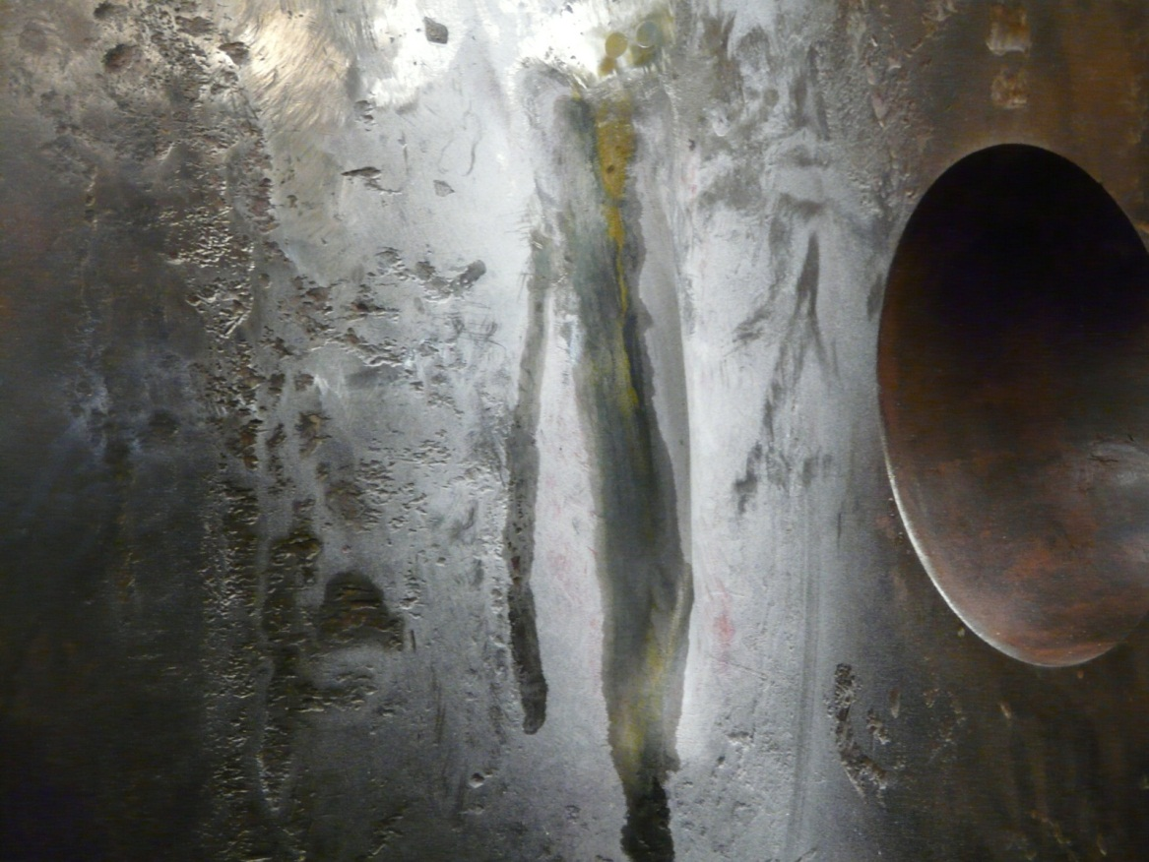
The dispute is over whether the fracture at issue was:
a latent defect (in manufacture or material of shaft)
caused by heavy weather
caused by work done in 2007 (i.e. shiprepairers’ negligence)
defect in design

Slide 6
English Perspective
  The Marine Insurance Act 1906 section 55 stipulates that, unless the policy otherwise provides, the Insurer is not liable for "ordinary wear and tear, ordinary leakage and breakage, inherent vice or nature of the subject-matter insured, … or for any injury to machinery not proximately caused by maritime perils".
  Whilst ITC do not expressly contradict these statutory exclusions of liability, the policy is treated as making contrary provisions to the extent that it is necessary in order to give effect to the clauses.
  Clause 6.2.3 of the ITC (the Inchmaree Clause) provides cover for "loss of or damage to the subject-matter insured caused by...bursting of boilers breakage of shafts or any latent defect in the machinery or hull".
  Inclusion of latent defect taken to preclude inherent vice and implied warranty of unseaworthiness defences of Marine Insurance Act
  This is one example of the Inchmaree Clause extending cover to the risk of damage to H&M not a direct consequence of a marine peril.

Slide 7
English Perspective
  A latent defect is one not discoverable by such examination as a reasonably careful skilled man would make. It is not the same as wear and tear which is not covered, though they may appear similar in terms of their gradual effects.
    Latent defect – created by positive act of human agency
    Wear and tear – uncorrected result of ordinary incident of trading
  Generally will include defective design (Prudent Tankers Ltd SA v Dominion Assurance Co Ltd (The Caribbean Sea) [1980] 1 Lloyd's Rep. 338.).
  Arguable that on very certain facts where the cause of the casualty is merely that the deign is inadequate for the ordinary tasks the ship is to perform that defective design will be excluded from latent defect (Jackson v Mumford (1902) 8 Com. Cas. 61)

Slide 8
English Perspective
  Clause 6.2.3 of the ITC makes the Insurer liable only for a loss caused by the peril insured, not for a loss constituted by the peril insured i.e.
    Can recover for the consequence of the latent defect or machinery failure
    Can not recover the cost of replacing/removing the part in question unless a latent defect has developed into a condition which can be described as damage (“Promet Engineering (Singapore) Pte Ltd v Sturge [1997] 2 Lloyd's Rep. 146 The Nukila”)
  A loss which is attributable simply to ordinary wear and tear is not recoverable; but a loss caused by a latent defect which would inevitably become patent is indemnifiable though the defect is revealed by wear and tear.
  The fact that a latent defect becomes patent without causing damage to any other part of the hull or machinery does not entitle the assured to recover the cost of replacing or repairing the defective part. This is not damage.

Slide 9
English Perspective
  The Insurer is not considered to be a guarantor of the soundness of the defective part (“Oceanic SS Co vs Faber (1906) 11 Com. Cas. 179;)
    “A defect initially latent but spreading until it becomes a patent defect is an ordinary incident in all machinery. . . That is a case of a latent defect developing into a patent defect. But it is so ordinary an instance that it is one of the commonest forms in which the economic wearing out of a part of the machinery occurs. . . I do not believe that this clause means that the machinery is insured against the existence of latent defects. It only means that if through their latency those defects have not been guarded against, and actual loss of the hull or machinery, or damage to the hull or machinery, arises from those defects, the insurers will bear the burden of that
    loss”.
  “Classic example in Wills & Sons v The World Marine Insurance Ltd [1980] 1 Lloyd's Rep. 350. A latent defect in the welding of hoisting chain on a bucket ladder caused the chain to break and effected damage to the H&M. Underwriters liable for damage to H&M and some consequential damage.

Slide 10
English Perspective
  Institute Additional Perils Clause, which fills the lacuna in ITC for an additional premium.
  1.1 the cost of repairing or replacing
  1.1.1 any boiler which bursts or shaft which breaks
  1.1.2 any defective part which has caused loss of or damage to the vessel covered by Clause 6.2.1 of the Institute Time Clauses-Hulls 1/11/95.
  1.2 loss of or damage to the vessel caused by any accident or by negligence, incompetence or error of judgement of any person whatsoever.
  Still does not extend to wear and tear or defective parts/errors in design which do not cause loss or damage to the vessel. Underwriters still unable to rely upon implied warranty of unseaworthiness or inherent vice defences

Slide 11
English Perspective
  Allows recovery of cost of replacement/recovery of defective part/shaft/boiler
  If a defective part, Additional Perils wording designed to cover cost of replacing the part with the latent defect regardless of whether or not the part itself has suffered damage. It must however, still have caused damage to the H&M.
  Perhaps not as wide an extension as thought?

Slide 12
English Perspective - Scenario
  Require expert input on true cause(s) of damage to shaft
    Damage by repairers is covered under ITC 6.2.4
    Damage by heavy weather may be covered under ITC 6.1.1 (weather must be unforeseen and not wear and tear/ordinary operation at sea)
    Damage caused by latent defect covered by ITC 6.2.2
      Replacement part/recovery covered by Additional Perils (still needs to have caused loss to Vessel)
      Replacement part/recovery may be covered if latent defect extends to part being inherently damaged.
      Generally will include defective design

Slide 13
English Perspective – Scenario
  General position is that Assured has to prove that the loss in question was proximately caused by the operation of an insured peril.
  With latent defect the policy in force when the damage caused by an insured peril was sustained will respond.
  Identifying which policy will respond will depend upon expert analysis of the cause of the loss in question and when it was sustained. The policy in force when any breakage or failure occurred would also respond to any consequential loss.
  If latent defect:
    Does not matter if latent defect existed before commencement of policy when damage sustained. The latent defect itself is not the “damage” suffered and mere discovery does not give rise to a claim.
    When deterioration in a part amounts to damage caused by latent defect the policy in force when the part should have been condemned will respond to bear cost of replacement.

Slide 14
German Perspective
No statutory marine insurance law, only German Civil Code
Market conditions:
  ADS 1919 and DTV Hull Clauses 1978/1992
  DTV-ADS 2009

Slide 15
German Perspective
All risk cover, § 28 ADS, cl. 27 DTV-ADS 2009
Limited to risk materializing during the cover period:
Unless otherwise agreed, the Insurer covers all risks to which the vessel is exposed during the duration of the insurance.
General rule: Peril must hit during cover period, damage may occur later

Slide 16
German Perspective
Consequence: all risks covered unless excluded
Burden of proof:
  Insured: - Causation of the damage during the policy period
  - Generally no proof of a particular peril required
  Insurer: - Causation by excluded peril
  - Causation by breach of obligation

Slide 17
German Perspective
Part of the all risks: Unseaworthiness, latent defects, wear and tear
Excluded:
  Unseaworthiness: cl. 23 DTV Hull Clauses, Cl. 33 DTV-ADS
  Wear and Tear: cl. 27 DTV Hull Clauses,. Cl. 55 DTV-ADS
  Covered: Latent defect
    under § 28 ADS, cl. 27 DTV-ADS if occurring during policy period
    under cl. 20 DTV-Hull and cl. 59 DTV-ADS if occurring prior to policy period

Slide 18
German Perspective
Cover acc. to cl. 20 DTV-Hull, cl. 59 DTV-ADS for damage caused by:
  Error in construction
  Latent defects due to faulty material
  Latent defects due to bad workmanship
  Latent vs. patent:
    A defect is latent as long as it cannot be detected by the ordinary care of prudent shipowner and his qualified crew during operation, maintenance and repairs
    Objective standard, i.e. irrelevant whether the actual owner and crew become aware of the latent defect
    Standards may change with developing practices

Slide 19
German Perspective
No cover for any other latent defect like:
  Defect caused in previous cover periods
    e.g. crew negligence
    e.g. unnoticed grounding
    → previous policy period
  Latent defect by wear and tear
    Generally no cover, cl. 27.1 DTV-Hull, 55.1 DTV-ADS
    But: partial cover possible if insured peril contributes to damage, cl. 27.2 DTV-Hull, 55.2 DTV-ADS

Slide 20
German Perspective
Speciality: breaking of shafts, cl. 20.2, 59.1.3 DTV-ADS
    Cover for damage caused by breaking of shafts, i.e. consequential damage resulting from the breaking of the shaft
    even if shafts break as a consequence of wear and tear
    But: cover may be prejudiced by:
      Exclusion for Unseaworthiness, cl. 23 DTV-Hull, cl. 33 DTV-ADS
      Exclusion for negligent causation of insured event,
        § 33 ADS: ordinary negligence prejudices cover
        cl. 33, 34 DTV-ADS: only gross negligence prejudices cover

Slide 21
German Perspective
Extent of cover:
    DTV Hull plus Marine Print 2002/2:
      Cover limited consequential damage caused by latent defect
    Cover limited to consequential damage to machinery
    DTV-ADS:
      Cover extended to the latently defective part, if specially classed
      Cover extended to consequential damage also to the hull

Slide 22
German Perspective
  Remember the general rule: Peril must hit during cover period, damage may occur later
  General rule does not apply here: Peril may hit prior to cover period, damage must occur during cover period
  Which policy answers?
    All policies refer to the same peril
    All policies cover damage occurred during its cover period
    → Partial cover under all policies during which damage occurred

Slide 23
German Perspective
  Practical problems:
    All policies are separate contracts. Insured has burden of proof under each and every policy.
    Technical experts required to determine what part of damage occurred during which policy period
    Necessary repair costs as decisive parameter
      “You can’t kill a dead cat”
      Dismantling costs usually allocated to policy covering initial damage

Slide 24
German Perspective
Solving our practical case:
Cover for latently defective shaft (design/material/workmanship)?
  Under ADS/DTV-Hull: no – only cover for consequential damage
  Under DTV-ADS: if shaft specially classed yes – otherwise no
    Policy: all policies for their respective damage occurred, the policy during which the shaft became unfit for repair bearing the balance to the replacement costs
  Cover for shaft damaged by work done in 2007 or heavy weather in 2010?
  Under ADS/DTV-Hull: yes – respective policy year
  Under DTV-ADS: yes – respective policy year

Slide 25
German Perspective
Solving our practical case:
  Cover for consequential damage?
  Under ADS/DTV-Hull: yes, but only consequential damage to machinery
  Under DTV-ADS: yes, including consequential damage to the hull
    Policies: of those years when consequential damage occurred
  Costs of removal and replacement of the part allowed as part of the claim?
  Under ADS/DTV-Hull: no
  Under DTV-ADS: yes, if the part is specially classed

Slide 26
Norwegian Perspective
The Nordic Marine Insurance Plan 2013
  Based on the Norwegian Marine Insurance Plan 1996 version 2010
  It’s all there!
  www.nordicplan.org
The facts of this matter raise three specific legal issues, all covered by the Nordic Plan:
  Cover: Clauses 2-8, 10-3, 12-3 and 12-4
  Burden of proof: Clause 2-12
  Causation and incidents of loss: Clauses 2-11 and 2-13

Slide 27
Norwegian Perspective
The main rule on cover is in Clause 2-8: ”An insurance against marine perils covers all perils to which the interest may be exposed …”
Losses due to ordinary use is excluded: Clause 10-3
  “The insurer is not liable for loss that is a normal consequence of the use of the ship and its equipment”
  According to the commentaries to this clause, losses due to heavy weather has in practice not been excluded

Slide 28
Norwegian Perspective
Losses caused by wear and tear, corrosion, rot, inadequate maintenance and the like are not covered: Clause 12-3
  Fractures in structures will normally not be deemed wear and tear under this clause
  Inadequate maintenance does not seem to be a cause in this matter
  This clause does not exclude cover for latent defects (as long as such defects have not been known about so that they should have been properly maintained)

Slide 29
Norwegian Perspective
Exclusion for errors in design or faulty material: Clause 12-4
  Clause 12-14 reads: “If the damage is the result of error in design or faulty material, the insurer is not liable for the cost of renewing or repairing the part or parts of the hull, machinery or equipment which were not in proper condition, unless the part or parts in question had been approved by the classification society”
  Note that “faulty workmanship” is not excluded by this clause, thus covered according to the general ruling Clause 2-8 (“all risk”)
  Latent defects would typically be “error in design” or “faulty material”
  Consequential damages to other parts will always be covered, the exclusion only applies to the particular part in question that has an inherent latent defect
  If the parts on the shaft in question were approved by the classification society, then also the renewing of such parts would be covered according to Clause 12-4

Slide 30
Norwegian Perspective
Burden of proof: Clause 2-12
  The insured has the burden of proving that he has suffered a loss of the kind covered by the insurance, thus that the loss has not been caused by ordinary use of the ship cf. Clause 10-3
  The insurer has the burden of proving that the loss was caused by a peril that is not covered by the insurance, cf. Clause 12-3 and 12-4
  In our matter it will be for the insurers to prove that the fractures were caused by wear and tear or by a latent defect not coverable under Clause 12-4

Slide 31
Norwegian Perspective
Causation and incidents of loss
  The main rule in Clause 2-11 (1): “The insurer is liable for loss incurred when the interest insured is struck by an insured peril during the insurance period”
  A latent defect is as such not a damage under the Nordic Plan, but the commentaries states that a small fracture or crack, even if it is not visible to the human eye, may constitute “damage”
  Clause 2-11 (2): A latent defect that results in a fracture (damage), is deemed to be a marine peril that strikes the ship at the time when the fracture (damage) starts to develop

Slide 32
Norwegian Perspective
Causation and incidents of loss
  Thus an unknown fracture may constitute damage, and the peril has stricken the ship at that time, even if it is unknown
  Clause 2-11 (3): For consequential damages however the original fracture (damage) shall be deemed to be a marine peril that strikes the ship at the time the damage to the other parts starts to develop
  Thus, the policy year that responds to the damaged shaft in our case will be the one applicable in the year when the fracture started to develop (even if it was unknown)
  CEFOR Clause on application of the Plan Clause 2-11

Slide 33
Norwegian Perspective
Combination of perils: Clause 2-13
  This is a unique solution according to the Nordic Plan whereby the loss should be apportioned over the individual perils according to the influence of each of them
  If all perils are covered, this will not cause any problem in our case
  If “wear and tear” has had influence, this may by the application of Clause 2-13 result in some reduction in cover

Slide 34
Norwegian Perspective
Solutions to our matter with fractures in shaft components
  Latent defect, heavy weather, faulty workmanship and defect in design all covered (assuming the shaft components were class approved)
  Burden of proof will be on insurers
  Peril strike the shaft components when the fractures started to develop

Slide 35
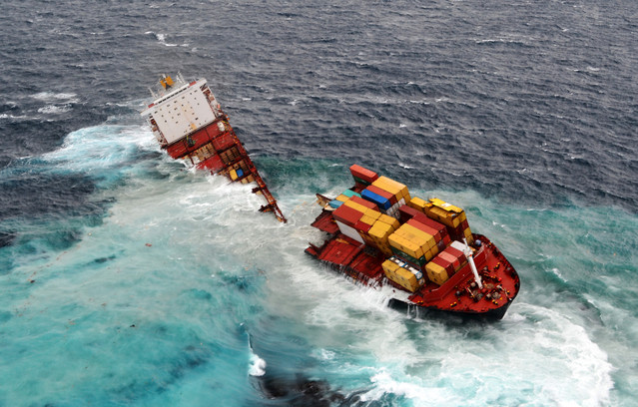
U.S. Perspective
  Policy Wording
    Coverage
    Exclusions
    Definitions
  Applicable Law
  Expert Evidence

Slide 36
U.S. Perspective
American Institute Hull Clauses (1977; 2009) – Additional Perils (Inchmaree) Clause
“Subject to the conditions of this Policy, this insurance also covers loss of or damage to the Vessel directly caused by the following…
Breakdown of motor generators or other electrical machinery and electrical connections thereto, bursting of boilers, breakage of shafts or any latent defect in the machinery or hull (excluding the cost and expense of replacing or repairing the defective part)…”

Slide 37
U.S. Perspective
Inchmaree Clause (cont.)
“Provided such loss or damage has not resulted from want of due diligence by the Assured, the Owners or Managers of the Vessel, or any of them. Masters, Officers, Crew or Pilots are not to be considered Owners within the meaning of this clause should they hold shares in the Vessel.”

Slide 38
U.S. Perspective
General Principles
  Defined in Policy?
  Hidden to the eye – visual inspection
  Cannot be discovered by any practicable means: ordinarily careful inspection
  Policy covers only whatever is caused thereafter and thereby. Ferrante v. Detroit Fire & Marine Ins. Co., 125 F. Supp. 621 (S.D. Cal. 1954)

Slide 39
U.S. Perspective – Case Law Sampling
Sinkings
  Evidence of seaworthiness at the inception of the risk
  Unexplained leakage
  Impossible to ascertain the exact cause of the disaster, the jury could nevertheless conclude “that it must have resulted from a peril of the sea, or that there must have been a hidden defect in the hull.” Massey SS Co. v. Importers & Exporters Ins. Co. of NY, 153 Minn. 88 (1922)

Slide 40
U.S. Perspective – Case Law Sampling
Sinkings
  Where a vessel, seaworthy on sailing, sank in fair weather and calm sea, about 3 hours after departure, from causes unknown, the court in Watson v. Providence Washington Ins. Co. (ED NC 1952) 106 F. Supp. 244; app. dismissed 201 F.2d 736 (4th Cir. 1953), in the absence of evidence establishing that the loss was the result of a peril insured against under a policy of marine insurance containing the Inchmaree clause found for defendant insurer.

Slide 41
U.S. Perspective – Case Law Sampling
Sinkings
  The worm-eaten condition of the boat was not a “latent defect,” because a reasonably careful inspection would have disclosed it. Reisman v. N.H. Fire Ins. Co., 312 F.2d 17 (5th Cir.1963)
  Such defects were result of 27 years of use and not inherently defective in their original construction. Sipowicz v. Wimble, 370 F. Supp. 442 (SDNY 1974)

Slide 42
U.S. Perspective
What Costs Are Covered?
  Policy wording clearly excludes cost of repair/replacement of defective part

Slide 43
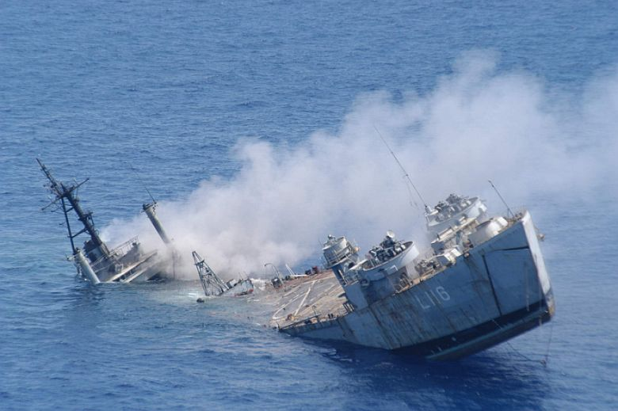
U.S. Perspective – Our Scenario
Coverage likely
Battle of the experts
Costs recoverable
Potential recoveries?

Slide 44
Summary: Is Repair/Replacement of the Damaged Shaft Covered by the H&M Policy?
  England: no – unless the part has deteriorated to such an extent that it too can be considered damaged or ITC additional perils cover in place.
  Germany: no – unless shaft specially classed (only DTV-ADS)
  Norway: yes, but cover may be reduced if the shaft/component was not approved by class
  U.S.: no - only resulting damage covered

Slide 45
Summary: Is Damage to the Shaft by Work Undertaken in 2007 and/or heavy weather in 2010 covered?
  England: yes – damage by repairers is covered under ITC 6.2.4
  – damage by heavy weather may be covered under ITC
  6.1.1 (weather must be unforeseen and not wear and
  tear/ordinary operation at sea)
  Germany: yes – respective policy year
  Norway: yes – respective policy year
  U.S.: yes – but issue as to apportionment over policy years, and potential recoveries

Slide 46
Summary: Is the Cost of Removing and Replacement of the part in question covered?
  England: yes – if replacing the part in question is covered. If a latent defect possibly also as a sue and labour expense.
  Germany: no –unless part is specially classed (only DTV-ADS)
  Norway: if approved by class, yes
  U.S.: no – unless such costs relate to repair of other damage caused

Slide 47
Summary: Is loss of hire and other consequential damage covered?
  England: Consequential damage covered if caused by operation of insured peril. Hire not covered unless additional loss of hire insurance in place.
  Germany: Under ADS/DTV-Hull only for consequential damage to machinery, under DTV-ADS including consequential damage to the hull
  Norway: yes, if LoH cover NMIP ch 16 is placed
  U.S.: yes – if latent defect caused other damage to the vessel

Slide 48
Summary: Which Policy Year will Respond to the Claim?
  England: will depend upon expert analysis of when/why the loss caused by an insured peril was sustained. Policy in place when damage occurs will respond if latent defect.
  Germany: the policy under which damage occurred. This may be several policies
  Norway: different policy years may respond to different parts of the claim
  U.S.: will depend upon expert analysis of when and how the covered damage occurred

Slide 49
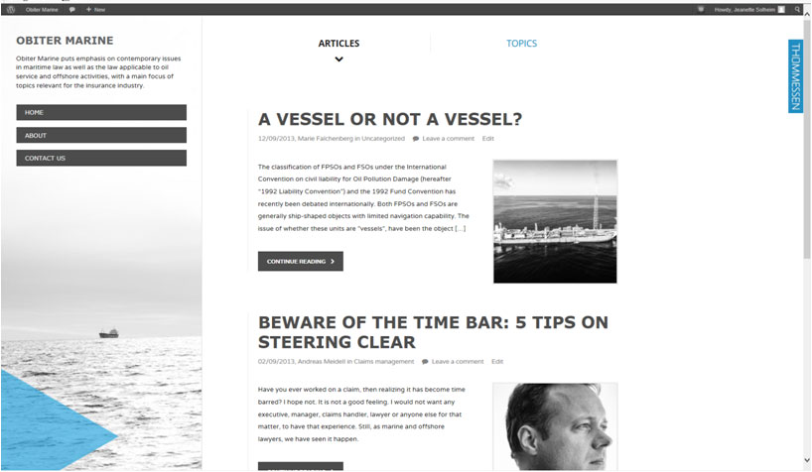
Visit our new Maritime Law blog: www.obitermarine.no

Slide 51

Dates for your diary
European Conference on Maritime Emergencies and their aftermath
Genoa – 29/29th November 2013
www.gastaldicongressi.it
Latin American Marine Insurance Conference
Mexico City - 8th-10th October
http://www.alsum.co/congreso2013/e/index.html

Slide 52
Dates for your diary
IMCC 2014
24-26th September 2014!

