Slide 1



IMCC’13
Deirdre Littlefield
Starr Marine

Slide 2



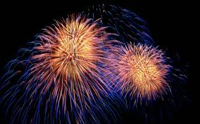
IMCC
10TH ANNIVERSARY

Slide 3



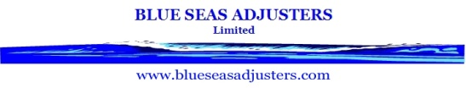




































IMCC 2013 : THANK YOU TO ALL OUR SPONSORS
Marine Professionals
Casualty Investigation  Consultancy  Claims Support

Slide 4
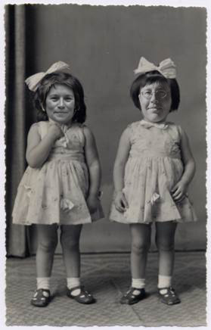

Slide 5
World Trade
2004 2013
World GDP Growth 4%
World Trade Growth 6%
Seaborne Trade 6 Billion Tons
Source: IMF, IUMI

Slide 6
World Fleet
2004 2013
World Fleet 600M GT
Vessels > 100 GT 22,000
New Deliveries 40M GT
Largest Shipbuilder Japan
Vessel Size 9,500 TEU
Weighted Freight Earnings $30,000 USD per day
Source: IMF, IUMI

Slide 7
Marine Insurance
2004 2013
GWP 15.5 Billion
Market Share
Europe
Asia
North America
63%
24.5%
11%
Underwriting Results
Hull
  Cargo
Source: IMF, IUMI

Slide 8
World Trade
2004 2013
World GDP Growth 4%
3.25%
World Trade Growth 6%
3.3%
Seaborne Trade 6 Billion Tons
9 Billion Tons
Source: IMF, IUMI

Slide 9
World Fleet
2004 2013
World Fleet 600 Million GT
1 Billion GT
Vessels > 100 GT 22,000
30,000
New Deliveries 40M GT
80M GT
Largest Shipbuilder Japan
China
Vessel Size 9,500 TEU
18,500 TEU
Source: IMF, IUMI

Slide 10
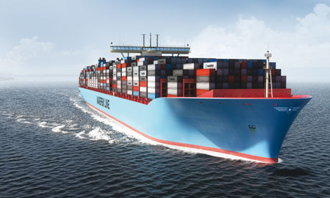
Maersk Triple-E Class
Page 10

Slide 11
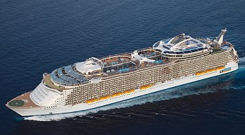
World Fleet
Maersk Triple-E Class
Royal Caribbean Allure

Slide 12
World Fleet
2004 2013
World Fleet 6 Million GT
1 Billion GT
Vessels > 100 GT 22,000
30,000
New Deliveries 40M GT
80M GT
Largest Shipbuilder Japan
China
Vessel Size 9,500 TEU
18,500 TEU
Weighted Freight Earnings $30,000 USD
per day
< $10,000 USD
Source: IMF, IUMI

Slide 13
Marine Insurance
2004 2013
GWP 15.5 Billion
GWP 32 Billion
Market Share
Europe
Asia
North America
63%
Europe
49%
24.5%
Asia
28%
11%
Latin America
8.3%
North America
6.8%
Underwriting Results
Hull
  Cargo
Hull
Cargo
Source: IMF, IUMI

Slide 14
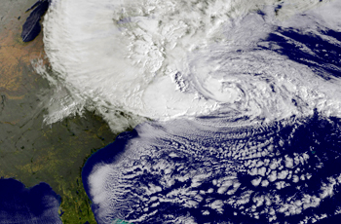
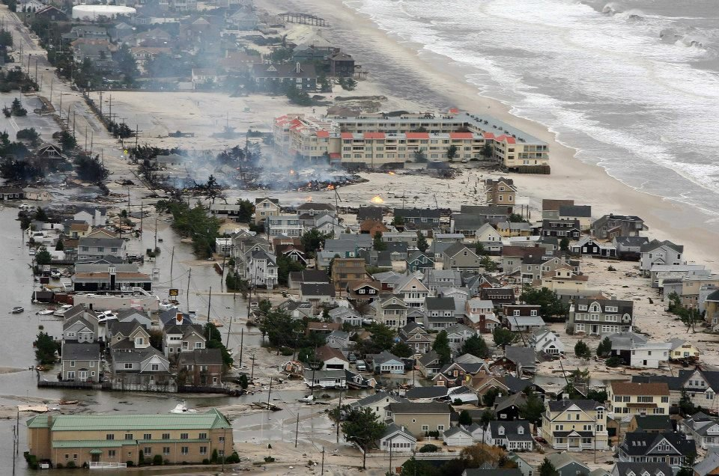
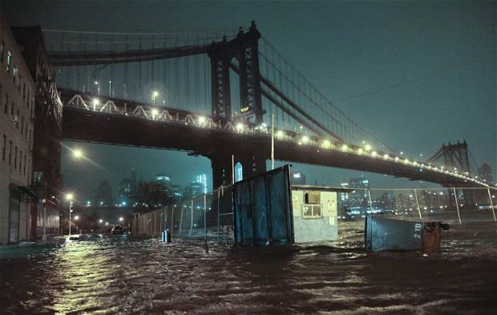
Cargo Exposure: Superstorm Sandy
Source: Bloomberg
Source: Business Insider
Source: Telegraph

Slide 15
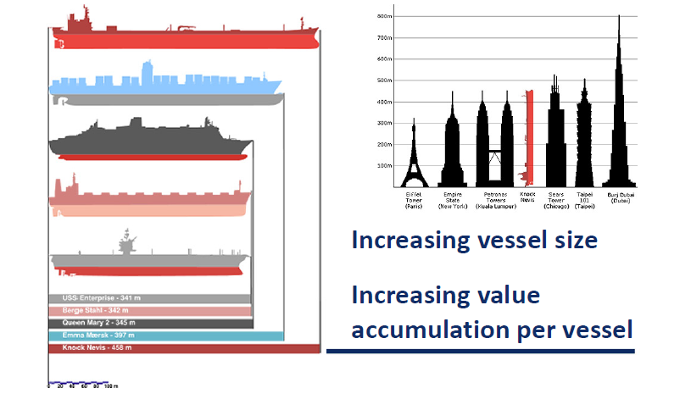
Can it get worse…?
Source: IMF, IUMI

Slide 16
Thank you.

